Slide 1
EEE241
Digital Design
Third Experiment
Resarch Ass. Ali HAZAR
Department of ELECTRICAL AND ELECTRONICS ENGINEERING
Gaziantep University

Slide 2
FPGA
FPGA (Field Programmable Gate Array) is an integrated circuit that allows hardware-level programming of digital logic circuits.
An FPGA lets users define logical functions (like addition, comparison, counting, etc.) using a Hardware Description Language (HDL) — typically VHDL or Verilog.

Slide 3
FPGA Design Flow
1)Design Entry: Write the logic in Verilog or VHDL.
2)Synthesis: The HDL code is converted into logic gates.
3)Place & Route: The synthesized logic is mapped onto FPGA resources.
4)Bitstream Generation: A configuration file (.bit) is created.
5)Programming the FPGA: The bitstream is uploaded to the FPGA to activate the circuit.

Slide 4
Verilog
Verilog is a Hardware Description Language (HDL). It is used to describe the structure and behavior of the hardware. The final product of a Verilog program is the generated hardware circuit.

Slide 5
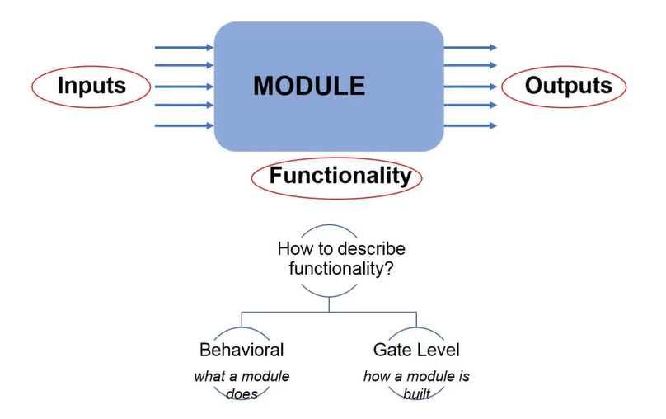

Slide 6
1. Behavioral description:
What a module does? → Describes what the module does.
At this level, logic gates are not used; the behavior is defined using constructs like if, case, always, etc.
Example: Y = A + B;
It does not need to be synthesizable always. Because it can be used as simulation module also.
This module can be used not only for actual hardware implementation but also for simulation purposes — for example, as a testbench module to verify the design before programming the FPGA.

Slide 7
1. Behavioral description:
initial begin
A = 0;
#10 A = 1;
#10 A = 0;
end
This code describes only simulation behavior.
In real hardware, there is no such thing as “#10” (wait for 10 time units).
Therefore, it cannot be synthesized.
always @(posedge clk)
Q <= D;
This defines the behavior of a D flip-flop — and can be synthesized.

Slide 8
2. Gate-Level description:
How a module is built?
→ Describes how the module is constructed.
At this level, the module is defined using logic gates (AND, OR, NOT, NAND, etc.).
Example: Y = (A AND NOT B) OR (B AND NOT A);

Slide 9
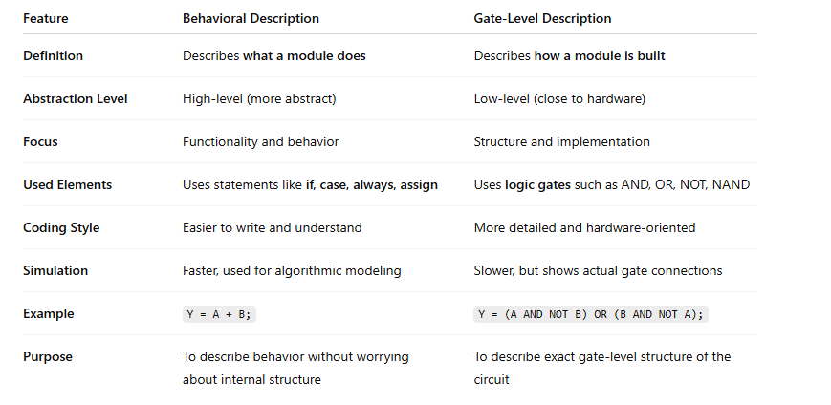

Slide 10
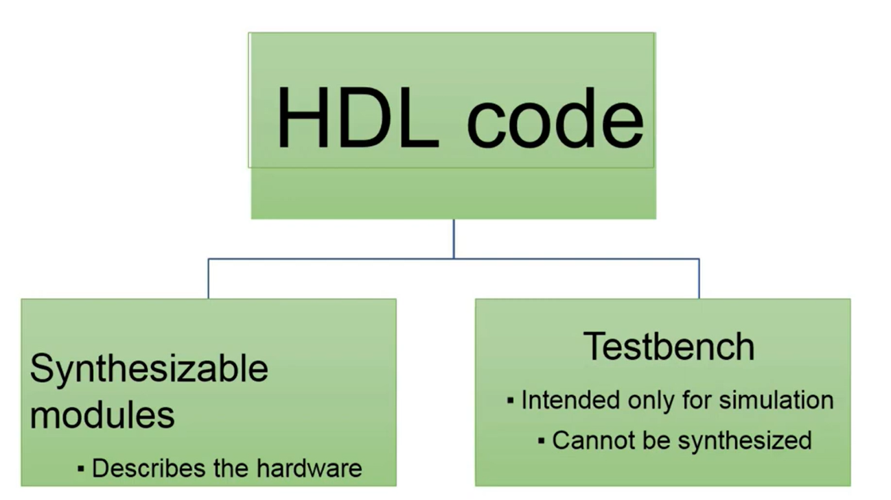

Slide 11
1. Synthesizable Modules
Description:
These modules define how the actual hardware behaves.
Purpose:
Used to create circuits that can be physically implemented (synthesized) on FPGA or ASIC devices.
Example:
module and_gate (input A, input B, output Y);
assign Y = A & B;
endmodule

Slide 12
2. Testbench (Test Environment / Test Setup)
Description:
These modules are used only for simulation purposes.
Purpose:
To test whether the hardware works correctly; they cannot be synthesized, meaning they cannot be implemented as real hardware.
Characteristics:
  Includes non-synthesizable commands such as timing, delays (like #10), or random input generation.
  Stimulates and observes the input/output signals to verify the synthesizable module.

Slide 13
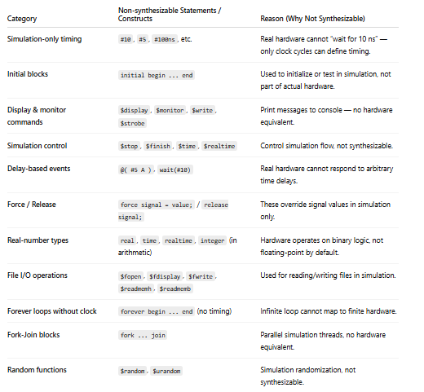
Common Non-Synthesizable Constructs

Slide 14
module testbench;
reg A, B; // Input Signals
wire Y; // Output
// Connecting the module to be tested (UUT: Unit Under Test)
and_gate uut (.A(A), .B(B), .Y(Y));
// Test
initial begin
// Initial values
A = 0; B = 0;
#10 A = 0; B = 1;
#10 A = 1; B = 0;
#10 A = 1; B = 1;
#10 $stop; // stop simulation
end
endmodule

Slide 15
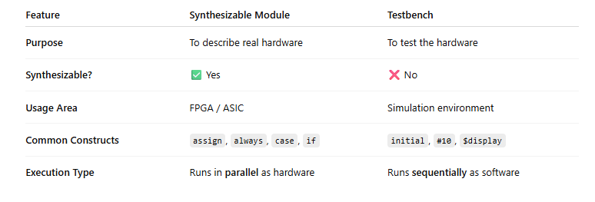
Summary

Slide 16
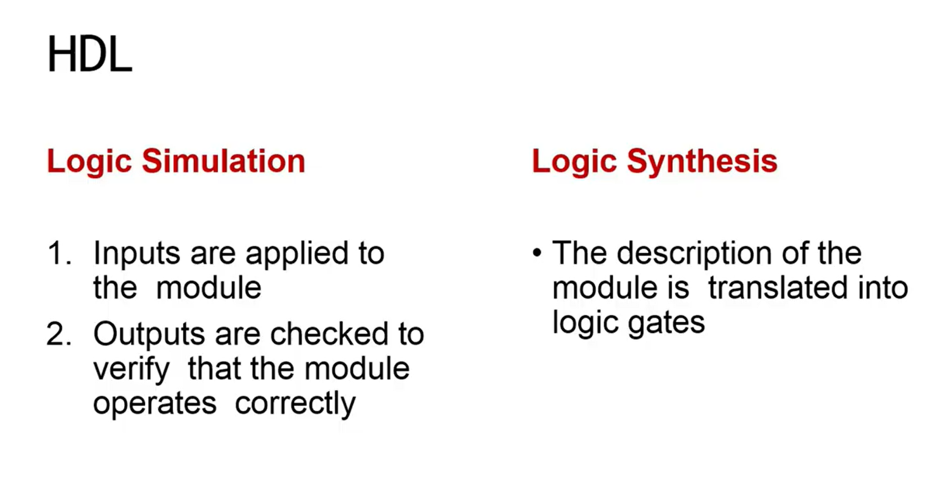

Slide 17
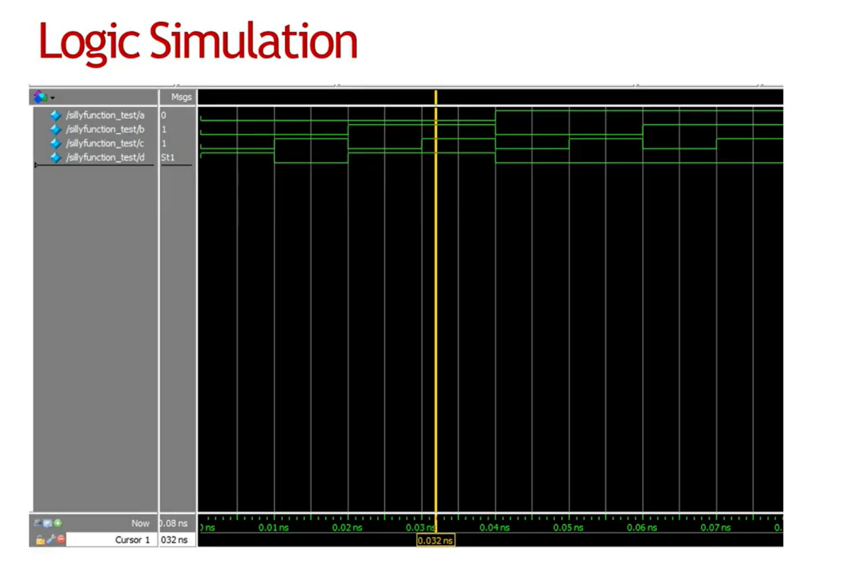

Slide 18
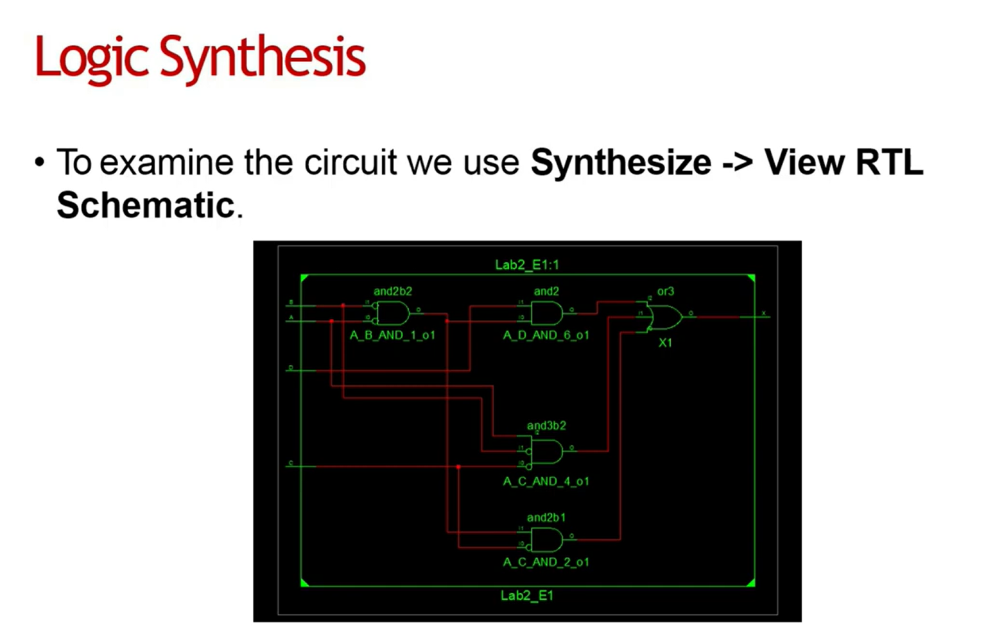

Slide 19
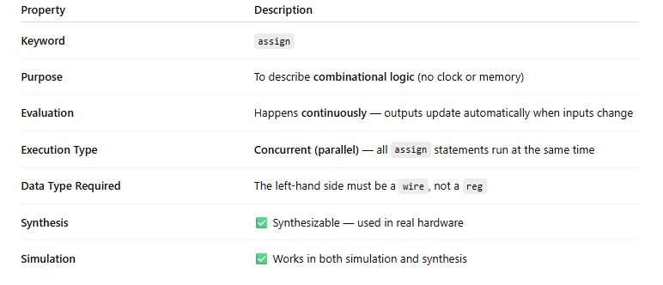
Continuous Assignment Statements (assign)
These statements are reevaluated anytime any of the inputs on the right-hand side change.
Describes only combinational logic.
Evaluated concurrently.
module and_gate (input A, input B, output Y);
assign Y = A & B; // continuous assignment
endmodule

Slide 20
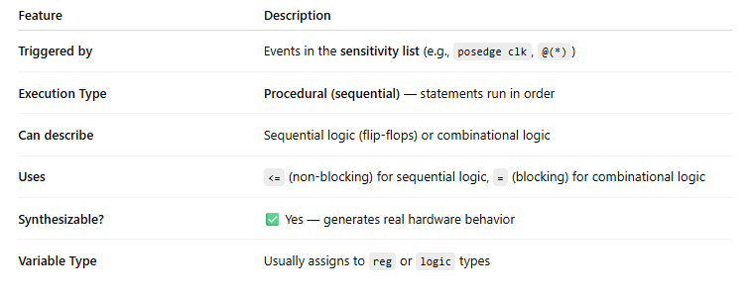
always statement
The always block describes behavioral logic that executes automatically when certain signals change. It’s used to model both sequential (clocked) and combinational logic, depending on the sensitivity list.
always @(sensitivity_list)
begin
// statements
end

Slide 21
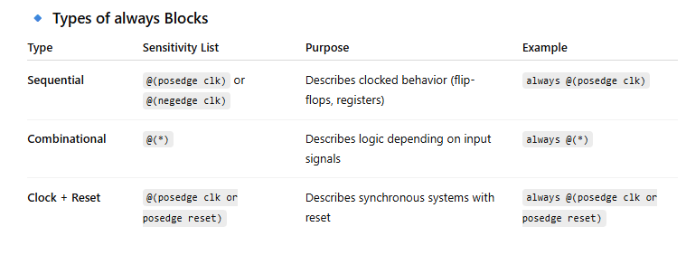
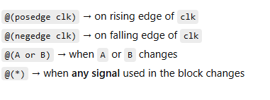
always statement
The always block describes behavioral logic that executes automatically when certain signals change.
It’s used to model both sequential (clocked) and combinational logic, depending on the sensitivity list.

Slide 22
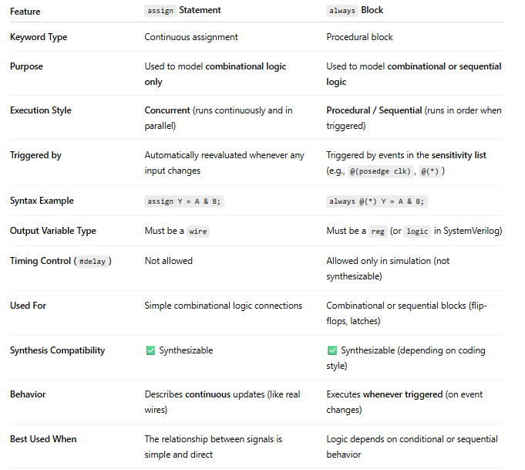
always statement vs assign statement

Slide 23
Implement assign and always statements
Y=A&B
assign
always
module and_gate_always (input A, input B, output reg Y);
always @(*) begin
Y = A & B;
end
endmodule
module and_gate_assign (input A, input B, output Y);
assign Y = A & B;
endmodule

Slide 24
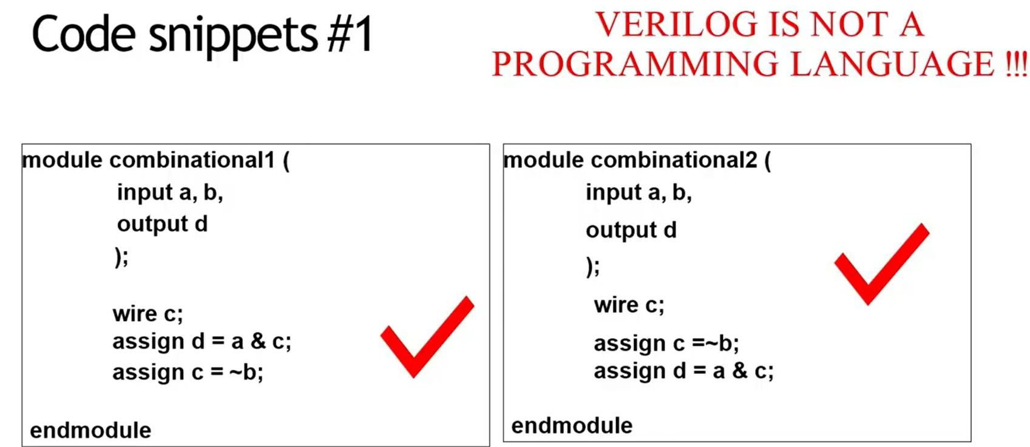
Verilog is not a programming language. It is a harware description language.

Slide 25
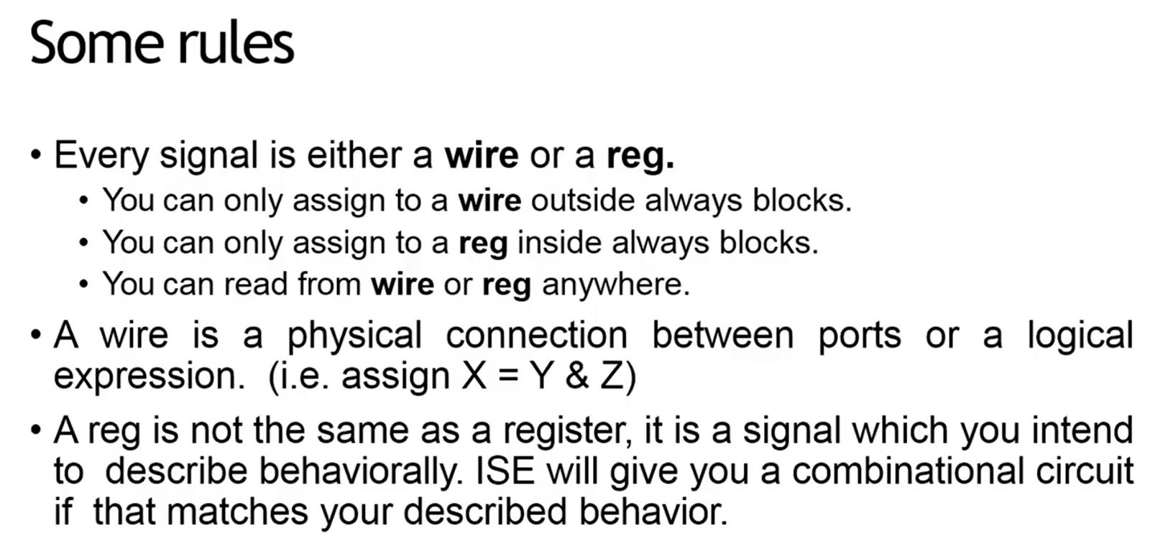

Slide 26
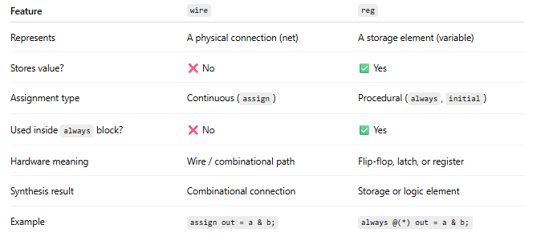
wire vs reg
reg Y;
always @(*) begin
Y = A & B;
end
wire Y;
assign Y = A & B;

Slide 27
Creating a Project

Slide 28
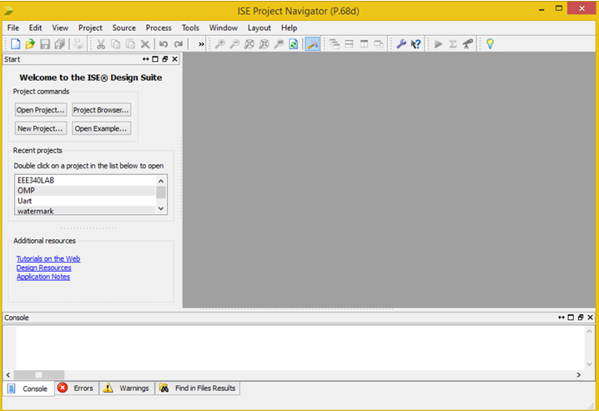
Creating a Project
You start ISE WebPACK by double-clicking the icon on the desktop. This will bring up an ISE Project Navigator window like the following one.

Slide 29
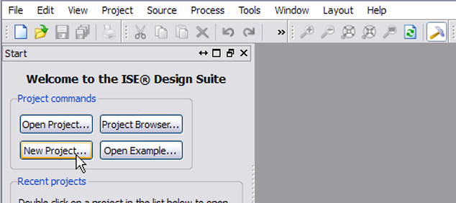
Creating a Project
To create your project, click on the New Project... button in the Navigator window.

Slide 30
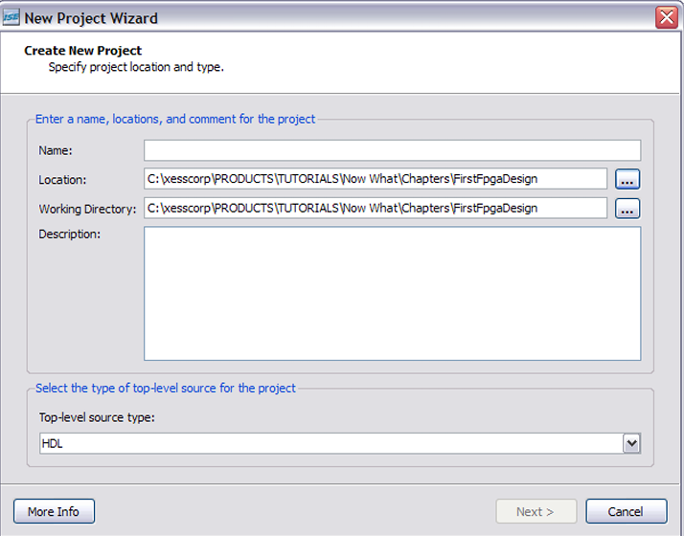
Creating a Project
This will bring up the New Project Wizard. The first thing to do is select a location for your project.
Then type in a name for the project. Notice how the project name is added to the end of the location you set previously. A folder with this name will be created there. Then click on the Next button.

Slide 31
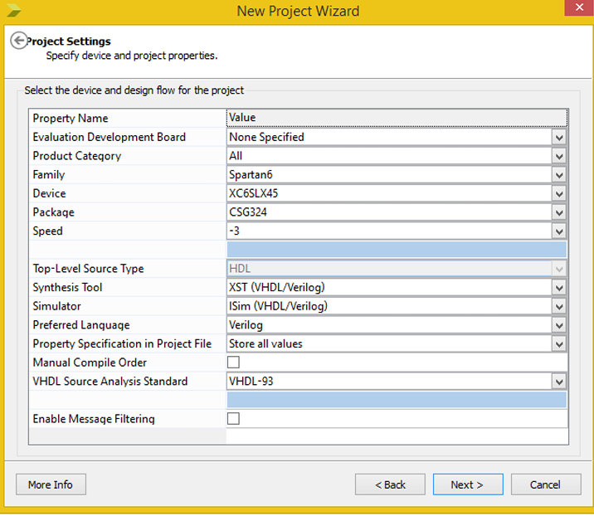
Creating a Project
The next screen that appears is used to select the type of FPGA you want to use for your design.
Set the Family, Device, Package and Speed fields as shown in the screenshot below. (This sets up your design for the particular FPGA used on the ATLYS board.)

Slide 32
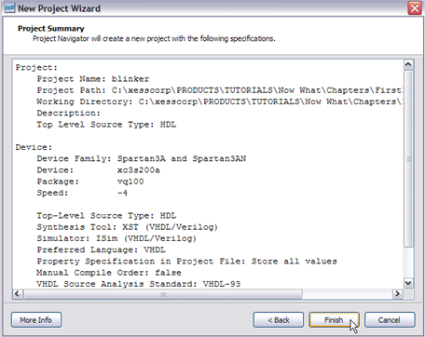
Creating a Project
Now you'll get a summary of the information you've entered about your project. Click on the Finish button and your new project will appear in the Navigator window.

Slide 33
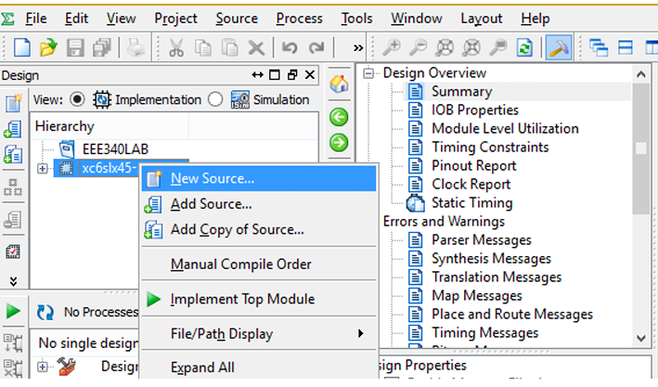
Creating a Project
At this point, your project exists, but it doesn't do anything. It's time to enter the source information that describes how your digital circuit works.
In the Navigator window, right-click on the FPGA identifier (xc6slx45-3csg324 in this design) in the Hierarchy pane and select New Source... from the drop-down menu.

Slide 34
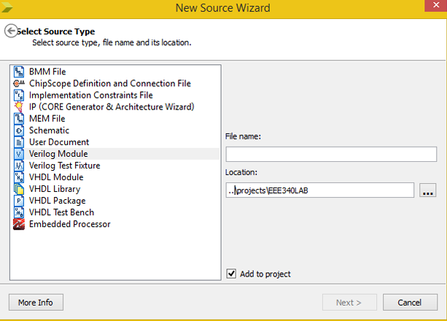
Creating a Project
The New Source Wizard window appears. Here, you can select how you want to describe your design. Select Verilog Module from the list of source types..
Then type a name for the Verilog source file. Then click on the Next button

Slide 35
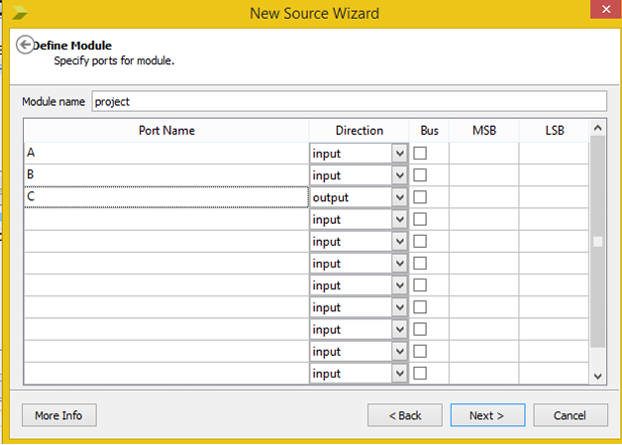
Creating a Project
The next window that appears lets you define the input and output ports for your design..
Type “A” into the first Port Name field. This will be the first input for an AND gate. Type “B” into the second Port Name field. This will be the second input

Slide 36
Creating a Project
Then you have to add a third signal named “C”. This will be the output of the AND gate. Don’t forget to choose its direction as out.

Slide 37
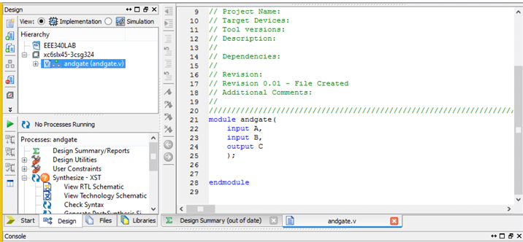
Creating a Project
That's all the inputs and outputs you need. Click on the Next button and you'll get a summary of your Verilog module. Click on the Finish button to complete the module.
Now you should see the contents of your Verilog module in the Navigator workspace pane to the right.

Slide 38
Creating a Project
Now we have inputs and output, but we haven’t described what our circuit will do. We have to tell the synthesizer that our two inputs will be of an AND gate, and output signal “C” will be the output of the AND gate. Here is the Verilog code to do that:
module andgate(
input A,
input B,
output C
);
and(C, A, B);
endmodule

Slide 39
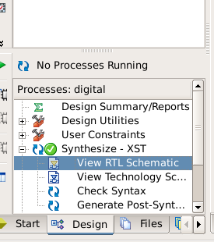
Synthesize
To run the synthesizer, left-click on the icon of your Verilog module in the Hierarchy pane. Once you do that, you should see a list possible operations appear in the Process pane. Double-click the Synthesize – XST process icon to start the Verilog synthesizer.
Now you should see the synthesis completed successfully.

Slide 40
Synthesize
To see schematic of the circuit double-click the View – XST process icon

Slide 41
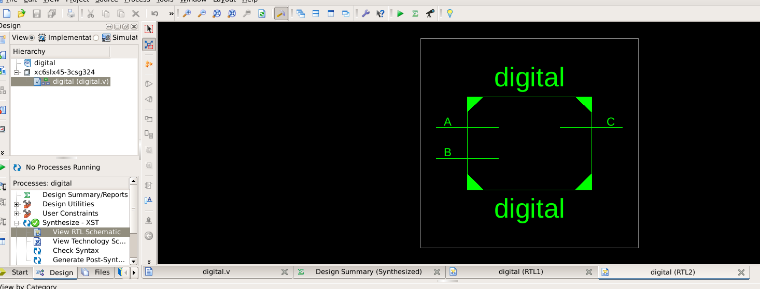
Synthesize

Slide 42
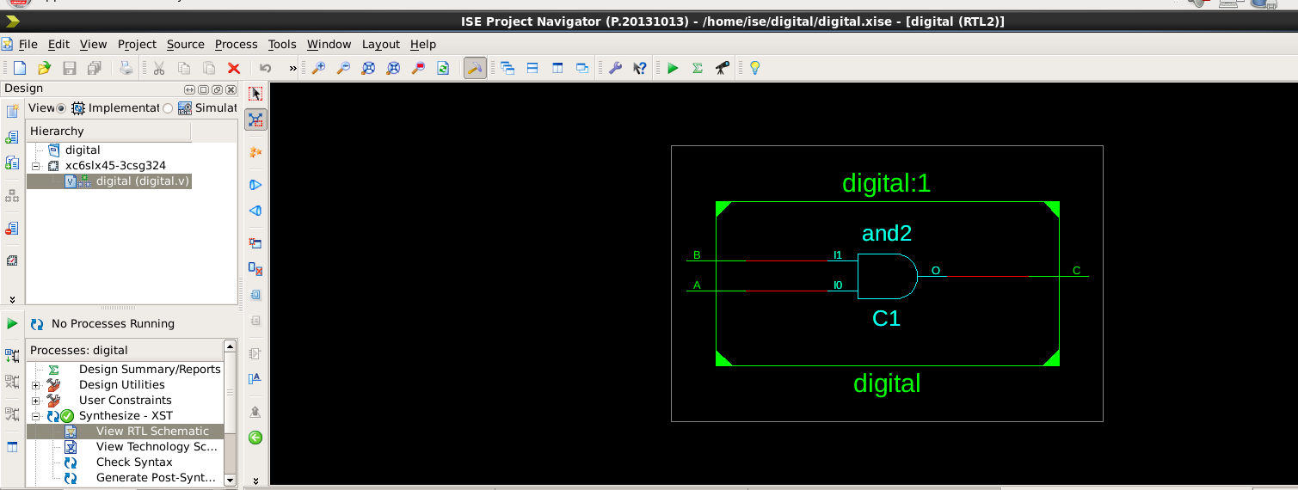
Synthesize

Slide 43
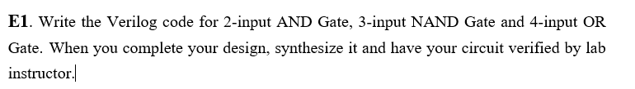
TASK 1)
module e1(
input A,
input B,
input C,
input D,
input E,
input F,
input G,
input H,
input I,
output X,
output Y,
output Z
);
and (X, A, B);
nand (Y, C, D, E);
or (Z, F, G, H, I);
endmodule

Slide 44
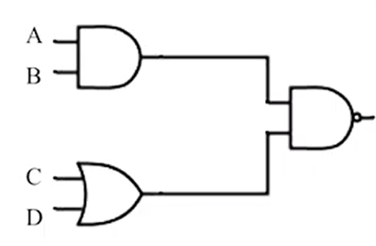
TASK 2)
module e2(
input A,
input B,
input C,
input D,
output E
);
wire X, Y;
and (X, A, B);
or (Y, C, D);
nand (E, X, Y);
endmodule

