Slide 1
EEE146
PROGRAMMING-I
5. Experiment
Resarch Ass. Ali HAZAR
Department of ELECTRICAL AND ELECTRONICS ENGINEERING
Gaziantep University

Slide 2
TASK 1
// Trigonometric Table
#include <iostream>
#include <cmath>
using namespace std;
int main()
{
cout.precision(3);
cout << fixed;
for (int deg = 0; deg <= 90; deg += 5)
{
double x = deg * M_PI / 180.0;
cout << deg << '\t' << sin(x) << '\t' << cos(x) << endl;
}
return 0;
}
This program calculates the sine and cosine values for angles given in degrees and display them in a well-formatted table. For this purpose, we increase the angles by 5 degrees using a for loop.
cout.precision(3); displays 3 digits after the decimal point in the output.
cout << fixed;
It ensures that numbers are displayed in standard decimal format instead of scientific notation (such as 1.23e+2).
In C++, functions like sin() and cos() work with radians, not degrees.

Slide 3
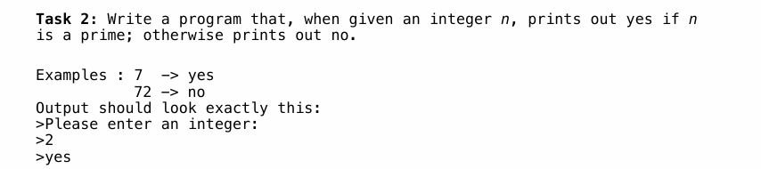
TASK 2

Slide 4
HINTS FOR TASK 2
int n;
bool isPrime = true;
cout << "Please enter an integer: ";
cin >> n;
for (int i = 2; i < n; i++) {
if (n % i == 0) {
isPrime = false;
break;
}
}
if (isPrime) {
cout << "yes" << endl;
} else {
cout << "no" << endl;
}
Prime Numbers
The loop starts from 2, so the number 2 is still considered prime.
{2, 3, 5, …}
Thanks to the break statement, we exit the loop early when needed

Slide 5
#include <iostream>
using namespace std;
int main() {
int n;
bool isPrime = true;
cout << "Please enter an integer: ";
cin >> n;
for (int i = 2; i < n; i++) {
if (n % i == 0) {
isPrime = false;
break;
}
}
if (isPrime) {
cout << "yes" << endl;
} else {
cout << "no" << endl;
}
return 0;
}

Slide 6
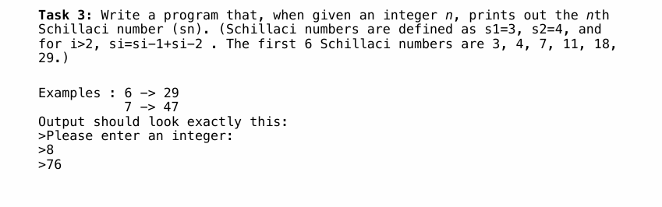
TASK 3
The Schillaci numbers are a sequence defined by starting with 3 and 4, where each number is the sum of the two preceding numbers.

Slide 7
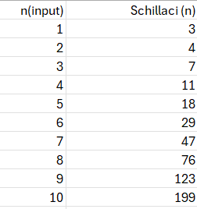
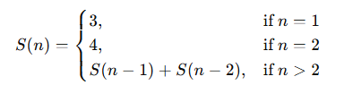

Slide 8
HINTS FOR TASK 3
int n;
cout << "Please enter an integer: ";
cin >> n;
int first = 3, second = 4, now = 0;
if (n == 1) {
cout << n << " st Schillaci is: " << first << endl;
}
else if (n == 2) {
cout << n << " nd Schillaci is: " << second << endl;
}
else {
for (int i = 3; i <= n; i++) {
now = first + second;
first = second;
second = now;
}
cout << n << "th Schillaci is: " << now << endl;
}

Slide 9
#include <iostream>
using namespace std;
int main() {
int n;
cout << "Please enter an integer: ";
cin >> n;
int first = 3, second = 4, now = 0;
if (n == 1) {
cout << n << " st Schillaci is: " << first << endl;
}
else if (n == 2) {
cout << n << " nd Schillaci is: " << second << endl;
}
else {
for (int i = 3; i <= n; i++) {
now = first + second;
first = second;
second = now;
}
cout << n << "th Schillaci is: " << now << endl;
}
return 0;
}

