Slide 1
EEE146
PROGRAMMING-I
Second Experiment
Resarch Ass. Ali HAZAR
Department of ELECTRICAL AND ELECTRONICS ENGINEERING
Gaziantep University

Slide 2
Remember!!!
cout << " enter 2 number " << endl;
cin >> x1 >> y1;
Escape Characters such as /n

Slide 3
#define
#include <iostream>
#define PI 3.14159
using namespace std;
int main() {
double radius, area;
cout << "Enter radius: ";
cin >> radius;
area = PI * radius * radius;
cout << "Area of the circle: " << area << endl;
return 0;
}
In C++, the #define preprocessor directive is used to define constant values.
When using #define, a semicolon (;) is not used at the end of the definition.

Slide 4
#const
#include <iostream>
using namespace std;
int main() {
const int LENGTH = 5;
const int WIDTH = 10;
const int AREA = LENGTH * WIDTH;
cout << "Area of rectangle: " << AREA << endl;
return 0;
}
In C++, the const keyword is used to declare a variable whose value cannot be changed.
Once a variable is defined using const and assigned a value, its value cannot be modified during the rest of the program.

Slide 5
#define versus const
Özellik | #define | const
Processing Time | Processed by the preprocessor before compilation | Evaluated during compilation
Type Information | No type information (e.g., #define PI 3.14) | Has a type (e.g., const double PI = 3.14;)
Debugging | Not visible as a variable during debugging | Appears as a variable in debugging
Memory Usage | Usually does not allocate memory (text substitution) | May allocate memory like a normal variable

Slide 6
If
#include <iostream>
using namespace std;
int main() {
int number;
cout << "Enter a number: ";
cin >> number;
if (number > 0) {
cout << "The number is positive." << endl;
}
else if (number < 0) {
cout << "The number is negative." << endl;
}
else {
cout << "The number is zero." << endl;
}
return 0;
}
In C++ and other programming languages, the if statement is a control structure that allows a program to execute different actions depending on whether a condition is true or false. It is used to control the flow of a program based on a specific condition.

Slide 7
TASK 1
// Length Converter converts
// a given length in m to other units
#include <iostream>
using namespace std;
#define FT 3.280839895013 // foot
#define YD 1.093613298338 // yard
int main(){
double x;
const double IN=1.0e+2/2.54; //inch
enum { MM=1000, CM= 100, DM= 10 };
cout << "Input a lenght in meters: ";
cin >> x;
cout << "This lenght is " << endl;
cout << x*MM << " mm" << endl;
cout << x*CM << " cm" << endl;
cout << x*DM << " dm" << endl;
cout << x*IN << " inch" << endl;
cout << x*FT << " foot" << endl;
cout << x*YD << " yard" << endl;
system("PAUSE");
return 0;
}
This program converts a length entered by the user in meters (m) into millimeters (mm), centimeters (cm), decimeters (dm), inches (in), feet (ft), and yards (yd) and prints the results on the screen.

Slide 8

TASK 2
Distance Between Two Points Program
This program calculates the Euclidean distance between two points entered by the user.The distance between the two points is calculated using the Euclidean Distance formula
(x1​,y1​) → First coordinates
(x2​,y2​) → Second coordinates
d→ distance

Slide 9
HINTS FOR TASK 2
Including Required Libraries
Declaring Variables
Getting Input from the User
Calculating the Distance
Displaying the Result
#include <iostream>
#include <cmath>
using namespace std;
int main() {
double x1, y1, x2, y2;
double distance;
distance = sqrt(pow(x1-x2,2) + pow(y1-y2,2));
cout << "Distance is: " << distance << endl;

Slide 10
#include <iostream>
#include <cmath>
using namespace std;
int main() {
double x1, y1, x2, y2;
double distance;
cout << "Please enter coordinates of the first point: " << endl;
cin >> x1 >> y1;
cout << "Please enter coordinates of the second point: " << endl;
cin >> x2 >> y2;
distance = sqrt(pow(x1-x2,2) + pow(y1-y2,2));
cout << "Distance is: " << distance << endl;
return 0;
}

Slide 11
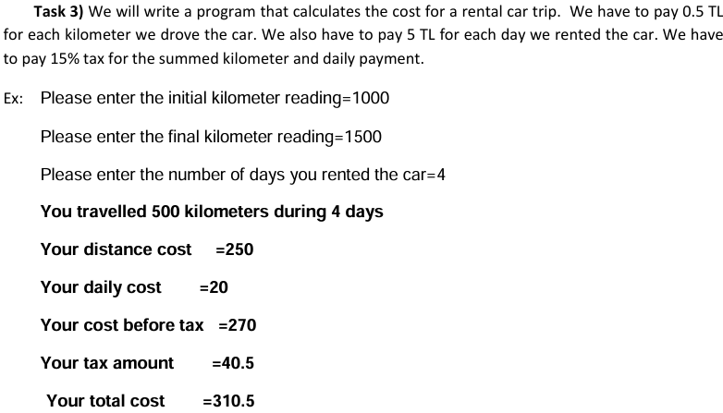
TASK 3

Slide 12
HINTS FOR TASK 3
#include <iostream>
using namespace std;
#define COSTPERKM 0.5
#define COSTPERDAY 5
double initialKM, finalKM, days;
double distanceCost, dailyCost, cost_before_tax, tax, total;
double kilometers;
Including Required Libraries
Declaring Variables
Getting Input from the User
Calculation
Displaying the Result
cin >> initialKM;
cin >> finalKM;
cin >> days;
kilometers= (finalKM-initialKM);
distanceCost= kilometers*COSTPERKM;
dailyCost= days*COSTPERDAY;
cost_before_tax= distanceCost+dailyCost;
tax= cost_before_tax *0.15;
total= cost_before_tax+ tax;
cout << kilometers <<endl;
cout << distanceCost << endl;
cout << dailyCost << endl;
cout << cost_before_tax << endl;
cout << tax << endl;
cout << total << endl;

Slide 13
#include <iostream>
using namespace std;
#define COSTPERKM 0.5
#define COSTPERDAY 5
int main()
{
double initialKM, finalKM, days;
cout << "Please enter the initial kilometer reading: "<< endl;
cin >> initialKM;
cout << "Please enter the final kilometer reading: " << endl;
cin >> finalKM;
cout << "Please enter thenumber of days: " << endl;
cin >> days;
double distanceCost, dailyCost, cost_before_tax, tax, total;
double kilometers;
kilometers= (finalKM-initialKM);
distanceCost= kilometers*COSTPERKM;
dailyCost= days*COSTPERDAY;
cost_before_tax= distanceCost+dailyCost;
tax= cost_before_tax *0.15;
total= cost_before_tax+ tax;
cout << "You have travelled " << kilometers << " kilometers for during " << days << " days" << endl;
cout << "Your distance cost is "<< distanceCost << endl;
cout << "Your daily cost is " << dailyCost << endl;
cout << "Your cost before tax is " << cost_before_tax << endl;
cout << "Your tax amount is " << tax << endl;
cout << "Your total cost is " << total << endl;
return 0;
}

Slide 14
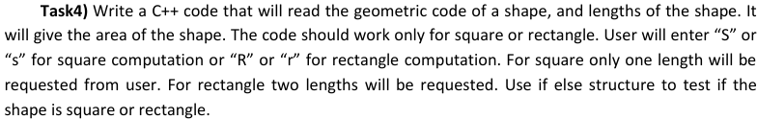
TASK 4

Slide 15
HINTS FOR TASK 4
#include <iostream>
#include <cmath>
using namespace std;
Including Required Libraries
Declaring Variables
Getting Input from the User
Calculation
Displaying the Result
char shape;
double length1, length2, area;
cout << "Enter 'S' or 's' for Square, 'R' or 'r' for Rectangle: ";
cin >> shape;
if (shape == 'S' || shape == 's') {
cout << "Enter the length of the square: ";
cin >> length1;
area = length1 * length1;
cout << "The area of the square is: " << area << endl;
}
else if (shape == 'R' || shape == 'r’)
{
}
else {
cout << "Invalid shape code! Please enter 'S' or 'R'." << endl;
}

Slide 16
#include <iostream>
using namespace std;
int main() {
char shape;
double length1, length2, area;
cout << "Enter 'S' or 's' for Square, 'R' or 'r' for Rectangle: ";
cin >> shape;
// For square (S veya s)
if (shape == 'S' || shape == 's') {
cout << "Enter the length of the square: ";
cin >> length1;
area = length1 * length1;
cout << "The area of the square is: " << area << endl;
}
// For rectangle (R or r)
else if (shape == 'R' || shape == 'r') {
cout << "Enter the length and width of the rectangle: ";
cin >> length1 >> length2;
area = length1 * length2;
cout << "The area of the rectangle is: " << area << endl;
}
else {
cout << "Invalid shape code! Please enter 'S' or 'R'." << endl;
}
return 0;
}

