Slide 1
EEE146
PROGRAMMING-I
Resarch Ass. Ali HAZAR
Department of ELECTRICAL AND ELECTRONICS ENGINEERING
Gaziantep University

Slide 2
TASK 1
#include <iostream>
using namespace std;
int main()
{
int n ;
cout << "How many values will you input? ";
cin >> n;
double x, mean, total = 0.0;
for (int i=1; i<=n; ++i)
{
cout << "Input value " << i << ": ";
cin >> x;
total = total + x;
}
mean = total/n;
cout << "The sum is " << total << endl; cout << "The mean is " << mean << endl;
system("PAUSE");
return 0;
}
This program calculates the average and the sum of the numbers entered by the user.

Slide 3
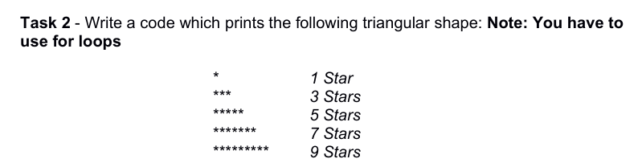
TASK 2

Slide 4

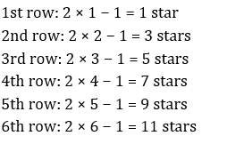
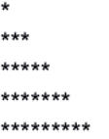
HINTS FOR TASK 2
int rows = 5; // How many rows will be printed
for (int i = 1; i <= rows; i++) {
for (int j = 1; j <= 2 * i - 1; j++) {
cout << "*";
}
cout << endl;
}

Slide 5
#include <iostream>
using namespace std;
int main() {
int rows = 6; // Number of rows to be printed
// It controls the rows
for (int i = 1; i <= rows; i++) {
// It prints 2*i - 1 stars
for (int j = 1; j <= 2 * i - 1; j++) {
cout << "*";
}
//next line
cout << endl;
}
return 0;
}

Slide 6
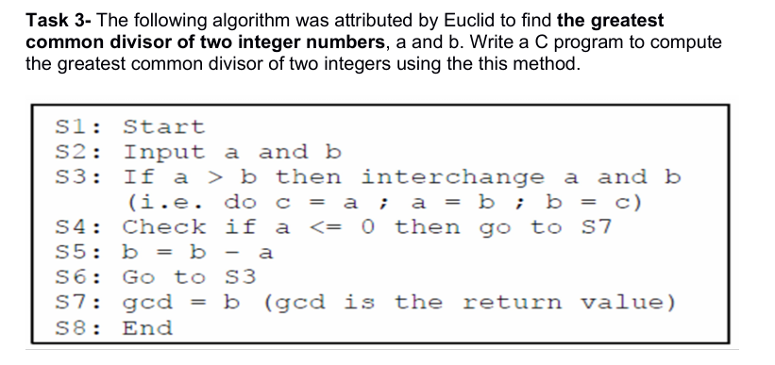
TASK 3
The Euclidean algorithm finds the greatest common divisor of two numbers by repeatedly subtracting the smaller number from the larger one until one of the numbers becomes zero.

Slide 7
Example: Let a = 6 and b = 15.
First, we check whether a ≥ b. If not, there will be no swap.
Then subtract a from b:
b = 15 − 6 = 9. This becomes the new value of b. b=9
We check again whether a ≥ b.
a = 6, b = 9 → No, a is not greater than b.
We repeat the operation:
b = 9 − 6 = 3.
Now a = 6 and b = 3. Since a ≥ b, swap the numbers:
a = 3, b = 6.
We repeat the operation:
b = 6 − 3 = 3.
When b = 3 − 3 = 0, we obtain a = 0 and b = 3.
At this point, the algorithm stops and b = 3 is the result.
Therefore, GCD(6, 15) = 3.

Slide 8
HINTS FOR TASK 3
int a, b;
cout << "Enter two integers: ";
cin >> a >> b;
if (a > b) {
int temp = a;
a = b;
b = temp;}
// Repeat until a <= 0
while (a > 0) {
b = b - a; // S5: Subtract a from b
// Swap if necessary
if (a > b) {
int temp = a;
a = b;
b = temp;
}}
cout << "GCD is: " << b << endl;
Including Required Libraries
Declaring Variables
Getting Input from the User
Calculation
Displaying the Result

Slide 9
#include <iostream>
using namespace std;
int main() {
int a, b;
// S2: Input a and b
cout << "Enter two integers: ";
cin >> a >> b;
// S3: Interchange if a > b
if (a > b) {
int temp = a;
a = b;
b = temp;
}
// Repeat until a <= 0
while (a > 0) {
b = b - a; // S5: Subtract a from b
// Swap if necessary
if (a > b) {
int temp = a;
a = b;
b = temp;
}
}
// S7: Result
cout << "GCD is: " << b << endl;
return 0; // S8: End
}

