Slide 1
EEE146 PROGRAMMING-I Third Experiment
Resarch Ass. Ali HAZAR
Department of ELECTRICAL AND ELECTRONICS ENGINEERING
Gaziantep University

Slide 2
If
#include <iostream> using namespace std; int main() { int number; cout << "Enter a number: "; cin >> number; if (number > 0) { cout << "The number is positive." << endl; } else if (number < 0) { cout << "The number is negative." << endl; } else { cout << "The number is zero." << endl; } return 0; }
In C++ and other programming languages, the if statement is a control structure that allows a program to execute different actions depending on whether a condition is true or false. It is used to control the flow of a program based on a specific condition.

Slide 3
TASK 1
// Grade calculator
#include <iostream>
#include <string>
using namespace std;
int main(){
int mt1, mt2, fin;
cout << "Enter the three exam scores: ";
cin >> mt1 >> mt2 >> fin;
double avr = 0.3*mt1 + 0.3*mt2 + 0.4*fin;
cout << "The weighted score is " << avr << endl;
string grade;
if (avr < 40. ) grade = "FF";
else if (avr >= 40. && avr < 50.) grade = "FD";
else if (avr >= 50. && avr < 60.) grade = "DD";
else if (avr >= 60. && avr < 70.) grade = "DC";
else if (avr >= 70. && avr < 75.) grade = "CC";
else if (avr >= 75. && avr < 80.) grade = "CB";
else if (avr >= 80. && avr < 85.) grade = "BB";
else if (avr >= 85. && avr < 90.) grade = "BA";
else grade = "AA";
cout << "The grade is " << grade << endl;
system("Pause”");
return 0; }
This program calculates the weighted average of a student's three exam scores and determines the letter grade accordingly.

Slide 4
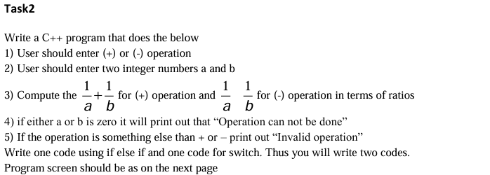
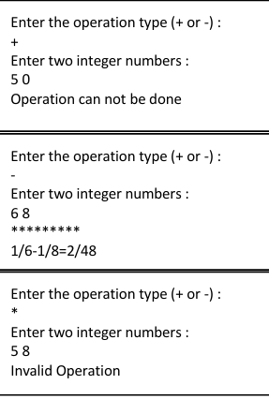
TASK 2

Slide 5
HINTS FOR TASK 2
#include <iostream>
using namespace std;
int main() {
char operation;
double a, b;
cin>>a>>b;
Including Required Libraries
Declaring Variables
Getting Input from the User
Calculation
Displaying the Result
if (a == 0 || b == 0) {
cout << ………………….<< endl;
}
else if (operation == '+') {
cout << "Result: " << ……………<< endl;
}
else if (operation == '-') {
cout << "Result: " << ……………..<< endl;
}
else {
cout << "Invalid operation" << endl;
}

Slide 6
#include <iostream>
using namespace std;
int main() {
char operation;
double a, b;
cout << "Enter operation (+ or -): ";
cin >> operation;
cout << "Enter two integers a and b: ";
cin >> a >> b;
if (a == 0 || b == 0) {
cout << "Operation can not be done" << endl;
}
else if (operation == '+') {
cout << "Result: " << (1 / a) + (1/ b) << endl;
}
else if (operation == '-') {
cout << "Result: " << (1 / a) - (1 / b) << endl;
}
else {
cout << "Invalid operation" << endl;
}
return 0;
}

Slide 7
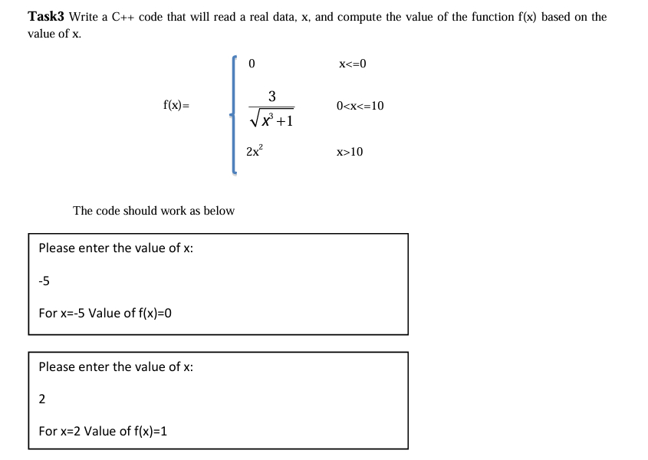
TASK 3

Slide 8
HINTS FOR TASK 3
#include <iostream>
#include <cmath>
using namespace std;
double x;
double result;
if(x <= 0){
result = 0;
}
else if( x > 0 && x <= 10 )
{
result = 3/ sqrt(pow(x,3) + 1);
}
else
{
result = ………..;
}
Including Required Libraries
Declaring Variables
Getting Input from the User
Calculation
Displaying the Result
cin >> x;
cout << << result << endl;

Slide 9
#include <iostream>
#include <cmath>
using namespace std;
int main() {
double x;
cout << "Enter the value of x: ";
cin >> x;
double result;
if(x <= 0){
result = 0;
}
else if( x > 0 && x <= 10 )
{
result = 3/ sqrt(pow(x,3) + 1);
}
else
{
result = 2*pow(x, 2);
}
cout << "For x= "<< x << " value of result = " << result << endl;
return 0;
}

Slide 10
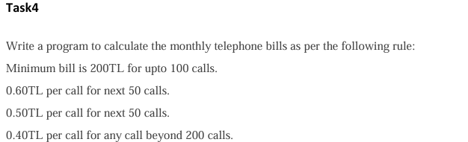
TASK 4

Slide 11
HINTS FOR TASK 4
#include <iostream>
#include <cmath>
using namespace std;
int calls;
double bill;
Including Required Libraries
Declaring Variables
Getting Input from the User
Calculation
Displaying the Result
cout << "Enter the number of calls: ";
cin >> calls;
if (calls <= 100) {
bill = 200; // Minimum bill for up to 100 calls
}
else if (calls >100 && calls <= 150) {
bill = 200 + (calls - 100) * 0.60; // 0.60 TL per call for next 50 calls
}
else if (calls <= 200) {
bill = 200 + 50 * 0.60 + (calls - 150) * 0.50; // 0.50 TL
}
else {
bill = 200 + 50 * 0.60 + 50 * 0.50 + (calls - 200) * 0.40; // 0.40 TL
}

Slide 12
#include <iostream>
using namespace std;
int main() {
int calls;
double bill;
// Get the number of calls from the user
cout << "Enter the number of calls: ";
cin >> calls;
// Calculate the bill based on the number of calls
if (calls <= 100) {
bill = 200; // Minimum bill for up to 100 calls
}
else if (calls >100 && calls <= 150) {
bill = 200 + (calls - 100) * 0.60; // 0.60 TL per call for next 50 calls
}
else if (calls <= 200) {
bill = 200 + 50 * 0.60 + (calls - 150) * 0.50; // 0.50 TL per call for next 50 calls
}
else {
bill = 200 + 50 * 0.60 + 50 * 0.50 + (calls - 200) * 0.40; // 0.40 TL per call for calls beyond 200
}
// Output the bill
cout << "The total telephone bill is: " << bill << " TL" << endl;
return 0;
}

