Slide 1
EEE146 PROGRAMMING-I 7. Experiment
Resarch Ass. Ali HAZAR
Department of ELECTRICAL AND ELECTRONICS ENGINEERING
Gaziantep University

Slide 2
C++ Arrays
In C++, arrays are data structures that store multiple values of the same type under a single variable name.
They are used to keep multiple data of the same type together in an organized and efficient way.
int s1 = 85, s2 = 90, s3 = 78;
int numbers[3] = {85, 90, 78};
double grades[4] = {89.5, 76.0, 92.3, 88.8};
char name[] = "Ali"; // {'A', 'l', 'i'}
string cities[3] = {"Istanbul", "Ankara", "Izmir"}; // string library

Slide 3
Arrays
data_type array_name[array_size];
Örnek:
int numbers[5];
double grades[4];

Slide 4
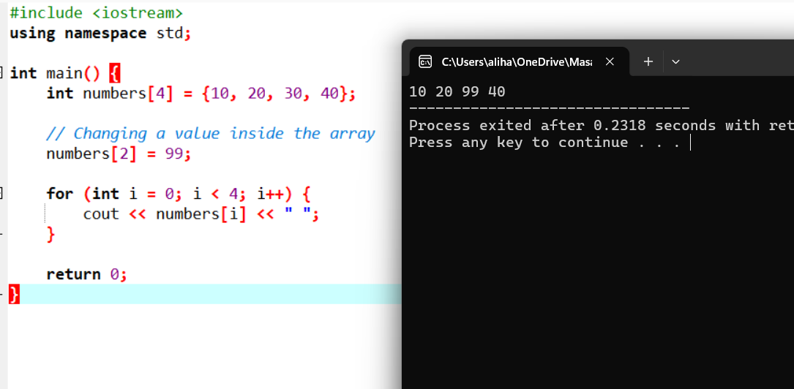
Array Properties
The values inside an array can be changed, but the size of the array cannot be changed.

Slide 5
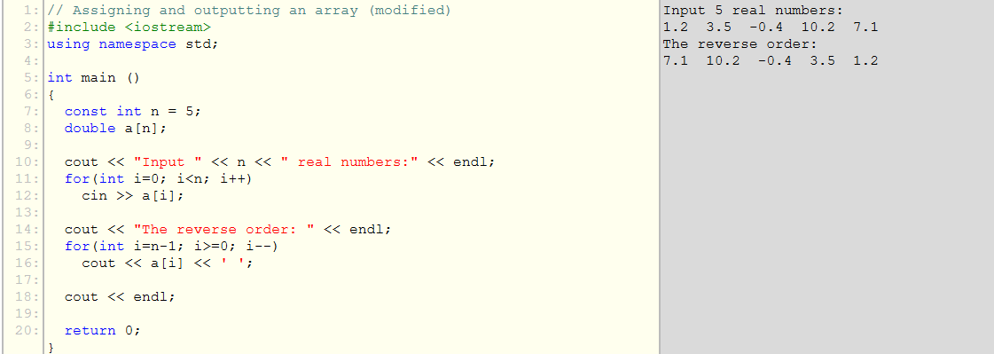

Slide 6
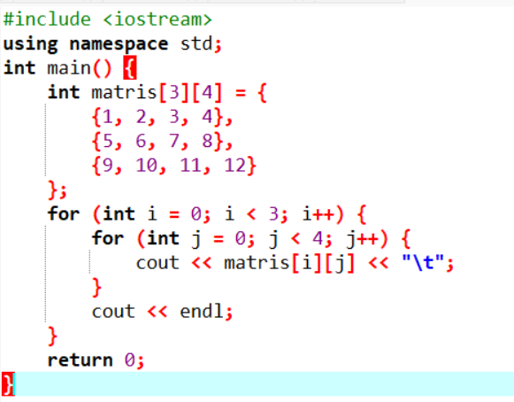
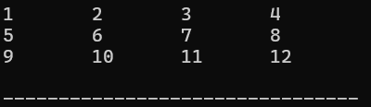

Slide 7
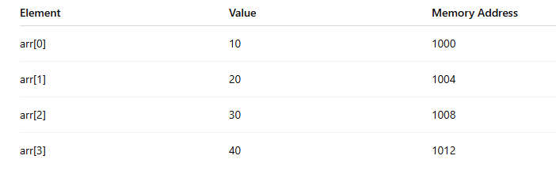
3 IMPORTANT NOTES:
1.Array elements start from index 0.
2.The size of an array is fixed and cannot be changed after declaration. For dynamic resizing, vectors are used.
3.Array elements are stored in contiguous memory locations
In most systems, an int typically occupies 4 bytes
int arr[4] = {10, 20, 30, 40};

Slide 8
Vectors
In C++, a vector is a data structure that represents dynamic arrays. It is a more flexible, safe, and modern alternative to traditional arrays.
vector <type> name;
Examples:
vector<int> grades;

Slide 9
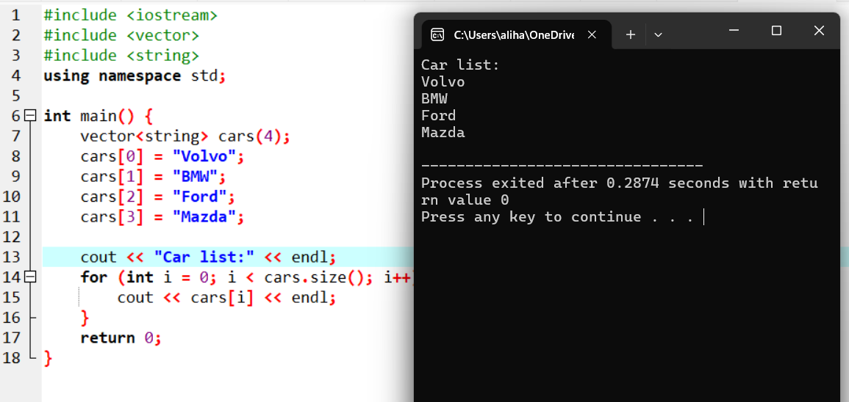
Example

Slide 10
Vector Functions
v.size() → Returns the number of elements in the vector.
v.empty() → Checks whether the vector is empty.
v.push_back(x) → Adds element x to the end of the vector.
v.pop_back() → Removes the last element.
v.at(i) → Accesses the element at index i with bounds checking.
v[i] → Directly accesses the element at index i (no bounds checking).
v.front() → Returns the first element.
v.back() → Returns the last element.
v.clear() → Removes all elements.
v.insert(it, x) → Inserts element x at the specified position (iterator it).
v.erase(it) → Removes the element at the specified position (iterator it).
v.begin() → Returns an iterator to the first element.
v.end() → Returns an iterator to one past the last element.
v.resize(n) → Changes the size of the vector to n.

Slide 11
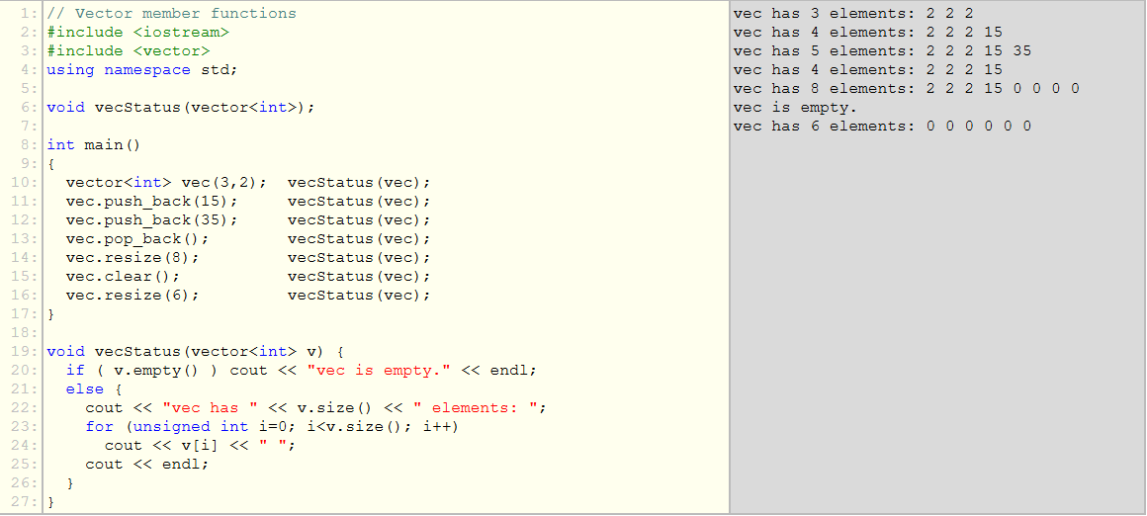

Slide 12
TASK 1
This program takes 5 numbers as input, finds the largest (maximum) value among them, and prints it to the screen.
#include <iostream>
using namespace std;
int main ()
{
const int n = 5; // number of elements in the array
double x[n], max;
cout << "input " << n << " numbers" << endl;
for(int i=0; i<n; ++i)
cin >> x[i];
// first element is assumed to be maximum
max = x[0];
for (int i=1; i<n; i++)
{
if (x[i] > max) max = x[i];
}
cout << "maximum is " << max << endl;
return 0;
}

Slide 13
TASK 2

Slide 14
HINTS FOR TASK 2
#include <cstring> // it is needed for stlen
using namespace std;
int main() {
char string1[20];
int length;
bool isPalindrome = true;
cout << "Enter a string: ";
cin >> string1;
length = strlen(string1);
for (int i = 0; i < length; i++) {
if (string1[i] != string1[length - i - 1]) {
isPalindrome = false;
}}
if (isPalindrome)
cout << "The string is a palindrome." << endl;
else
cout << "The string is not a palindrome." << endl;
return 0 ;}
To implement this program, we defined a character array (char).
if (string1[i] != string1[length - i - 1])
This line compares the i-th element of the array with the i-th element from the end.
The strlen() function is used in C++ (and C) to calculate the length of a character array (string).
It is included in:
#include <cstring>

Slide 15
#include <iostream>
#include <cstring> // it is needed for strlen
using namespace std;
int main() {
char string1[20];
int length;
bool isPalindrome = true;
cout << "Enter a string: ";
cin >> string1;
length = strlen(string1);
for (int i = 0; i < length; i++) {
if (string1[i] != string1[length - i - 1]) {
isPalindrome = false;
break;
}
}
if (isPalindrome)
cout << "The string is a palindrome." << endl;
else
cout << "The string is not a palindrome." << endl;
return 0;
}

Slide 16
TASK 3

Slide 17





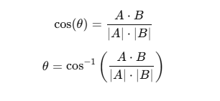
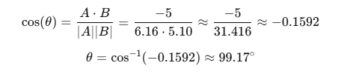

Dot Product and Angle Between Vectors
A = (a₁, a₂, a₃)
B = (b₁, b₂, b₃)
Dot Product
Angle Between Vectors

Slide 18
To find Angle Between A and B
A = (a₁, a₂, a₃)
B = (b₁, b₂, b₃)
1. Create vectors A and B
2. Take input values for vector A
3. Take input values for vector B
4. Calculate the dot product
5. Compute the magnitude (norm) of vector A
6. Compute the magnitude (norm) of vector B
7. Calculate cos(theta)
8. Find the angle using acos()
9. Convert the angle from radians to degrees
10. Print the results

Slide 19
#include <iostream>
#include <vector>
#include <cmath>
using namespace std;
int main() {
vector<double> A(3), B(3);
// Read components of vector A and B
cout << "Enter components of vector A (a1 a2 a3): ";
for (int i = 0; i < 3; i++) {
cin >> A[i];
}
cout << "Enter components of vector B (b1 b2 b3): ";
for (int i = 0; i < 3; i++) {
cin >> B[i];
}
// Calculate dot product
double dot = 0;
for (int i = 0; i < 3; i++) {
dot += A[i] * B[i];
}
double normA = sqrt(A[0]*A[0] + A[1]*A[1] + A[2]*A[2]);
double normB = sqrt(B[0]*B[0] + B[1]*B[1] + B[2]*B[2]);
// Calculate angle (convert from radians to degrees)
double cosTheta = dot / (normA * normB);
double thetaRad = acos(cosTheta);
double thetaDeg = thetaRad * (180.0 / M_PI);
// Print results
cout << "\nDot product: " << dot << endl;
cout << "Angle (degrees): " << thetaDeg << endl;
return 0;
}

Slide 20
#include <iostream>
#include <vector>
#include <cmath>
using namespace std;
int main() {
vector<double> A(3), B(3);
// Read components of vector A
cout << "Enter components of vector A (a1 a2 a3): ";
for (int i = 0; i < 3; i++) {
cin >> A[i];
}
// Read components of vector B
cout << "Enter components of vector B (b1 b2 b3): ";
for (int i = 0; i < 3; i++) {
cin >> B[i];
}
//Calculate dot product
double dot = 0;
for (int i = 0; i < 3; i++) {
dot += A[i] * B[i];
}
double normA = sqrt(A[0]*A[0] + A[1]*A[1] + A[2]*A[2]);
double normB = sqrt(B[0]*B[0] + B[1]*B[1] + B[2]*B[2]);
// Calculate angle (convert from radians to degrees)
double cosTheta = dot / (normA * normB);
double thetaRad = acos(cosTheta);
double thetaDeg = thetaRad * (180.0 / M_PI);
// Print results
cout << "\nDot product: " << dot << endl;
cout << "Angle (degrees): " << thetaDeg << endl;
return 0;
}

