Slide 1
EEE146
PROGRAMMING-I
6. Experiment
Resarch Ass. Ali HAZAR
Department of ELECTRICAL AND ELECTRONICS ENGINEERING
Gaziantep University

Slide 2
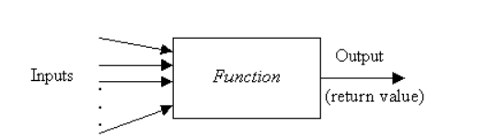

What is a Function?
Functions are blocks of code that perform a specific task.
They make our code more organized, readable, and reusable.

Slide 3
Why Are Functions Used?
To divide complex programs into smaller parts
To avoid writing the same code repeatedly
To easily find and fix errors

Slide 4
Basic Structure of a Function
returnType functionName(parameters) {
// operations performed by the function
return value;
}
Örnek:
int sum(int a, int b) {
return a + b;
}

Slide 5
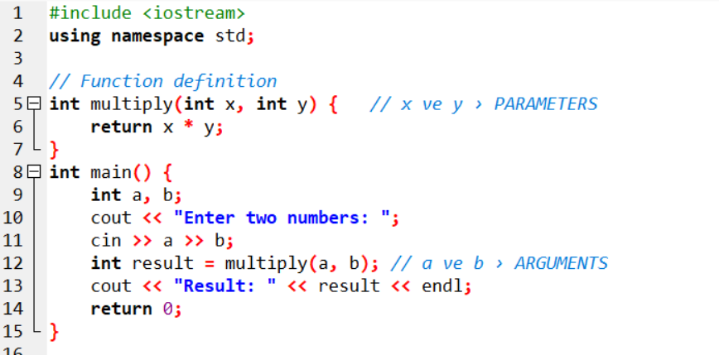

Slide 6
#include <iostream>
using namespace std;
// Function declaration (prototype)
void myFunction(int a, double b);
// Main function
int main() {
// Variable declarations
int x = 5;
double y = 2.5;
// Function call
myFunction(x, y);
return 0;
}
// Function definition
void myFunction(int a, double b) {
// Operations performed by the function
cout << "a: " << a << ", b: " << b << endl;
}
1)#include <iostream> should always be included
2)int main() {} → the main function must always exist
3) Do not forget to define the function

Slide 7
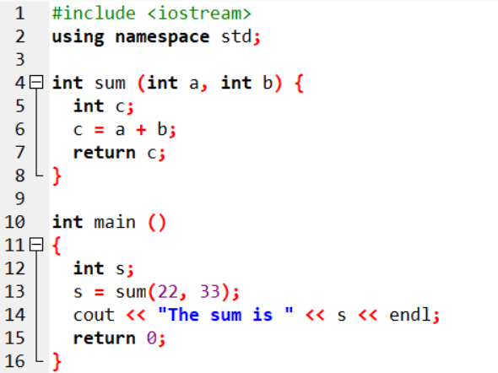

Slide 8
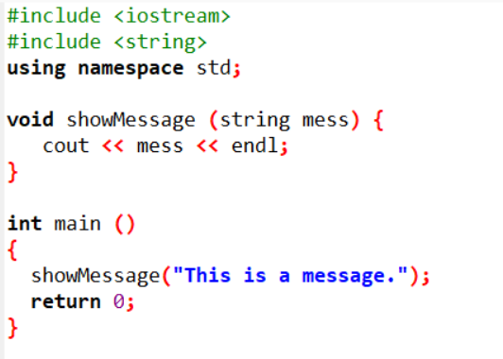
void Functions (No Return Value)
A void function does not return any value.
It performs an action but does not send a result back.
The keyword void is used as the return type.

Slide 9
Reference Parameters (in C++)
A variable passed with & allows the function to access the original variable directly.
In other words, operations are performed on the actual variable, not on a copy.
Changes made inside the function are permanent.
void update(int &x) {
x = x + 10;
}

Slide 10
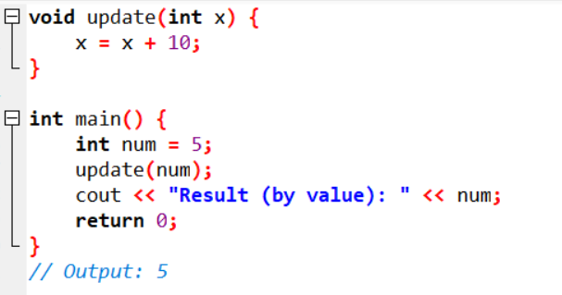
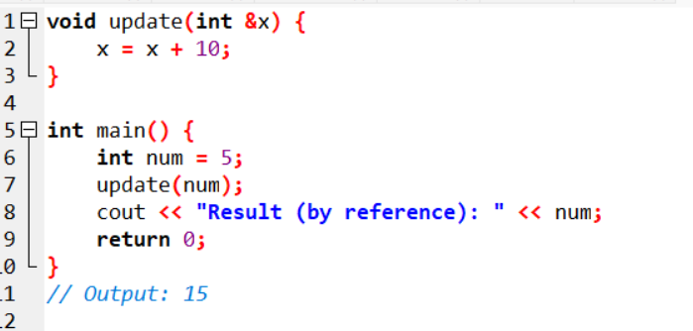

Slide 11
TASK 1
This program calculates the area of a triangle given its three side lengths.
It takes the side lengths from the user, checks whether they form a valid triangle, and calculates the area using Heron’s formula.
// Returns the area of any triangle
double TArea(double a, double b, double c)
{
// Check if any side is negative
if (a<0. || b<0. || c<0.) return 0.0;
// Check if any side is greater than sum of two
if (a >= b+c) return 0.0;
if (b >= a+c) return 0.0;
if (c >= a+b) return 0.0;
// Calculate and return the area
double u, area;
u = 0.5*(a+b+c);
area = sqrt(u*(u-a)*(u-b)*(u-c));
return area;
}
#include <iostream>
#include <cmath>
using namespace std;
// The function prototype
double TArea(double, double, double);
int main()
{
double a, b, c, alan;
cout << "Enter the sides of the triangle: ";
cin >> a >> b >> c;
alan = TArea(a, b, c);
cout << "The area of this triangle is " << alan << endl;
// system(“Pause”); // not adding in VS-Code. You may add on Dev-C++
return 0;
}

Slide 12
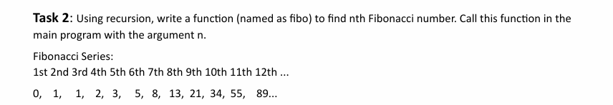
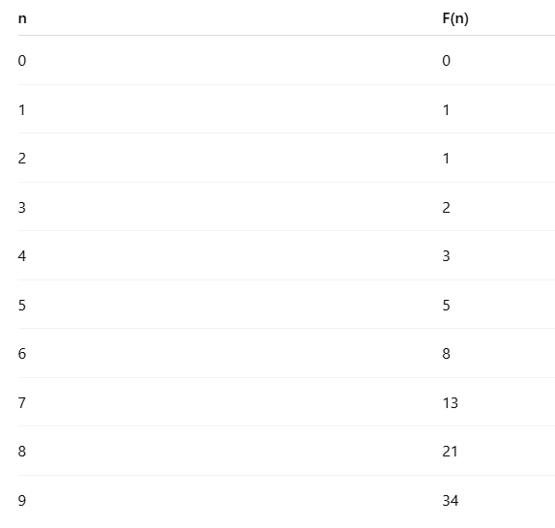
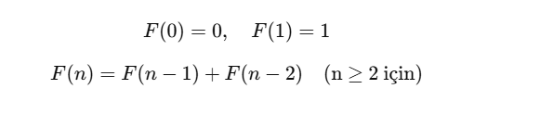
TASK 2

Slide 13
HINTS FOR TASK 2
int fib(int x);
int main() {
int x;
cout << "Enter the number of terms of the series: ";
cin >> x;
cout << "Fibonacci Series: ";
for (int i = 0; i < x; i++) {
cout << " " << fib(i);}
cout << endl;
return 0;
}
int fib(int x) {
if (x == 1 || x == 0) {
return x;
} else {
return fib(x - 1) + fib(x - 2);
}

Slide 14
#include <iostream>
using namespace std;
int fib(int x);
int main() {
int x;
cout << "Enter the number of terms of the series: ";
cin >> x;
cout << "Fibonacci Series: ";
for (int i = 0; i < x; i++) {
cout << " " << fib(i);}
cout << endl;
return 0;
}
int fib(int x) {
if (x == 1 || x == 0) {
return x;
} else {
return fib(x - 1) + fib(x - 2);
}
}

Slide 15
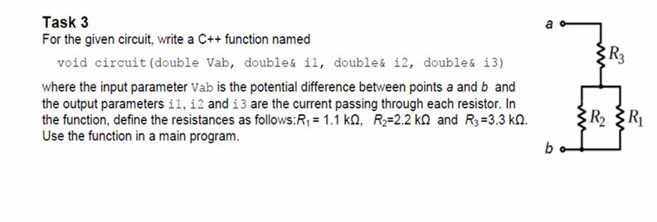
TASK 3
Its purpose is to calculate the currents flowing through resistors when the potential difference (voltage) is given.

Slide 16
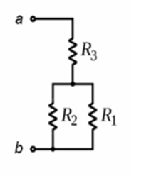




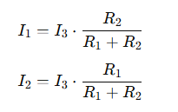
void circuit(double Vab, double &i1, double &i2, double &i3) ;
int main() {
double Vab;
cout << "Enter the potential difference between a and b (volts): ";
cin >> Vab;
double i1, i2, i3;
circuit(Vab, i1, i2, i3);
cout << "i1: " << i1 << endl;
cout << "i2: " << i2 << endl;
cout << "i3: " << i3 << endl;
return 0;
}
void circuit(double Vab, double &i1, double &i2, double &i3) {
double r1 = 1.1; // kilo-ohm
double r2 = 2.2;
double r3 = 3.3;
double Req = r3 + ((r1 * r2) / (r1 + r2));
i3 = Vab / Req;
i2 = i3 * (r1 / (r1 + r2));
i1 = i3 - i2;}

Slide 17
#include <iostream>
using namespace std;
void circuit(double Vab, double &i1, double &i2, double &i3) ;
int main() {
double Vab;
cout << "Enter the potential difference between a and b (volts): ";
cin >> Vab;
double i1, i2, i3;
circuit(Vab, i1, i2, i3);
cout << "i1: " << i1 << endl;
cout << "i2: " << i2 << endl;
cout << "i3: " << i3 << endl;
return 0;
}
void circuit(double Vab, double &i1, double &i2, double &i3) {
double r1 = 1.1; // kilo-ohm
double r2 = 2.2;
double r3 = 3.3;
// Eşdeğer direnç hesabı: r1 ve r2 paralel, sonra r3 seri
double Req = r3 + ((r1 * r2) / (r1 + r2));
// Toplam akım
i3 = Vab / Req;
// Paralel kollardaki akımlar
i2 = i3 * (r1 / (r1 + r2));
i1 = i3 - i2;
}

