Slide 1
EEE146
PROGRAMMING-I
First Experiment
Resarch Ass. Ali HAZAR
Department of ELECTRICAL AND ELECTRONICS ENGINEERING
Gaziantep University

Slide 2
Grading for Lab
There will 4-6 quizes(60%) and final exam(40%)
Attendance is mandatory with a minimum requirement of 80% participation. Otherwise you will be NA

Slide 3
References
https://cplusplus.com/doc/tutorial/
This site is very informative, we highly recommend it
http://cpp.gantep.edu.tr/
Another web site created by our Professors.

Slide 4
What is C++?
C++ is
General-purpose programming language
Developed by Bjarne Stroustrup
Used in system/software development, game development, and high-performance applications
Purpose of C++: Designed to provide high-performance and efficient memory management while supporting both procedural and object-oriented programming paradigms.

Slide 5
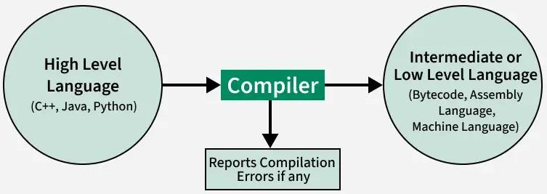
What is a compiler?
CPU understand only one language and that language consists of sets of instructions made of ones and zeros. This computer language is appropriately called machine language.

Slide 6
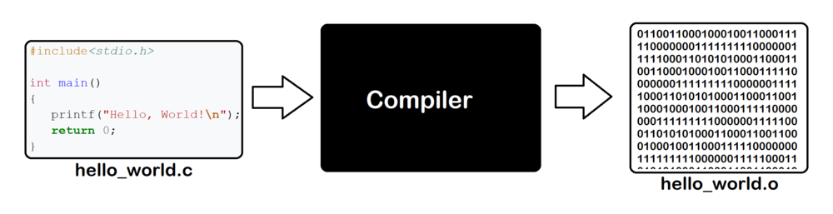
What is a compiler?
✔ A compiler translates the entire code into machine language before execution.
✔ The compiled program runs faster because it's already translated.
✔ However, you must recompile the code after every change.

Slide 7
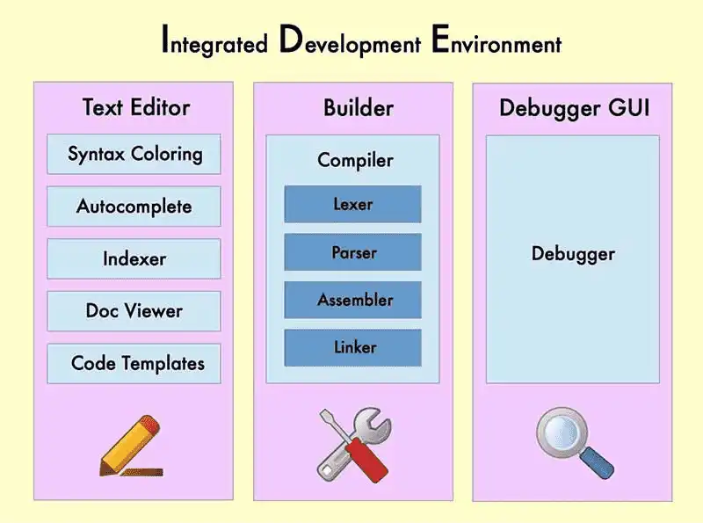
What is a IDE? (Integrated Development Environment)
IDEs increase programmer productivity by combining common activities of writing software into a single application: editing source code, building executables, and debugging.

Slide 8
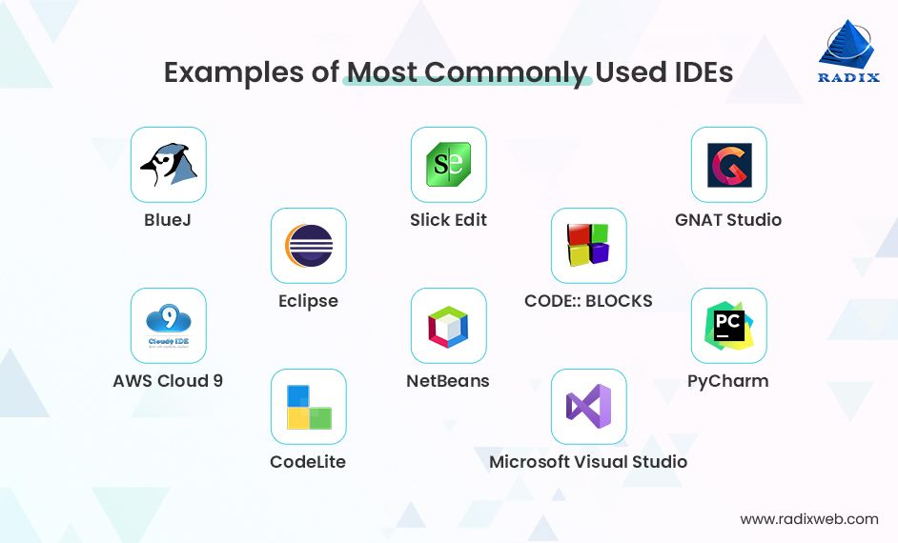
What is a IDE? (Integrated Development Environment)

Slide 9
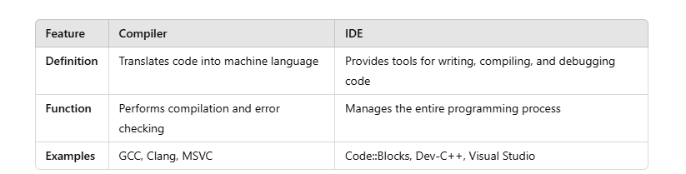
What is a IDE? (Integrated Development Environment)
In this experiment we will use Dev-C++ IDE

Slide 10
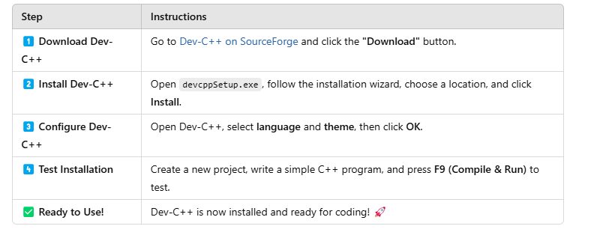
How to Download Dev-C++
https://sourceforge.net/projects/orwelldevcpp/

Slide 11
First C++ Program
#include <iostream>
using namespace std;
int main()
{
cout << " Hello World! " << endl;
cout << "\n" ;
system("Pause");
return 0;
}

Slide 12
First C++ Program
#include <iostream>
using namespace std;
int main()
{
cout << " Hello World! " << endl;
cout << "\n" ;
system("Pause");
return 0;
}
✔ Lines starting with # are preprocessor directives. The preprocessor runs before the compiler, converting these lines into special commands to prepare the code for compilation.
✔ #include <iostream> is a header file that allows input and output operations.
✔ It enables the use of cout for printing text.
✔ Without this line, cout will not work!

Slide 13
First C++ Program
✔ std (standard namespace) contains objects like cout and cin.
✔ This will allow us to write cout, cin, endl, etc. instead of std::cout, std::cin, std::endl respectively.
#include <iostream>
using namespace std;
int main()
{
cout << " Hello World! " << endl;
cout << "\n" ;
system("Pause");
return 0;
}

Slide 14
First C++ Program
✔ Every C++ program starts execution from the main() function.
✔ int means the function returns an integer value.
✔ Every function has a type and main function’s is int.
✔ The {} braces define the function’s body.
#include <iostream>
using namespace std;
int main()
{
cout << " Hello World! " << endl;
cout << "\n" ;
system("Pause");
return 0;
}

Slide 15
First C++ Program
✔ cout stands for "console output" – it prints text to the screen.
✔ "Hello World!" is a string that gets displayed.
✔ endl moves the cursor to a new line (like \n).
#include <iostream>
using namespace std;
int main()
{
cout << " Hello World! " << endl;
cout << "\n" ;
system("Pause");
return 0;
}

Slide 16
First C++ Program
✔ \n creates a new line.
✔ Equivalent to endl, but slightly faster.
#include <iostream>
using namespace std;
int main()
{
cout << " Hello World! " << endl;
cout << "\n" ;
system("Pause");
return 0;
}

Slide 17
First C++ Program
✔ It is used in Windows to pause the program before closing.
✔ It waits for the user to press a key.
✔ It is not required in modern IDEs.
✔ Not recommended for Linux/macOS – It can be used cin.get(); instead of it
#include <iostream>
using namespace std;
int main()
{
cout << " Hello World! " << endl;
cout << "\n" ;
system("Pause");
return 0;
}

Slide 18
First C++ Program
✔ main() returns an integer value to the operating system. ✔ 0 means the program executed without errors.
✔ It is optional in modern C++ but a good practice.
#include <iostream>
using namespace std;
int main()
{
cout << " Hello World! " << endl;
cout << "\n" ;
system("Pause");
return 0;
}

Slide 19
First C++ Program
SUMMARY
✅ #include <iostream> → Enables input/output.
✅ using namespace std; → Allows using cout easily.
✅ main() → Entry point of the program.
✅ cout → Prints text to the screen.
✅ endl or \n → Creates a new line.
✅ system("Pause") → Stops program from closing immediately.
✅ return 0; → Indicates successful execution.
#include <iostream>
using namespace std;
int main()
{
cout << " Hello World! " << endl;
cout << "\n" ;
system("Pause");
return 0;
}

Slide 20
Escape Characters
SOME OTHER FEATURES
\n → New line
\t → Tab space
\" → Double quote
\\ → Backslash
// → Comment line(It is ignored by compiler.
/* */ → Comment lines
#include <iostream>
using namespace std;
int main() {
cout << "Hello, World!\n";
cout << "This is a\ttab space.\n";
cout << "Printing a double quote: \"Hello!\"\n";
cout << "Backslash example: C:\\Program Files\\MyApp\n";
return 0; //Successfully completed.
}

Slide 21
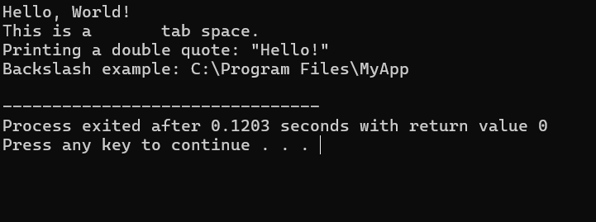
Escape Characters
#include <iostream>
using namespace std;
int main() {
cout << "Hello, World!\n";
cout << "This is a\ttab space.\n";
cout << "Printing a double quote: \"Hello!\"\n";
cout << "Backslash example: C:\\Program Files\\MyApp\n";
return 0; // Successfully completed
}

Slide 22
NOTES
Each statement must end with a semicolon character (;)
It is very important; otherwise, the compiler will generate an error.
Comments help make code easier to understand and maintain in the future.

