Slide 1

EEE 247 Laboratory Presentation
Data transfer
Advanced Plot
Symbolic Math
Res. Asst. Muhterem Alper KAPLAN

Slide 2
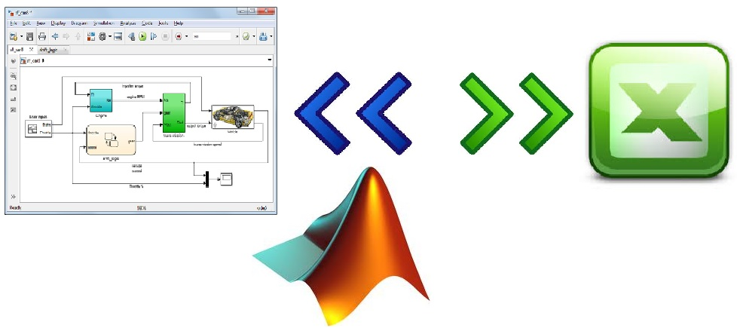
Data transfer
Matlab has functions that allow reading and saving variables from files. For example, Excel.

Slide 3
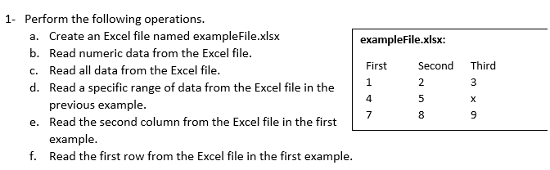
Data transfer
‘xlswrite’ function will be used to create Excel file and ‘xlsread’ function will be used to read from the Excel file.
For specific range, xlRange=‘B2:C3’ can be determined. Rows of Excel is named with letter (A,B,C,D..) and Columns of Excel is named with number(1,2,3,4,..).

Slide 4
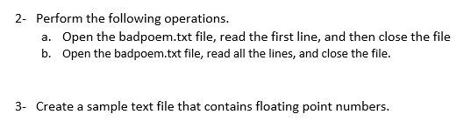
Data transfer
Badpoem.txt file is an example file is ready inside of Matlab. You do not need to construct this file. ‘fopen’ is used for open the file. ‘fgetl’ read strings from the text file and lastly we use ‘fclose’ function to close the file.
Again we use ‘fopen’ function but we need also ‘fprintf’ function in third question. Because we construct this file, it is not builted text file like previous question.

Slide 5
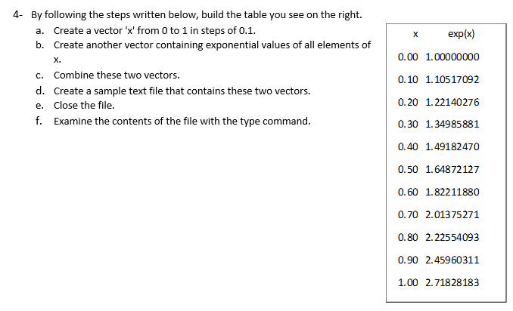
Data transfer
We use ‘fopen’ and ‘fprintf’ functions also in this question. Additionally, we have to know the format string ‘%f %c’could be used to read the number and the letter, skipping the space in between them.

Slide 6

Advanced Plot
MATLAB has a powerful graphics system for presenting and visualizing data, which is reasonably easy to use.

Slide 7
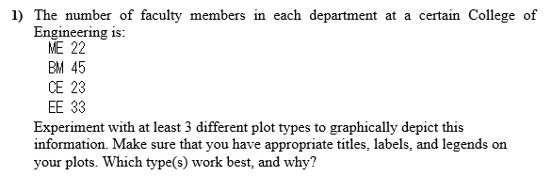
Advanced Plot
The question wants 3 different plot types. Let’s plot with pie chart, bar chart and standart plot. To do this;
pie() function creates a pie chart
bar(x,y) function creates a vertical bar chart
plot(x,y) linear plot of vector y vs. vector x and compare to graphic result.

Slide 8
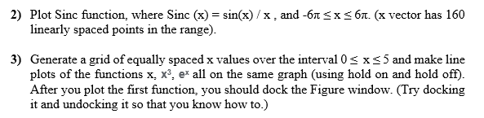
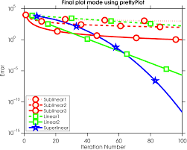
Advanced Plot
linspace(x1,x2) returns a row vector of evenly spaced points between x1 and x2. Then, we can determine the sinc function.
Lastly, plot in that range.
Hold on retains the current plot and certain axes properties
so that subsequent graphing commands add to the
existing graph.
Line marker add the plot specification.

Slide 9

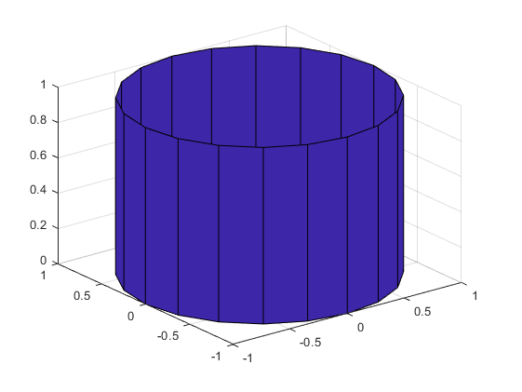
Advanced Plot
surf function displays both the connecting lines and the faces of the surface in color.
[X,Y,Z] = cylinder(r,n) returns the x-, y-, and z- coordinates of a cylinder with the specified profile curve, r, and n equally spaced points around its circumference.

Slide 10
Symbolic Math
Symbolic Math Toolbox software lets you to perform symbolic computations within the MATLAB numeric environment. It provides tools for solving and manipulating symbolic math expressions and performing variable-precision arithmetic.
Differentiation
Integration
Linear algebraic operations
Simplification
Transforms
Variable-precision arithmetic
Equation solving

Slide 11
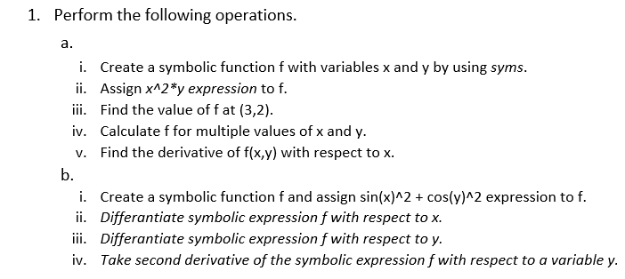
Symbolic Math
syms command creates symbolic variables and expressions.
diff command is used to differentiate a symbolic expression.

Slide 12
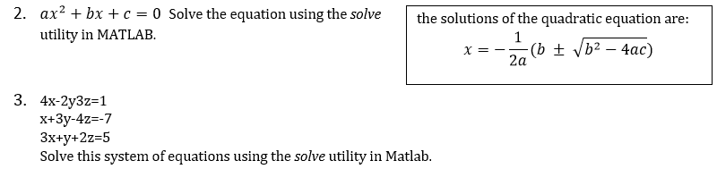
Symbolic Math
If eqn is an equation, solve(eqn, x) solves eqn for the symbolic variable x.
Use the == operator to specify the familiar quadratic equation and solve it using solve.
syms a b c x
eqn = a*x^2 + b*x + c == 0;
solx = solve(eqn, x)
solx is a symbolic vector containing the two solutions of the quadratic equation.

Slide 13
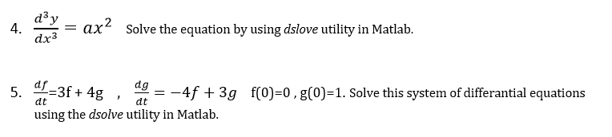
Symbolic Math
dsolve(eqn) solves the differential equation eqn, where eqn is a symbolic equation. Use diff and == to represent differential equations. For example, diff(y,x) == y represents the equation dy/dx = y. Solve a system of differential equations by specifying eqn as a vector of those equations.

Slide 14
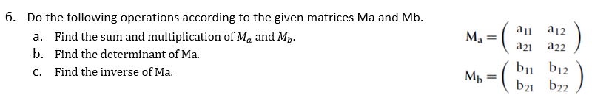
Symbolic Math
We need to determine whole elements of both matrices by using syms command.
det() command takes determinant of the matrice.
inv() command takes inverse of the matrice.

Slide 15
Thanks for your listening
Any problem or question?
You can write to command part of Youtube experiment videos.
Also send me e-mail: efganugur@gantep.edu.tr

