Slide 1
EEE241 Digital Design First Experiment
Resarch Ass. Ali HAZAR
Resarch Ass. Alper KAPLAN
Department of ELECTRICAL AND ELECTRONICS ENGINEERING
Gaziantep University

Slide 2
Grading for Lab
There will 3-4 quiz(40%), Report (20%) and final exam(40%)
Attendance is mandatory with a minimum requirement of 80% participation.

Slide 3
Aim of the 241 Lab
This laboratory course is designed to provide students with a practical understanding of digital logic.
In addition, you will implement and test these circuits, and analyze their behavior with hardware description languages (HDLs).

Slide 4
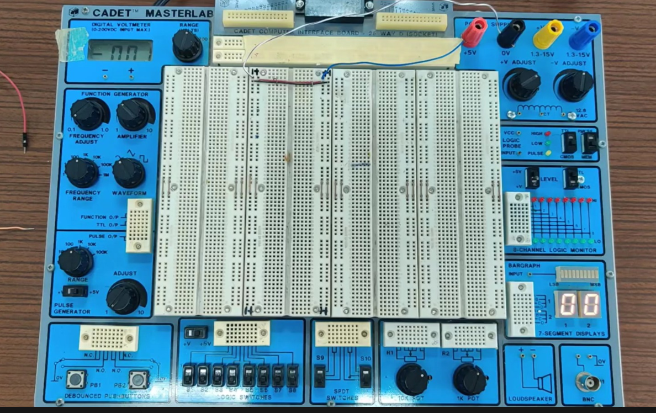
Training Kit

Slide 5

Digital Design Training Kit – Overview
There is a large central space for building and testing digital circuits. You will set your circuit in this region.
Power supply section: It provides fixed voltage.
Function generator: It produces various waveforms (sine, square and triangle) for testing purposes.
Pulse generator: It supplies clock pulses at different frequencies for use with sequential circuits.
Logic switches: It has eight toggle switches for manual binary input (0 or 1). The Logic Monitor is an 8-channel LED display showing circuit outputs (HIGH/LOW).
7-segment display and bar graph: It is for visual representation of digital outputs.
Additional modules: Potentiometers, a loudspeaker and a BNC connector for external devices.

Slide 6
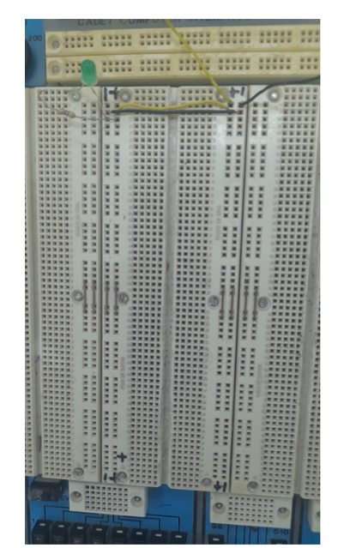
Breadboard
It is used for building and testing circuits quickly.
Vertical columns (5 holes each) are connected internally components placed in the same column are electrically connected.
Horizontal rails (+ and –) at the top and bottom are for power supply connections (Vcc and GND).
Components (ICs, etc.) are inserted directly into the holes without soldering.
It makes easy to connect, remove, and rearrange circuit parts during experiments.

Slide 7
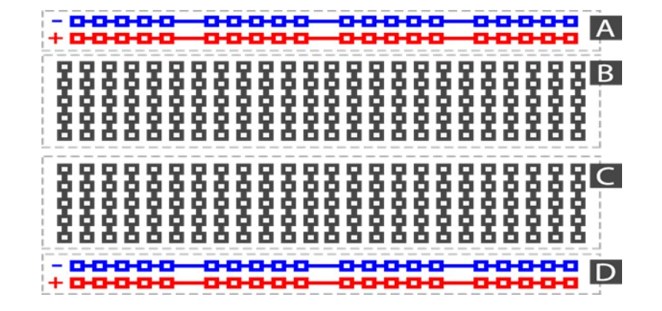
The rows on the breadboard marked with + and – are used for voltage connections. After voltage is applied to these rails, the power requirements of the components placed on the board are supplied from them. All + rows are internally connected to each other, and all – rows are also internally connected to each other.
In the middle part of the breadboard, there are columns consisting of 5 holes. These holes are connected by the same metal strip, so they are electrically conductive. This means that the pins inserted into the holes of the same column are connected to each other, allowing easy connections between circuit components

Slide 8
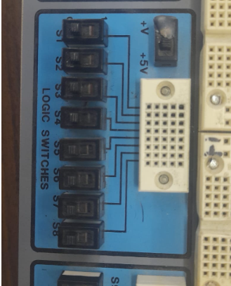
Logic Input Switches
This block provides manual input signals for digital circuits. There are 8 toggle switches (S1–S8), each representing a single binary input.
Each switch can be set to:
LOW (0) → when the switch is OFF
HIGH (1) → when the switch is ON
The white socket next to the switches allows you to connect these inputs directly to your breadboard circuit.
This feature helps us simulate binary inputs (like control signals, enable, reset, or data bits) without needing external components.

Slide 9
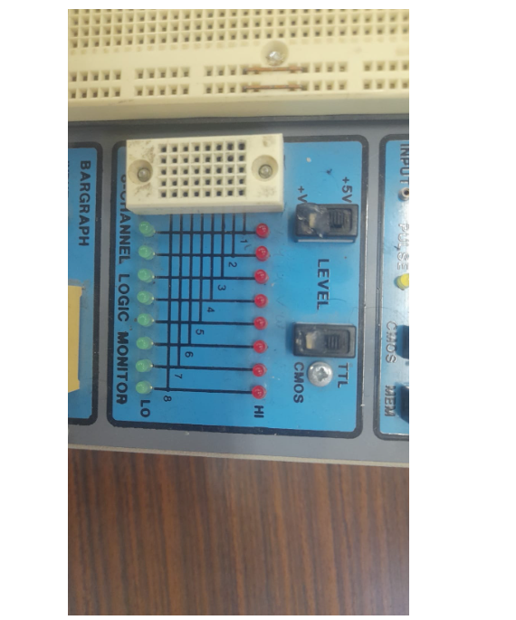
Logic Output Monitor
This section is used to visualize logic signals (0 and 1) with LEDs.
It has 8 channels, so you can observe 8 different logic inputs at the same time.
Green LED → LOW (0),
Red LED → HIGH (1).

Slide 10
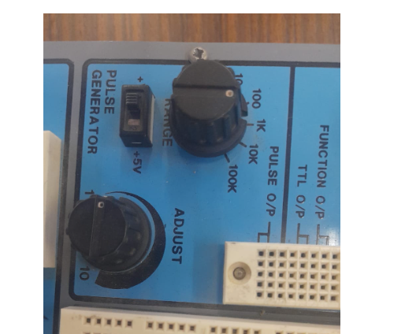
Pulse Generator (Clock Signal Source)
It provides clock or pulse signals for digital circuits.
It has a Range knob to select frequency scale (100, 1k, 10k, 100k Hz).
It Has an Adjust knob to fine-tune the frequency within the selected range.
The Output is available as TTL or CMOS signal levels.
The +5V switch must be ON for operation.
Used to drive counters, flip-flops, and sequential circuits as a clock source.

Slide 11
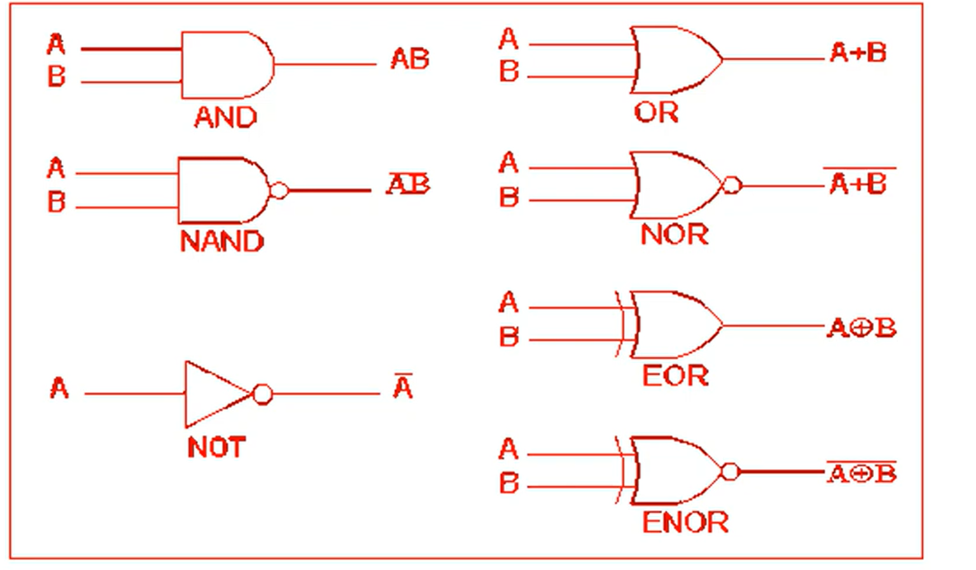
Some Important Gates

Slide 12
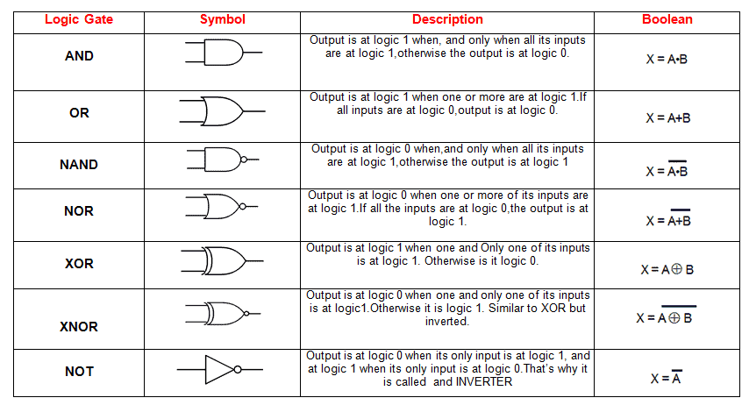
Some Important Gates

Slide 13
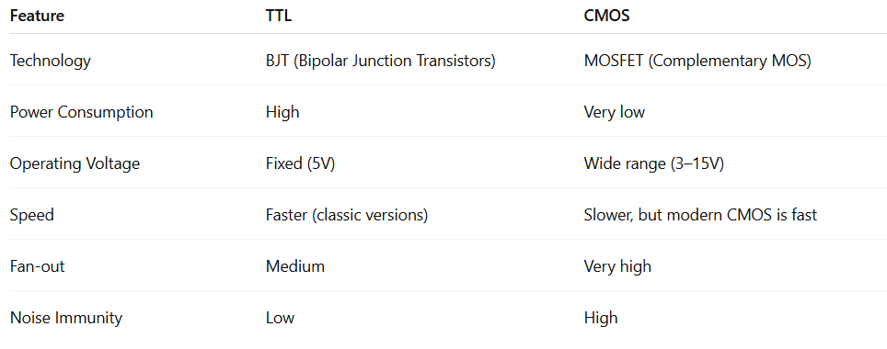
TTL vs CMOS
While TTL circuits are faster and traditionally use more power, CMOS circuits offer lower power consumption and higher noise immunity. In our laboratory, we will use TTL chips such as 7400 (NAND),7020, 7404 (NOT), 7408 (AND), 7432 (OR), and 7476 (JK Flip-Flop).

Slide 14
Some Important Gates
Since we will use TTL technology in our laboratory, we will work with the 74XX series chips (e.g., 7400 NAND, 7404 NOT, 7408 AND, 7432 OR, 7476 JK Flip-Flop). At the initial stage, CMOS circuits (40XX series) will not be used.
AND Gate
7408 → Quad 2-input AND gate (contains 4 AND gates)
4081 → CMOS Quad 2-input AND gate
🔹 OR Gate
7432 → Quad 2-input OR gate
4071 → CMOS Quad 2-input OR gate
🔹 NOT Gate (Inverter)
7404 → Hex inverter (contains 6 NOT gates)
4049 / 4069 → CMOS Hex inverter
🔹 NAND and NOR (very common universal gates)
7400 → Quad 2-input NAND gate
7402 → Quad 2-input NOR gate
📌 Notes:
74xx series → TTL-based (e.g., 7408, 7432, 7404).
40xx series → CMOS-based (e.g., 4081, 4071, 4069).
The most commonly used in labs are 7400, 7408, 7432, 7404.

Slide 15
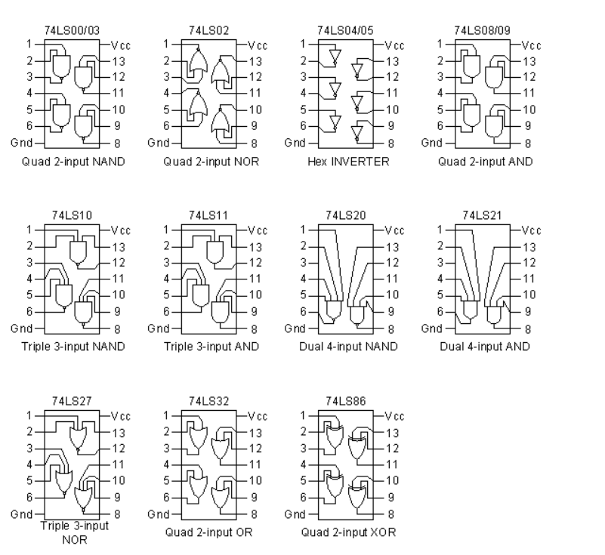
Some Important Gates

Slide 16
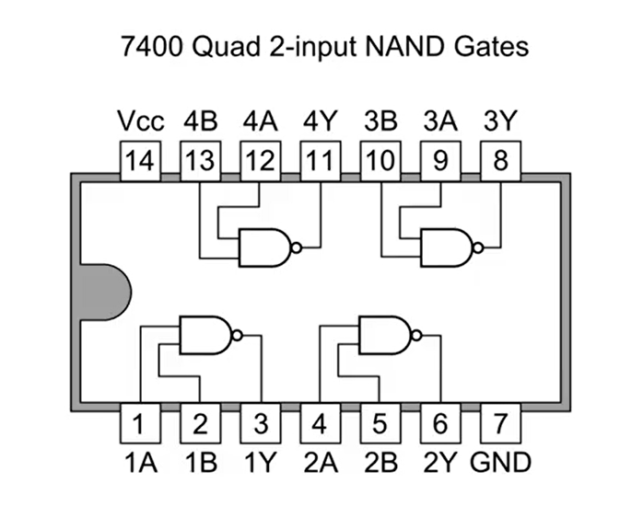
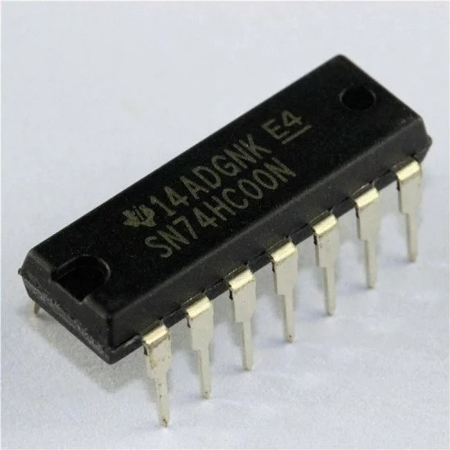
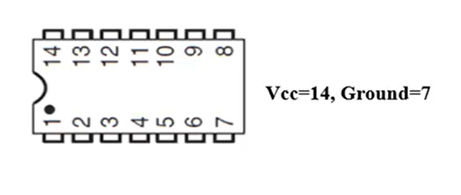
NAND GATE-7400

Slide 17
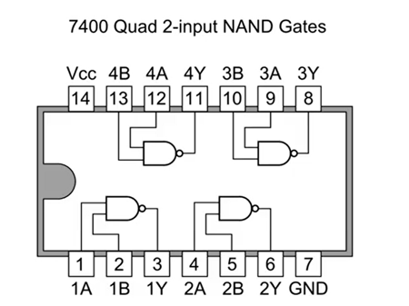
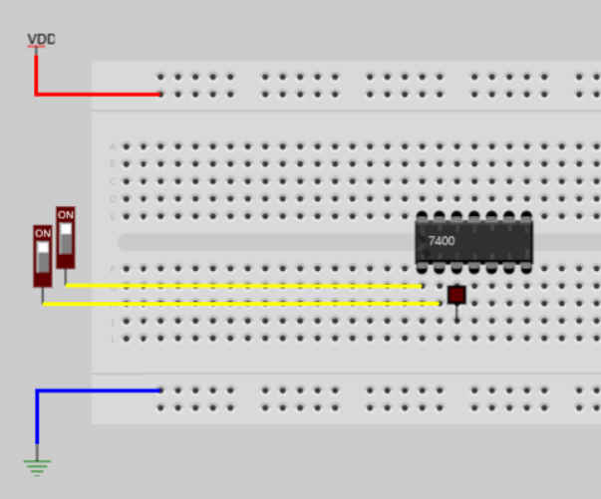
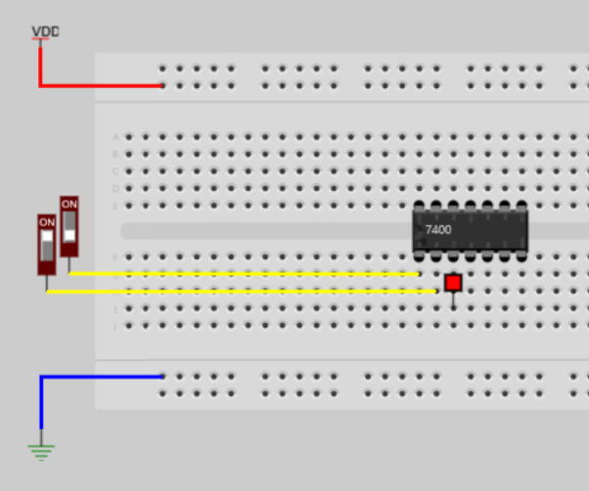
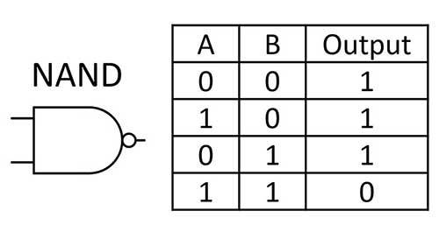
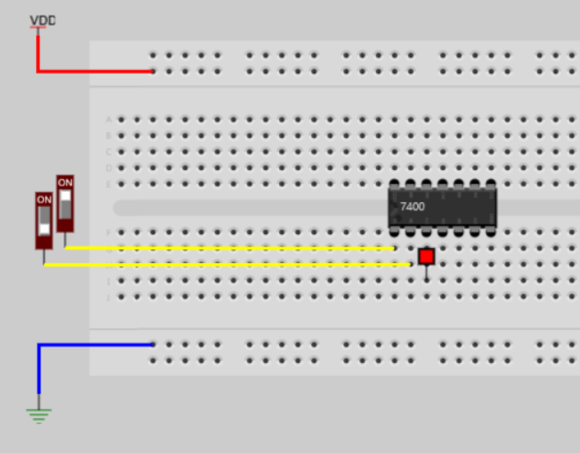
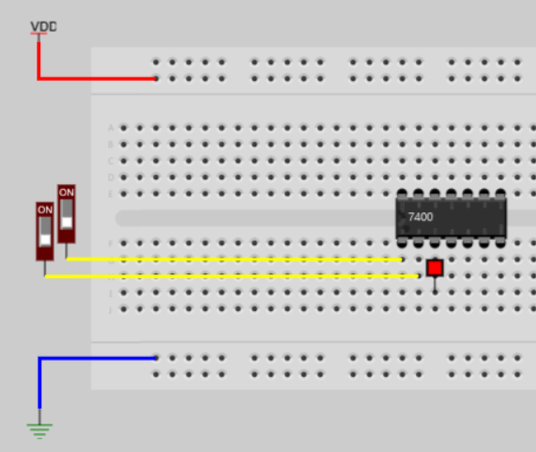
NAND GATE Demonstration-7400

Slide 18
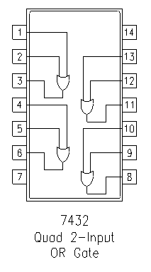
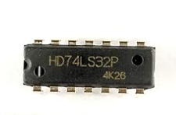
OR GATE-7432

Slide 19
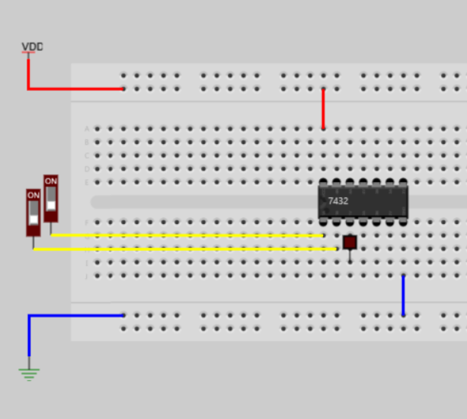
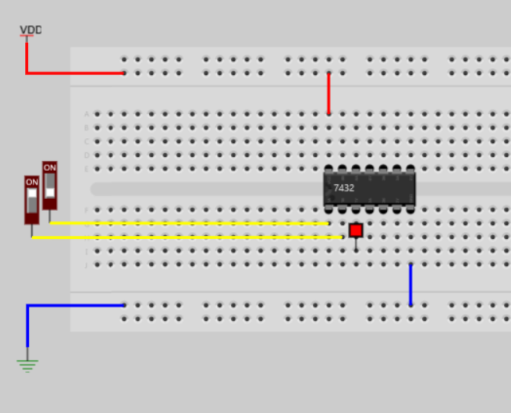
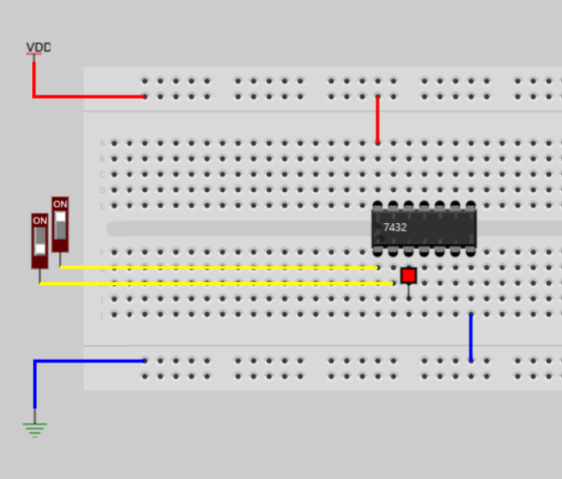
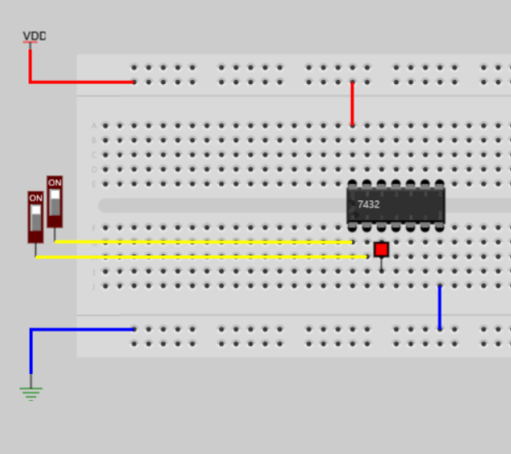
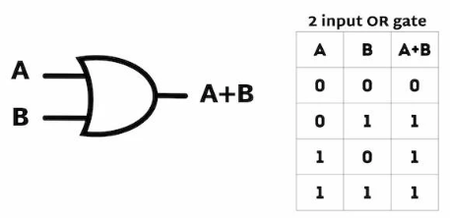
OR GATE Demonstration-7432

Slide 20
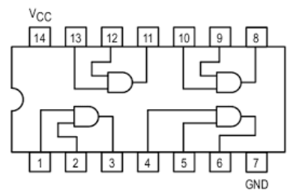
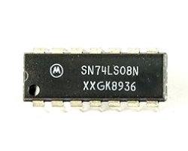
AND GATE-7408

Slide 21
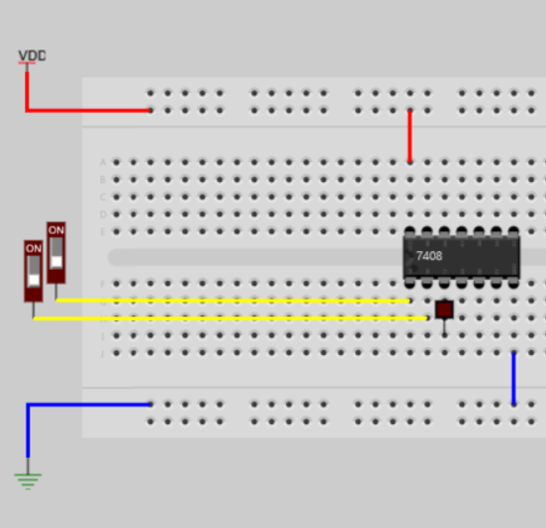
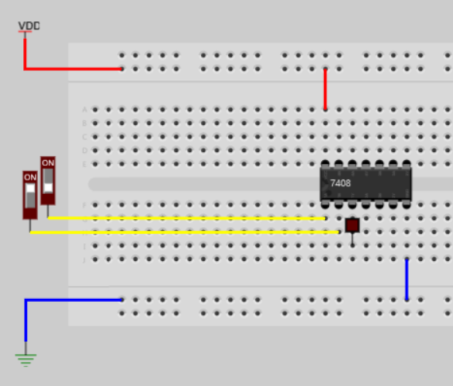
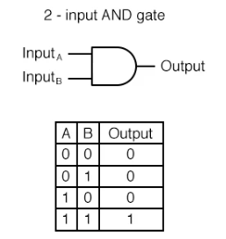

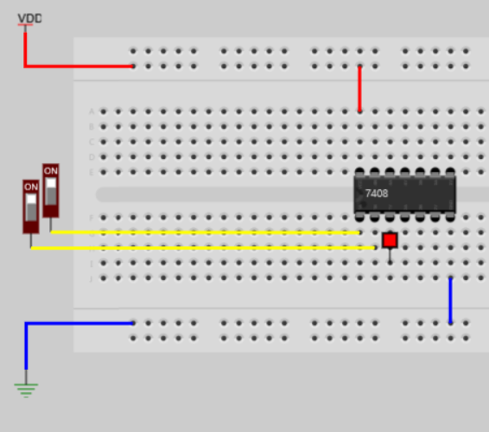
AND GATE Demonstration-7408

Slide 22
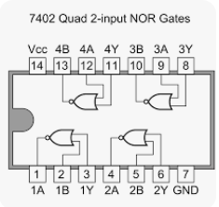
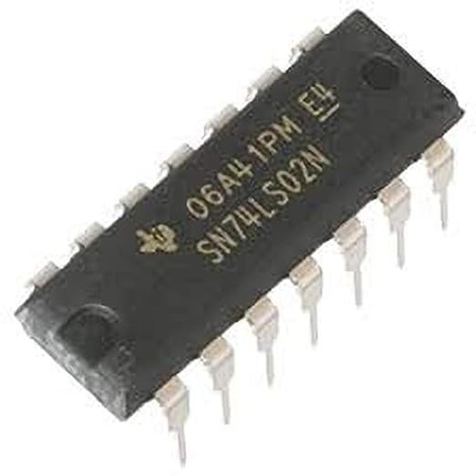
NOR GATE-7402

Slide 23
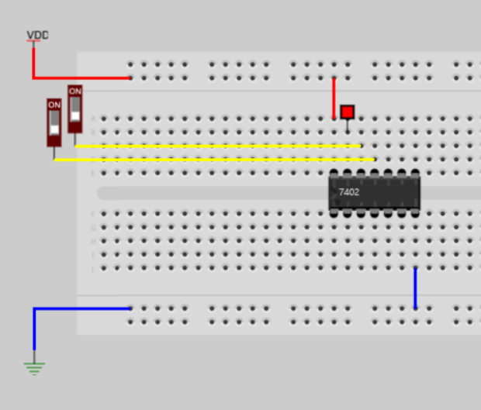
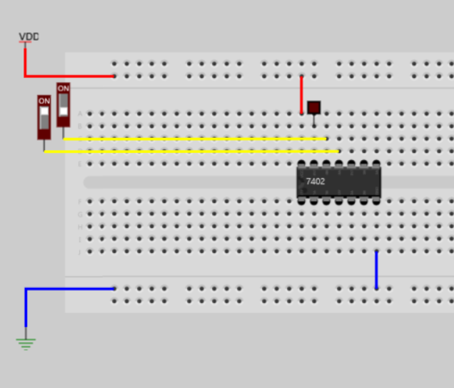
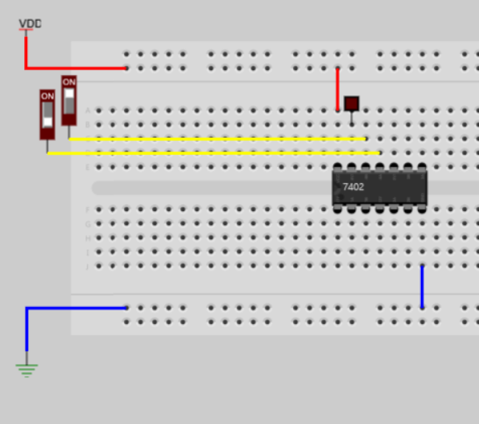
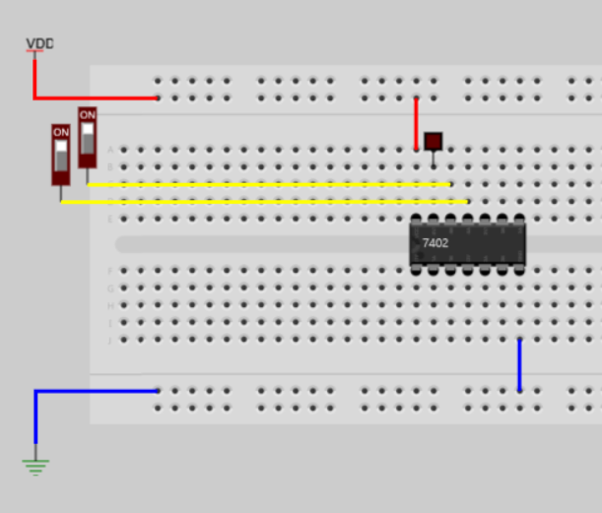
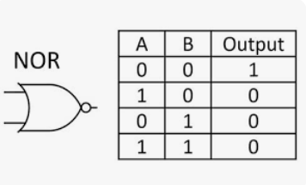
NOR GATE Demonstration-7402

Slide 24
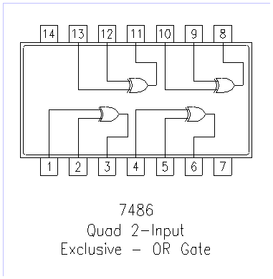
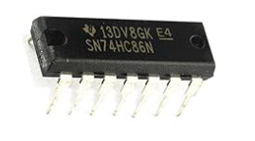
XOR GATE-7486

Slide 25
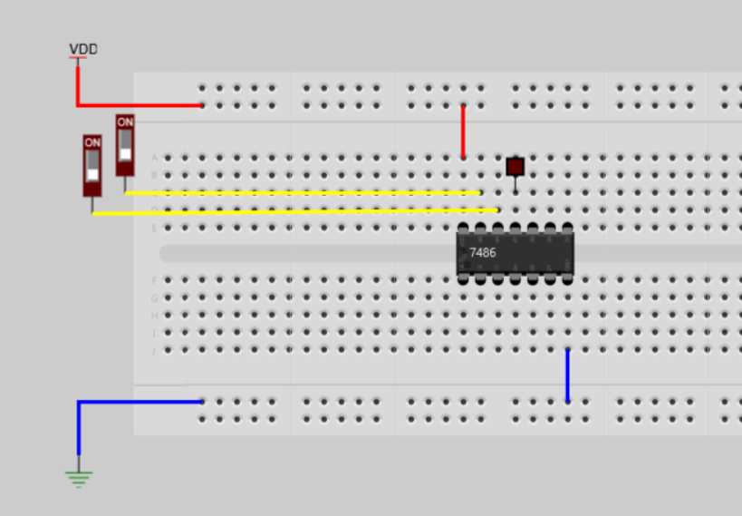
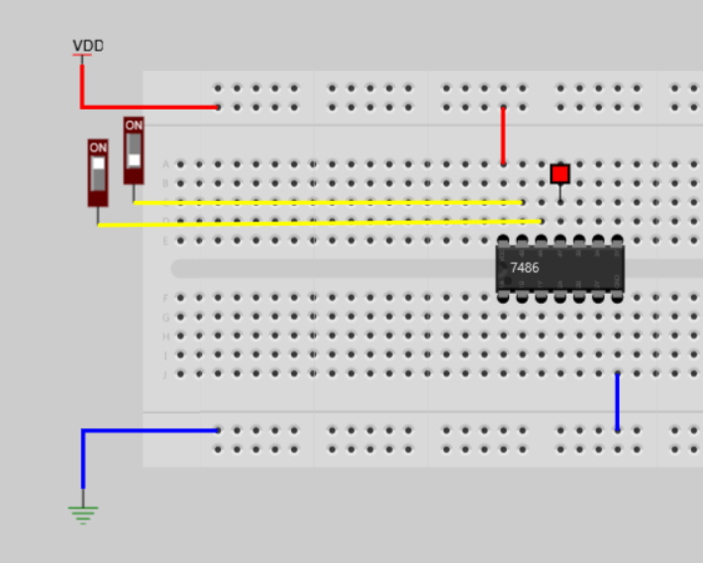
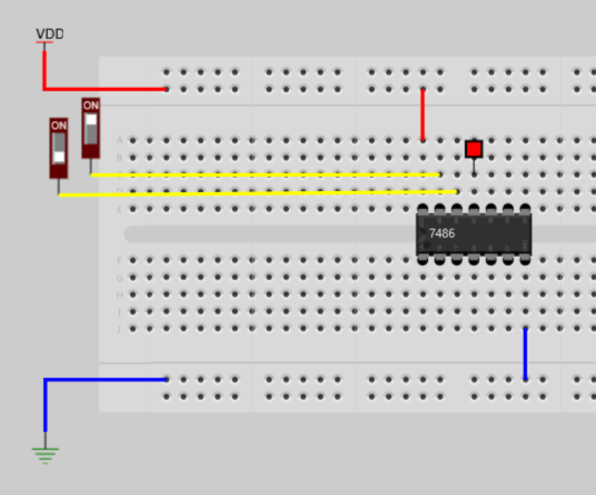
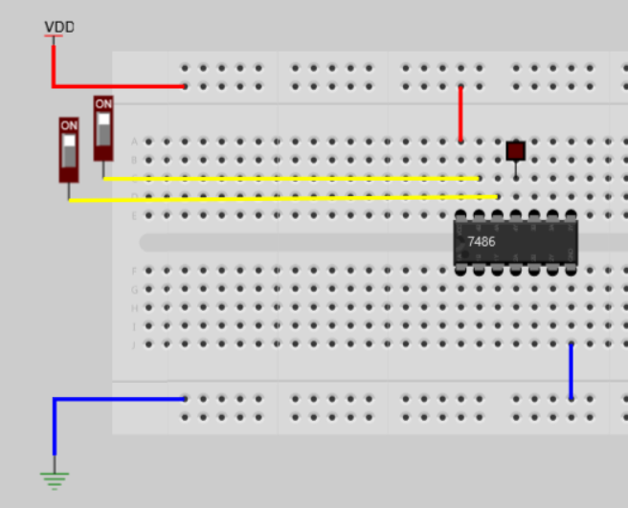
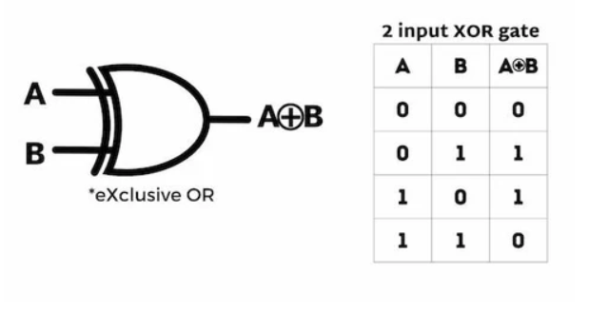
XOR GATE Demonstration-7486

Slide 26
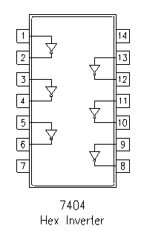
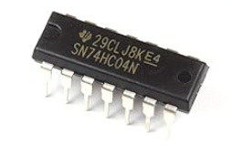
NOT GATE-7404

Slide 27
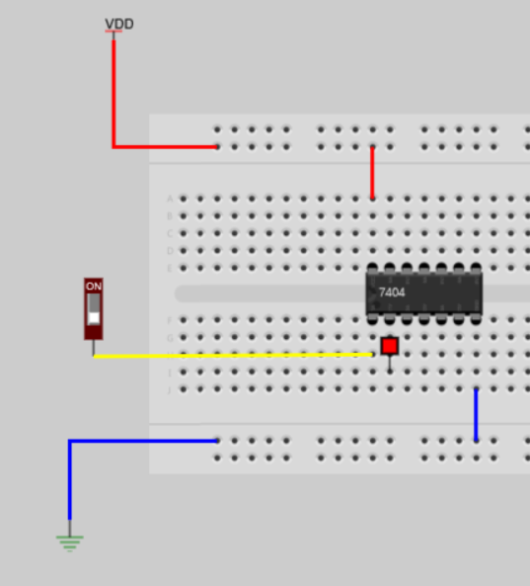
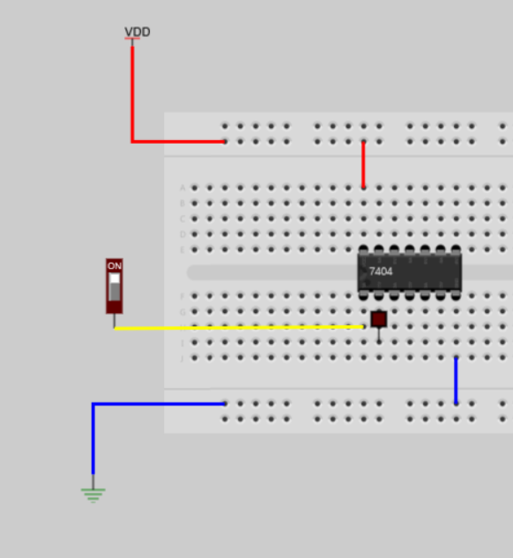

NOT GATE Demonstration-7404

Slide 28

Task 2 a)

Slide 29

Task 3)

Slide 30


Task 4a)
Not gate using by NAND gate

Slide 31


Task 4a)
Or gate using by NAND gate

Slide 32


Task 4a)
And gate using by NAND gate

Slide 33
SOME WARNINGS
When removing chips, pull them vertically upward by both edges simultaneously. Otherwise, the chip pins may be damaged.
Keep the experiment boards powered ON. If a wrong connection or a faulty chip is detected, the warning LED will turn off. In such a case, immediately turn off the power.
Use short wires for nearby connections. This will make the circuit simpler and easier to understand.

