Slide 1

EEE 247 Laboratory Presentation
Functions
Guide
Simulink
Res. Asst. Muhterem Alper KAPLAN

Slide 2
Functions
function [y1,...,yN] = myfun(x1,...,xM)
declares a function named myfun that accepts inputs x1,...,xM
and returns outputs y1,...,yN.
This declaration statement must be the first executable line of the function.
Valid function names begin with an alphabetic character, and can contain letters, numbers.

Slide 3
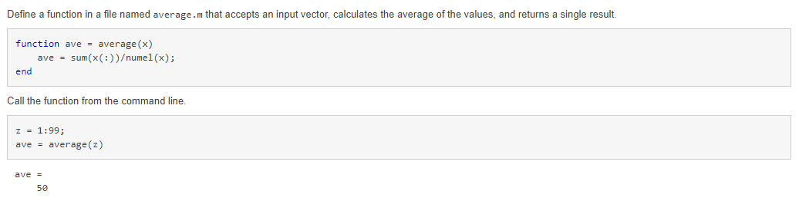
Examples of functions

Slide 4
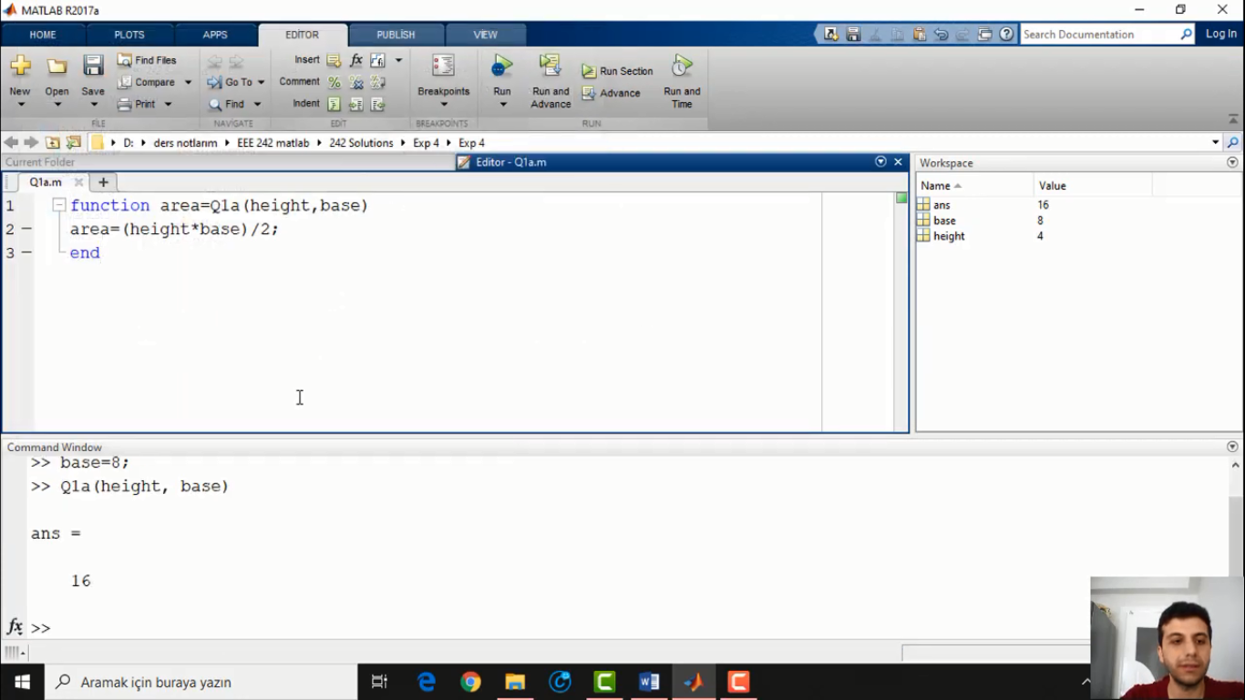
Functions
Find area of triangle with function?

Slide 5
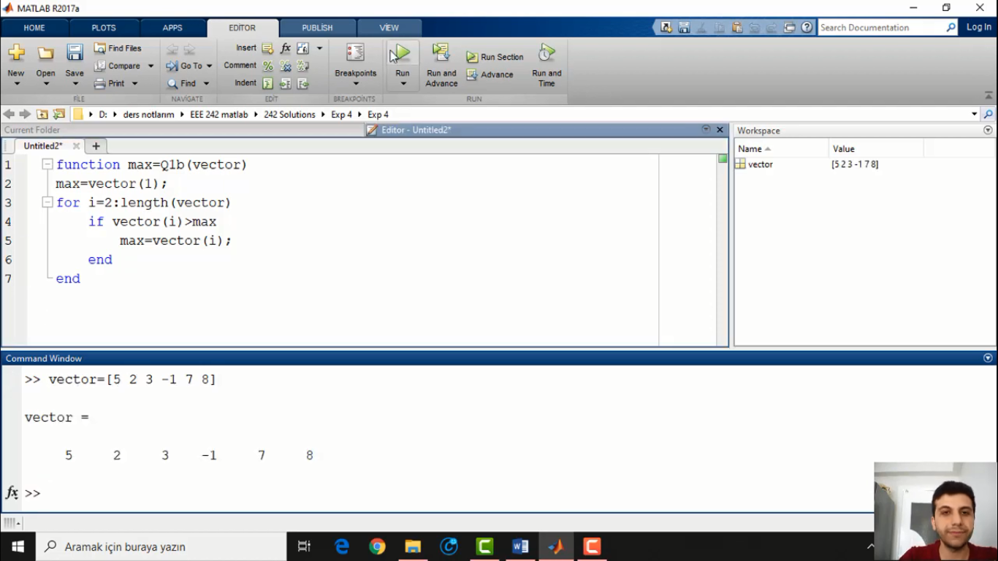
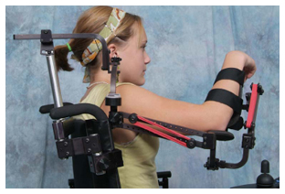
There are many kind of disability and electric wheelchair is useless in some of them. For example,
Find maximum value of any vector?
Neuromuscular disabilities
Reflex disabilities
Visually handicapped people don’t use standart wheelchair.
Also, these people constitute %4.1 of our country .

Slide 6
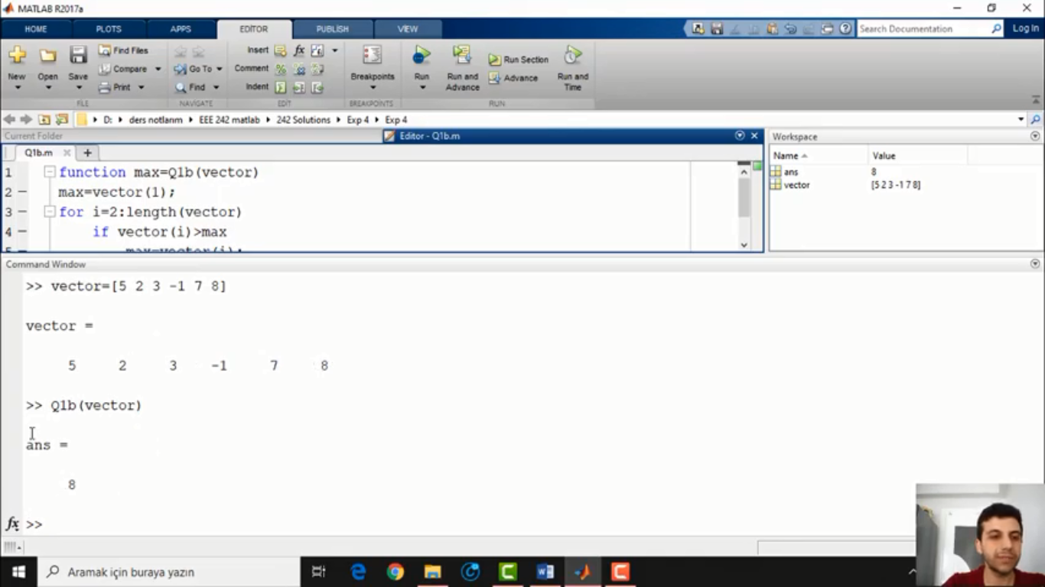
Similar project to our project
Tokyo University
of Technology
University of Kent
University of Essex

Slide 7
Guide (Graphical User Interface Development Environment)
This approach starts with a figure that you populate with components from within a graphic layout editor. GUIDE creates an associated code file containing callbacks for the GUI and its components. GUIDE saves both the figure (as a FIG-file) and the code file. Opening either one also opens the other to run the GUI.

Slide 8
Guide (Graphical User Interface Development Environment)
Start GUIDE by typing guide at the MATLAB prompt.
To add functionality to your buttons, add commands to the 'Callback' functions in the MATLAB file. For example, when the user clicks the ADD button, the add_Callback function will be called and executed. All the data for the GUI is stored in the handles, so use set and get to get data and change it if necessary. Any time you change the handles, save it using guidata.

Slide 9
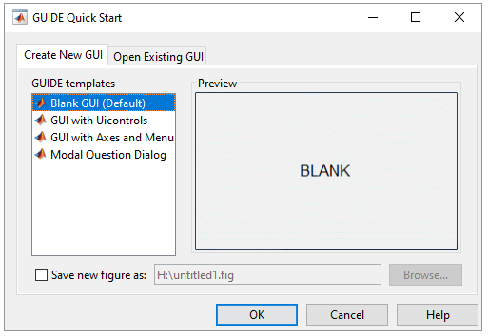
Guide Steps
Write ‘guide’ to command window, then opens this window select Blank GUI (Default) and click on OK

Slide 10
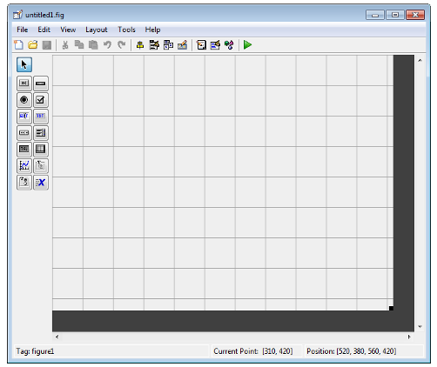
Guide Steps
Then this window is opened.
To see components name
Select File > Preferences > GUIDE.
Select Show names in component palette.
Click OK.

Slide 11
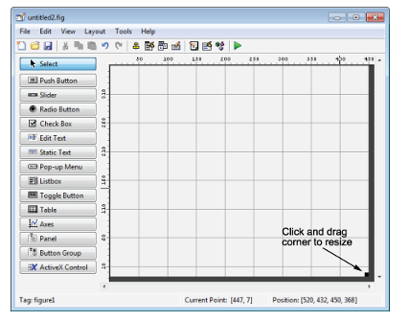
Guide Steps
Now, name of components are shown and you can also set the size of grid area by click and drag corner.

Slide 12
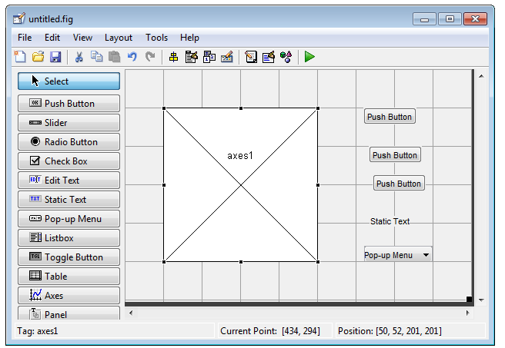
Guide Steps
You can add buttons by click to window.

Slide 13
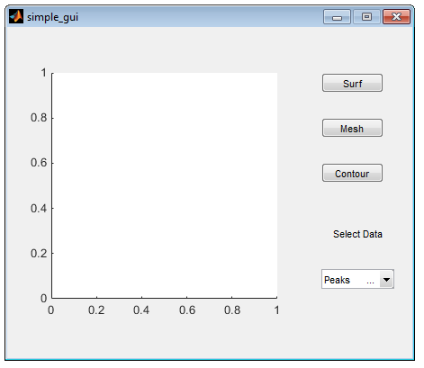
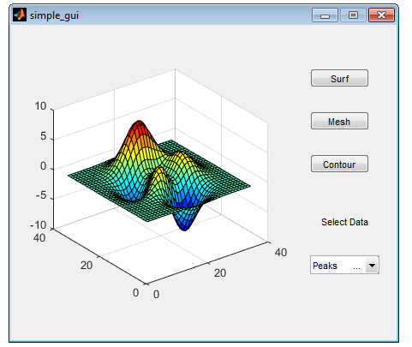
Guide Steps
After writing the codes in m. file, fig. file as shown in the below.

Slide 14

Simulink is a MATLAB-based graphical programming environment for modeling, simulating and analyzing multidomain dynamical systems. Its primary interface is a graphical block diagramming tool and a customizable set of block libraries.

Slide 15
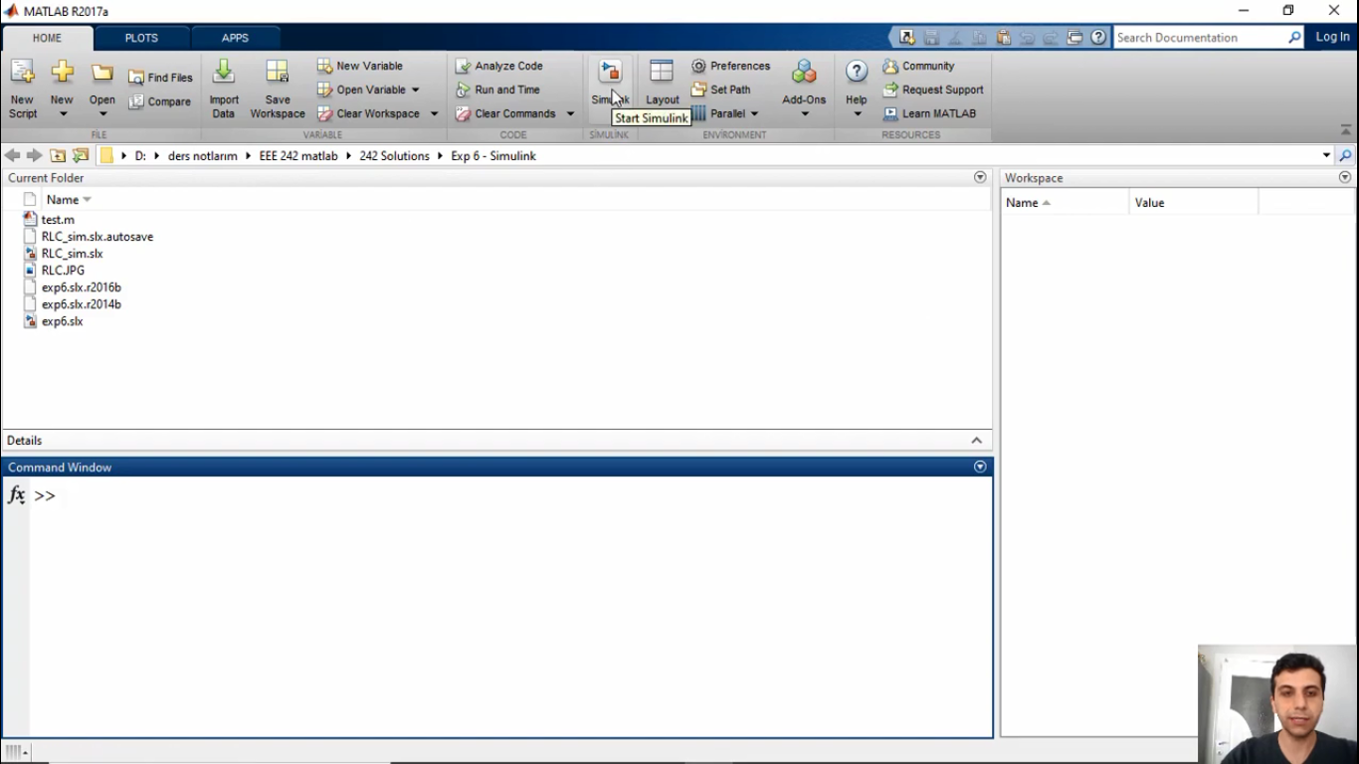
Simulink

Slide 16
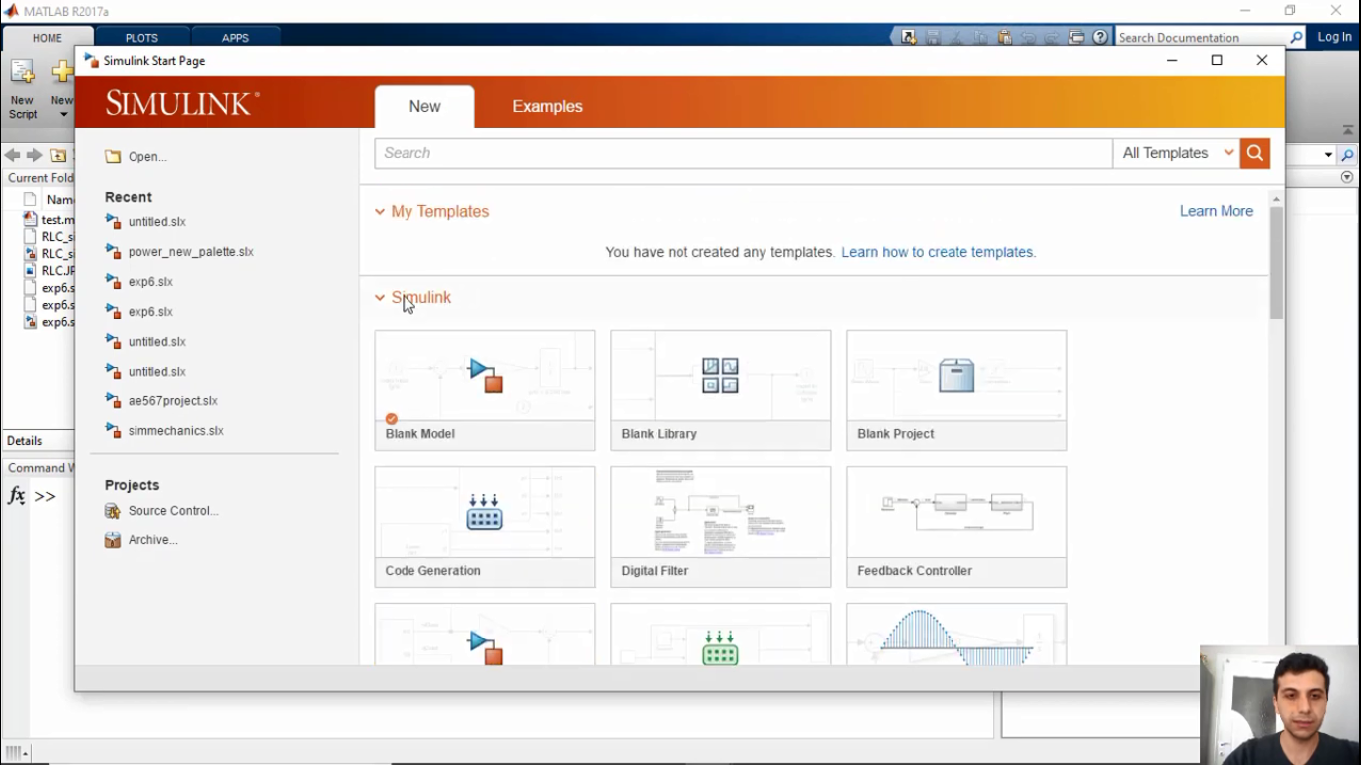
Simulink (Select blank model)

Slide 17
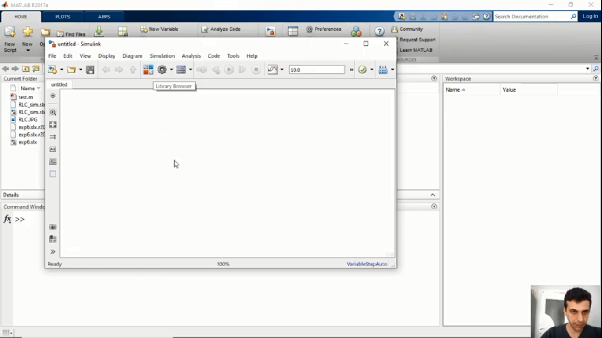
Simulink (Library browser)

Slide 18
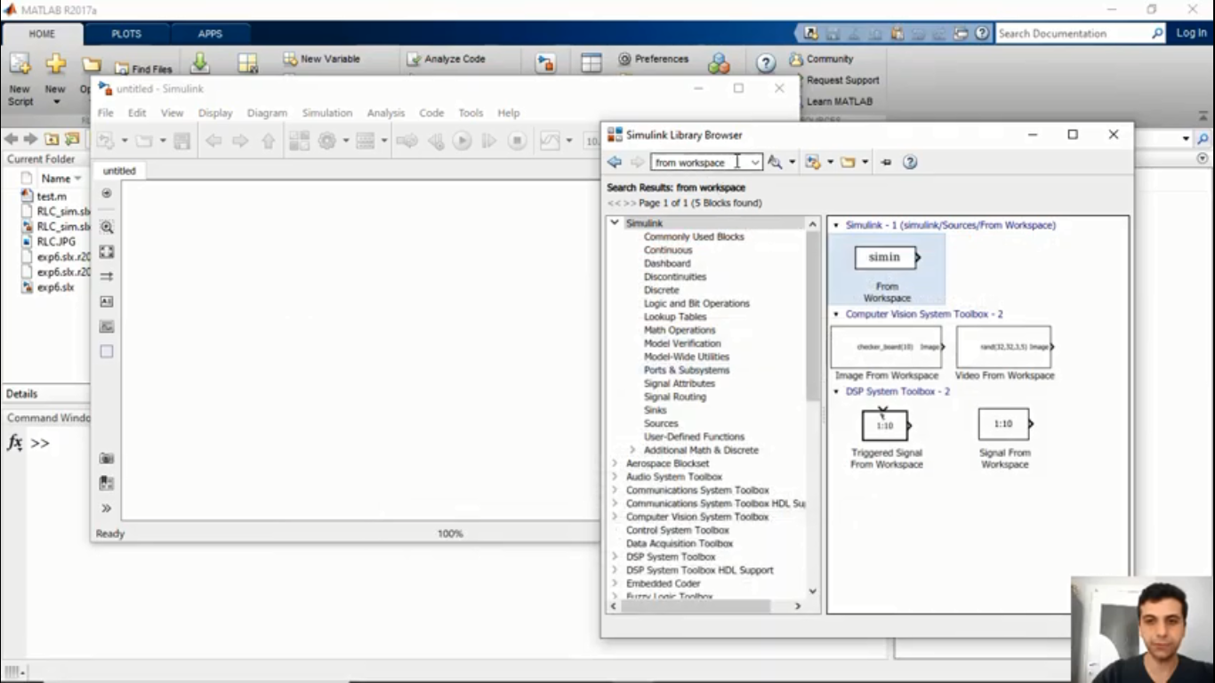
Simulink (Searching for blocks in library)

Slide 19
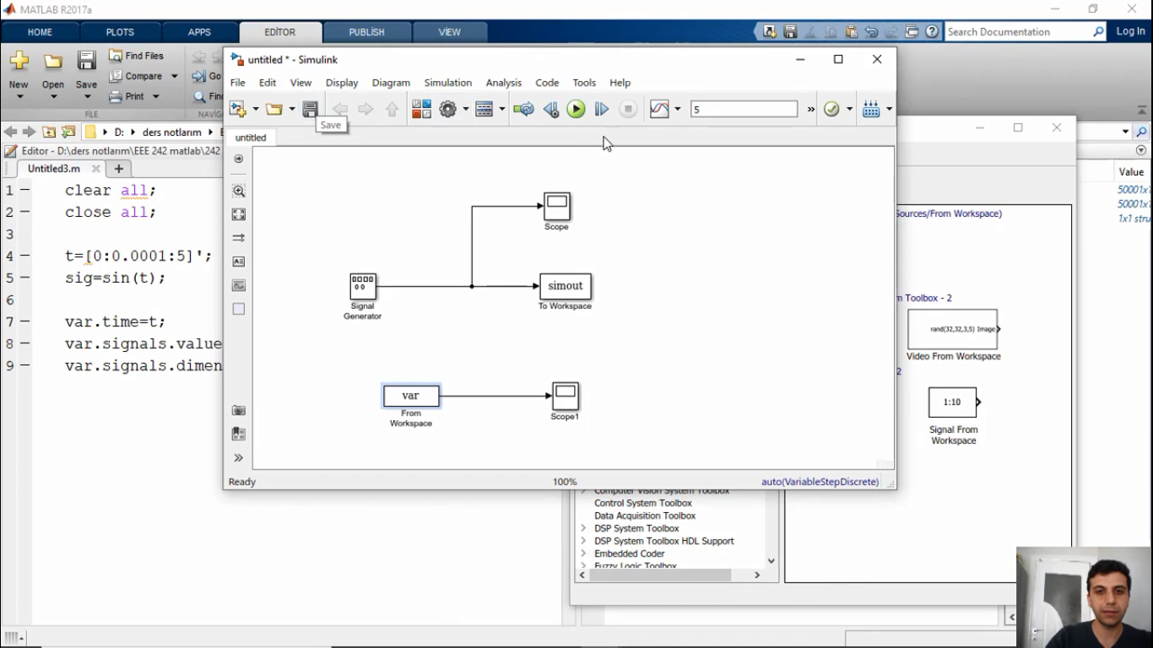
Simulink (Blocks and connections)

Slide 20
Thanks for your listening
Any problem or question?
You can write to command part of Youtube experiment videos.
Also send me e-mail: efganugur@gantep.edu.tr

