Slide 1
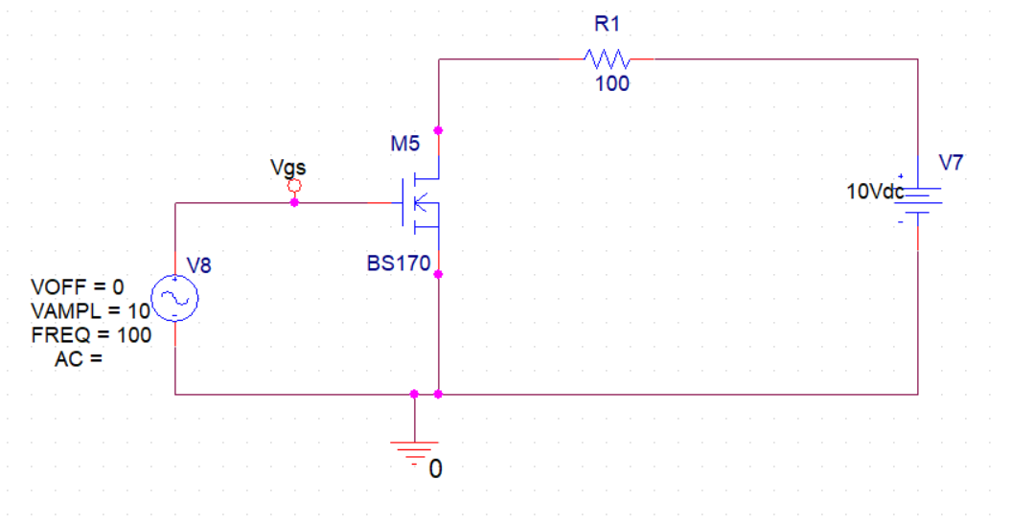
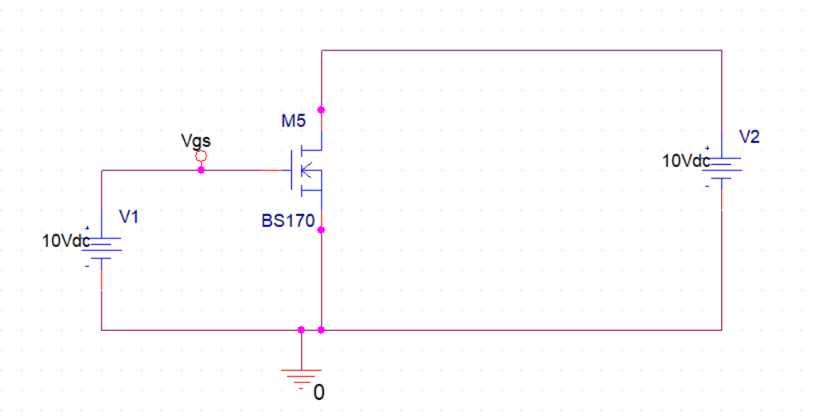
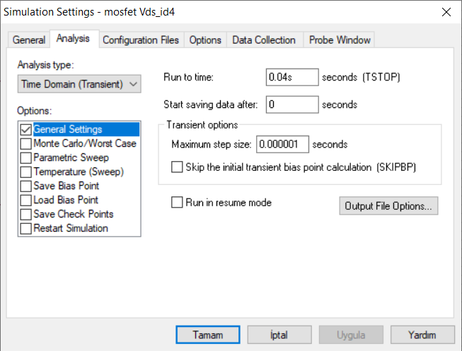
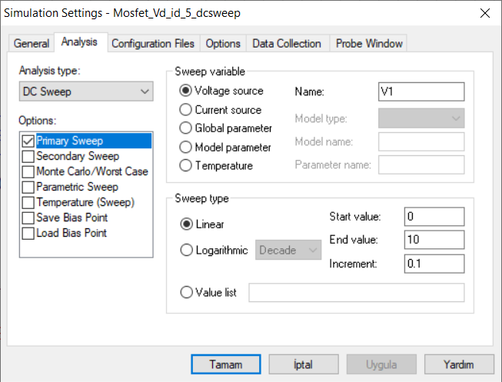
MOSFET ANALYSIS EXPERIMENT 1.A: $V_{GS}$ - $I_{D}$ Curve
PRELIMINARY PART OF THE EXPERIMENT
Simulation_1 Circuit
Simulation_2 Circuit
Simulation_1 procedure ( Transient Analysis)
Simulation_2 procedure ( DC Sweep )

Slide 2
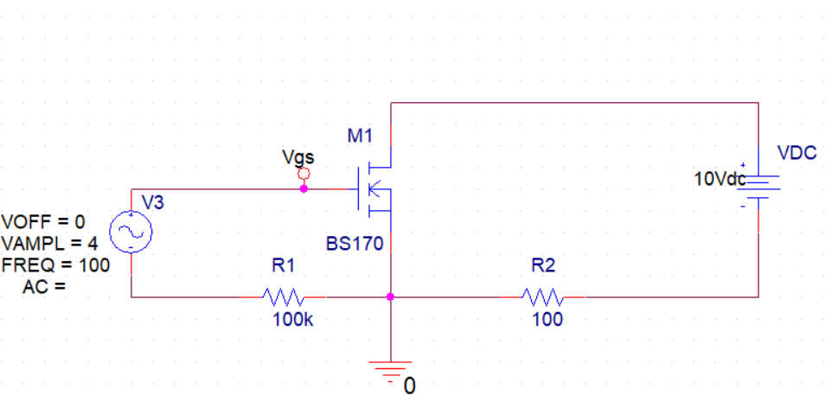
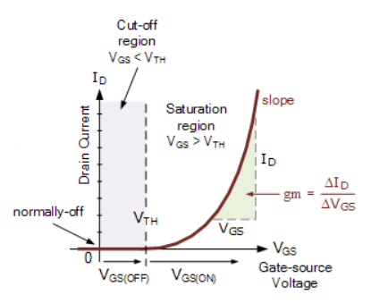




MOSFET EXPERIMENT 1.A: $V_{GS}$ - $I_{D}$ Curve
X Probe
$$V_{GS}$$
Experimental Procedure
1- Test your equipment before starting experiment.
E1- Connect the circuit of Figure 1.A , and observe the Gate voltage versus drain current characteristics of an n channel enhancement type MOSFET.
E2- Determine $V_{th}$ (threshold voltage) by using graphic which you got from E1.
Y Probe
$$I_{D}$$
Figure. 1.A. Circuit to obtain $V_{GS}$ - $I_{D}$ curve of an n channel enhancement
mode field effect transistor

Slide 3
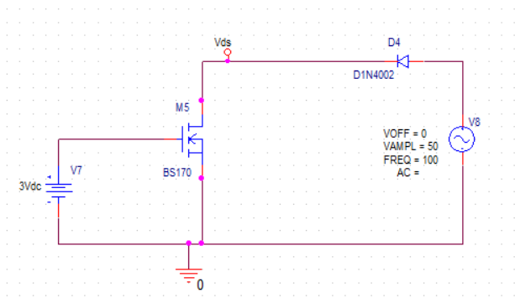
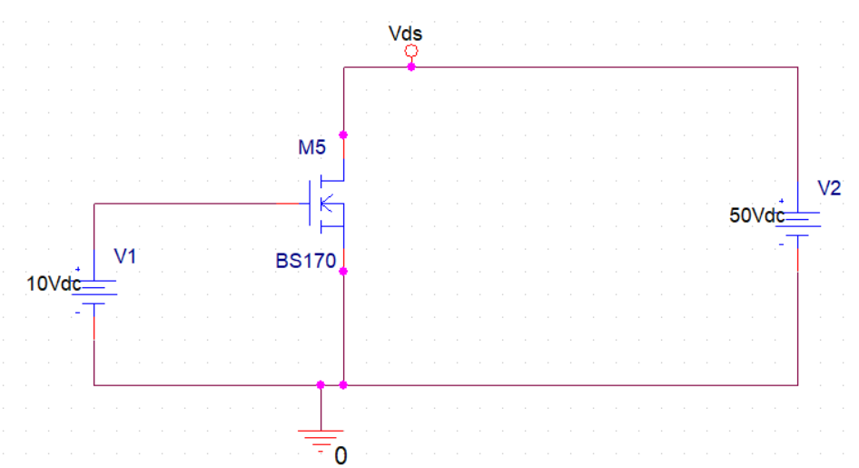
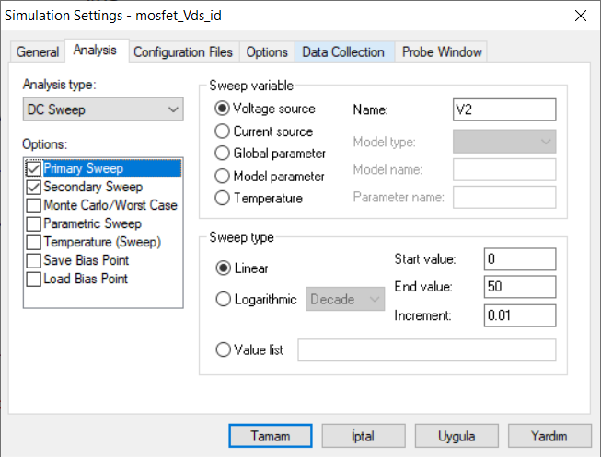
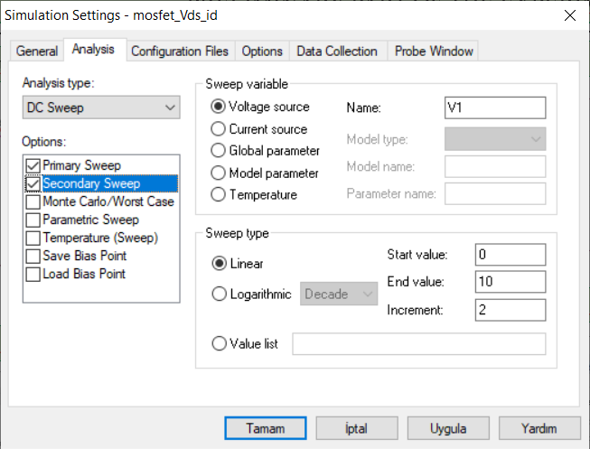



MOSFET EXPERIMENT 1.B : $V_{DS}$ - $I_{D}$ Curve
PRELIMINARY PART OF THE EXPERIMENT
Simulation_1 Circuit
Simulation_2 Circuit
Change $V_{GS}$ value from 3 to 9V in 3 steps, observe $I_{D}$ current changing by the effect of $V_{DS}$.
Observe $I_{D}$ current changing by the effect of $V_{DS}$.
Simulation_1 procedure ( Transient Analysis)
Simulation_2 procedure ( DC Sweep )

Slide 4
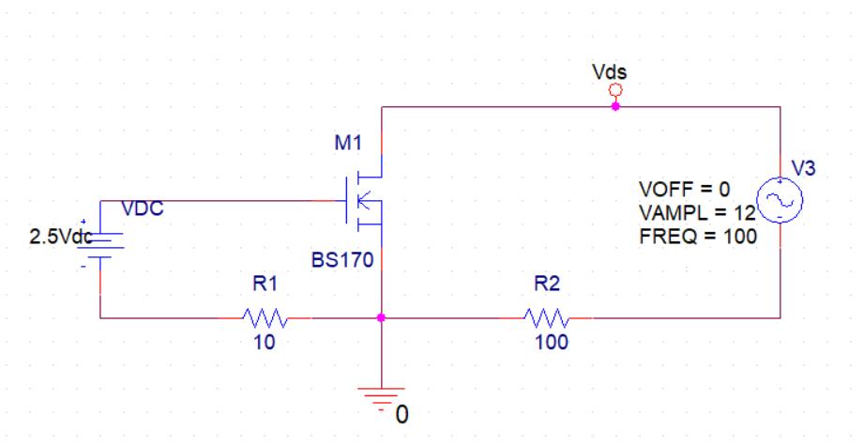
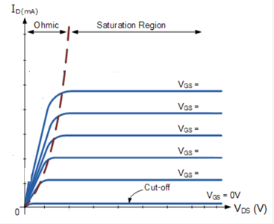

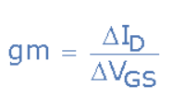
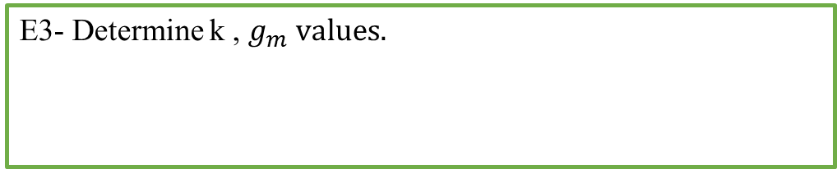




MOSFET EXPERIMENT 1.B : $V_{DS}$ - $I_{D}$ Curve
X probe
$$V_{DS}$$
Experimental Procedure
1- Test your equipment before starting experiment.
E1- Connect the circuit of Figure 1.B , and observe the Drain Voltage versus Drain Current characteristics of an n channel enhancement type MOSFET.
E2- Change $V_{GS}$ value from 0 to 10V in 5 steps, observe $I_{D}$ current changing by the effect of $V_{DS}$.
$$V_{GS}$$
Y probe
$$I_{D}$$
Figure. 1.B. Circuit to obtain $V_{DS}$ - $I_{D}$ curve of an n channel enhancement
mode field effect transistor
10V
8V
6V
E3- Determine k , $g_{m} values.$
4V
2V

