Slide 1
COURSE SYLLABUS • WEEK 1
Engineering Responsibility & Public Safety
Core professional duties, conflicting loyalties, and the Challenger disaster case study.
Introduction to Codes, Law, and Public Welfare

Slide 2
SESSION OVERVIEW
Learning Objectives
Distinguish Concepts
Social Duty
Paramount Priority
Differentiate clearly between morality, professional ethics, and codified statutory law.
Comprehend the social contract inherent in engineering authority and technological practice.
Enforce public safety as the absolute first specification overriding schedule or cost.

Slide 3
THEORETICAL DISTINCTION
Ethics vs. Morality
PERSONAL SPHERE
COLLECTIVE GOVERNANCE
Morality
Professional Ethics
Culturally or personally adopted principles of right and wrong, such as individual honesty and character.
Systematic standards and formal disciplinary codes established by professional engineering bodies.
Domain: Individual conscience and personal conduct.
Domain: Occupational duty and societal trust.

Slide 4



BOUNDARIES & COMPLIANCE
The Relationship Between Law and Ethics
Legal ≠ Ethical
Unethical ≠ Illegal
Regulations often lag behind technology; compliance with the legal minimum does not guarantee safety.
Concealing non-critical test anomalies may violate professional codes without breaching criminal statutes.
The Standard
For engineers, professional ethics begins where legal minimums stop.

Slide 5


PROFESSIONAL SCOPE
What is Engineering? More Than Pure Technical Calculation
Harnessing Forces
Engineering directs physical forces and material sciences to advance societal welfare.
Public Exposure
Public users must place blind trust in complex systems they cannot personally audit.
Core Reality: Technical competence without ethical stewardship creates public hazard.

Slide 6
LOYALTY HIERARCHY
The "Public Welfare" Principle
TIER 3
TIER 2
TIER 1 • PARAMOUNT
Employer
Client
Public Safety
Faithful agent duties, protecting trade secrets and business profitability within ethical bounds.
Contractual delivery, rigorous specifications, and disciplined budget stewardship.
The fundamental priority that overrides any competing business contract or managerial command.

Slide 7
PROFESSIONAL CODES
NSPE Code of Ethics: Fundamental Canon 1
“Engineers shall hold paramount the safety, health, and welfare of the public.”
— National Society of Professional Engineers (NSPE Canon 1)
The term "Hold paramount" explicitly indicates that public welfare is not one factor among equals; it is the non-negotiable trump card in every engineering decision.

Slide 8
COMPUTING & ELECTRONICS
IEEE and ACM Professional Standards
Anticipating System Harm
Mandatory Disclosure
Software and hardware architects must foresee direct and indirect failure modes affecting human life.
Promptly disclosing factors that might endanger the public or environment to relevant authorities.
Mandate: Rigorous verification of automated failsafes.
Mandate: Transparent reporting without executive distortion.

Slide 9

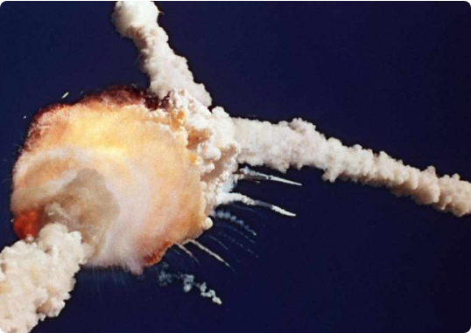
CASE STUDY • 1986
Space Shuttle Challenger Disaster
The Incident
On January 28, 1986, Challenger broke apart 73 seconds into flight, killing all 7 crew members.
The Fundamental Question
Was this an unforeseen hardware failure or a breakdown of organizational ethics?
Status: The canonical case study on engineering dissent and managerial suppression.

Slide 10

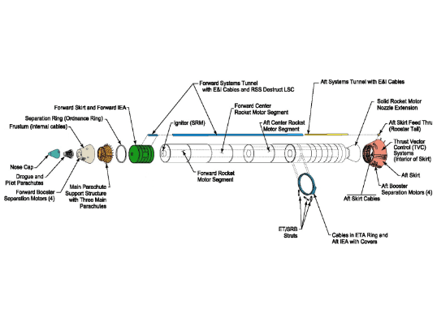
TECHNICAL SPECIFICATIONS
Technical Background: SRB O-Ring Joint
Joint Sealing Mechanism
Two rubber O-rings sealed the pressurized combustion gas gaps in the solid rocket boosters.
Cold Resilience Loss
At cold temperatures, the elastomer stiffened, failing to seat in time to prevent hot gas blow-by.
Ambient launch temperature: -1°C (31°F), far outside any qualified baseline.

Slide 11
INTERNAL DISSENT
Engineers' Warning and Resistance
THE EVIDENCE
THE REVERSAL
Boisjoly's Teleconference
Shifted Burden of Proof
Morton Thiokol engineers argued strenuously the night before launch that the launch must be delayed.
NASA demanded engineers prove the rocket would fail, rather than proving it was safe to launch.
Warning: "Temperature below 53°F is completely outside empirical data."
Flaw: Reversing the fundamental safety presumption.

Slide 12
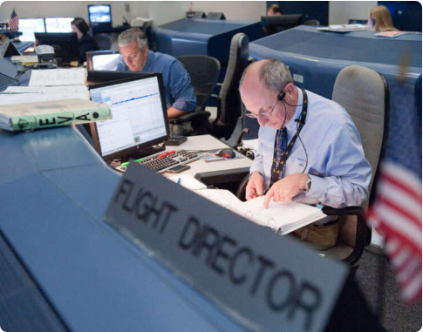
MANAGERIAL OVERRIDE
"Take Off Your Engineering Hat"
“Take off your engineering hat and put on your management hat.”
— Morton Thiokol executive directive prior to reversing recommendation
The Motivation
PR deadlines, presidential address schedules, and contract renewal anxieties overwhelmed safety.

Slide 13
ETHICAL DILEMMA
The Breaking Point: Conflicting Loyalties
Employer Loyalty
Public & Crew Duty
Protecting relationship with sole customer (NASA) and preserving multi-million dollar solid booster contracts.
Protecting the lives of seven astronauts who relied entirely on technical safety integrity.
Cost of Dissent: Company reputation, project cancellation.
Ethical Outcome: Public safety must hold absolute primacy.

Slide 14
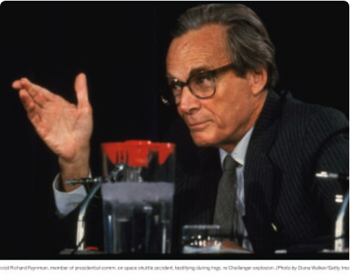
OFFICIAL INVESTIGATION
Findings of the Rogers Commission
Institutional Failure
The commission found the accident was rooted in flawed communication and management culture.
Suppression of Dissent
Critical concerns of working engineers were filtered out before reaching mission directors.
Feynman's Dictum: "Reality must take precedence over public relations, for nature cannot be fooled."

Slide 15
CLASS DISCUSSION 1
Whistleblowing: Thresholds and Consequences
Escalation Duty
The Personal Cost
If management formally overrides technical safety warnings, does the engineer hold a moral obligation to contact regulators or the press?
Roger Boisjoly suffered career blacklisting, industry ostracization, and emotional distress after testifying honestly.
Key factor: Imminent threat vs. internal chain of command.
Core Dilemma: Would you blow the whistle knowing you might never work again?

Slide 16
CLASS DISCUSSION 2
Role Conflicts: Engineering vs. Management
The Dual Identity Trap
Expanded Accountability
Engineers are trained in empirical reality and risk bounds. Managers are trained in resource allocation, risk acceptance, and scheduling.
When an engineer enters management, their ethical responsibility does not dissolve—it multiplies across the entire team.
Question: Can a person ethically discard technical ethics upon promotion?
Takeaway: The "management hat" never excuses compromising public safety.

Slide 17
SYSTEMIC REFORMS
Lessons Learned & Institutional Changes
Dissenting Opinion
Direct Escalation
Risk Standardization
Formal mechanisms enabling engineers to file official dissenting safety reports without reprisal.
Unfiltered safety reporting channels direct to independent technical review boards.
Mandatory ethical risk assessment frameworks built into every engineering milestone.

Slide 18
KEY TAKEAWAYS
Summary of Week 1
1. Public Safety is Non-Negotiable
The welfare of the public stands paramount over all employer demands, budgets, and milestones.
2. Data Must Govern Over Pressure
Commercial and political timelines must never justify reversing empirical engineering safety limits.
3. Silence Equals Complicity
Failing to voice verified technical warnings makes the engineer a co-author of the resulting disaster.

Slide 19
CURRICULUM ROADMAP
Preview: Week 2
THEORY
CASE STUDY
Normative Ethical Frameworks
Ford Pinto Fuel Tank Crisis
Utilitarianism (consequentialism), Deontology (duty-based ethics), and Virtue Ethics in engineering decisions.
The ethical failure of assigning dollar figures to human lives through mathematical Cost-Benefit Analysis.

Slide 20
OPEN FLOOR & DISCUSSION
Thank You for Your Engagement.
References: NSPE Code of Ethics (nspe.org) & The Rogers Commission Report (1986).
Questions, case inquiries, and comments are welcome.

Slide 21





Image Sources
https://photos.peopleimages.com/picture/202303/2770911-man-architect-or-engineer-and-planning-for-inspection-construction-or-maintenance-in-safety-and-security-on-site.-male-engineer-builder-or-contractor-checking-project-plans-for-industrial-architecture-fit_400_400.jpg
Source: peopleimages.com
https://res.cloudinary.com/aenetworks/image/upload/c_fill,w_1200,h_630,g_auto/dpr_auto/f_auto/q_auto:eco/v1/the-space-shuttle-challenger-exploded
Source: www.history.com
https://frontend-assets.simscale.com/media/2018/10/Space_Shuttle_SRB_diagram.png
Source: www.simscale.com
https://npr.brightspotcdn.com/dims4/default/fc80e8c/2147483647/strip/true/crop/1200x798+0+0/resize/880x585!/quality/90/?url=http%3A%2F%2Fnpr-brightspot.s3.amazonaws.com%2Flegacy%2Fwp-content%2Fuploads%2F2021%2F12%2Fjsc2011e045475orig.jpg
Source: www.cfpublic.org
https://sothebys-md.brightspotcdn.com/dims4/default/0016d2a/2147483647/strip/true/crop/3064x2164+0+0/resize/385x272!/quality/90/?url=http%3A%2F%2Fsothebys-brightspot.s3.amazonaws.com%2Fmedia-desk%2F3c%2Ff5%2F9681772a456d8f72daa04f637c6e%2F073n10719-bzqvl-comp-caption.jpg
Source: www.sothebys.com

