Slide 1
GENERAL & PROFESSIONAL ETHICS • GME 100
ETHICAL PROBLEM-SOLVING & METHODOLOGY
Systematic Decision-Making Frameworks in Engineering Ethics
Week 3 Presentation
Engineering Ethics Course

Slide 2
LESSON OVERVIEW
02
Learning Objectives
1. Issue Analysis
2. Line Drawing Technique
3. Flow Charts & Conflicts
Distinguish factual, conceptual, and moral issues in complex ethical dilemmas.
Evaluate ambiguous cases against positive and negative paradigms systematically.
Apply flow charts and creative middle way methods for structured conflict resolution.
GME 100 • Ethics
Lesson Overview

Slide 3
METHODOLOGY MAP
03
Methodological Process Flow
Structured Problem Solving
Sequential logic: Progress from facts to ethical evaluation.
Systematic validation: Test each assumption against established standards.
Defensible outcomes: Document clear logic for engineering decisions.
GME 100 • Ethics
Process Flow

Slide 4
INTRODUCTION
04
Why Systematic Methodology?
No Direct Formulas
Objective Decisions
Unlike technical engineering problems, ethical dilemmas have no plug-and-chug formulas or simple single-equation answers.
Provides defensible, logical, and consistent results rather than relying purely on subjective gut feelings or intuition.
GME 100 • Ethics
Introduction

Slide 5
ISSUE ANALYSIS
05
Three Types of Issues
01
02
03
Factual Issues
Conceptual Issues
Moral Issues
What is known or disputed about the case (scientific data, test results, specifications).
Definition and scope of a concept (e.g., Is this an acceptable gift or a bribe?).
Determining which moral principle applies to the situation once facts are clear.
GME 100 • Ethics
Issue Analysis

Slide 6
STEP 1
06
Resolving Factual Issues
Uncertainty in Facts
Many ethical disputes stem not from deep moral disagreements, but from missing, incomplete, or unclear factual information.
Solution Steps
List known data clearly and objectively.
Identify missing info and underlying assumptions.
Conduct testing or research to resolve facts.
Key Takeaway: Clarifying facts often resolves the dispute before moral arguments are needed.
GME 100 • Ethics
Factual Issues

Slide 7
STEP 2
07
Conceptual Issues
Defining Concepts
Example: Gift vs. Bribe
Definition Strategy
Agreement on key concepts is vital. What exactly constitutes "Confidential Data"? Where does "Conflict of Interest" begin?
Is a dinner offered by a supplier a harmless gesture of goodwill or an influential bribe designed to bias choices?
Clarify concepts using professional codes of ethics, legal regulations, and institutional policies.
GME 100 • Ethics
Conceptual Issues

Slide 8
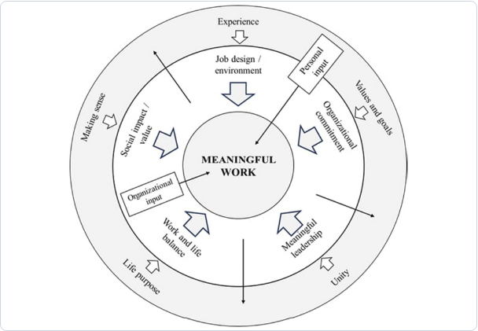
CONCEPTUAL FRAMEWORK
08
Organizational Context & Values
Organizational Alignment
Conceptual clarity depends heavily on the organizational environment, professional leadership, and ethical values surrounding the workspace.
Social impact & value alignment
Organizational commitment & clear guidelines
GME 100 • Ethics
Organizational Context

Slide 9
STEP 3
09
Applying Moral Principles
Moral Principle Selection
Conflict Scenarios
Once facts and concepts are cleared, apply core moral principles such as Public Safety, Honesty, and Professional Loyalty.
Moral issues become complex primarily when two valid ethical principles directly conflict with each other in practice.
GME 100 • Ethics
Moral Issues

Slide 10
METHODOLOGY 1
10
Line Drawing Technique
What is the Line Drawing Technique?
A method to analyze ambiguous cases in gray areas by placing them on a continuum between a clearly acceptable (Positive) paradigm and a clearly unacceptable (Negative) paradigm.
Positive Paradigm (PP)
Negative Paradigm (NP)
Completely ethical, fully transparent, and 100% compliant with professional standards and ideal practices.
Clearly unethical, illegal, dangerous, or unacceptable extreme scenario.
GME 100 • Ethics
Line Drawing

Slide 11
LINE DRAWING
11
Line Drawing Steps
1
2
3
4
Paradigms
Features
Scoring
Evaluation
Define clear Positive (PP) and Negative (NP) paradigms.
List morally relevant features (value, timing, intent).
Mark the test case along the line for each feature.
Evaluate which paradigm the case leans closer toward.
GME 100 • Ethics
Line Drawing Steps

Slide 12
CASE STUDY
12
Line Drawing Example: Waste Disposal
Scenario
A company plans to dump slightly hazardous waste into a lake used for drinking water. Waste concentration is 5 ppm. The legal EPA limit is 10 ppm.
Negative Paradigm (NP): Toxic Dumping
Test Case: 5 ppm
Positive Paradigm (PP): Zero Waste
GME 100 • Ethics
Case Study

Slide 13
METHODOLOGY 2
13
Conflict Problems
Conflicting Valid Principles
Classic Conflict Dilemma
Conflict problems present a difficult choice between two competing moral obligations, where both appear correct and justifiable on their own.
Loyalty to Client / Employer (Confidentiality & Trade Secrets) VS. Protecting Public Health & Safety (Whistleblowing).
GME 100 • Ethics
Conflict Problems

Slide 14
RESOLUTION STRATEGIES
14
Solving Conflict Problems
1
2
3
Lower Level Consideration
Creative Middle Way
Hard Choice
If one value is obviously more critical (e.g., Human Life > Financial Cost), choose the dominant obligation primary.
Develop a win-win compromise solution that satisfies both conflicting moral requirements partially or fully.
When trade-offs are inevitable, choose the option that minimizes overall harm and damage.
GME 100 • Ethics
Resolution Strategies

Slide 15
FOCUS APPROACH
15
Creative Middle Way Approach
Engineering Ingenuity
Implementation Strategy
The art of resolving ethical standoffs using technical innovation and diplomacy instead of resorting to binary "either-or" choices.
Protect both sides by redesigning systems, adding safety margins, adjusting parameters, or renegotiating terms with stakeholders.
GME 100 • Ethics
Creative Middle Way

Slide 16
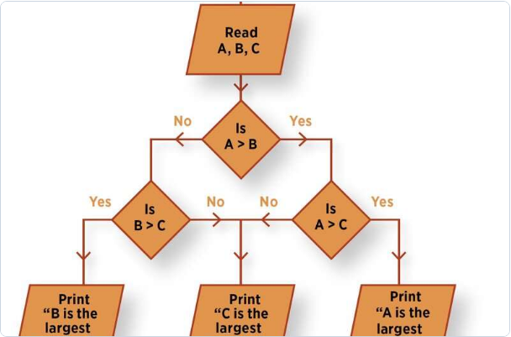
METHODOLOGY 3
16
Flow Charting Technique
Sequential Analysis
Visualizes decisions and consequences sequentially. Highly effective for process-driven cases.
Decision Nodes
Branches out at each step by asking key questions: "Is this action safe?", "Is it legal?".
GME 100 • Ethics
Flow Charting

Slide 17
CASE STUDY 1
17
Pressure Vessel Dilemma
Situation
Methodological Resolution
The design code specifies a 20mm wall thickness for safety. The client requests reducing thickness to lower manufacturing costs.
Factual: Violating design codes directly increases catastrophe risk.
Moral: Public safety overrides client preference. Request rejected.
GME 100 • Ethics
Case Study 1

Slide 18
CASE STUDY 2
18
Hospitality vs. Bribe
Situation
Line Drawing Analysis
A equipment supplier offers you an all-expenses-paid 10-day luxury holiday in exchange for specifying their brand in contract specs.
This offer leans 95% toward the Negative Paradigm (Bribe) in value and timing. Must be declined immediately.
GME 100 • Ethics
Case Study 2

Slide 19
SUMMARY FRAMEWORK
19
8-Step Ethical Decision-Making Framework
Step | Action Item | Description
1 | Identify Stakeholders | List all parties affected by the decision.
2 | Identify Safety Risks | Evaluate potential harm to public or environment.
3 | Applicable Codes/Laws | Review relevant standards, laws, and professional codes.
4 | Clarify Assumptions | Separate facts from unverified assumptions.
5 | Evaluate Uncertainties | Address missing factual information.
6 | Consult Ethic Codes | Apply fundamental moral principles.
7 | Seek Supervisor Input | Discuss with mentors, ethics officers, or advisors.
8 | Document Reasoning | Record the full logic behind the final choice.
GME 100 • Ethics
8-Step Framework

Slide 20
KEY TAKEAWAYS
Systematic Approach to Ethics
Ethical problems require structured logical methodologies, creative middle-way solutions, and steadfast commitment to public welfare.
THANK YOU
Questions & Discussion
GME 100 • Week 3
End of Presentation

Slide 21



Image Sources
https://www.frontiersin.org/files/Articles/1612575/xml-images/fbuil-11-1612575-g001.webp
Source: www.frontiersin.org
https://www.frontiersin.org/files/Articles/1578825/xml-images/fpsyg-16-1578825-g001.webp
Source: www.frontiersin.org
https://asq.org/-/media/Images/LAQ/Flowchart-ASQ-Featured.jpg
Source: asq.org

