Slide 1
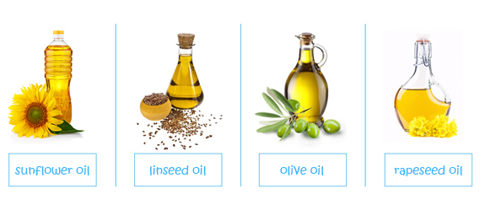
Enzyme Applications in Fats and Oils Industry
FE 461
Enzymes in Fats and Oil Industry
Dr. Hasene KESKİN ÇAVDAR

Slide 2
Enzymes in Oil- and Lipid Based Industries
Enzyme Application in Oil Extraction
Enzyme Application in Oil Refining
Enzyme Application in Lipid Modification

Slide 3
Oil Processing
Oil Processing
Oilseed
Extraction
Crude Oil
Refining
Refined Oil

Slide 4
Extraction of Fats and Oils
Oil extraction involves separation of crude oil from the solids high in protein or washing flaked or modestly pressed material with solvent, almost always hexane.
Fats and oils are extracted from plants and animals.

Slide 5
Extraction of Fats and Oils (Continued)
Oils and lipids are not only used in the food industries in manufacturing of edible
products but are also a major component in other nonedible applications such as cosmetics, varnishes, adhesives, lubricants,
soaps, synthetic resins, greases, paints, and waxes.

Slide 6
Extraction Methods
The method used for extraction of the oil is of paramount importance as it determines the quality of the final products and the possible environmental implications.
Types of conventional extractions:
    Rendering
    Mechanical Pressing
    Solvent Extraction
Types of novel extraction methods:
    Ultrasound-assisted extraction
    Microwave assisted extraction
    Supercritical fluid extraction
    Enzyme-assisted aqueous extraction
    Pulsed electric field extraction
    Gas-assisted mechanical extraction
    Supercritical carbon dioxide

Slide 7
Extraction Methods (Continued)
Why are novel techniques required?
Traditional methods have different shortcomings like more energy, more time, low yield, and less environmentally friendly.

Slide 8
Extraction Methods (Continued)
The physical methods of oil extraction can only recover approximately 80% of oil present in oleaginous material; hence, to recover the remaining 20%, different technology has to be applied.
The application of the organic solvents raises health, safety, and environmental concerns and, therefore, regardless of their high extraction efficiency, their usage is not only harmful and toxic but also leads to air pollution.

Slide 9
Extraction Methods (Continued)
Research shows that novel extraction techniques have eliminated effectively and successfully the shortcomings posed by traditional methods in extracting valuable components from plants and seed materials.
Advantages of novel technologies:
    Improved quality of extracted products
    Time efficient and
    Less solvent consumed
    Ecofriendly,
    high yield,
    cost-effective,
    co-products can be obtained without any deterioration in quality

Slide 10
Mechanical Oil Extraction
Used for removing oil from oilseeds or fruit rich oils
Various types of mechanical presses and expellers are used to squeeze oil from oilseeds
Before the extraction, seeds are usually heated slightly to partially break down the cell structure and to melt fat for easier release of oil.
  cold pressing means no heat applied-
  hot pressing - external heat is applied

Slide 11
Mechanical Pressing (Continued)
Raw material
Cleaning
Crushing
Oil Pressing
Steam Cooking
Flaking
Oil Cake
Pressed Oil
Oil Filtering
Crude Oil

Slide 12
Mechanical Oil Extraction (Continued)
Oil extraction efficiency with hot pressing is higher than cold pressing, but due to the heat generated during the compressing, the quality of the resulting oil is lower and the oil extracted by cold pressing preserves its natural properties and is free of chemical materials; therefore, the demand for oils obtained by cold-pressing approach is getting increased
Even though cold pressing at temperatures below 60 °C is used extensively in the specialty oil market, cold pressing is limited in terms of oil recovery and the high levels of residual oil left in the meal

Slide 13
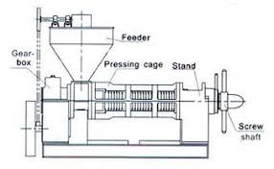
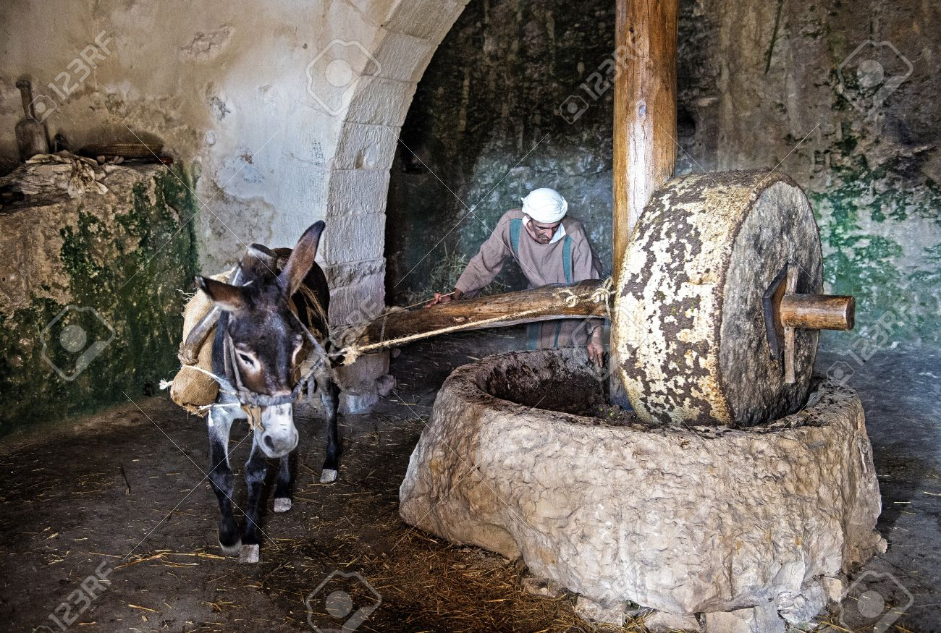
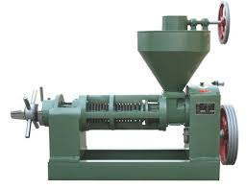
Mechanical Oil Extraction
https://www.youtube.com/watch?v=MGkbU4tXd3g
https://www.youtube.com/watch?v=nHfFk0O54YI
https://www.youtube.com/watch?v=dnsUHSNl2YY

Slide 14
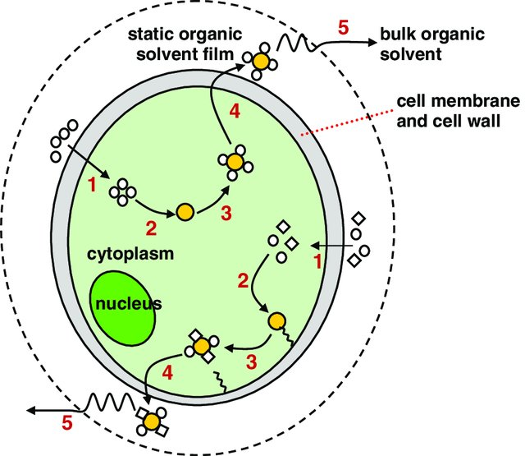
Solvent Extraction
Step 1: penetration of organic solvent through the cell membrane.
Step 2: interaction of organic solvent with the lipids.
Step 3: formation of organic solvent–lipids complex.
Step 4: diffusion of organic solvent–lipids complex across the cell membrane.
Step 5: diffusion of organic solvent–lipids complex across the static organic solvent film into the bulk organic solvent

Slide 15
Solvent Extraction (Continued)
The oil is dissolved in solvent and later solvent is separated through evaporation and distillation or with de-emulsification and centrifugation.
Conventional techniques use organic solvents like n-hexane, hexane, petroleum ether, ethyl acetate, acetone, and chloroform.
Wide industrial applications, better reproducibility and efficiency, and less extract manipulation are the advantages of Soxhlet extraction over the other novel extraction methods

Slide 16
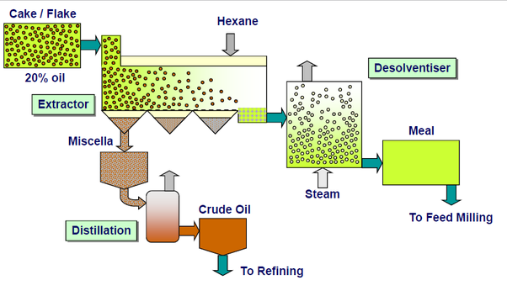
Solvent Extraction (Continued)

Slide 17
Solvent Extraction (Continued)
Disadvantages of solvent extraction
    Longer extraction time,
    Requirement of costly and high purity solvent,
    Evaporation of the huge amount of solvent,
    Thermal decomposition of thermolabile compounds
    Undesirable solvent residue in the oil.

Slide 18
Solvent Extraction (Continued)
When the oil has been obtained after solvent is removed, a trace percentage of the solvent may still be present in the final oil
However, n-hexane is classified as a neurotoxin and a volatile organic compound by the National Institute for Occupational Safety and Health (NIOSH) and the United States Environmental Protection Agency (USEPA)
Hexane use is under greater scrutiny due to increasing government restrictions, consumer concerns regarding the safety on the use of organic solvents in food processing, and demands are for “natural” or organic products, processed without the use of organic solvents

Slide 19
Novel Technologies in Fats and Oil Extraction
Ultrasound-assisted extraction
Microwave assisted extraction
Supercritical fluid extraction
Enzyme-assisted aqueous extraction
Pulsed electric field extraction
Gas-assisted mechanical extraction
Supercritical carbon dioxide

Slide 20
Enzyme Application in Oil Extraction
Aqueous extraction is a traditional technique that uses water as a solvent to extract oil from oleaginous materials.
Water in oil extraction:
    Water acts as the media for oil extraction
    facilitates diffusion and mobility of both oil and enzymes
    enhance hydrolytic reactions necessary for the recovery process
Because water takes long to degrade the cell wall of oil-bearing material, the process is less effective and results in low yield.

Slide 21
Enzyme Application in Oil Extraction
Enzyme-assisted extraction process accelerate the recovery of oils from oil seeds.
Aqueous enzymatic extraction (AEE) uses both water and enzymes to degrade the cell wall network of the oil-bearing material, thereby allowing for the transfer of intercellular contents.
Application of enzymes either individually or as a combination of different enzymes has a positive effect on the overall oil yield.

Slide 22
Principle of Enzyme-Assisted Aqueous Extraction from Oilseeds
Enzyme application in oil extraction includes three main steps:
Analyzing the microstructure of oil-bearing (Oil containing) material and its pretreatment.
Enzyme-assisted treatment on the material
Oil recovery from an emulsion system (Seperation and Cream Demulsification)

Slide 23
Principle of Enzyme-Assisted Aqueous Extraction from Oilseeds (Continued)
The cell wall of plant materials is composed of cellulose, hemicellulose, and pectin
Since the oil bodies have a complex constitution and structure, limiting the oil droplet in oilseeds, the destruction of the seed is generally very important as a privilege step for oil extraction.
The major role of enzymes used in AEE is to degrade and break down the cell wall of the oilseed to facilitate the release of oil from the matrix.

Slide 24
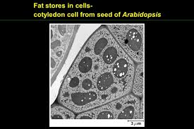
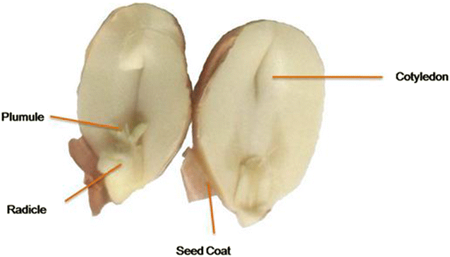
Principle of Enzyme-Assisted Aqueous Extraction from Oilseeds (Continued)
The main components of the cell wall are cellulose, hemicellulose, and pectin. The cotyledon cell, which contains a large amount of oils and proteins was wrapped in the cell wall, block the release of oils and proteins.
Enzymes degrade cell walls with water acting as solvent. Enzymes can simultaneously solubilize and hydrolyze the proteins and disrupt polysaccharide constituents, which facilitate oil extraction.

Slide 25
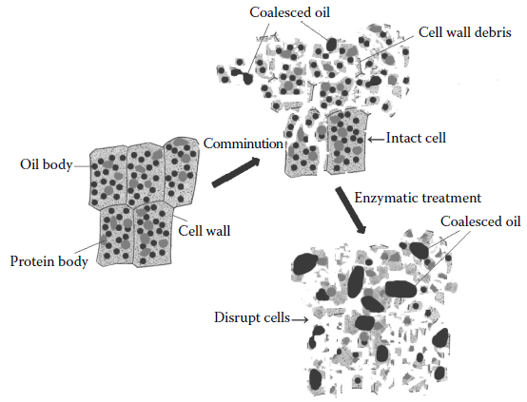
Principle of Enzyme-Assisted Aqueous Extraction from Oilseeds
Effect of mechanical comminution and enzymatic treatment on oilseed cell structure
The cell wall must be disrupted prior to aqueous or enzyme-assisted aqueous extraction processing
Disruption of cell wall may be done by mechanical methods such as milling, flaking, extrusion, cracking, ultrasonication, microwave treatment.
(Enzymes in food and beverage processing, (Editted by Chandrasekaran, M.) 2016. CRC Press, FL, USA.

Slide 26
Selection of Appropriate Enzyme
Selection of the enzyme depends on the anatomy of the oil-bearing seed, the type of enzyme in use, as well as the constituents of the enzyme
The location of oil within the cell and the specific component surrounding it are the critical factors that act as obstacles in extraction of oil
Commonly used cell wall degrading enzymes include cellulase, pectinase, hemicellulase, protease, and phospholipase, and selection solely depends on the structure of the oilseed as well as the composition of the cell wall

Slide 28
Selection of Appropriate Enzyme (Continued)
The success of this novel technology heavily relies on prior understanding of the structure of the target oilseed and judicious use of enzymes is paramount for higher yields and recovery of co-products

Slide 29
Oil Recovery
Emulsion formed during aqueous or enzyme-assisted extraction of vegetable oil was the major problem to releasing free oil.
Because the lipid molecules are amphipathic, only the water-soluble portion diffuses into the water, while the other components culminate into an emulsion.
The oil is further de-emulsified either by the application of enzymes that dissolves it or by changing the temperature of the emulsion. The common methods, such as ultrasound treatment, heating treatment, ethanol treatment, the phase inversion method, freezing–thawing, and enzymatic treatment, were widely used in cream demulsification

Slide 30
Oil Recovery (Continued)
The amount of emulsion that formed during the AEP or EAEP process needs to be further separated into free oil or cream, skim, and residual solid. Therefore, a longer time is needed to render the emulsion naturally settled.
Actually, a centrifugal apparatus was preferred for most processes. However, the processes of centrifuge and pipeline could create problems, such as stable emulsion formation. Therefore, ways to reduce emulsion formation during the centrifuge and pipeline processes are necessary to scale up laboratory EAEP or AEP processes

Slide 31
Oil Recovery (Continued)
The common methods, such as ultrasound treatment, heating treatment, ethanol treatment, the phase inversion method, freezing–thawing, and enzymatic treatment, were widely used in cream demulsification.
The freezing–thawing method can lower the stability of the emulsion and achieve the highest oil recovery in many oilseeds. Fat crystals may form and pierce the water phase during the freezing–thawing process. However, the disadvantages, including quite high energy consumption and difficulty in scale-up, were obvious.
Ethanol is regarded as a “green” solvent for the food industry, but manufacturers and customers still worry about residual solvent in the product. And this limits the application of ethanol for demulsification.
In the case of enzymatic demulsification, after the addition of proteases to the emulsion, the interface protein was hydrolyzed, and the major substance to stabilize the emulsion was destroyed. It could be very specific due to the difference of starting material as well as EAEP processes Its industrial application in EAEP processes would be promising with advantages such as mild reaction temperature, less by-product, and good quality of oil along with the decreased cost of enzyme, the recycling and utilization of water, and development of new ingredients/foods

Slide 32
Oil Recovery (Continued)
Scheme of various enzyme-assisted extraction methods and the value-added products

Slide 33
Factors affecting aqueous enzymatic extraction
1. Particle size
The smaller particle size of materials, the better oil extraction. Thus, grinding is the the first and critical step during EAEP to improve oil extraction from oilseeds. Grinding is used to rupture cell walls and release the oil so that it can be recovered as free oil and oil-rich cream.
Reducing the size causes a higher disruption of the cell wall and reduces the length of the diffusion path through which both enzymes and cellular components have to diffuse
Materials with very low particle size are not recommended and there appears to be an optimum size. But grinding of materials with high oil content into very low particle sizes may cause the particles to adhere.
If the oilseed contains high oil content, the small-sized particles tend to adhere together
A research conducted a test on linseed and obtained a 31% increase in yield as a result of reducing the size of the particles from 400 to 100 μm.

Slide 34
Factors affecting aqueous enzymatic extraction (Continued)
2. pH:
Higher efficiency of oil extraction is only achieved at an optimum pH and each enzyme has its specific optimum value.
Ex: when treated with Alcalase 2.4 L® and Viscozyme L®, the oil yield was 29.48% and 20.23% for a pH of 4.5 and uncontrolled pH, respectively.

Slide 35
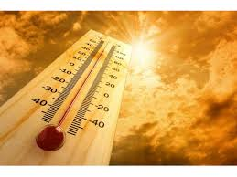
Factors affecting aqueous enzymatic extraction (Continued)
3. Temperature
Enzymes are also sensitive to temperature and are active within a narrow
range of temperature
AEE is most effective at or below 45 ◦C depending on the fatty acids present and the type of oilseed. Temperature above 45 ◦C denatures the proteins and lowers enzymatic hydrolysis, hampering the process of oil extraction
Effects the enzyme activity and oil yield.
Optimum extraction temperature is different for different oilseeds and enzymes.
Effects the oil and protein characteristics. Ex. High temperature decreases enzyme activity and cause darkening of oil and protein denaturation.
Studies show that the optimum temperature for enzymatic extraction is 30 ◦C for olive, 34 ◦C for linseed, and
40 ◦C for peanut

Slide 36
Factors affecting aqueous
enzymatic extraction (Continued)
4. Enzyme to substrate ratio
Oil yield increases by increasing the concentration of the enzymes in the extraction medium.
The higher the concentration of enzymes, the greater the interaction between the substrate and the enzymes that degrade the peptide bonds. Thus, oil yield is increased.
However, degradation of the extracted oil occurs beyond a certain saturation point. Negative effects of oversaturation include the development of off-flavors and bitterness in the oil.

Slide 37
Factors affecting aqueous enzymatic extraction (Continued)
5. Water to substrate ratio
Water: substrate ratio should be optimized for oil yield, amount of liquid waste and demulsification.
High water:substrate ratio increases extraction yield while also increasing liquid waste and cause difficulty in demulsification
Low water:substrate ratio decrease extraction yield preventing the enzymes from effectively penetrating into substrate.

Slide 38
Factors affecting aqueous enzymatic extraction (Continued)
6. Time
Optimum extraction time depends on the oilseeds and enzymes.
Oil yield, protein quality, recovery rate and economic costs should be taken into consideration during the determination of the optimal incubation time.
Long extraction time enhance the degradation of cell wall components while increases difficulty in demulsification against oil extraction. Short incubation time reduces efficiency of enzymatic hydrolysis of oil materials hence leading to low oil yields

Slide 39
Factors affecting aqueous enzymatic extraction (Continued)
7. Agitation
Shaking regime determines the process time and separation of the resulting oil from the emulsion.
Agitation disrupts the mechanical barriers and causes uniform mixing of the constituents, thereby increases mass transfer and reduces process time

Slide 40
Advantages of enzyme-assisted oil extraction
Safer and eco-friendly
Lower energy consumption, operational costs and lower capital investment
Produces high quality products and suitable for human consumption

Slide 41
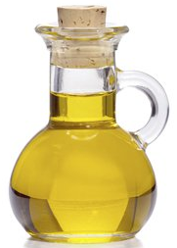
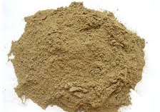
Advantages of enzyme-assisted oil extraction
EAEP
Crude Oil
High oxidative stability
Low phosholipid concentration
Protein residue
Used in feed stuffs and fertilizers with higher nutritional benefit
Higher oil yields

Slide 42


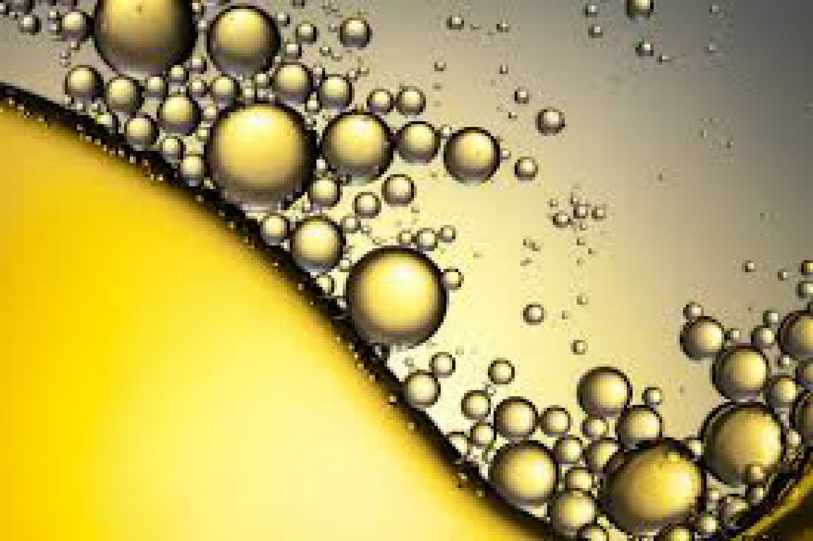

Disadvantages of enzyme-assisted oil extraction
- Long processing time
Higher cost of production since the price of enzyme is quite high
Additional downstream steps (centrifugation,
demulsification, drying for protein) are required.
Emulsification is unavoidable in enzyme-assisted
aqueous oil extraction

Slide 43
Quality of Oil Obtained By EAEP
Generally, oils extracted by enzyme assisted extraction are of better quality (nutrient content, fatty acid composition, free fatty acid content, peroxide value…) than other oils extracted by traditional methods

Slide 44
Application of EAEP in Industrial Scale
At industrial scale, one advantage of EAEP is environment benefit because it can avoid the risk of organic solvents and particularly hexane.
Altough the extraction yields of EAEP are lower than those of conventional solvent extraction processing, the quality of the products produced by the smooth process is usually higher.
It is the selectivity and the mild reaction conditions that preserve the integrity of the products. At an industrial scale it is very important for profits concerning the high quality of the products.
The high cost of enzyme and complex purification of the products are limitations of EAEP at industrial scale.

Slide 45
Summary
EAAE is an effective technology for obtaining high oil extraction yields from oilseeds. Nowadays, it has started to be used in industrial scale.
Moderate extraction conditions provide high-quality products preserving valuable compounds.
Extraction of oil and protein occurs at the same time.
Enviromentally friendly process
Still has some disadvantages (such as cost and complex purification of products)
The oil yield is lower when compared to solvent extraction and should be improved.

Slide 46
References
Zhang, W., Li, P. and Yang, R. (2016). Enzymes in Oil- and Lipid-Based Industries. In: Enzymes in Food and Beverage Processing ( Muthusamy Chandrasekaran, Ed.) pp. 227-254
Liu, J. J., Gasmalla, M. A. A., Li, P., Yang, R. (2016). Enzyme-assisted extraction processing from oilseeds: Principle, processing and application. Innovative Food Science & Emerging Technologies, 35, 184-193.
Halim, R., Danquah, M. K., & Webley, P. A. (2012). Extraction of oil from microalgae for biodiesel production: A review. Biotechnology advances, 30(3), 709-732.
Mwaurah, P. W., Kumar, S., Kumar, N., Attkan, A. K., Panghal, A., Singh, V. K., & Garg, M. K. (2020). Novel oil extraction technologies: Process conditions, quality parameters, and optimization. Comprehensive Reviews in Food Science and Food Safety, 19(1), 3-20.

