Slide 1
Separation of enzymes based on solubility
Dr. Hasene KESKİN ÇAVDAR
FE 361 Enzymology

Slide 2
Separation of enzymes based on solubility
Solubility of proteins in solution depends on the distribution of amino acid residues on surface.
Protein solubility can be affected by changes in;
pH
İonic strength
Miscible organic solvent
Temperature

Slide 3
Effect of pH on protein solubility (Isoelectric precipitation)
Proteins can be positively or negatively charged due to the terminal ammonia and corboxyl group and the group on the side chain.
Protein is positively charged at low pH values and negatively charged at high pH values. The intermediate pH at which a protein molecule has a net charge is zero is called isolectronic point of that protein.
Isoelectronic point is shown by pI.

Slide 4
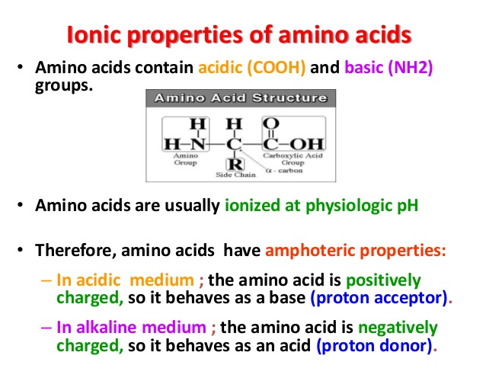

Slide 5
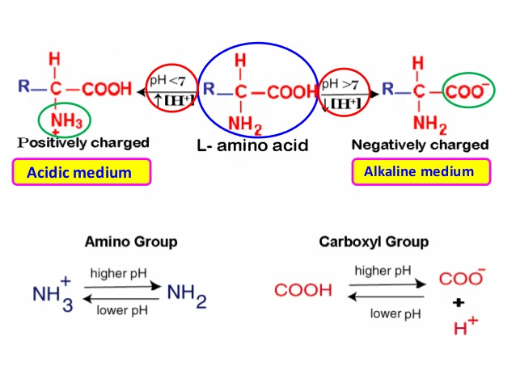

Slide 6
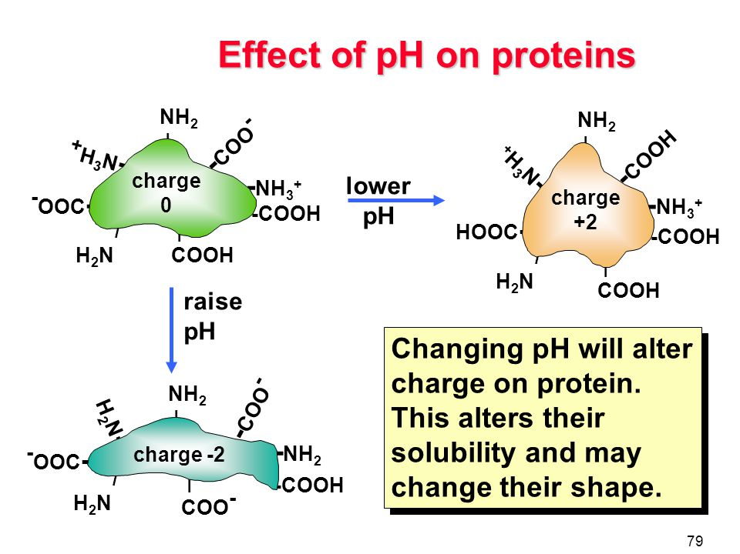

Slide 7
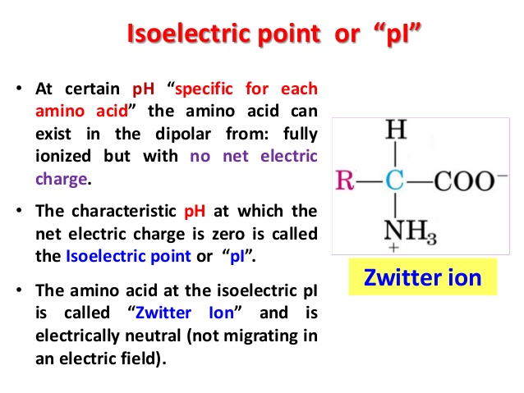

Slide 8
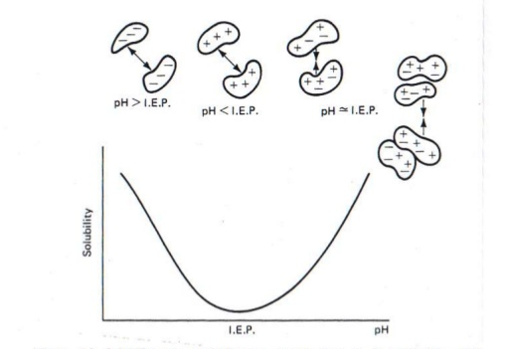

Slide 9
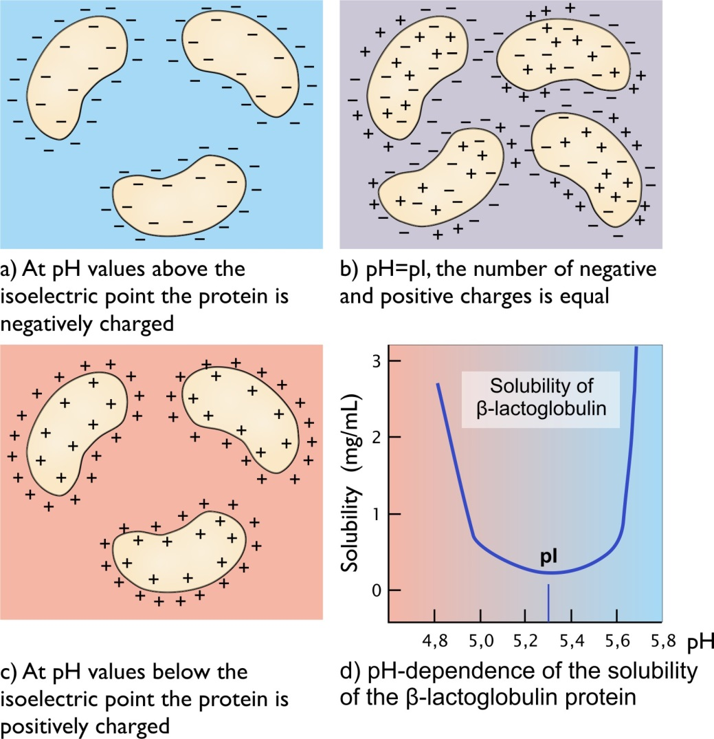

Slide 10
Protein is the least soluble when the pH of solution is at its isoelectronic point.
Mixture of protein A, B, C, D have pI values 5, 6.5, 7, 8.

Slide 11
Effect of Ionic Strength on Solubility
When salt ions are added into the protein solution, the charge of protein molecules around increases, the interaction between protein and solvent molecules will be promoted and finally the protein solubility will increase. This is called SALTING IN.

Slide 12
Effect of Ionic Strength on Solubility (Continued)
When salt concentration continues to increase a large number of salt ions reduces relative concentration of water. Then, the hydration of the protein will be weakened. Finally the proteins aggregates and precipitates. This is called SALTING OUT.
The salt molecules compete with the protein molecules in binding with water.
The salt concentration for precipitation of protein is different for different proteins. So, this method can be used for precipitation of proteins.

Slide 13
Effect of Ionic Strength on Solubility (Continued)
The salt concentration for precipitation of protein is different for different proteins. So, this method can be used for precipitation of proteins.
Fractionation by raising the salt just below the point where protein to be purified becomes insoluble and removed from other proteins by centrifugation.

Slide 14
The salt commonly used is ammonium sulfate because:
Its large solubility in water.
Its relative freedom from temperature effects.
It has no harmful effects on most of the proteins.
The amount of salt needed to isolate a specific protein is determined from the salt's fractionation table.

Slide 15
Effect of Solvent on Solubility
Organic solvent decreases the solubility of proteins in aqueous medium. The most commonly organic solvents for precipitation of protein are
- methanol
- ethanol
- buthanol
- acetone

Slide 16
Effect of Solvent on Solubility (Continued)
The organic solvent effects the protein solubility and cause precipitation by two combined action
1. Through their polar groups, solvent acts on polar groups on the protein, that is competition with water.
2. Secondly, the hydrophobic groups may distrupt the intermolecular hydrophobic interaction stabilizing the protein structure and force the formation of new hydrophobic interactions.

Slide 17
Effect of Solvent on Solubility (Continued)
A large volume of organic solvent reduces the effective concentrations of water and less water remains for dehydration of protein and the factor cause a decrease şn solubility of protein.
The addition of water miscible organic solvent can significantly reduces the dielectric constant of solution so that, electostatic interaction between enzyme molecules is enhanced and the enzyme will precipitate.

