Slide 1
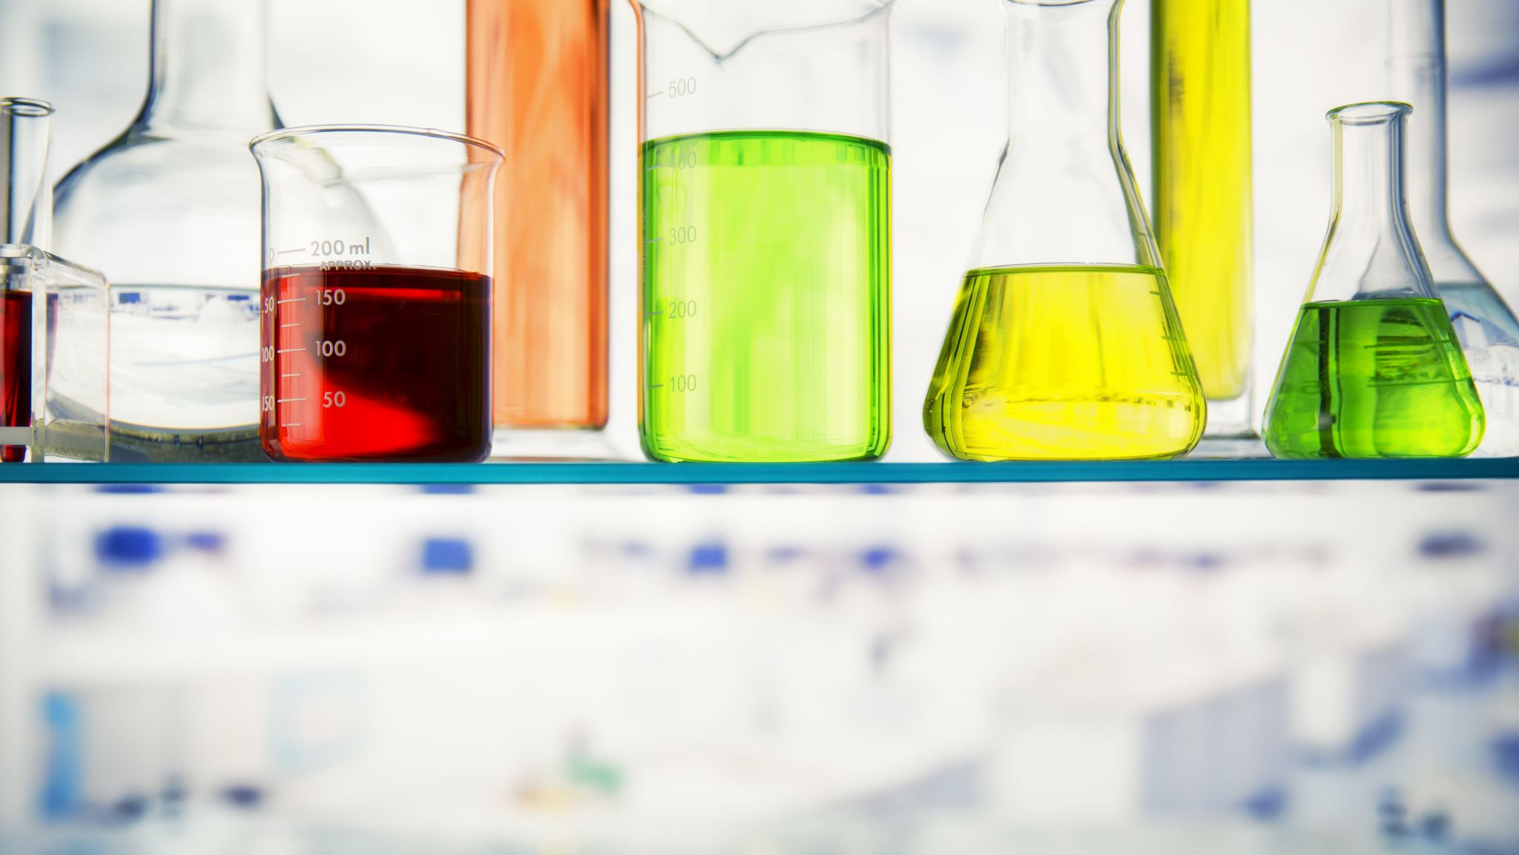
FE 461 Enzymes in Fats and Oils Industry
Enzymes
Dr. Hasene Keskin Çavdar
12.02.2025

Slide 2
Why enzymes?
Thousands of different chemical reactions must happen inside a cell every second in order for it to function. If these cellular reactions happen too slowly, the cell may die. If the cell is part of a larger multicellular organism then this might harm the whole individual.
Chemical reactions can be speeded up by increasing the temperature because more molecules will have sufficient energy to react with each other. However, increasing temperature will cause damage to cells.
Living cells solve this problem by producing proteins called enzymes.

Slide 3
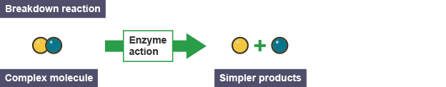
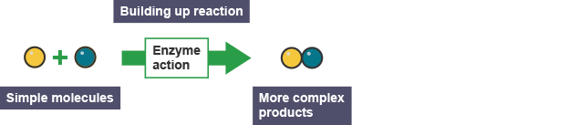
Enzymes can speed up the break down of complex molecules into simpler molecules or the building up of simple molecules into more complex molecules.

Slide 4
Introduction to Enzymes
What are Enzymes?
Biological catalysts that speed up chemical reactions.
Mostly proteins (some RNA molecules act as enzymes, e.g., ribozymes).
Key Properties:
Highly specific to their substrates.
Not consumed in reactions (can be reused).
Work under mild physiological conditions (temperature, pH).
Importance in Biology & Industry:
Essential for metabolism, digestion, and DNA replication.

Slide 5
Importance of Enzymes
Biological Functions:
✔ Essential for metabolism (breaking down and synthesizing molecules).
✔ Aid in digestion (e.g., amylase, protease, lipase).
✔ Support DNA replication & repair.
Industrial Applications:
✔ Food industry (cheese-making, brewing, baking).
✔ Pharmaceutical industry (drug synthesis, disease diagnostics).
✔ Textile & detergent industry (biodegradable stain removers).
Environmental Benefits:
✔ Biodegradable and eco-friendly alternatives to chemicals.
✔ Help in waste treatment and biofuel production.

Slide 6
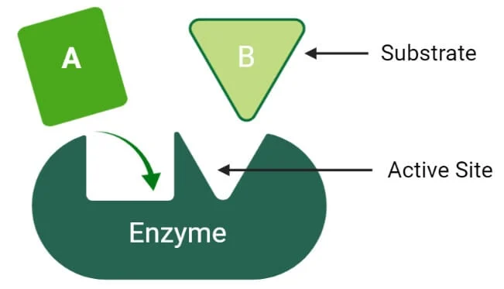
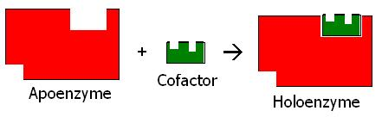
Structure of Enzymes
Enzymes are proteins. Their folded chains of amino acids can be represented by simple shapes.
1. Apoenzyme (Protein Part) The main protein component, responsible for enzyme specificity.
2. Active Site: A specific region where the substrate binds and reaction occurs.
3. Cofactors & CoenzymesCofactors: Inorganic molecules (e.g., metal ions like Zn²⁺, Mg²⁺).Coenzymes: Organic molecules (e.g., vitamins like B-complex).
4. Holoenzyme (Active Form)Apoenzyme + Cofactor/Coenzyme = Fully functional enzyme.

Slide 7
Active site
The active site is the region that binds the substrates (& cofactors if any)
It contains the residues that directly participate in the making & breaking of bonds
The interaction of the enzyme and substrate at the active site promotes the formation of the transition state
The active site is the region that most directly lowers the Free Energy of the reaction – and activation energy resulting in rate enhancement of the reaction
3-Dimensional structure

Slide 8
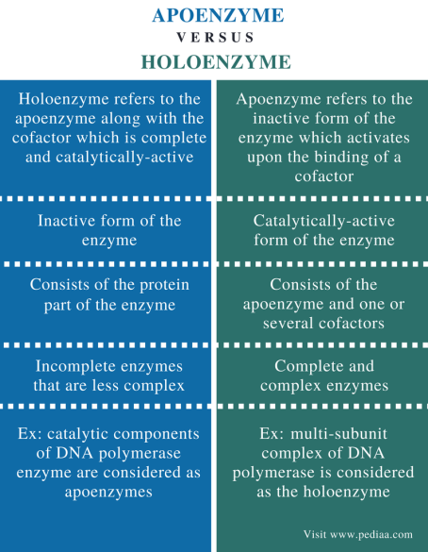

Slide 9
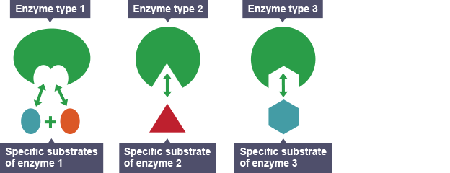
Enzyme Specificity – Introduction
What is Enzyme Specificity?
The ability of an enzyme to recognize and bind to a specific substrate.
Ensures precise biochemical reactions.
Enzymes are specific because different enzymes have differently shaped active sites. The shape of the active site of an enzyme is complementary to the shape of its specific substrate. This means they are the correct shapes to fit together.

Slide 10
Types of Enzyme Specificity
1️⃣ Absolute Specificity✔ Enzyme acts on only one substrate (e.g., Urease → Urea).
2️⃣ Group Specificity✔ Enzyme acts on a specific functional group (e.g., Alcohol Dehydrogenase → Alcohols).
3️⃣ Linkage Specificity✔ Recognizes a specific type of bond (e.g., Proteases → Peptide Bonds).
4️⃣ Stereochemical Specificity✔ Distinguishes between different isomers (e.g., Lactic Acid Dehydrogenase → L-Lactate).

Slide 11
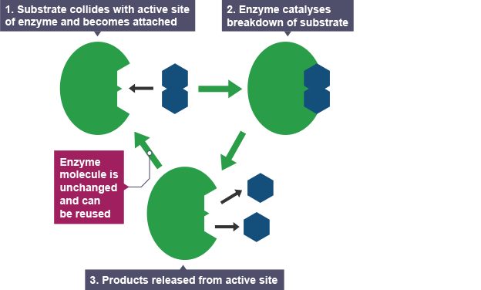
How enzymes catalyse biological reactions?
The diagram below shows how an enzyme catalyses the breakdown of one substrate into two products.

Slide 12
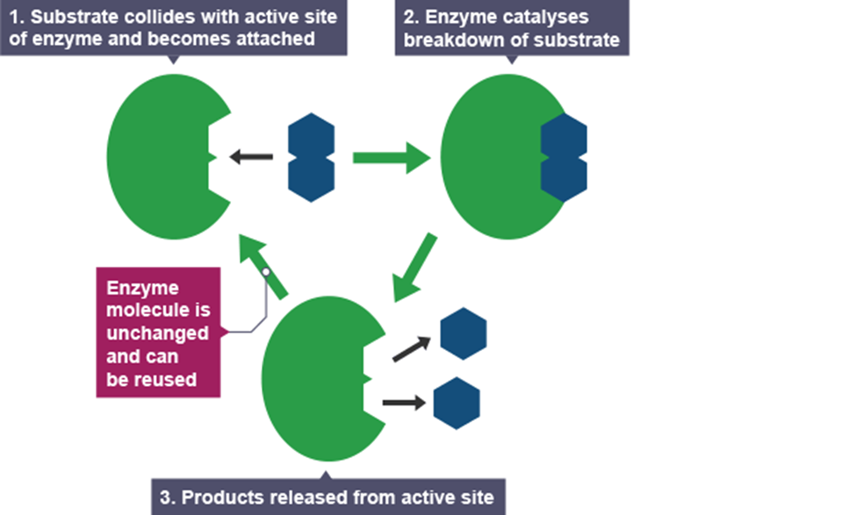
Enzyme-Substrate Complex
What is the Enzyme-Substrate Complex?
A temporary structure formed when the enzyme binds to its specific substrate.
Critical for catalyzing biochemical reactions efficiently.
Steps in Formation:
1. Substrate Binding – The substrate attaches to the enzyme's active site.
2. Enzyme-Substrate Complex Formation – The enzyme stabilizes the substrate in the correct orientation.
3. Catalysis – The reaction occurs, converting the substrate into products.
4. Product Release – The enzyme releases the product and remains unchanged.

Slide 13
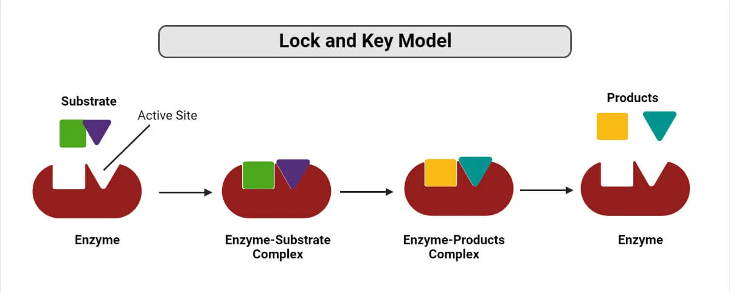
Mode of Action of Enzymes:
Lock-and-Key (ES) Model
This model assumes that the active site of the enzyme and the substrate fit perfectly into one another such that each possesses specific predetermined complementary geometric shapes and sizes.
This specificity is analog to the lock and key model, where the lock is the enzyme, and the key is the substrate.
This model supposes the enzyme is a rigid structure whose shape does not change upon binding with a suitable substrate.

Slide 14
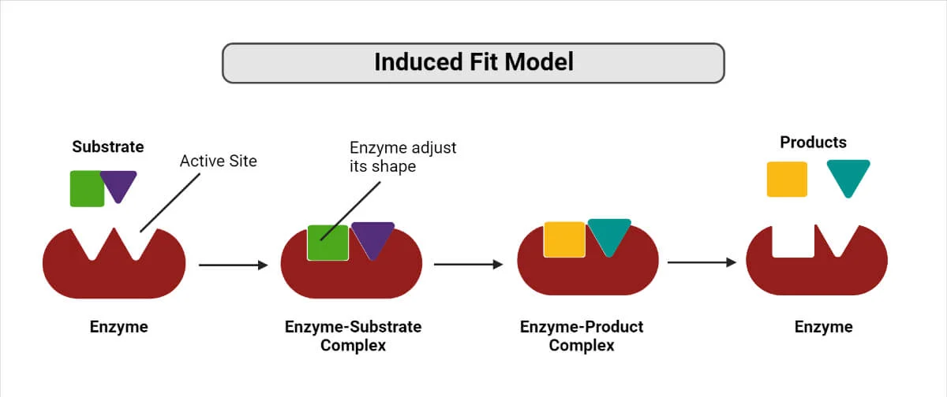
Mode of Action of Enzymes
Induced Fit (ES) Model
In this model, the active site can change shape slightly to accommodate substrates with similar shapes and charges. The induced fit model accounts for conformational alterations that occur during binding and enable interactions between proteins with various degrees of shape complementarity in the unbound state.
Thus, the name induced fit model is termed so for the induced small change of active site of an enzyme such that substrate can achieve optimal fit. This configuration change catalyzes the reaction, meanwhile lowering the activation energy barrier and resulting in an increase in the overall rate of the reaction.

