Slide 1
Affinity Chromatography
Assist. Prof. Dr. Hasene KESKİN ÇAVDAR

Slide 2
Why do we need a pure protein?
It is essential to obtain a pure protein for structural characterization and explanation in nature.
These proteins should be free of contaminants if they will be used for biotechnological purposes.
Many proteins have the ability to bind strongly to specific molecules and thus can be purified by affinity chromatography.

Slide 3
Affinity Chromatography
Developed in 1930s
Purification of a biomolecule with respect to biological function or individual chemical structure.
Used to study enzymes and other proteins
One of the most powerful chromatographic methods for purification of a specific molecule or group of molecules from complex mixtures.

Slide 4
Principle
Affinity chromatography depends essentially on the interaction between the molecule to be purified and a solid phase that will allow the separation of contaminants.
The biological affinity between an enzyme (protein with catalytic activity) and its substrate and/ or other small ligands usually in the active site of the enzyme results from a selective interaction.
The protein (enzyme) to be purified is specifically and reversibly adsorbed to a ligand (binding substance, immobilized by a covalent bond to a chromatographic bed material (matrix).

Slide 5
Ligand
A ligand has a specific affinity for particular compound gets covalently bonded to gel matrix and it is material filled into the column.
Samples are applied under proper conditions for their specific binding to ligand.
Substances of interest are bound to the ligand while unbounds substances are washed away.
The ligands bind only to the desired molecule.

Slide 6
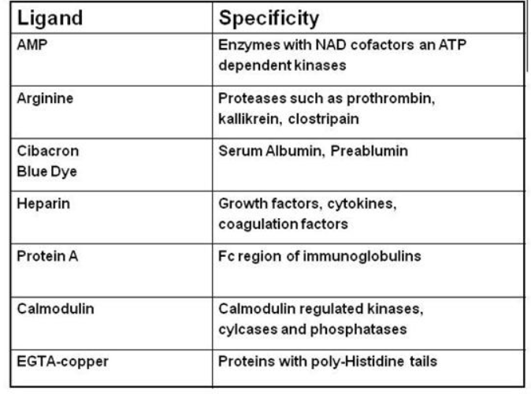

Slide 7
First Part: equilibration
The affinity support must be equilibrated with a binding buffer to achieve adequate conditions for affinity interaction between the protein and immobilized molecule.
Firstly, selected ligand and the matrix are bound covalently.
Most ligands are attached first to spacer arms which are then bonded to the matrix. Because, the substrate might not be able to reach ligand active site if it is hiddedn deep within the ligand.

Slide 8
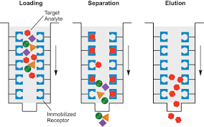

Slide 9

Second Part
When an impure solution is passed through the affinity support, the protein of interest interacts with ligand (adsorption) and the other contaminants (other proteins or molecules) are washed from the column by binding buffer.

Slide 10
Third Part
In order to remove unbound impurities a strong wash of column should be performed.
The desired molecule can be obtained highly purified by changing the elution conditions to release the protein from the support.
The elution may be performed by changing the conditions of pH, ionic strength or temperature or with a solution containing a high concentration of free ligand that will compete for the binding sites of the protein (a bioselective desorption). The protein is then free to run the column and be collected.
E+L←→ EL L+support→ covalent bonding (can not be broken)
E+L → noncovalent bonding

Slide 11
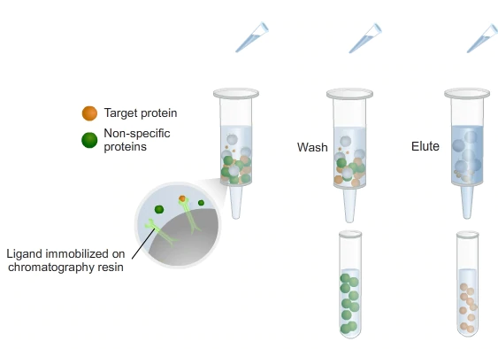

Slide 12
Properties of the insoulbe matrix
1. It must possess suitable and abundant chemical groups to couple the ligand covalently. It must be stable under the conditions of attachment.
2. It must be stable during binding at the macromolecules and its subsequent elution.
3. It must interact weakly with other molecules to minimize specific absorption.
4. It should exhibit good flow properties.

Slide 13
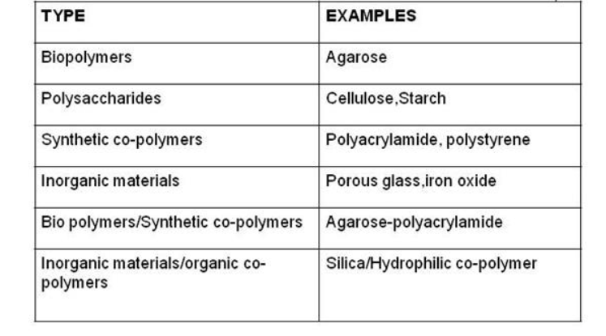
Examples of matrix

Slide 14
Applications
Purify and concentrate a substance from a mixture into a buffering solution
Reduce the amount of a substance in a mixture
Discern what biological compounds bind to a particular substance
Purify nuclecic acids and antibodies
Purify and concentrate an enzyme solution
Production of vaccines- antibody purification from blood serum

Slide 15
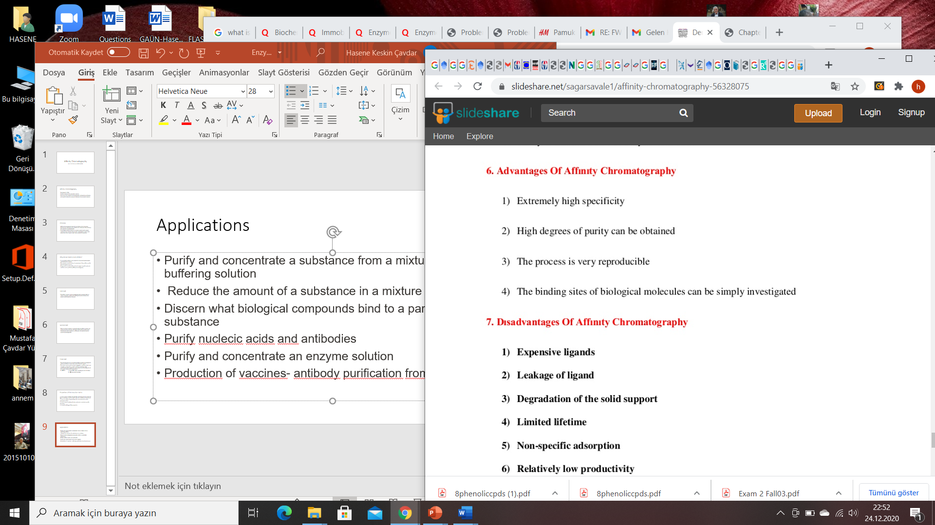
Advantages

Slide 16
Disadvantages

