Slide 1
FRUIT JUICE
A wide range of drinks can be made using extracted fruit juice or fruit pulp as the base material.
The types of drinks made from fruit can be separated into two basic types;
Those that are drunk straight after opening
Those that are used little by little from bottles which are stored between use

Slide 2
The first group should not require any preservative if they are processed and packaged properly.
However,
Second group must contain a certain amount of permitted preservatives to have a long shelf-life after opening.

Slide 3
The different types of drinks are classified according to the fruit juice concentration:
Juice; pure fruit juice with nothing added
Nectars; normally contain 25-50% juice content and usually with added sugar.
Still drinks; normally contain 6-30% juice content mixed with sugar syrup. They are diluted to taste with water and may contain preservatives
Fruit juice concentrate; concentrated fruit juices with 60-70 Brix by evaporation

Slide 4
Method of Production
The production process for fruit juice production is simple. This involves the following unit operations
Selection and weighing of fresh fruits:
Wholesame and fresh fruits are selected and weighed
Washing:
The selected fruits are washed in a trough using potable water
Peeling:
The fruits are peeled manually

Slide 5
Juice extraction:
The juice is extracted using an extractor
Juice Formulation:
This is the addition of other ingredients like sugar, preservatives and water to obtain the right formulation
Mixing:
The juice is mixed in a tank using a homogenizer (mixer), in order to achieve a uniform blending of the formulated juice

Slide 6
Bottling:
The mixed juice is bottled and corked, either manually or with automatic bottle filling machine, depending on the scale of operation. Tetra brik or tetra pak packages can also be used.
Pasteurizing:
The bottled juice is pateurized at a predetermined temperature and time using a pasteurizer.
Cooling and Packaging
The pasteurized juice is allowed to cool and then arranged in corrugated cartons and sealed.

Slide 7
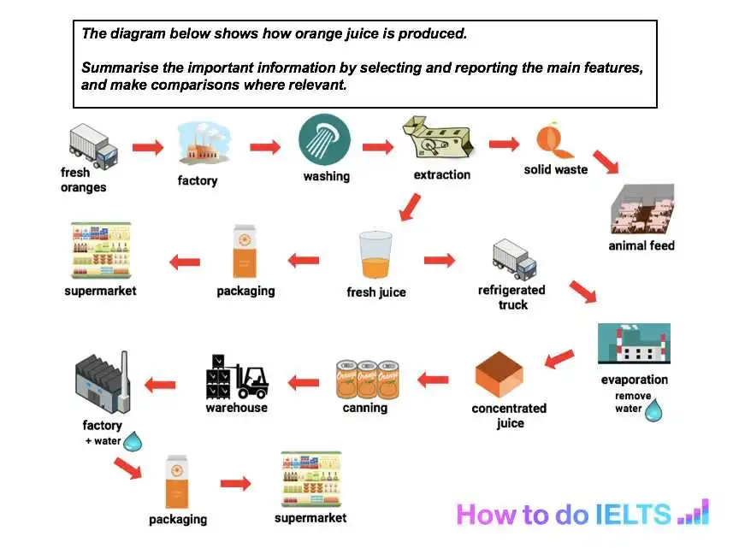

Slide 8
Ingredients of Juice:
Water
Sweeteners (sucrose, aspartame, etc)
Coloring agents (carotenoids, anthocyanin,etc)
Preservatives (sodium benzoate, citric acid, etc)
Clouding agents (modified starch,etc)

Slide 9
The use of chemical preservatives in fruit juices and fruit drinks
Pure fruit juice as the name given to the extracted juice of fruit and should not have any preservative, or any other ingredients (such as sugar) added.
Fruit drinks that are not consumed in one can have preservatives added to help prolong the shelf life once they have been opened.

Slide 10
There are several chemical preservatives that can be added to fruit juices.
Sulphites and sulphur dioxide (0.005-0.2)
Sulphur dioxide gas and the sodium or potassium salts of sulphite, bisulphite or metabisulphite are the most commonly used forms. Sulphurous acid inhibits yeast, moulds and bacteria. Sulphur dioxide is mainly used to preserve the colour of fruits during drying.
Sorbic acid (0.05-0.2%)
Sorbic acid and the sodium and potassium sorbate are widely used to inhibit the growth of moulds and yeasts.

Slide 11
Benzoic acid (0.03-0.2%)
Benzoic acid, in the form of sodium benzoate is a widely used preservative
Citric acid (no limit)
Citric acid is the main acid found naturally in citrus fruits. It is widely used in carbonated beverages and as an acidifier of foods

Slide 12
Quality Control
The freshness and quality of the extracted fruit juice is central to the quality of the final product.
As soon as the juice is extracted from the fruit it starts to deteriorate, both as a result of chemical activity (enzyme action) and bacterial spoilage.
It is important to move from the juice extraction stage to pasteurization as quickly as possible to minimize any spoilage.

Slide 13
The quality of each day’s production should be monitored and controlled to ensure that every bottle of juice has the correct keeping and drinking qualities.
For the quality, the following points must be considered:
Only fresh, fully ripe fruit should be used
Mouldy or insect damaged fruit should be thrown away. All unwanted parts (dirt, skins, stones) should be removed.
Water quality is critical

Slide 14
Pay particular attention to the quality of re-usable bottles and always use new caps or lids
The concentration of preservative should be carefully controlled
The temperature and time of heating are critical for achieving both the correct shelf-life of the drink and retaining a good colour and flavour
The correct weight should be filled into the bottles each time

Slide 15
Experiments
pH (use pH meter)
Brix (use refractometer)
Acidity
Measure 5 g sample
Dilute with recently boiled distilled water to 100 mL
Add a few drops phenolphthalein
Titrate with 0.1 N NaOH
Calculate the result as percent citric acid
1 mL of 0.1 N NaOH = 0.0064 g citric acid

Slide 16
Formal Index
Using pH meter
Titrate 25 mL of fruit juice with 0.1 N NaOH until the pH of solution is 8.50
Add 10-15 mL formaldehyde solution, stand for 1 min
Continue to titration with 0.1 N NaOH until pH is 8.50
For 100 mL of fruit juice, mL of 0.1 N NaOH consumed (total) gives formal index
For example, 1st titration= 15.0 mL 18.7 mL NaOH for 25
2nd titration= 3.7 mL mL
For 100 mL= 18.7x4= 74.8 mL NaOH (formal index)

Slide 17
Ascorbic acid
Reagents:
Acid soln: metaphosphoric acid (HPO₃ ) + glacial acetic acid
Dye soln: 2,6-dichlorophenol indophenol sodium salt + water
Dye soln is standardized with standard ascorbic acid soln.
Dye titer value must be given (e.q. X mL dye soln/ mg ascorbic acid)
Then take 5 mL fruit juice
Add 5 mL acid soln
Titrate with dye soln
Calculation:
(1/ dye titer)x titrant (mL dye spentx2)x100/10 = mg a.a / 100 mL sample
Dye titer value= 2.06 mL/ mg ascorbic acid

Slide 18

Turkish Standards Institution (TSE)
The Turkish Standards Institution (TSE) is a public agency responsible for developing and promoting industrial standards, including those related to the food industry. It provides certification services to food producers, ensuring that products meet specified national and international standards. The TSE's standards cover a wide range of areas, from food packaging to processing technologies.

Slide 19
Why are standards important?
The implementation of this standard;
provides effective communication between all relevant parties including suppliers, consumers, legal bodies, ensuring product traceability at every stage of production,
controlling hazards that pose a threat to human health, completely eliminating them or reducing them to acceptable limits, managing risks, complying with legal requirements, and optimizing resources through post-production verifications.
It increases competitiveness in the international market and the sense of trust in the brand, and develops a proactive thinking system instead of a reactive thinking system.

Slide 20
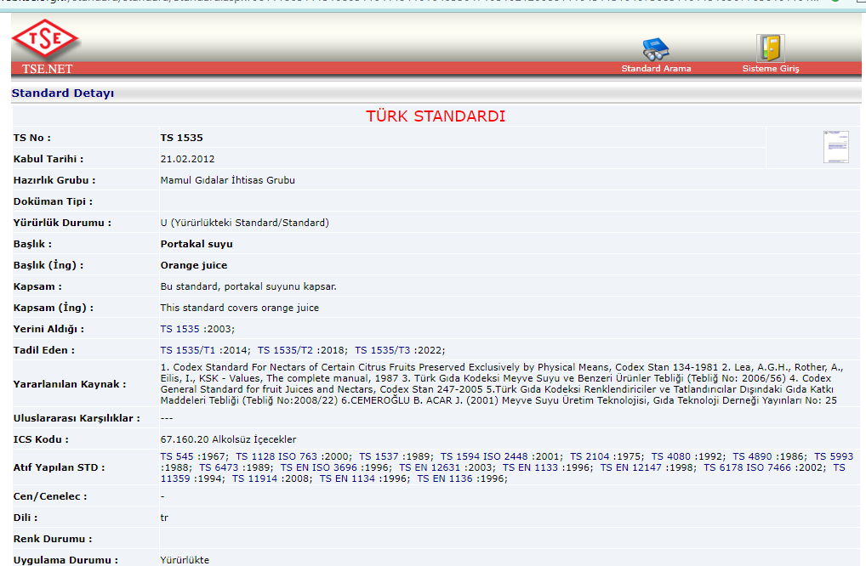
TSE 1535-Orange juice

Slide 21
