Slide 1
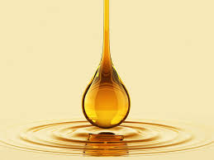
FE 376
FOOD QUALITY CONTROL
FATS AND OILS

Slide 2
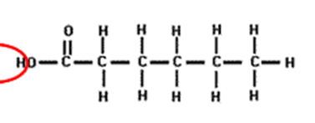
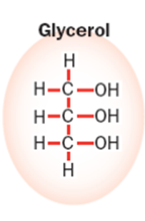



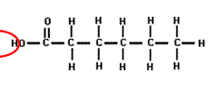

What is fat and oil?
A class of esters which results from the reaction of acids and alcohols
Fats and Oils – Triglycerides
+
H₂O
Fatty acids

Slide 3
Quality evaluation of fats and oils
The physical Quality parameters for plant oils:
Refractive index
Specific gravity
Color
Melting point
The chemical Quality parameters for plant oils:
Acid value
Peroxide value
Iodine value
Saponification value

Slide 4
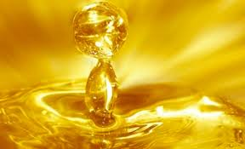
Experiment: Acid value

Slide 5
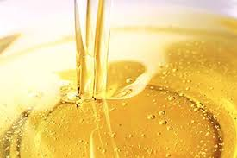
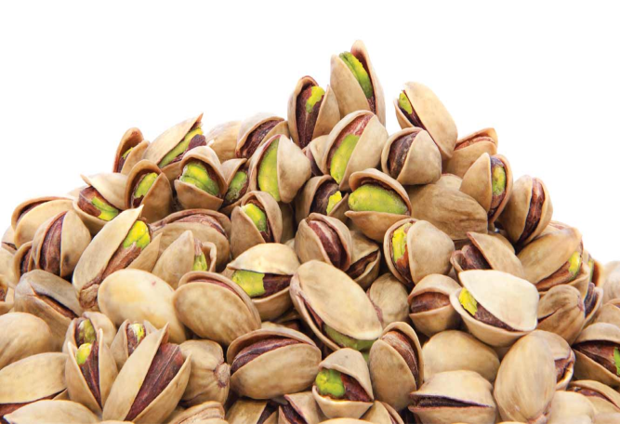
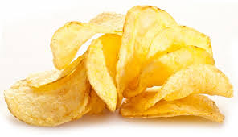
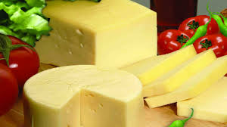
WHAT IS THE AIM OF THE EXPERIMENT?
To determine acid value in an oil (or in the oil of a food product)

Slide 6
PRINCIPLE?
ACID BASE TITRATION
Definition: the weight in milligrams of potassium hydroxide required to neutralize one gram of oil.
measurement of rancidity as free fatty acids are usually formed during decomposition of oil glycerides.

Slide 7

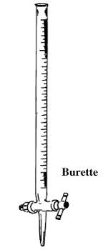

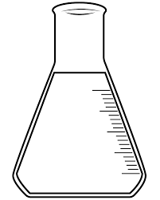
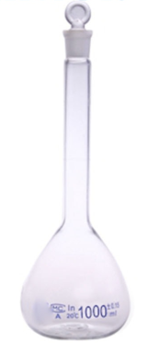
Chemicals and Materials
Apparatus
Analytical balance
Graduated cylinder
Burette
Erlenmeyer flask
Balloon joje

Slide 8
Reagents
0.1 or 0.5 N Potassium hydroxide solution (standardized) : The solution should be colorless or straw yellow
Phenolphthalein indicator solution: Dissolve one gram of phenolpthalein in 100 ml of ethyl alcohol (95%)
Ethyl alcohol- diethyl ether solution: 1:1 v/v mixture of ethanol and diethyl ether neutralized to phenolphthalein

Slide 9
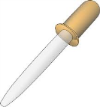


Procedure
1. Weigh 5 to 10 g of oil into a 250 ml Erlenmeyer flask.
2. Add 50 to 150 ml of a mixture of ethanol and diethyl ether (1:1 v/v) to dissolve the oil
3. Add about one ml of phenolphthalein indicator solution
4. Titrate, while shaking, with the 0.1 N KOH solution until the color of the indicator changes.
5. Steps above are repeated with a blank sample which does not contain any oil sample

Slide 10

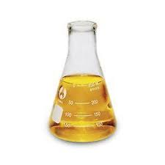
DATA TO RECORD
1
Weight of oil sample (g)
2
Volume of consumed potassium hydroxide solution (ml)
0.1 N KOH solution used for blank sample (Blank) V_{b}(ml)
0.1 N KOH solution used for sample (with oil sample) V_{s}(ml)
V_{s} - V_{b} = V_{t} (ml)

Slide 11

CALCULATION
Titre value (V_{t})
x Normality of KOH
x 56.1
Acid value (mg KOH/g oil) =
Weight of oil sample (g)

Slide 12
Experiment: Peroxide value

Slide 13
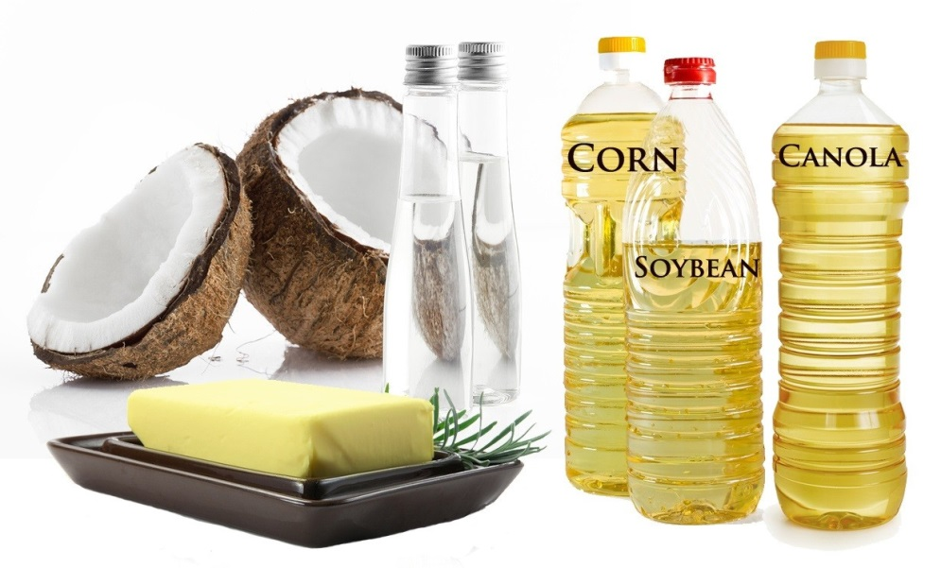
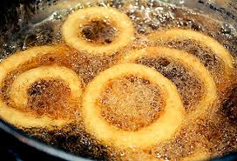
WHAT IS THE AIM OF THE EXPERIMENT?
To determine peroxide value in an oil (or in the oil of a food product)

Slide 14
PRINCIPLE?
Peroxide value
The most widely used indicator of fat oxidation
measurement of the lipid peroxides and hydroperoxides formed during the initial stage of the oxidation.
The peroxide value is determined by measuring the amount of iodine which is formed by the reaction of peroxides with iodide ion.

Slide 15
Chemicals and Materials
Apparatus
Analytical balance
Graduated cylinder
Burette
Erlenmeyer flask

Slide 16
Reagents
0,1 or 0,01 N sodium thiosulfate (standardized) : The solution has to be kept well sealed and in the dark
Starch indicator solution : Dissolve one gram of starch in 100 ml of distilled water
Saturated potassium iodade: Saturated solution of potassium iodide in distilled water is prepared. The solution must remain saturated
Chloroform
Acetic acid

Slide 17
Procedure
1. Weigh 5 g of oil into a 250 ml erlenmeyer flask.
2. Add 10 ml of chloroform and 15 ml of acetic acid
3. Add about one ml of saturated potassium iodade solution
4. Place the erlenmayer flask in a dark place for 5-10 min
5. Add 75 ml of distillated water and 1 ml of starch solution (black-blue color)
6. Titrate, while shaking, with the 0.1 N sodium thiosulfate until solution turns from the dark blue into colorless.
Steps above are repeated with a blank sample which does not contain any oil sample

Slide 18
DATA TO RECORD
1
Weight of oil sample (g)
2
Volume of consumed sodium thiosulfate solution (ml)
0.1 N Na₂S₂O₃ solution used for blank sample (Blank) V_{b}(ml)
0.1 N Na₂S₂O₃ solution used for sample (with oil sample) V_{s}(ml)
V_{s} - V_{b} = V_{t} (ml)

Slide 19
CALCULATION
Formula:
Titre value (V_{t})
x Normality of Na₂S₂O₃
x 1000
Peroxide value (meq/kg oil) =
Weight of oil sample (g)

Slide 20
Experimet: Saponification value

Slide 21
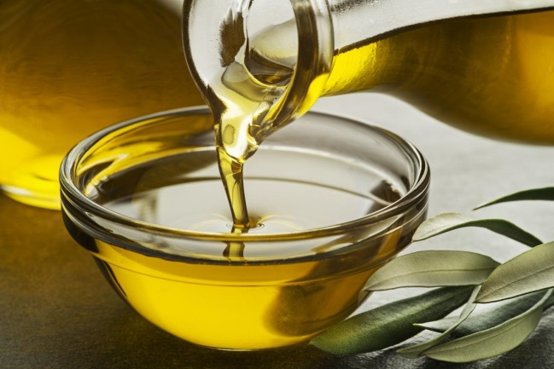
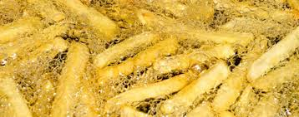
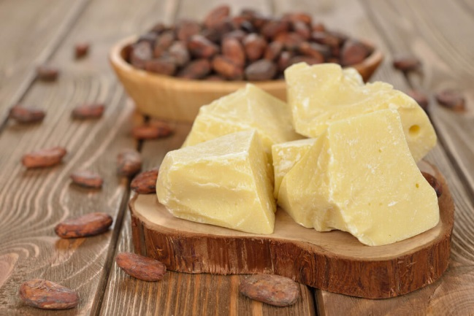
WHAT IS THE AIM OF THE EXPERIMENT?
To determine saponification value in an oil (or in the oil of a food product)

Slide 22
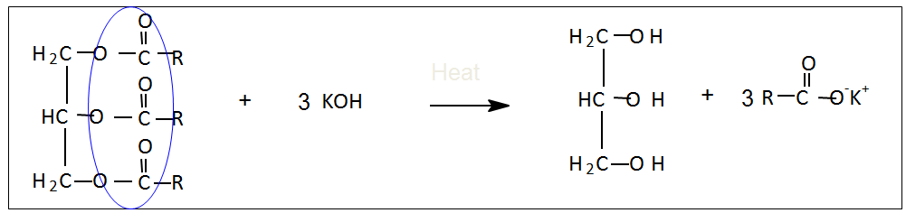
PRINCIPLE?
Saponification - Hydrolysis of ester (triglycerides) under alkaline condition.
Definition: weight of KOHin mg required to saponify 1 g of the oil or fat

Slide 23
Saponification Value
B
Tricaprylin (MW= 450)
A
Tristearin (MW= 890)
1Gram of Oils A and B

Slide 24
Saponification Value
B
A
; Large molecular triglycerides
; Small molecular triglycerides

Slide 25
Sample A has large molecular weight triglyceride (e.g. MW.890).
Sample B has small molecular weight triglyceride(e.g. MW.450).
In one gram of sample, number of triglyceride in B is about two times
more than number of triglyceride in A.
Less mg of KOH is needed to saponify sample A than sample B.
Therefore, saponification value of A is about half of that of sample B

Slide 26
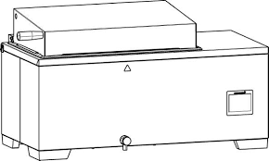
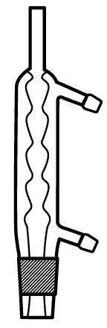
Chemicals and Materials
Apparatus
Analytical balance
Graduated cylinder
water bath
Erlenmeyer flask
condenser
Burette

Slide 27
Reagents
0.5 N alcoholic KOH solution : Dissolve 28.055 g KOH in 1 L of alcohol.
Phenolphthalein indicator (1%): Dissolve one gram of phenolpthalein in 100 ml of ethyl alcohol (95%)
0.5 N HCl: Dilute 43.01 mL of 36.5-38% HCl to 1 L with distilled water

Slide 28
Procedure
1. Weigh out accurately 2 g of oil ito a flask (A) and blank (B).
2. Add exactly 25 mL of 0.5 N alcoholic KOH solution.
3. Attach the reflux condenser and immerse the flask in boiling water for 60 min.
4. Swirl the flask frequently during the heating.
5. After refluxing, add 0.5 mL of 1% phenolphthalein and titrate with 0.5 N HCl.
6. Conduct blank determination.

Slide 29
DATA TO RECORD
1
Weight of oil sample (g)
2
Volume of consumed HCl (ml)
0.5 N HCl solution used for blank sample (Blank) B(ml)
0.5 N HCl solution used for sample (with oil sample) A(ml)

Slide 30
CALCULATION
Formula:
(B-A) x
28.05
Saponification value =
Weight of oil sample (g)

Slide 31
Turkish Food Codex and TSE standards
The Turkish Food Codex (TFC) is a regulatory framework that includes standards, rules and regulations for food production, processing, consumption and trade in Türkiye. This codex was created to ensure food safety, protect the health of consumers and regulate trade in the food sector.
TURKISH FOOD CODEX NOTIFICATION ON OILS CALLED BY PLANT NAMES (NOTIFICATION NO: 2012/29)
Purpose
The purpose of this Notification is to determine the characteristics of the oils called by plant names within the scope of this Notification in order to ensure their production, preparation, processing, preservation, storage, transportation and marketing in a hygienic manner and in accordance with the technique.
Ek-2 Diğer Kalite Kriterleri
Uçucu Madde (l05° C) | En çok % 0,2 (m/m)
Çözünmeyen Safsızlıklar | En çok % 0,05 (m/m)
Sabun Miktarı | Rafine yağlarda en çok % 0,005 (m/m) Soğuk preslenmiş ve natürel yağlarda bulunmamalı
Asit Sayısı | Rafine yağlarda en çok 0,6 mg KOH /g yağ Soğuk preslenmiş ve natürel yağlarda en çok 4,0 mg KOH/g yağ Natürel palm yağında en çok 10,0 mg KOH/g yağ
Peroksit Sayısı | Rafine yağlarda en çok l0 miliekivalen aktif oksijen / kg yağ Soğuk preslenmiş ve natürel yağlarda en çok l5 miliekivalen aktif oksijen / kg yağ

Slide 32
Turkish Food Codex and TSE standards
EK - 3 Bitkisel Yağların Fiziksel ve Kimyasal Özellikleri
Bitkisel Yağlar | Bağıl Yoğunluk (Xº C/su 20º C) | Yoğunluk (g/mL) | Kırılma İndisi | Sabunlaşma Sayısı (mg KOH/g yağ) | İyot Değeri (Wijs) | Sabunlaşmayan Madde (g/kg)
Aspir Yağı | 0,922-0,927 X=20º C |  |  | 186-198 | 136-148 | ≤ 15
Aspir Yağı (yüksek oleik asitli) | 0,913-0,919 X=20º C 0,910-0,916 X=25º C | 0,912-0,914 20º C’de | 1,460-1,464 40º C’de 1,466-1,470 25º C’de | 186-194 | 80-100 | ≤ 10
Ayçiçek Yağı | 0,914-0,923 X=20º C |  | 1,461-1,471 40º C’de | 188-194 | 94-141 | ≤ 15
Ayçiçek Yağı (yüksek oleik asitli) | 0,909-0,915 X=25º C |  | 1,467-1,471 25º C’de | 182-194 | 78-90 | ≤ 15
Babassu Yağı | 0,914-0,917 X=25º C |  | 1,448-1,451 40º C’de | 245-256 | 10-18 | ≤ 12
Fındık Yağı | 0.898-0.915 X=20º C |  | 1,468-1,473 20º C’de | 188-198 | 81-95 | ≤ 15
Hindistancevizi Yağı | 0,908-0,921 X=40º C |  | 1,448-1,450 40º C’de | 248-265 | 6,3-10,6 | ≤ 15
Kanola/Düşük Erusik Asitli Kolza Yağı | 0,914-0,920 X=20º C |  | 1,465-1,467 40º C’de | 182-193 | 105-126 | ≤ 20
Mısır Yağı | 0,917-0,925 X=20º C |  | 1,465-1,468 40º C’de | 187-195 | 103-135 | ≤ 28
Palm Yağı | 0,891-0,899 X=50º C | 0,889-0,895 50º C’de | 1,454-1,456 50º C’de | 190-209 | 50,0-55,0 | ≤ 12
Palm Çekirdeği Yağı | 0,899-0,914 X=40º C |  | 1,448-1,452 40º C’de | 230-254 | 14,1-21,0 | ≤ 10
Palm Çekirdeği Olein | 0,906-0,909 X=40º C | 0,904-0,907 40º C’de | 1,451-1,453 40º C’de | 231-244 | 20-28 | < 15
Palm Çekirdeği Stearin | 0,902-0,908 X=40º C | 0,904-0,906 40º C’de | 1,449-1,451 40º C’de | 244-255 | 4-8,5 | <15
Palm Olein | 0,899-0,920 X=40º C | 0,896-0,898 40º C’de | 1,458-1,460 40º C’de | 194-202 | ≥ 56 | ≤ 13
Palm Stearin | 0,881-0,891 X=60º C | 0,881-0,885 60º C’de | 1,447-1,452 60º C’de | 193-205 | ≤ 48 | ≤ 9
Palm Süperolein | 0,900-0,925 X=40º C | 0,886-0,900 40º C’de | 1,459-1,460 40º C’de | 180-205 | ≥ 60 | <13
Pamuk Yağı | 0,918-0,926 X=20º C |  | 1,458-1,466 40º C’de | 189-198 | 100-123 | ≤ 15
Soya Yağı | 0,919-0,925 X=20º C |  | 1,466-1,470 40º C’de | 189-195 | 124-139 | ≤ 15
Susam Yağı | 0,915-0,924 X=20º C |  | 1,465-1,469 40º C’de | 186-195 | 104-120 | ≤ 20
Üzüm Çekirdeği Yağı | 0,920-0,926 X=20º C |  | 1,467-1,477 40º C’de | 188-194 | 128-150 | ≤ 20
Yer Fıstığı Yağı | 0,912-0,920 X=20º C |  | 1,460-1,465 40º C’de | 187-196 | 86-107 | ≤ 10

Slide 33
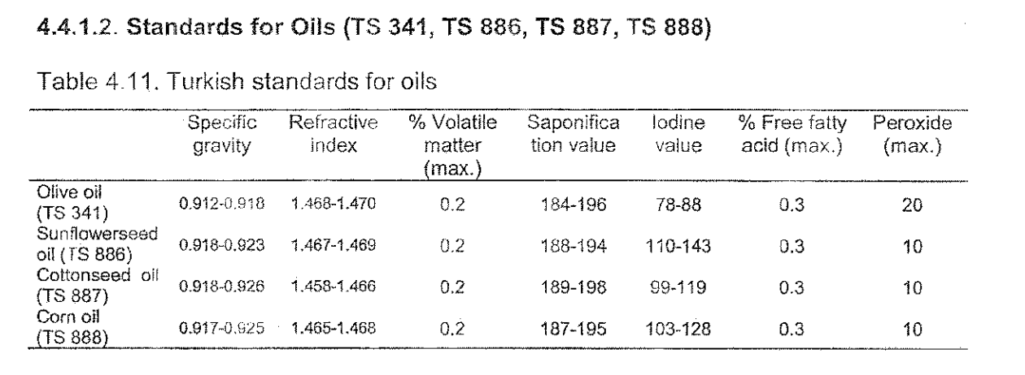
Turkish Food Codex and TSE standards

