Slide 1
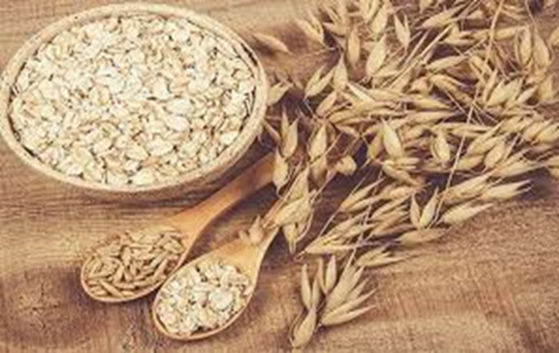
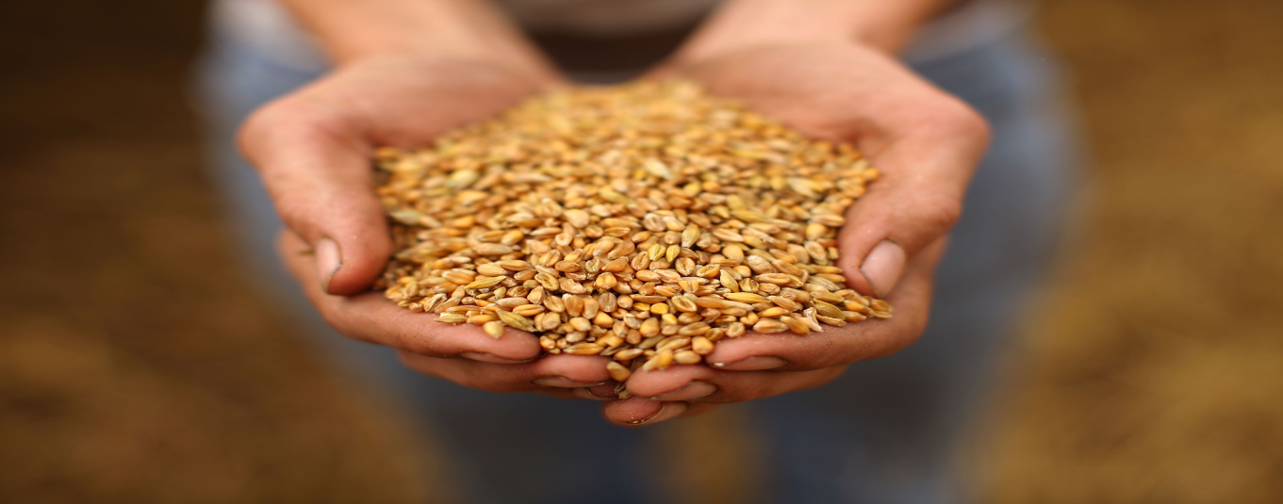
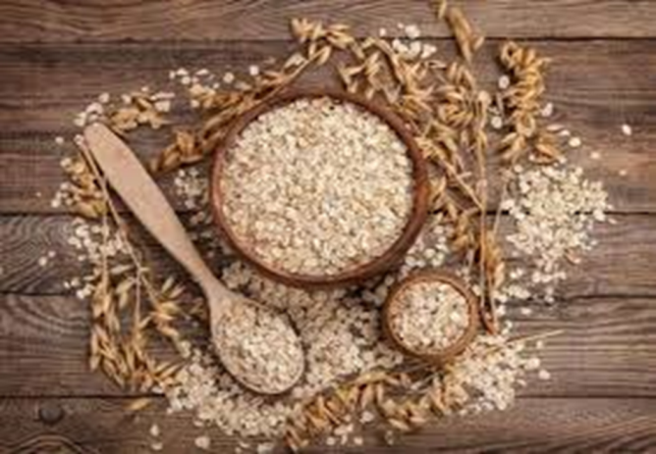
FE 376
QUALITY CONTROL LABARATORY
EXPERIMENT 3
CEREALS

Slide 2
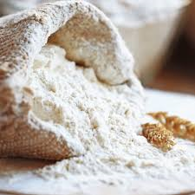
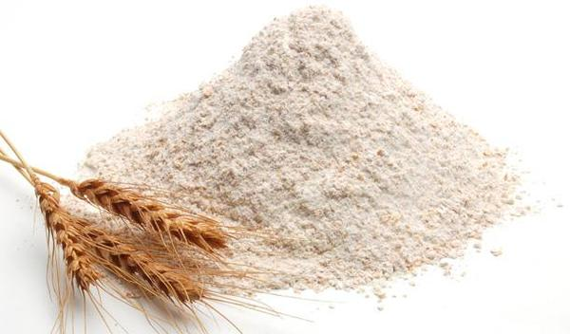
FLOUR
Flour is a finely ground powder prepared from grain or other starchy plant foods and used in baking.
Although flour can be made from a wide variety of plants, the vast majority is made from wheat.
Dough made from wheat flour is particularly well suited to baking bread because it contains a large amount of gluten, a substance composed of strong, elastic proteins. The gluten forms a network throughout the dough, trapping the gases which are formed by yeast, baking powder, or other leavening agents. This causes the dough to rise, resulting in light, soft bread.

Slide 3
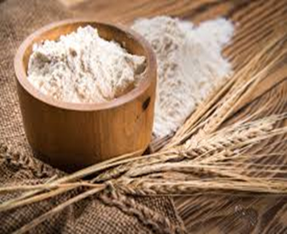
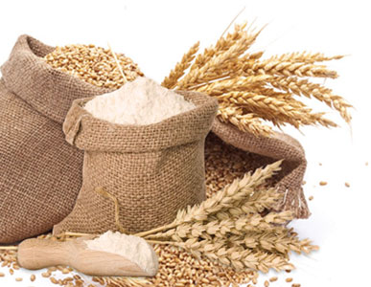
Raw Materials
Wheat
Although most flour is made from wheat, it can also be made from other starchy plant foods.
These include barley, corn, oats, potatoes, soybeans, rice, and rye.
In general, wheat is either hard (containing 11-18% protein) or soft (containing 8-11% protein).
For bread making , hard wheat flour is used. The high percentage of protein in hard wheat means the dough will have more gluten, allowing it to rise more than soft wheat flour.
For cakes and pastry, soft wheat flour is used.
All-purpose flour is made from a blend of soft and hard wheat.
Durum wheat is a special variety of hard wheat used for semolina and pasta products.

Slide 4
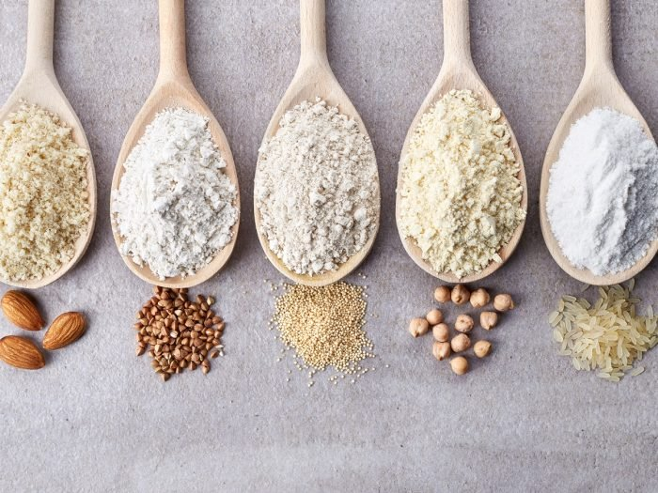
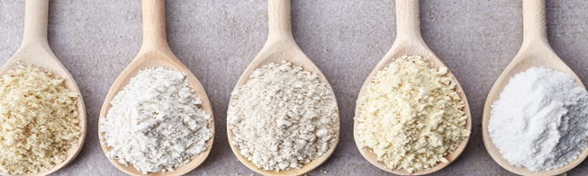
Categories of Wheat
Wheat can be classified by three major categories: growing season, bran color and kernel hardness.
First category→ Growing Season-Winter vs. Spring
Winter wheat (10 and 12% protein) : planted in the fall, and harvested during late spring to early summer.
Spring wheat (12 and 14% protein) : planted in the spring and harvested during late summer.

Slide 5
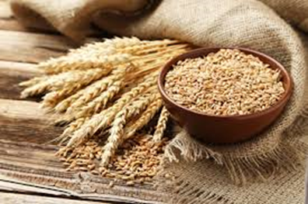
Second category→Bran Color-Red vs. White
The bran is the outer protective coating of the wheat kernel. Wheat can be classified as either red or white.
Third category→Kernel Hardness-Hard vs. Soft
Hard wheat flours have a medium to high protein content and stronger gluten-forming proteins .These flours are used in yeast-raised goods such as breads, pizza crusts.
Soft wheat flours are low in protein and therefore low in gluten strength. Soft wheat flours are used for chemically leavened goods, such as cakes, cookies and biscuits.

Slide 6
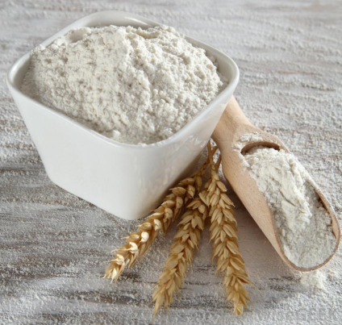
Other Raw Materials
Flour usually contains a small amount of additives:
Bleaching agents such as benzoyl peroxide are added to make the flour more white.
Oxidizing agents (also known as improvers) such as potassium bromate, chlorine dioxide, and azodicarbonamide are added to enhance the baking quality of the flour.
Self-rising flour contains salt and a leavening agent such as calcium phosphate. It is used to make baked goods without the need to add yeast or baking powder.
Most states require flour to contain added vitamins and minerals to replace those lost during milling. The most important of these are iron and the B vitamins, especially thiamin, riboflavin, and niacin.

Slide 7
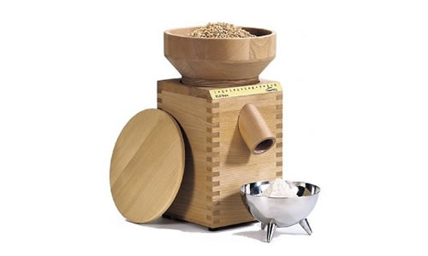
The manufacturing process of flour
Grading the wheat (Samples of wheat are taken for physical and chemical analysis. The wheat is graded based on several factors, the most important of which is the protein content)
Purifying the wheat (aspirator, disk separator, magnetic separators used to clean wheat)
Preparing the wheat for grinding (tempering or conditioning: addition of water to a certain level(14-16% water level))
Grinding the wheat (1st break,2nd break)
Processing the flour
(bleaching agents, oxidizing agents, vitamins, minerals added)

Slide 8
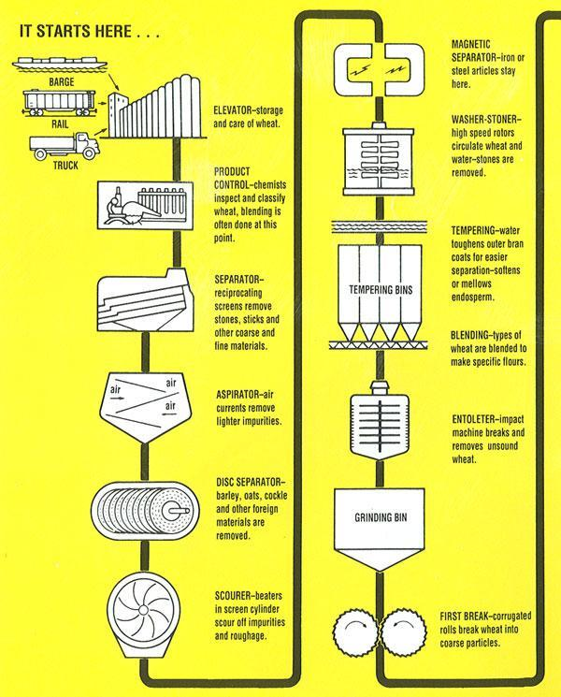
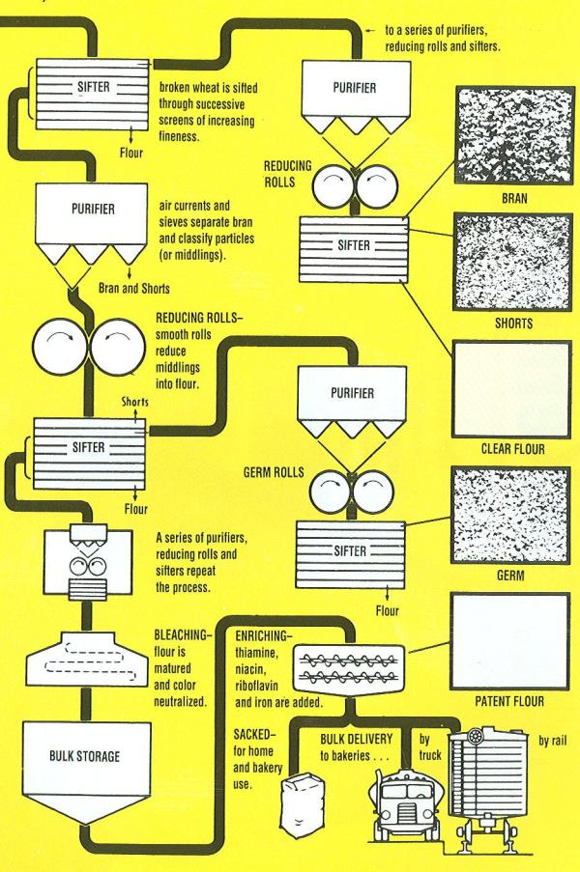
Simlified milling process diagram

Slide 9
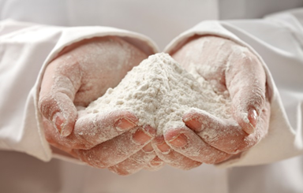

Quality Control
The quality control of flour begins when the wheat is received at the flour mill. The wheat is tested for its protein content, ash content (is the portion which remains after burning, and consists of various minerals).
During each step of the purification process, several samples are taken to ensure that no foreign matter ends up in the flour.
All the equipment used is thoroughly cleaned and sterilized by hot steam and ultraviolet light.
The equipment is also treated with antibacterial agents and antifungal agents to kill any microscopic organisms which might contaminate final product. Hot water is used to remove any remaining traces of these chemical agents.

Slide 10
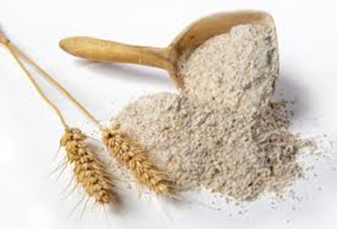
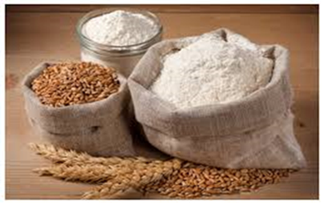
The final product of milling is tested for baking in test kitchens to ensure that it is suitable for the uses for which it is intended.
The vitamin and mineral content is measured in order to comply with government standards.
The exact amount of additives present is measured to ensure accurate labeling.

Slide 11
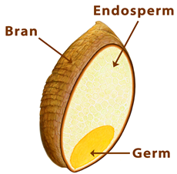
Byproducts/Waste
A kernel of wheat consists of three parts, two of which can be considered byproducts of the milling process.
The bran is the outer covering of the kernel and is high in fiber.
The germ is the innermost portion of the kernel and is high in fat.
The endosperm makes up the bulk
of the kernel and is high in proteins
and carbohydrates.

Slide 12

Whole wheat flour uses all parts of the
kernel, but white flour uses only the
endosperm.
Bran removed during milling is often added to breakfast cereals and baked goods as a source of fiber. It is also widely used in animal feeds.
Wheat germ removed during milling is often used as a food supplement or as a source of edible vegetable oil. Like bran, it is also used in animal feeds.

Slide 13

Experimental Analyses of Flour
Ash determination
Crude gluten determination
Moisture content determination
Acidity of flour by water extract method
Soy flour detection

Slide 14
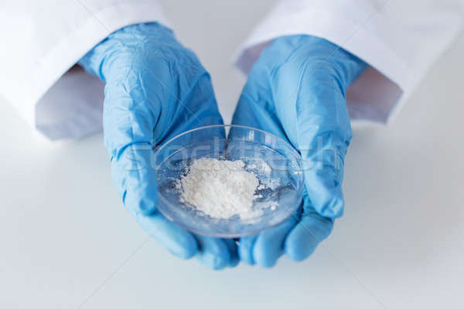
Flour Analyses
Ash, an index of flour extraction:
Ash is a measure of the mineral content of flour. The mineral content of the wheat kernel is concentrated in the bran layer.
The objective of the miller is to separate the endosperm from the bran as completely as possible.
Ash is a measure of the degree of endosperm separation from the bran during milling. The closer the miller gets to the bran layer, the higher the ash level becomes. Higher extraction will result in higher ash levels.

Slide 15
Determination of ash content
2 2 g of flour sample is weighed into dry porcelain crucible
Initial burning of crucible is done on Bunsen burner
Crucible is transferred into ash oven and kept at 800 ºC for two hours (time required to come constant weight)
Porcelain crucible is transferred to desiccator
After cooling, it is weighed and total ash content is calculated as a percentage

Slide 16
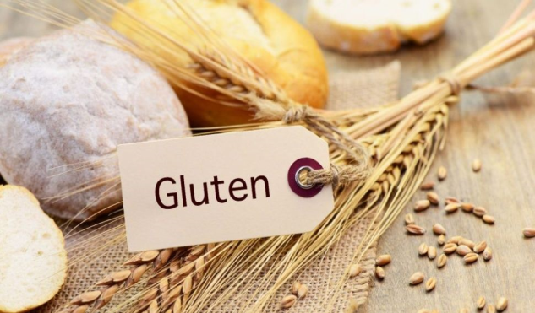
Protein and gluten
the framework of bread
Wheat flour is unique because it in the only cereal grain that possesses gluten-forming proteins.
When flour combined with water under mixing stress, the proteins in the flour will form what is called gluten.
This gluten structure is responsible for providing extensibility, elasticity and gas-retaining properties to yeast-leavened baked goods.
The quantity of the gluten is proportional to the amount of protein in the flour. The amount of gluten will increase as the protein content increases.

Slide 17
Determination of Crude Gluten in Flour (Hand washing method)
25 g of flour is weighed and put into a mortar, petri dishes etc.
25 ml of distilled water is gradually added onto the flour.
The mixture is blended via spatula and then kneaded to get dough.
The dough is allowed to stand for one hour.
The dough is washed gently under tap water for 10-15 min to remove soluble matters and starch.

Slide 18
Determination of Crude Gluten in Flour (Hand washing method)
One or two drops of KI are poured onto resultant dough during washing under top water to test the presence of starch within the dough.
This process will be repeated until disappearance of the blue color during washing with addition of KI.
Finally an elastic mass (gluten) is obtained. This elastic material is compressed as dry as possible, it is rolled into a ball and weighed and wet gluten is calculated using formula.
The color, toughness and elasticity of the dough is also recorded.
Then, the elastic mass is dried at 100 °C until a constant weight is obtained, and it is weighed, and dry gluten is calculated using formula.

Slide 19
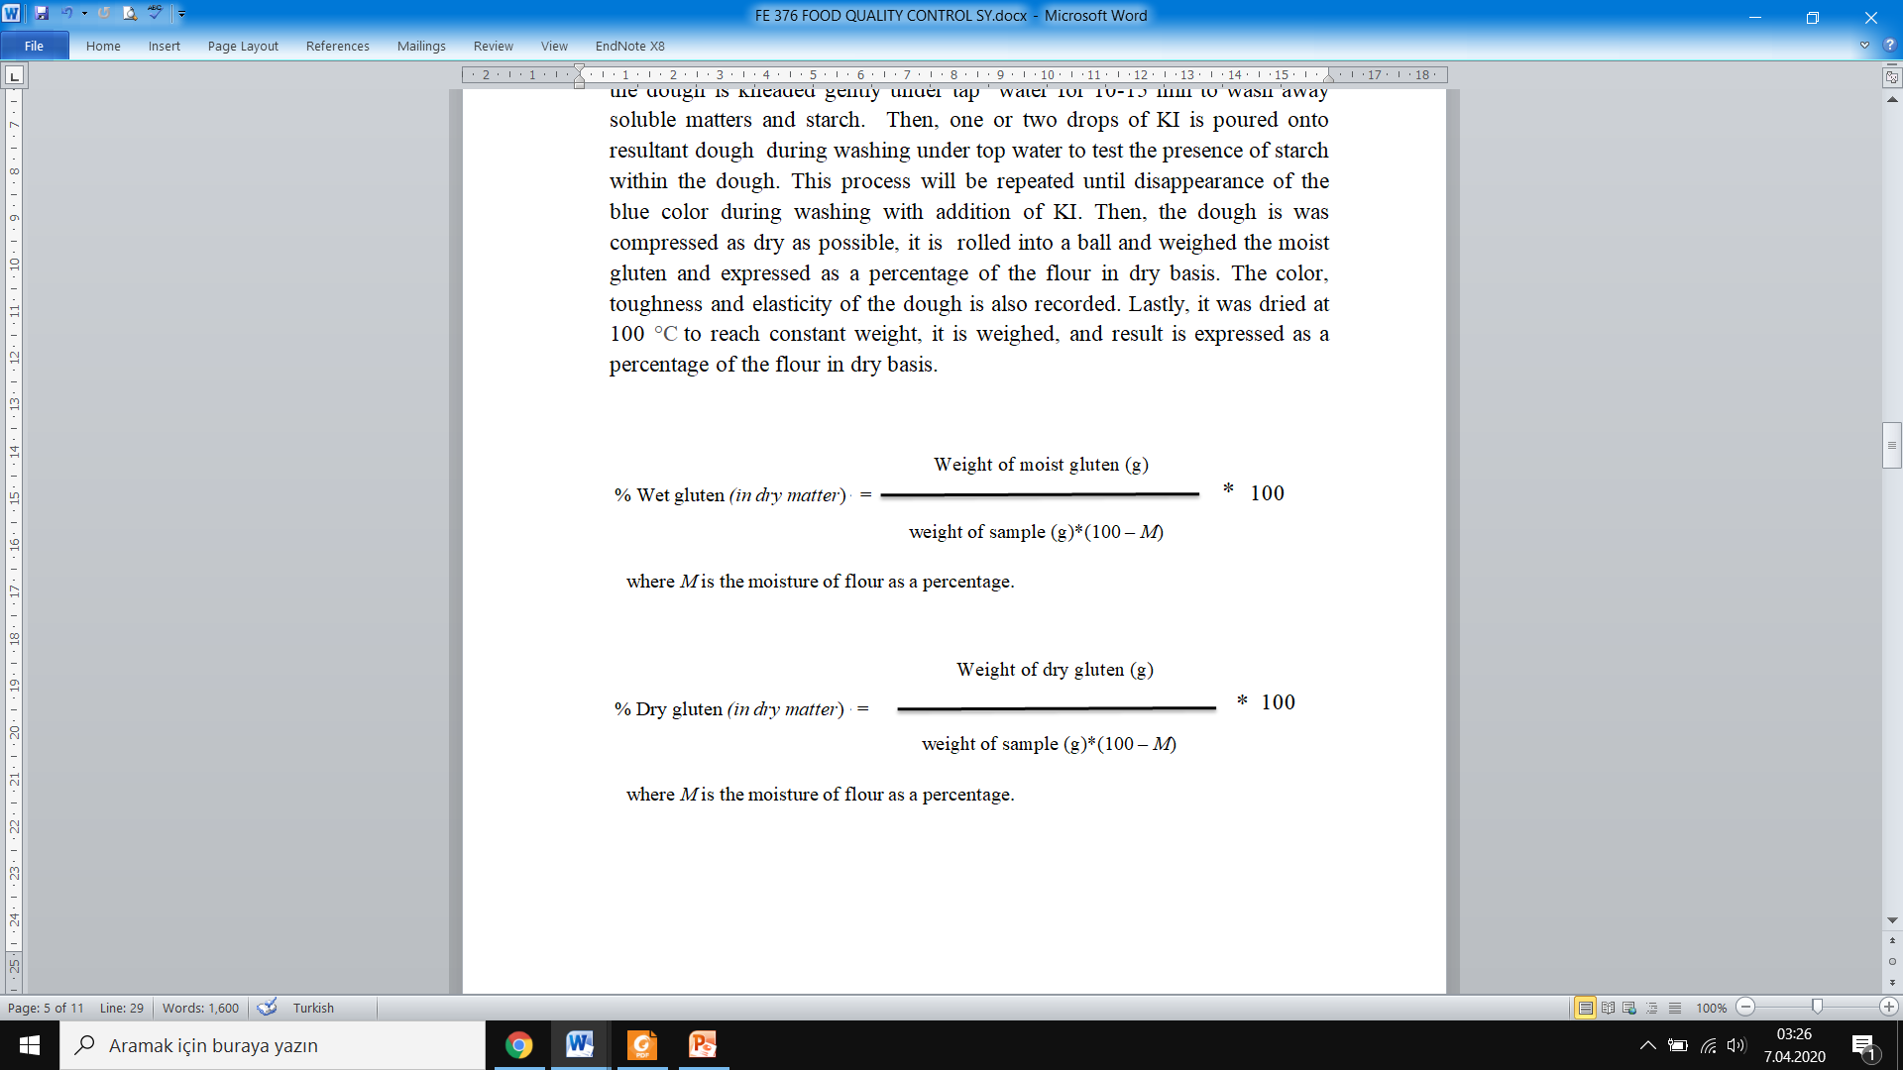
Calculations

Slide 20

Moisture content (as a percentage):
Should be in the range of 12-15%,
Wheat or flour with high moisture content (greater than 14.5 percent) attracts mold, bacteria, and insects, all of which cause deterioration during storage. Wheat or flour with low moisture content is more stable during storage.
High moisture increases lipid hydrolysis
Moisture content can be an indicator of profitability in milling. Flour is sold by weight, grain is bought by weight, and water is added to reach the standard moisture level before milling. The more water added, the more weight and profitability gained from the wheat.

Slide 21
Determination of moisture content
2 g of flour is weighed into a petri dish, which has already came to constant weight prior to the analyses.
Sample is spreaded as thinly as possible over the base of the dish.
Sample is put the in a oven at 105 ºC and dried for two hours.
After two hours, it is transferred into desiccator, it is cooled and weighed.
Then, sample is was returned to the oven and redried for further 30 minutes.
Again it is transferred to the desiccator, then cooled and reweighed. This process is continued until reaching a constant weight.
Finally, moisture content of sample is calculated as percentage.

Slide 22

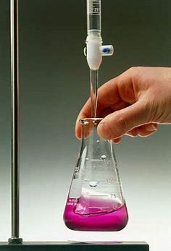
Acidity:
Shows presence of bleaching agents.
As acidity increases, strength of gluten decreases
In aged flour, acidity increases due to the formation of FFA as a result of the lipid hydrolysis

Slide 23
Acidity of Wheat Flour(Water Extract Method)
Firstly 18 gr of flour is mixed with 200 ml of CO2-free water in a conical flask.
The mouth of the flask is covered and it is placed in a water bath at 40 ºC for one hour.
After one hour, the sample is filtered by using filter paper.
Then, 100 ml of filtrate is titrated with 0.05 M standard NaOH solution in the presence of phenolphthalein as an indicator.
Finally the acidity of the water extract is calculated in terms of KH₂PO₄ or lactic acid using following formulas:

Slide 24
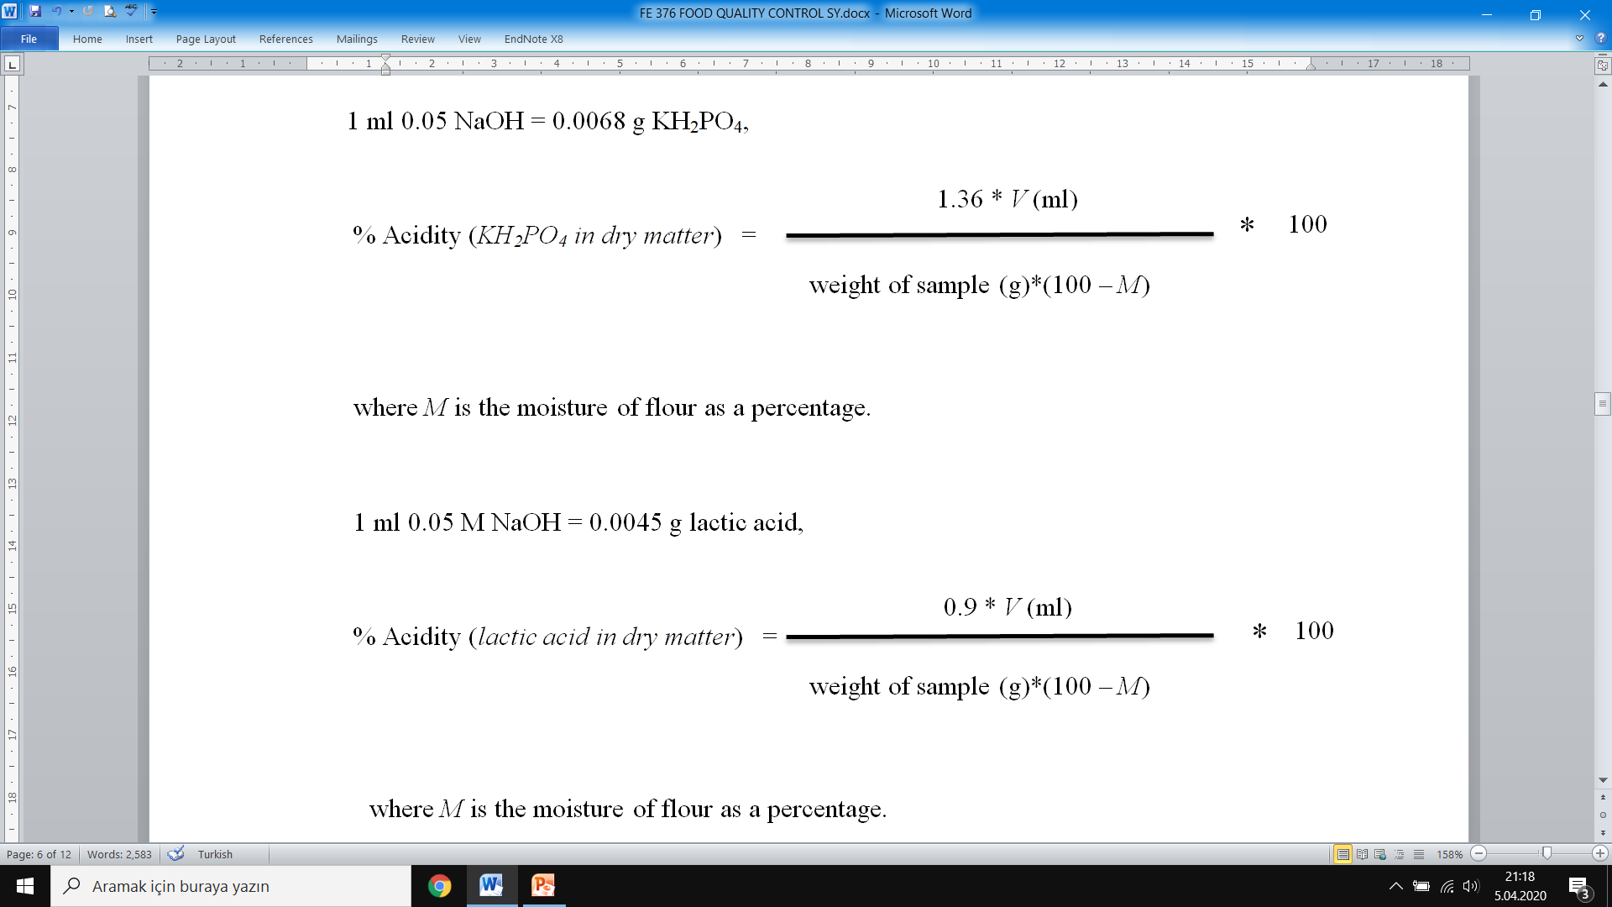
Calculations

Slide 25
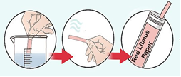
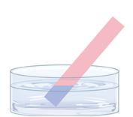
Presence of soy flour:
Soy flour contains urease enzyme which converts urea to ammonia, and a basic medium occurs as a result of ammonia formation. So litmus paper changes its color from RED to BLUE, and shows the presence of soy flour. Wheat flour does not contain urease enzyme.
This test is applied only for flour, the test is not suitable for cooked products because of the evaporation of ammonia during cooking.

Slide 26
Detection of soy flour presence in wheat flour
0.5 g flour sample is mixed with 5 ml of 2 % urea solution in a test tube.
Then, a strip of red litmus paper is put into the test tube.
Mouth of the test tube is covered to prevent evaporation of water, and the closed test tube is heated in a water bath at 40 ºC for 30 min.
Turning of litmus paper from RED to BLUE, which results from the evolution of NH₃ liberated from urea by urease present in the soy flour (naturally urease do not present in the wheat flour), will be the indicator of the presence of soy flour..

