Slide 1


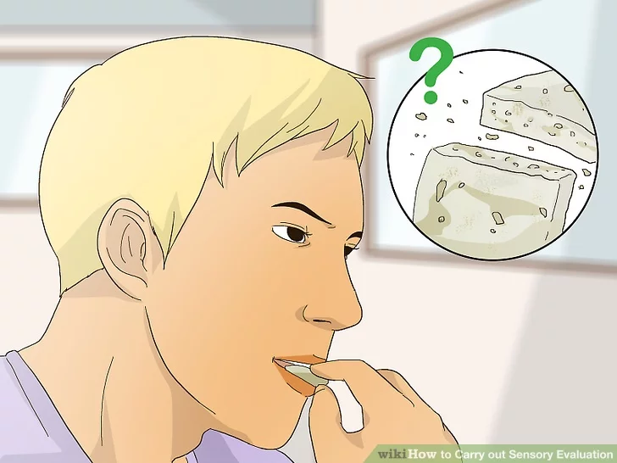
SENSORY EVALUATION OF FOOD

Slide 2
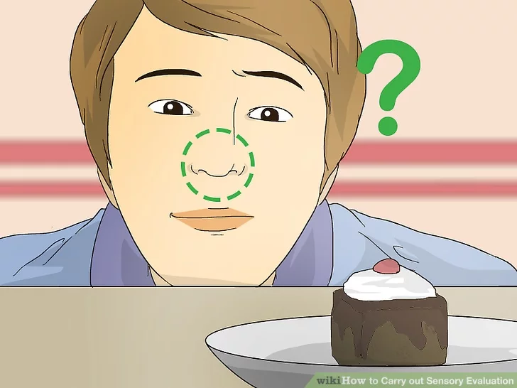
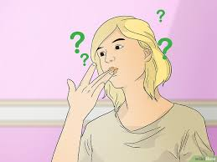
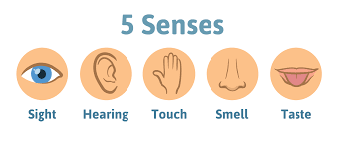
What is sensory evaluation?
‘…used to evoke, measure, analyse and interpret those responses to products that are perceived by the senses of sight, smell, touch, taste and hearing.’
A scientific discipline that analyses and measures human responses to the composition of food or drink.

Slide 3

Objectives of Food Evaluation
To develop new products.
To observe consumer reactions.
To identify changes in menus to make food acceptable.
To collect information of food acceptability.
To assist in determining the shelf life of a product.
To understand how the product competes in the market.
To determine whether or not consumers can detect differences between products due to recipe modification.

Slide 4
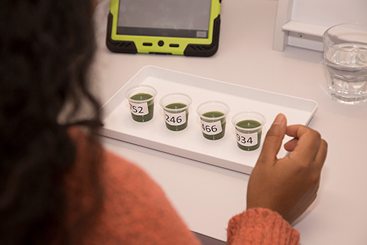
Principles of Good Practice
Facilities should be well designed
- Lighting should be controlled
- There should be good ventilation
Samples should be prepared properly
- Temperature should be controlled and the same for all samples
- Volume served should be equal for all samples
-Samples should be served at equivalent shelf-life or time since cooking/preparation
Experimental Design Considerations
- Samples should be labelled with random 3-digit codes to avoid bias
- Samples should be served in random or counterbalanced order

Slide 5
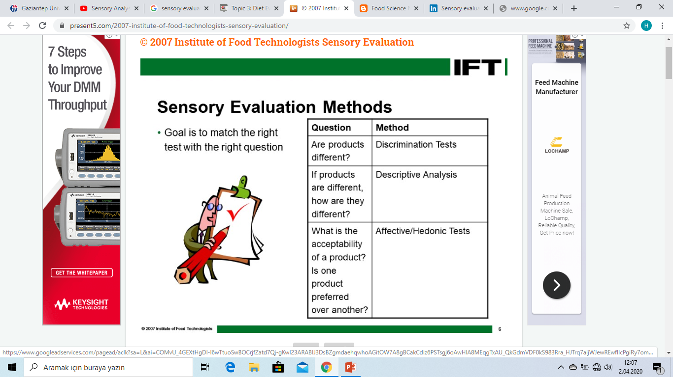
Sensory Evaluation Methods
Goal is to match the right test with the right question
QUESTION | METHOD
Are products different? | Discrimination Tests
If products are different, how are they different? | Descriptive Analysis
What is the acceptability of a product? Is one product preferred over another? | Affective/Hedonic Tests

Slide 6
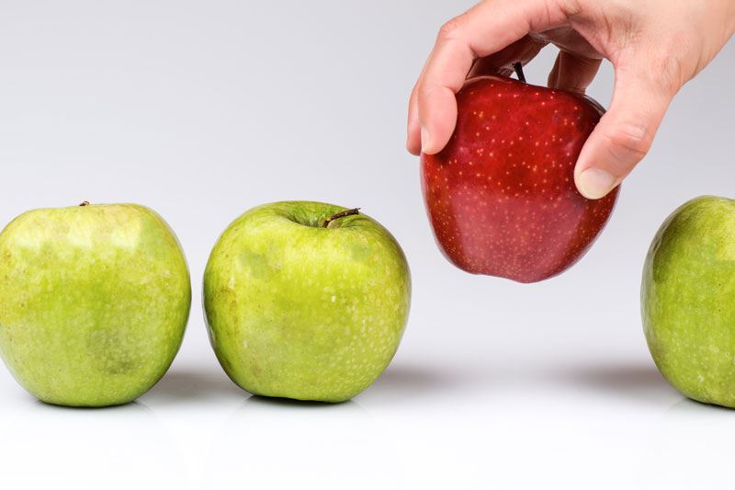
Discrimination Tests
Characteristics:
- Qualitative
- Used to determine if panelists could tell the difference between samples
3 subgroups:
- Triangle Test
- Duo-Trio Test
- Paired Comparison Test

Slide 7
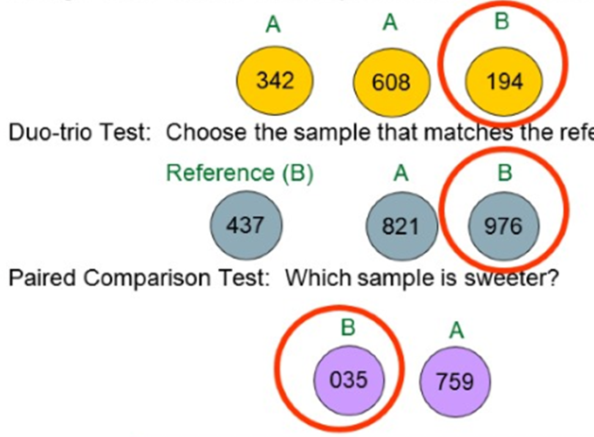
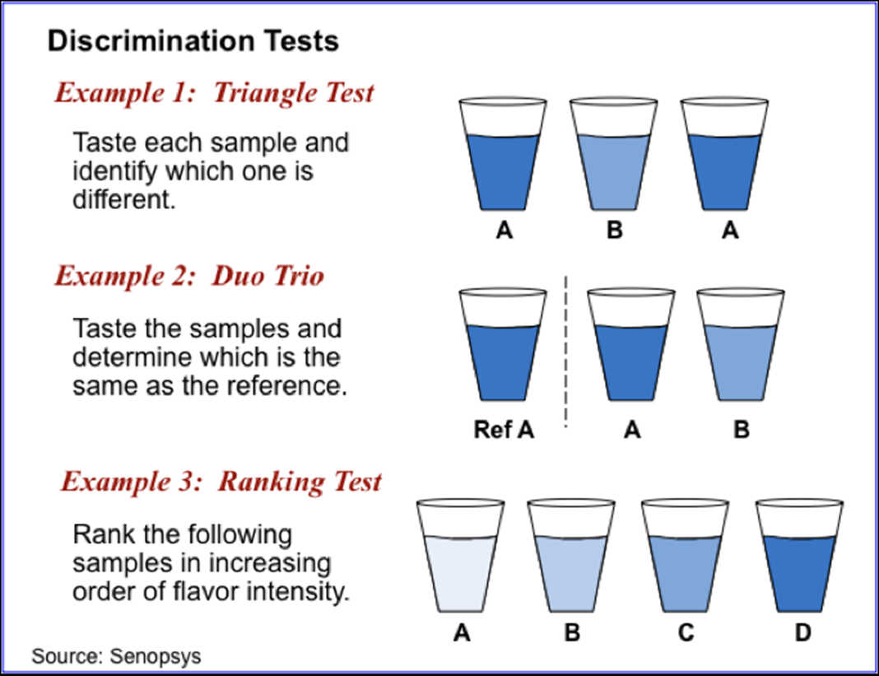
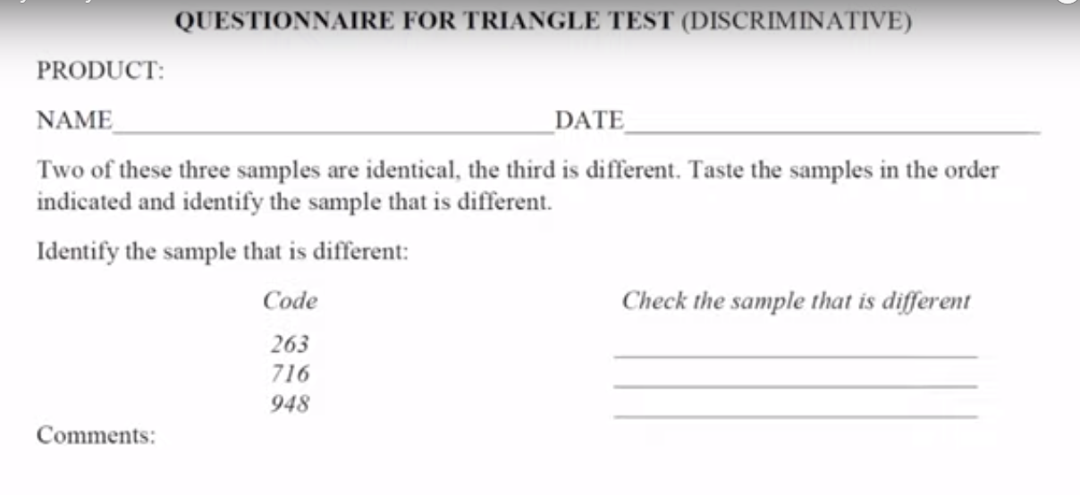
Discrimination Tests
Triangle Test: Choose the sample that is most different?
342
608
194

Slide 8
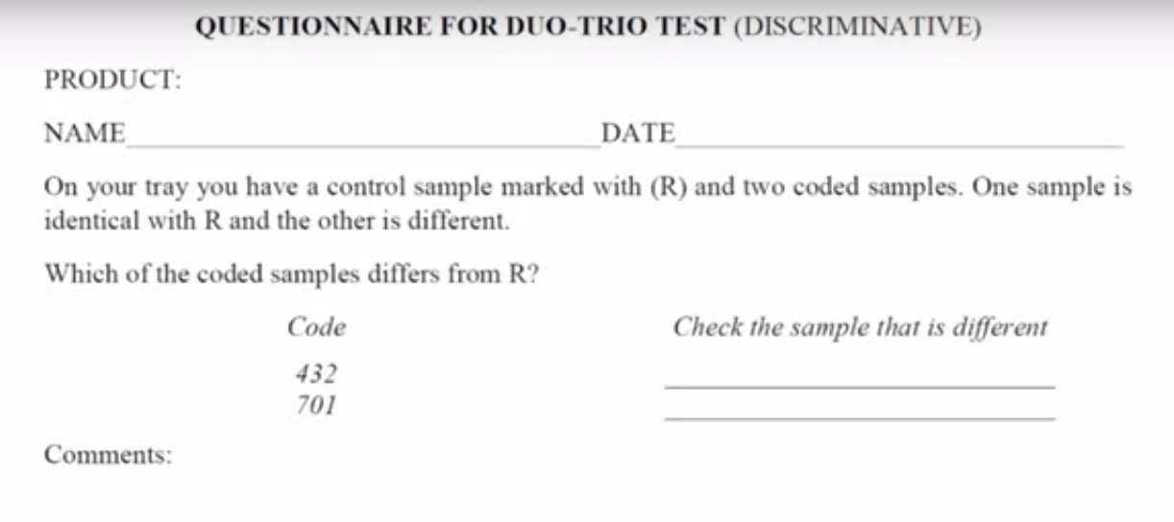
Discrimination Tests
Duo-trio Test: Choose the sample that is different from the reference.
B
A
821
976

Slide 9
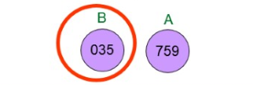
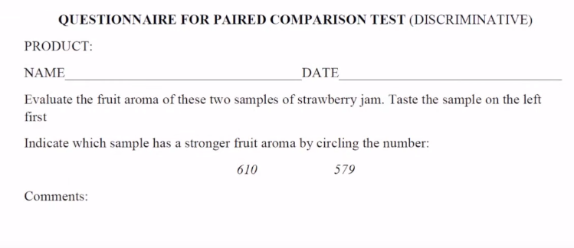
Discrimination Tests
Paired Comparison Test: Which sample has a stronger fruit aroma?
610
579

Slide 10
Descriptive Analysis
Characteristics:
- Qualitative
-Used to determine how samples are different from each other based on a specific criteria such as aroma, flavor and oral texture.
Descriptive tests are subjective tests. They give information about people’s likes and dislikes of a product.
Reference scales are used to ensure consistency between panelists across repeated evaluations.
Category Scaling
Line Scaling
Ratio Scaling

Slide 11
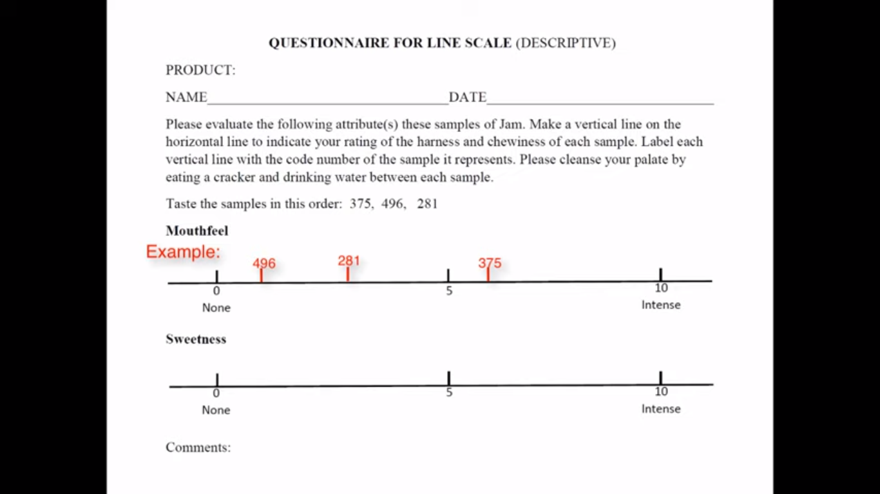
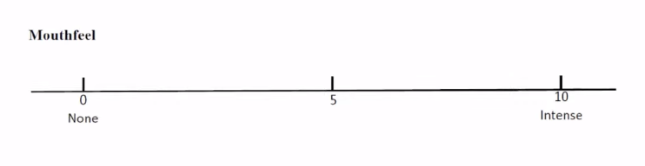
Descriptive Analysis
Line Scaling:

Slide 12
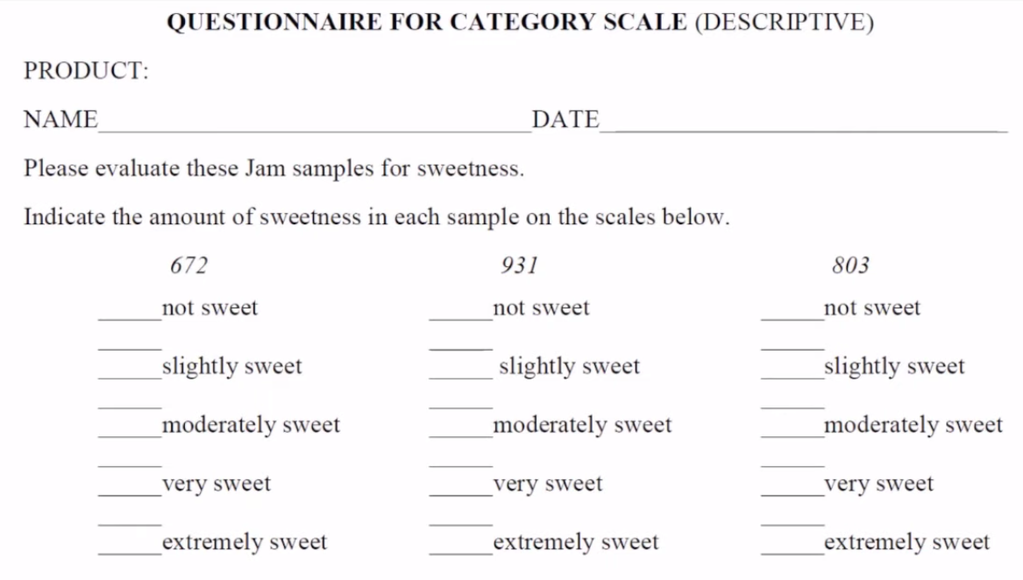
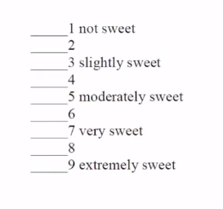
Descriptive Analysis
Category Scaling

Slide 13
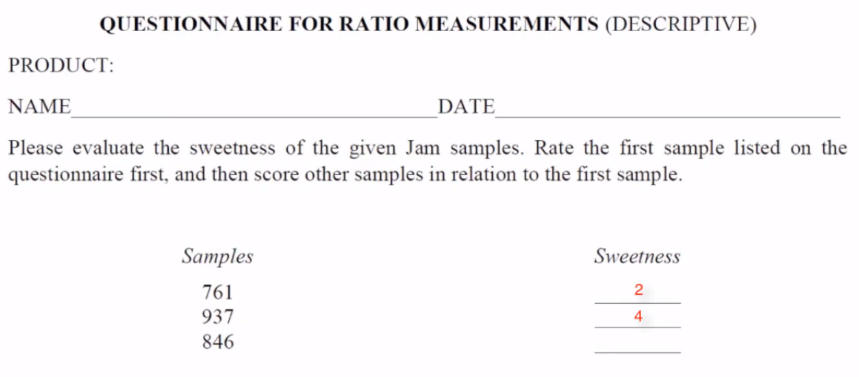
Descriptive Analysis
Ratio Scaling:

Slide 14
Affective/Hedonic Tests
Used to measure consumers’ preference, liking, or acceptance of a product.
Affective sensory analysis covered in this presentation:
Paired Comparison PreferenceTest
Hedonic Scaling
Ranking Test

Slide 15
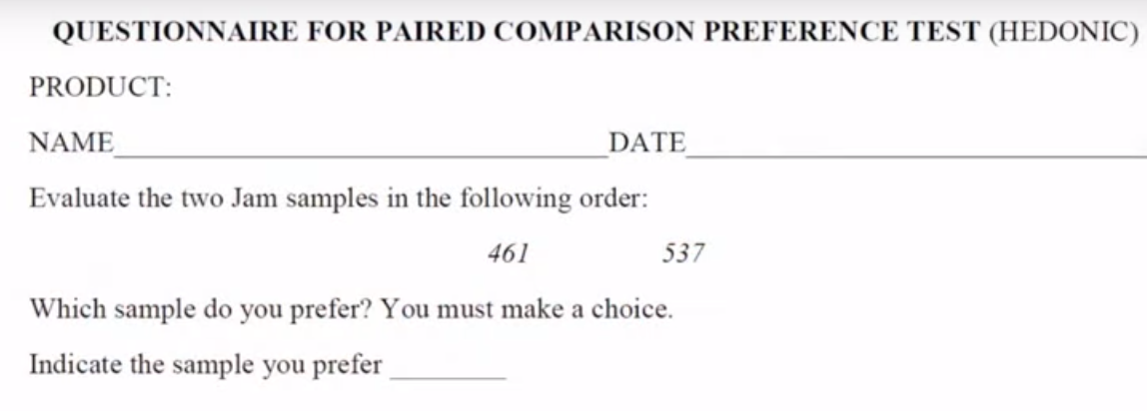
Affective/Hedonic Tests
Paired Comparison Preference Test

Slide 16
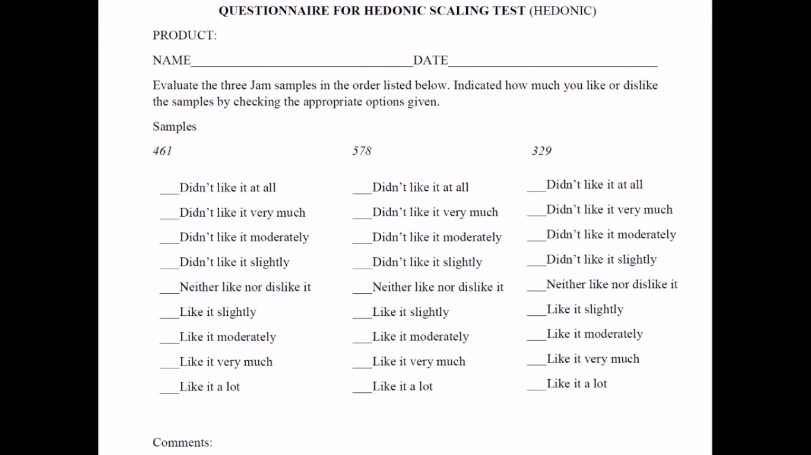
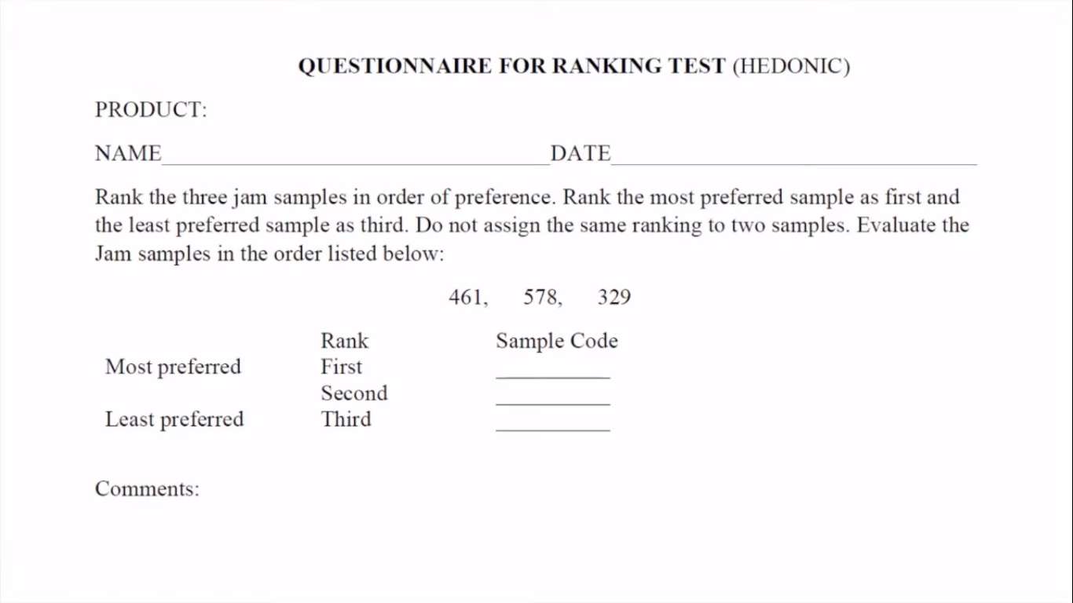
Affective/Hedonic Tests
Hedonic Scaling
Ranking Test

Slide 17
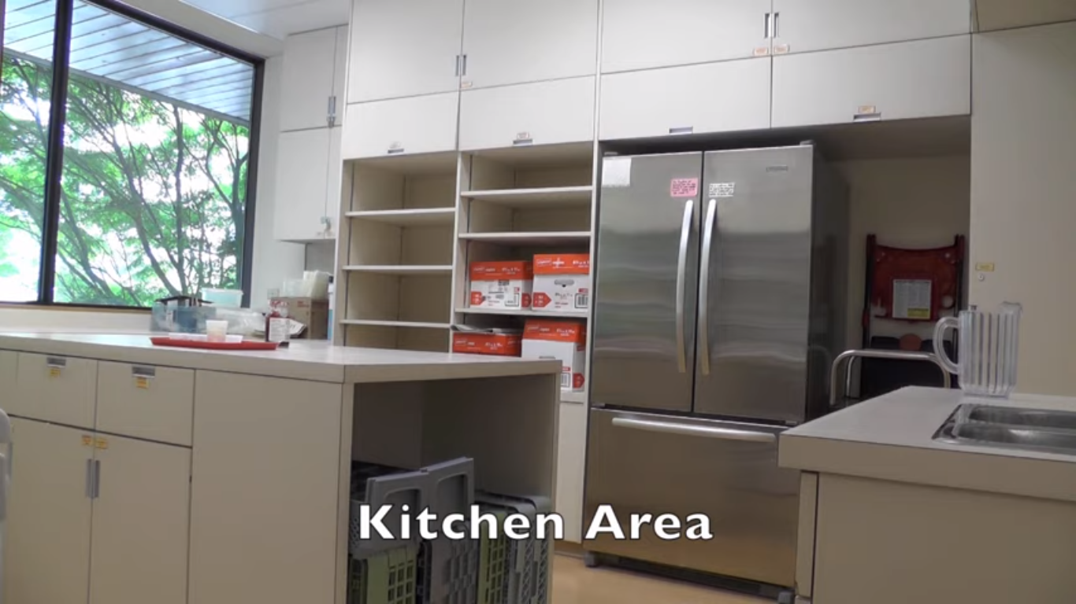

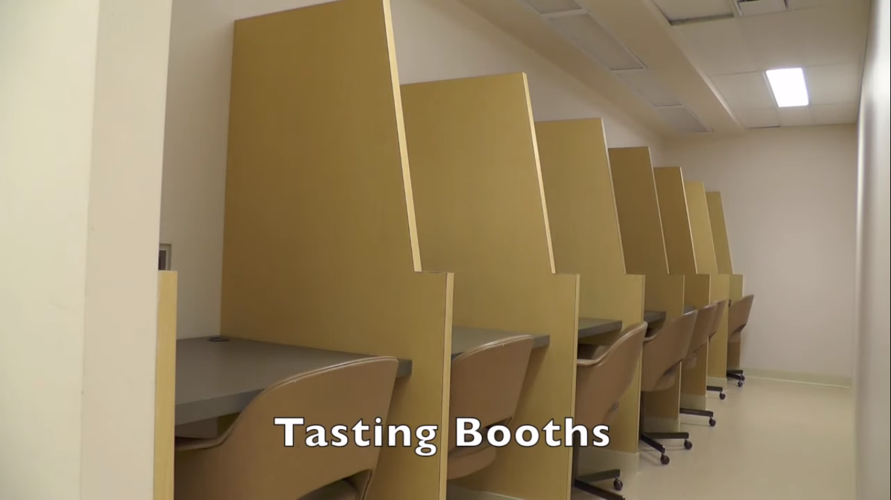
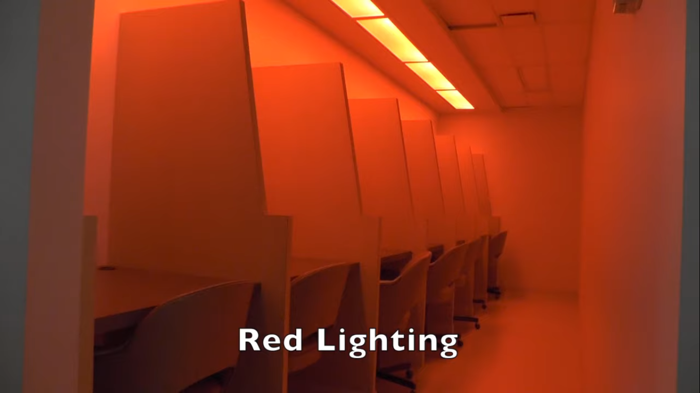
Application of Triangle Test
Sensory Analysis Lab

Slide 18
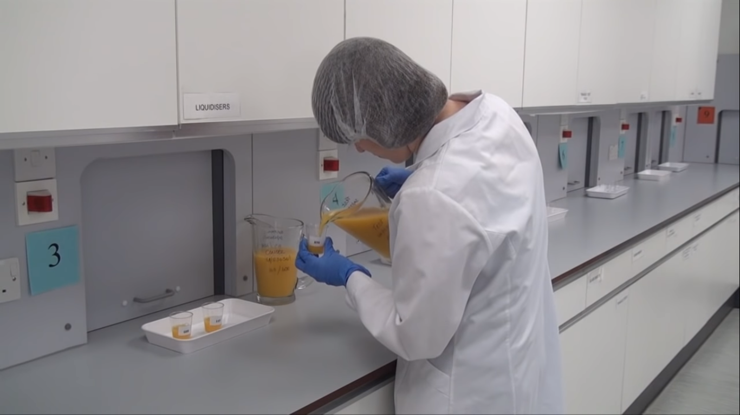
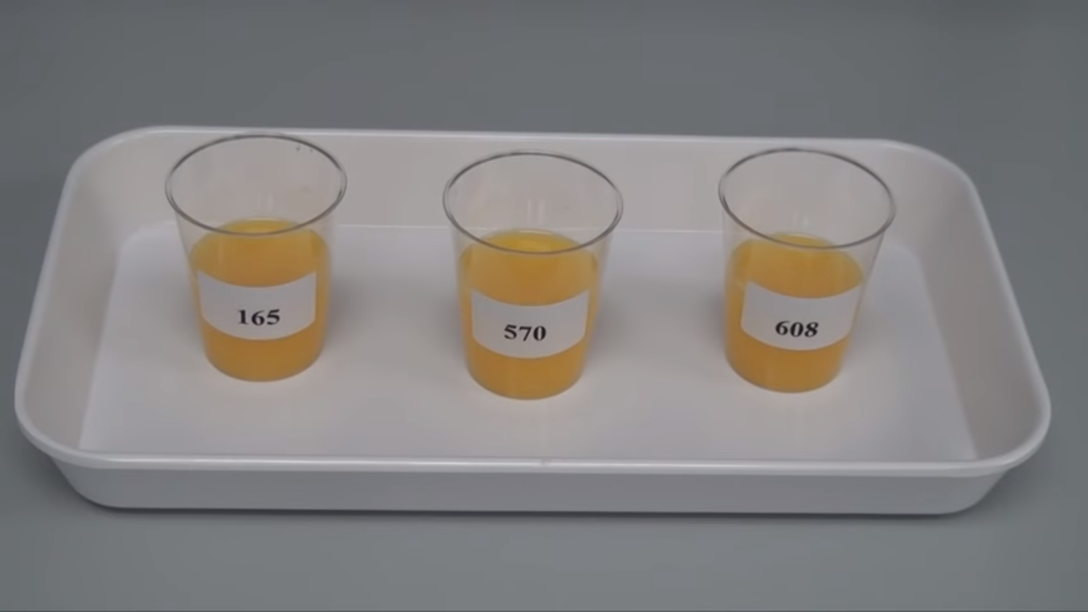
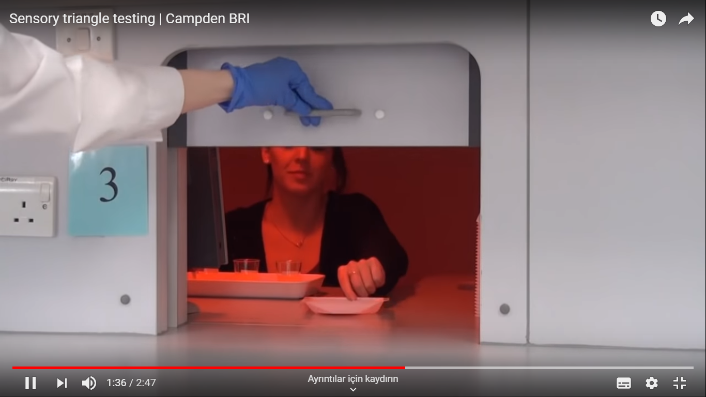
Application of Triangle Test

Slide 19
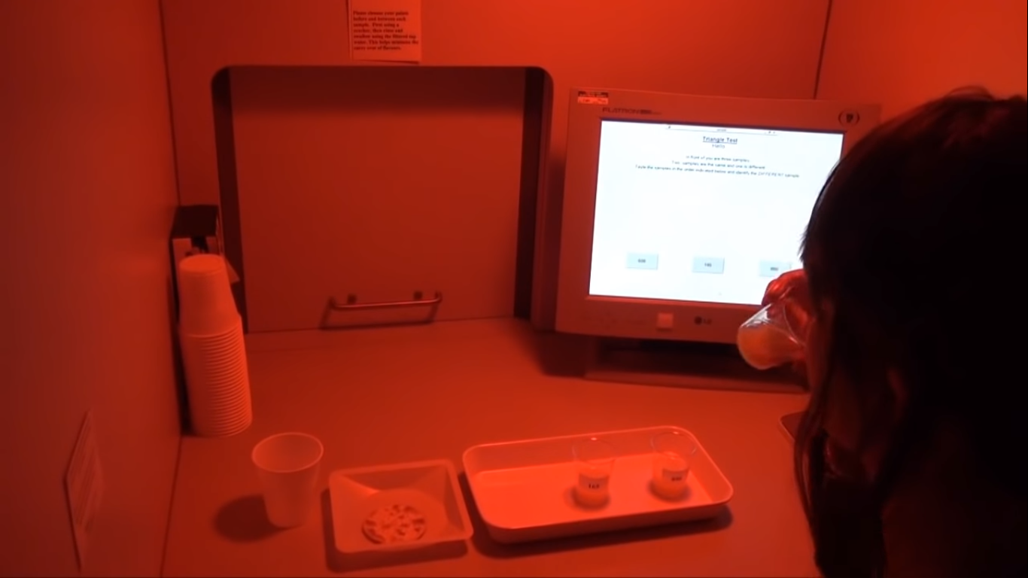
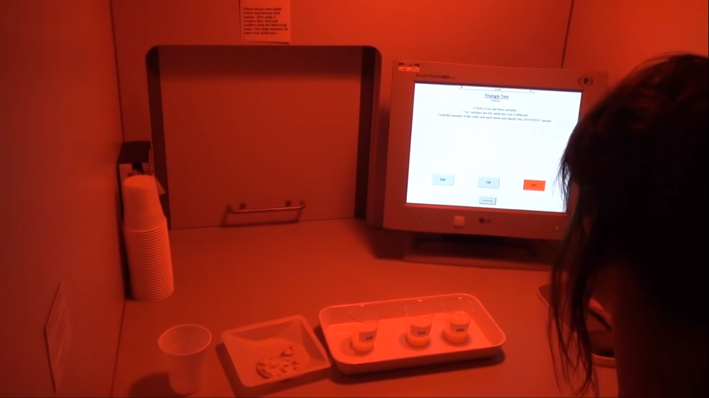
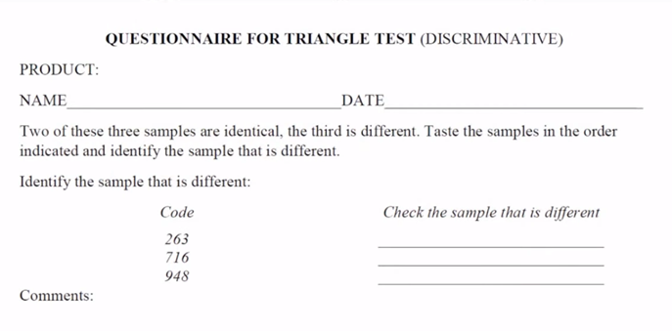
Application of Triangle Test
165
570
608

Slide 20
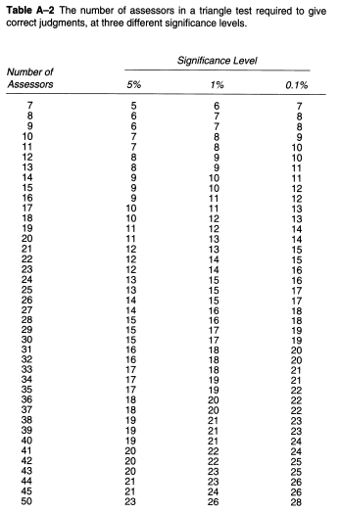
Example of triangle test and the analysis of the results
For example, two wines processed under identical conditions are fermented in the bottle for 6 months at two different temperatures, 7°C and 13°C, in order to determine if the warmer fermentation temperature results in a different product.
Twenty-four panelists evaluate the two wines, using a triangle test.
A difference is wanted at a 5% level of significance (p≤0.05).
15 of the 24 panelists correctly identify the odd sample. Is there an overall difference between the product fermented at 7°C, compared with the product fermented at 13°C?
At the 5% level of significance with 24 panelists, a minimum of 13 correct responses were needed to determine that there was a significant difference between the samples.
There is a 95% or greater probability that the product fermented at 13°C is noticeably different from the product fermented at 7°C.

