Slide 1
FE 517
Edible films and coatings
Dr. Burcu GÖKKAYA ERDEM

Slide 2
Antimicrobial packaging systems
Antimicrobial packaging is a system that can kill or inhibit the growth of micro-organisms and thus extend the shelf life of perishable products and enhance the safety of packaged products (Han, 2000).
Antimicrobial packaging is one of the most promising innovations of active packaging technologies (Floros et al., 1997). It can be constructed by using antimicrobial packaging materials and/or antimicrobial agents inside the package space or inside foods. Most food packaging systems consist of the food products, the headspace atmosphere and the packaging materials. Any one of these three components of food packaging systems could possess an antimicrobial element to increase antimicrobial efficiency.

Slide 3
Antimicrobial packaging systems
Antimicrobial packaging research generally started with the development of antimicrobial packaging materials that contain antimicrobial chemicals in their macromolecular structures. However, without the use of alternative packaging materials, common packaging materials can be utilized for antimicrobial packaging systems when there is antimicrobial activity in packaged foods or in the in-package atmosphere.
Edible antimicrobial agents can be incorporated into food ingredients, while antimicrobial resources can be interleaved in the in-package headspace in the form of sachets, films, sheets or any in-package supplements, to generate antimicrobial atmospheres.

Slide 4
Antimicrobial packaging systems
Besides the use of antimicrobial packaging materials or antimicrobial inserts in the package headspace, gaseous agents have been used to inhibit the growth of micro-organisms.
Common gases are carbon dioxide for MAP, sulfur dioxide for berries, and ethanol vapor for confections. These gases are injected into the package headspace or into palletized cases after shrink-wrapping of a unit load on a pallet. Vacuum, nitrogen-flushing and oxygen-scavenging packaging, which were originally designed for preventing the oxidation of packaged foods, also possess antifungal and antimicrobial properties against aerobic bacteria as a secondary function, since these micro-organisms are restrictively aerobic (Smith et al., 1990; Han, 2003b). However, these technologies, which control the low oxygen concentration to inhibit the growth of aerobic micro-organisms, could cause the onset of anaerobic microbial growth. Controlling anaerobic bacteria in modified atmosphere packaging is a very important issue in maintaining the quality and safety of the products.

Slide 5
Antimicrobial agents
Various antimicrobial agents could be incorporated into conventional food packaging systems and materials to create new antimicrobial packaging systems. Table 6.1 shows potential antimicrobial agents and food-grade preservatives.
They can generally be classified into three groups; chemical agents, natural agents, and probiotics.

Slide 6
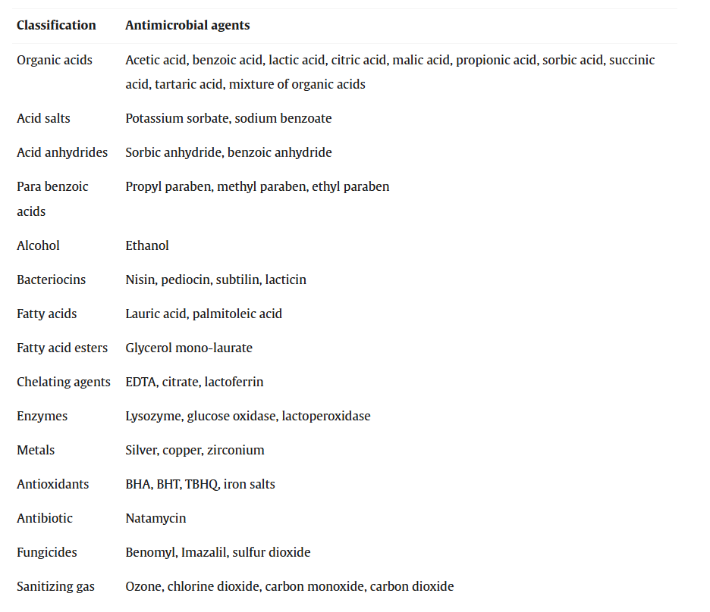
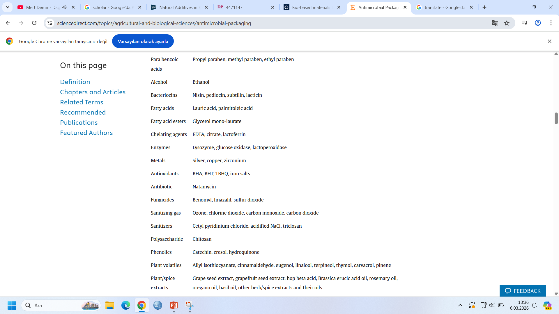
Examples of potential antimicrobial agents for antimicrobial food packaging systems

Slide 7
Chemical antimicrobial agents
For the purpose of food preservation, all packaging ingredients should be food-grade additives. The chemical agents can be mixed with food ingredients, incorporated into packaging additives or inserted into the headspace atmosphere. The antimicrobial agents are in contact with and consumed with the food products in these applications.
Therefore, the chemical antimicrobial agents should be controlled as food ingredients regardless of where the chemical antimicrobial agents were positioned initially – in the food products, in the packaging materials, or in the package headspace atmosphere.
In the case of non-food-grade chemicals, the only way to incorporate the chemical into the food packaging system is through the chemical binding of the antimicrobial agents to packaging material polymers (immobilization). In this case, the migration or residual amount of the non-food-grade chemical in the food products is prohibited by regulation. Therefore, it is necessary to verify that there is no migration of the chemical from packaging materials to foods, and there is no residual free chemical after the immobilization reaction.

Slide 8
Chemical antimicrobial agents
The most common chemical antimicrobials used by researchers are the various organic acids. Organic acids are widely used as chemical antimicrobial agents because their efficacy is generally well understood and cost effective.
Many organic acids, including fatty acids, are naturally existing chemicals and have been used historically. Currently, most of them are produced by chemical synthesis or chemically modified from natural acids.
Organic acids have characteristic sensitivities to micro-organisms. For example, sorbic acid and sorbates are very strong antifungal agents, while their antibacterial activities are not effective – they have various antimicrobial mechanisms. Therefore, the correct selection of organic acids is essential to have effective antimicrobial agents. Mixtures of organic acids have a wider antimicrobial spectrum and stronger activity than a single organic acid.

Slide 9
Chemical antimicrobial agents
Fungicides are also common antimicrobial agents. Imazalil has been incorporated into the wax coating of oranges and other citrus fruits. Since fungicides are not permitted as a direct food preservative, they cannot be mixed into food ingredients or added to food-contact packaging materials as food-contact substances. Therefore, it is necessary to design antimicrobial food packaging systems when non-food-grade antimicrobial agents, such as fungicides, are used.
Food sanitizers and another chemical antimicrobial groups are included in Table 6.1. They are food cleansing agents, food contact substances or food contact surface sanitizers. Residual food sanitizers on foods are permitted, with specific control limits. Thus the use of food sanitizers has many advantages over the use of other non-food-grade antimicrobial agents such as fungicides.

Slide 10
Natural antimicrobial agents
Table includes herb extracts, spices, enzymes, and bacteriocins as naturally occurring antimicrobial agents. Looking to the consumers’ demand for chemical preservative-free foods, food manufacturers are now using naturally occurring antimicrobials to sterilize and/or extend the shelf life of foods.
Herb and spice extracts contain multiple natural compounds, and are known to have a wide antimicrobial spectrum against various micro-organisms. Apart from antimicrobial activity, other advantages they offer include antioxidative activity and their effect as alternative medicines. However, their mode of action and kinetics are generally unknown, and their chemical stability is also of concern. In addition, they create some problems with respect to flavors.

Slide 11
Natural antimicrobial agents
Specificity of enzymes should be considered carefully, since antimicrobial activity is very sensitive to the environments and substrates. For an example, the activity of lysozyme can be significantly affected by temperature and pH. In most cases, lysozyme is not effective against gram-negative bacteria. This is due to the complex cell wall structure of gram-negative bacteria and the specificity of lysozyme for peptidoglycan.
Various bacteriocins, such as nisin, pediocin, lacticin, propionicin etc., can be incorporated into foods and/or food packaging systems to inhibit the growth of spoilage and pathogenic micro-organisms (Daeschul, 1989). The extracted bacteriocins, which are generally small molecular weight peptides, can be utilized in various ways; however, it is very important to characterize their resistance to thermal treatment and pH. In the case of fermented food products, live bacteria which produce bacteriocins can be intentionally added as probiotics in the packaged food system to obtain antimicrobial effectiveness.

Slide 12
Probiotics
Table also shows the possible use of probiotics {Lactobacillus reuteri) to control E. coli O157:H7 (Muthukumarasamy et al., 2003). Various micro-organisms, e.g. lactic acid bacteria, produce bacteriocins and non-peptide growth-inhibiting chemicals such as reuterin. These naturally produced antimicrobials can inhibit the growth of other bacteria.
Use of probiotics can therefore effectively control the competitive undesirable micro-organisms. Many traditional fermented food products contain antimicrobial probiotics. There has been much research and development regarding the function of antimicrobial probiotics for the preservation of fermented foods. Currently there is only limited research into the use of probiotics for the purpose of antimicrobial packaging design. With the new technology development for the delivery of live probiotics, the use of probiotics as an antimicrobial source for antimicrobial food packaging will be more popular in future due to its safety and effectiveness.

Slide 13
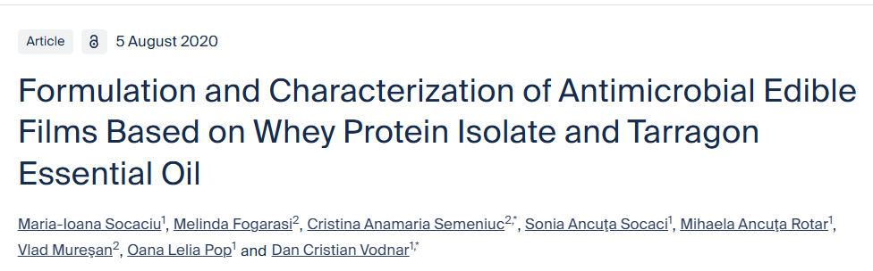
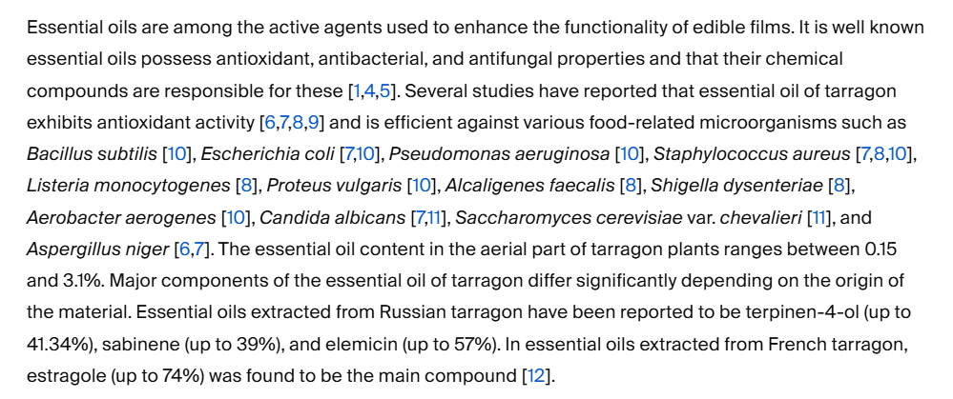
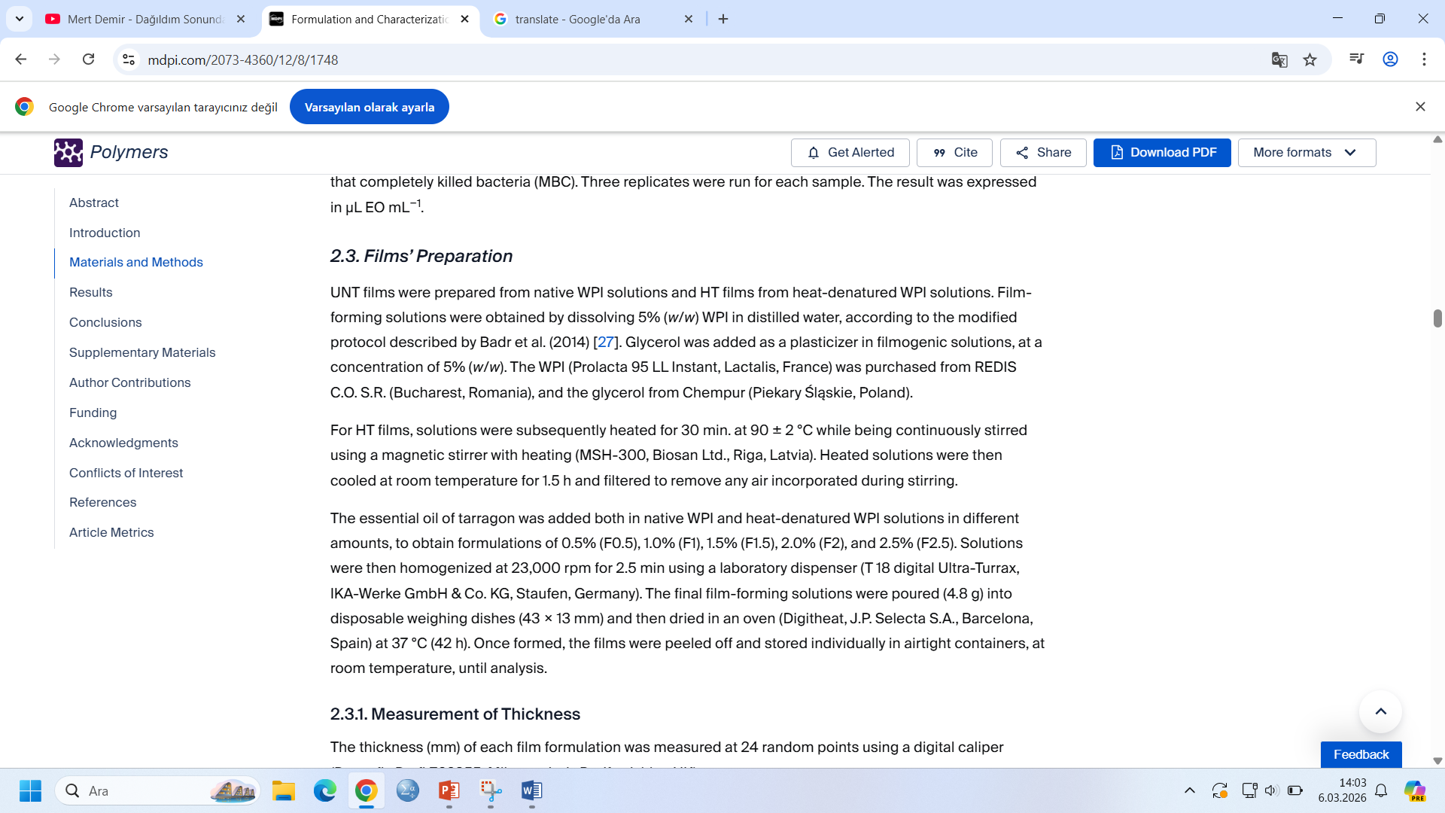
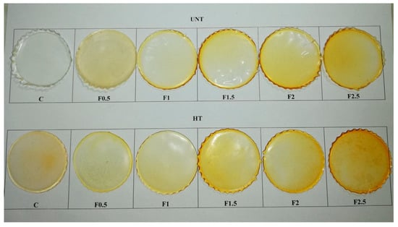
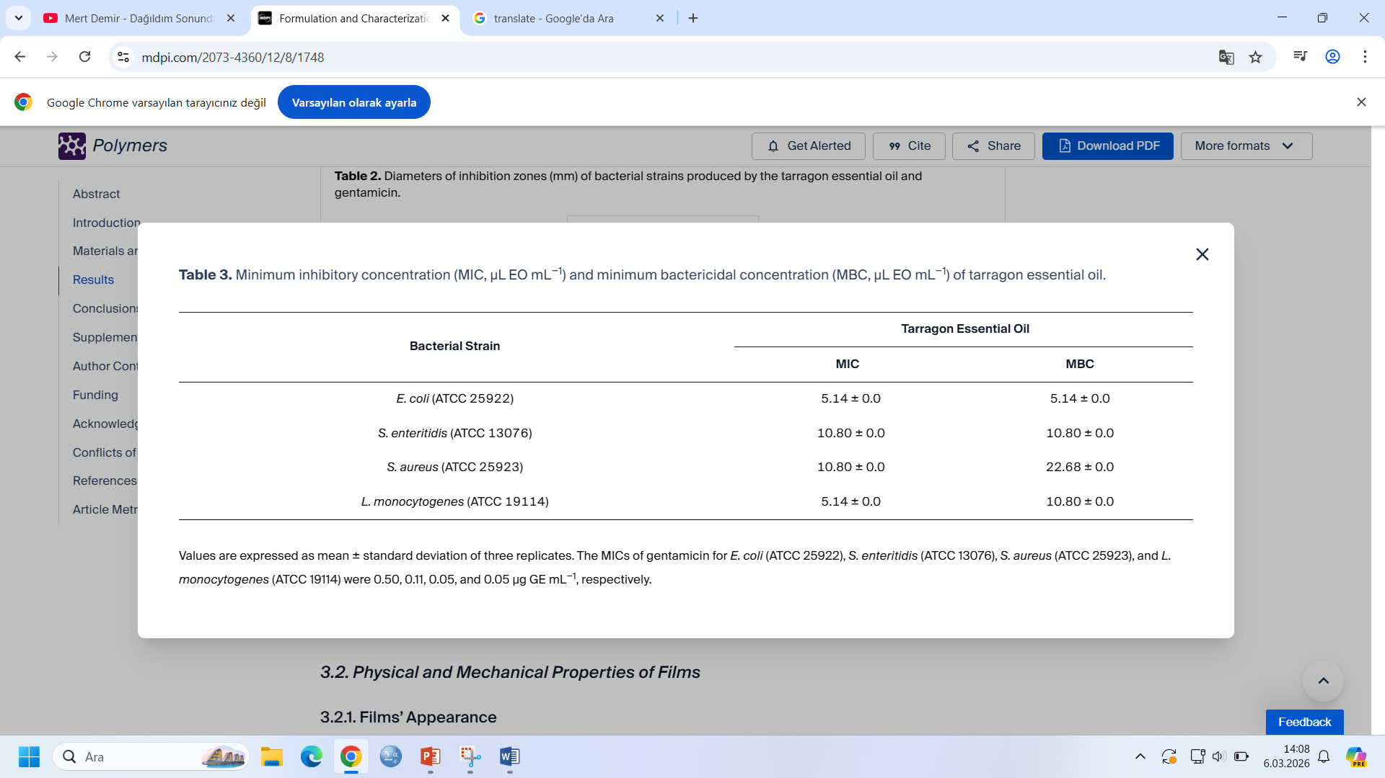
The lower the MIC/MBC value, the higher the antibacterial activity of essential oil [26]. The essential oil of tarragon revealed both bacteriostatic and bactericidal properties as follows: Against E. coli > L. monocytogenes > S. enteritidis > S. aureus.

Slide 14
Thank You =)
Ref: https://www.sciencedirect.com/topics/agricultural-and-biological-sciences/antimicrobial-packaging
Ref: https://doi.org/10.3390/polym12081748
Please prepare a 2-3-4 page assignment/report related to this presentation.

