Slide 1
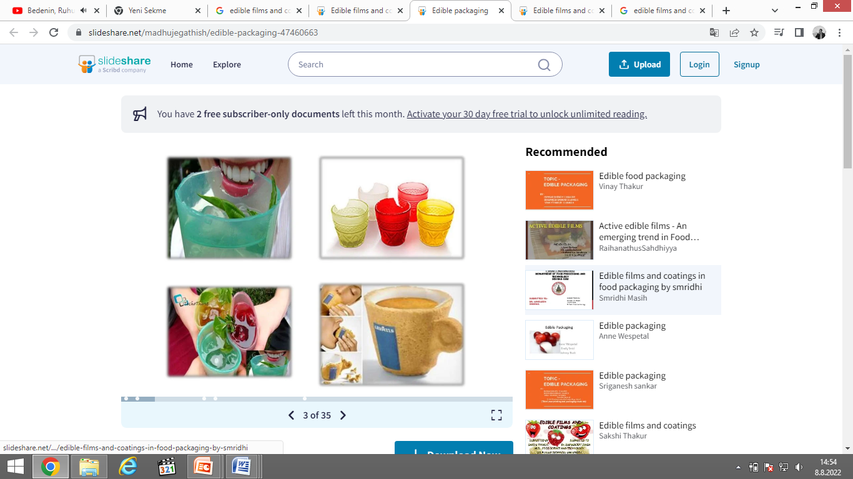
FE 517
Edible Films and Coatings
Dr. Burcu GÖKKAYA ERDEM

Slide 2
COURSE CONTENT
The importance of food packaging
What is edible packaging?
Edible films and edible coatings
Components of edible films and coatings
EF and EC formation methods
Bioactive EFs and ECs
Functional properties, requirements and drawbacks
Mechanical, thermal, optical, barrier and physical properties
Application

Slide 3
Midterm (2 midterms)
Final exam and/or Task-study
Attendance

Slide 4
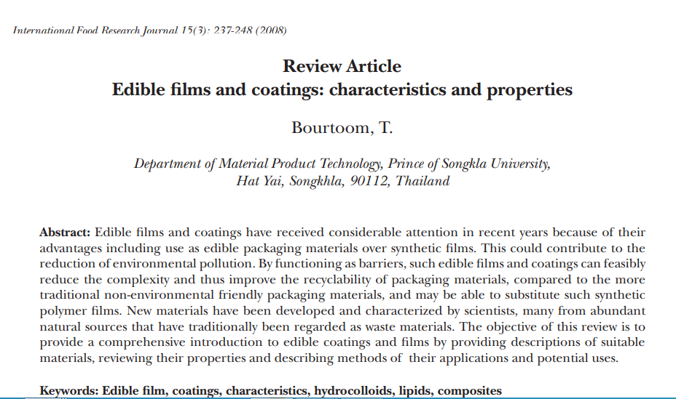
Search and read some of the artıcles about edıble fılms and coatıngs

Slide 5
