Slide 1
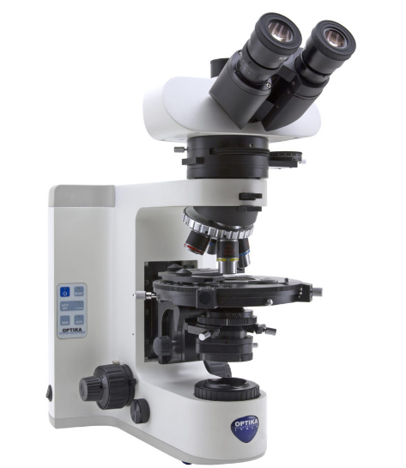
FE 315 Instrumental Analysis
Image Analyzing with Polarized Light Microscope

Slide 2
CONTENT
What is “Microscope”?
What is “Polarized Light Microscope (PLM)”?
What are the most important parts of the PLM?
Placement of polarizer and analyzer on PLM
Application of PLM
What is the difference between LM and PLM?
Some advantages and drawbacks of image analyzing

Slide 3
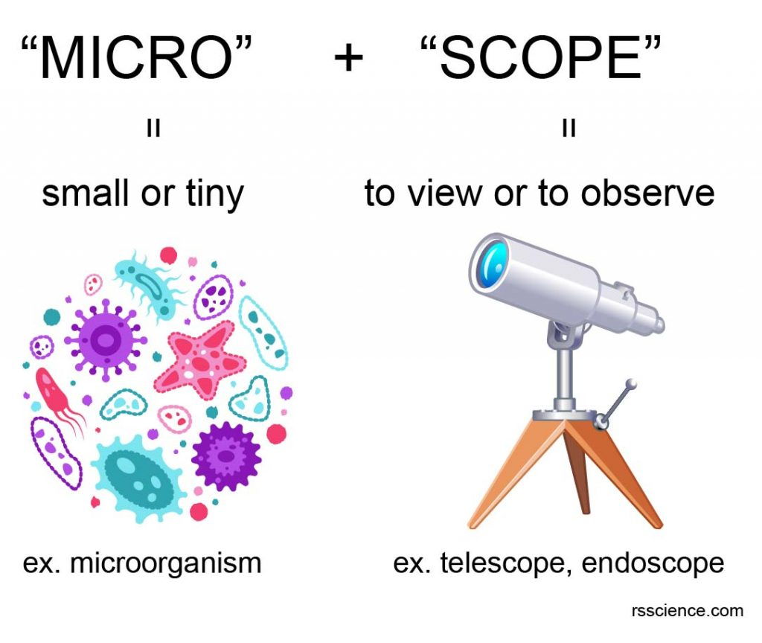
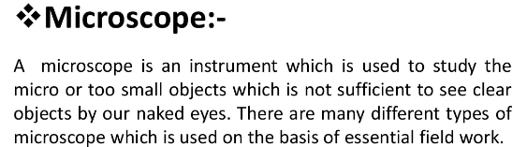
What is “Microscope”?

Slide 4
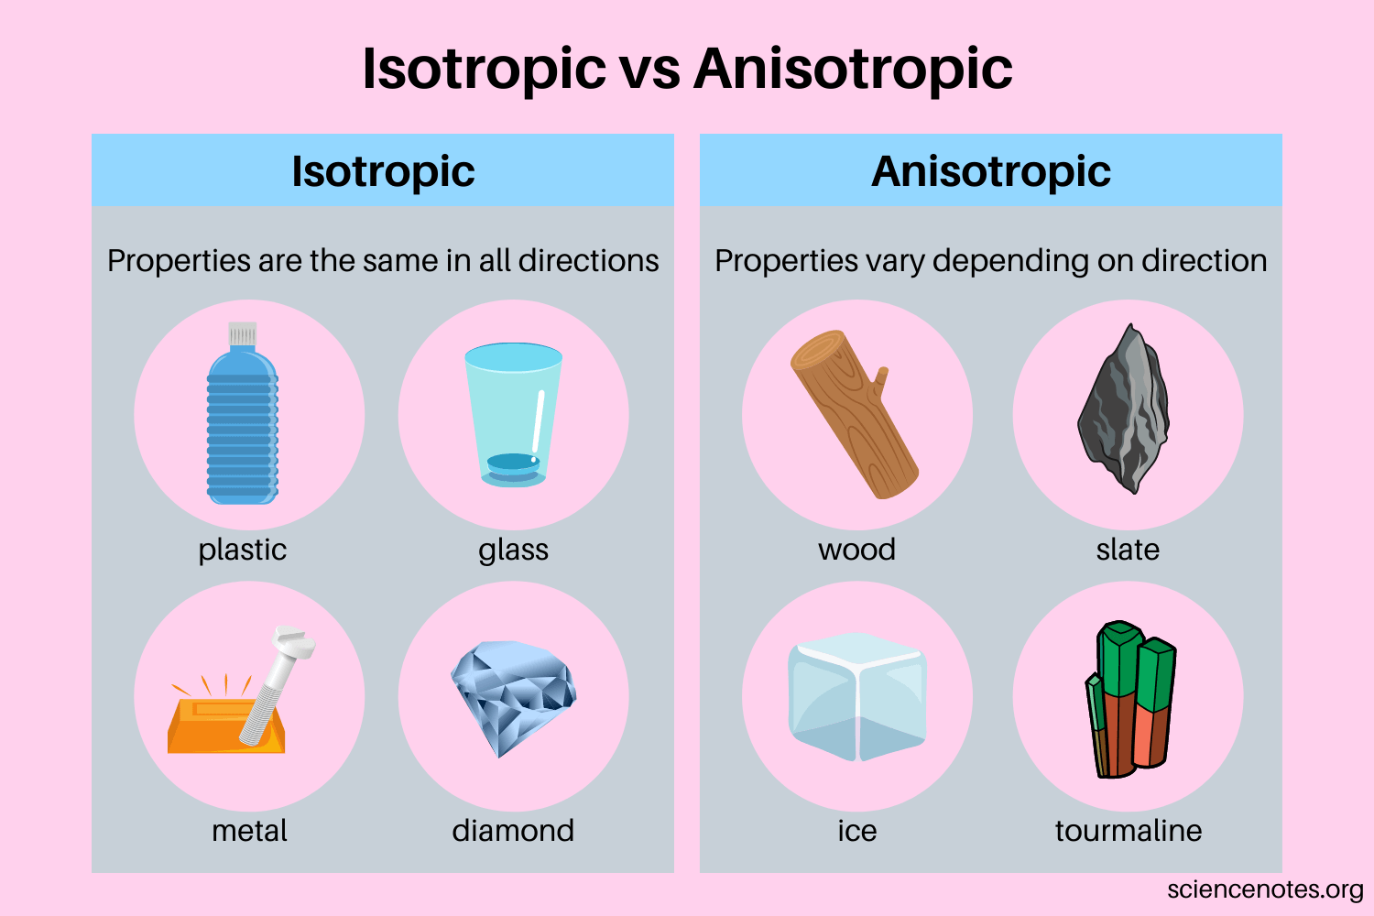
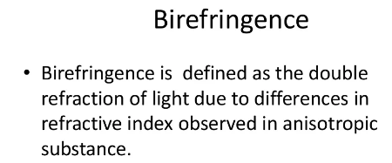
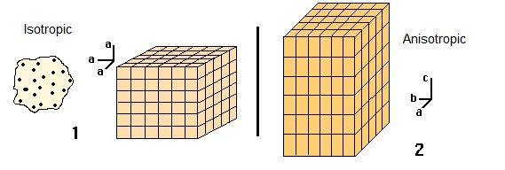
What is “Polarized Light Microscope (PLM)”?
- Polarize light microscopy is a technique involving polarized light for illumination of the sample, while blocking the directly transmitted light with a polarizer.
- PLMs have a high degree of sensitivity and can be utilized for both quantitative and qualitative studies at a wide range of birefringent materials.

Slide 5
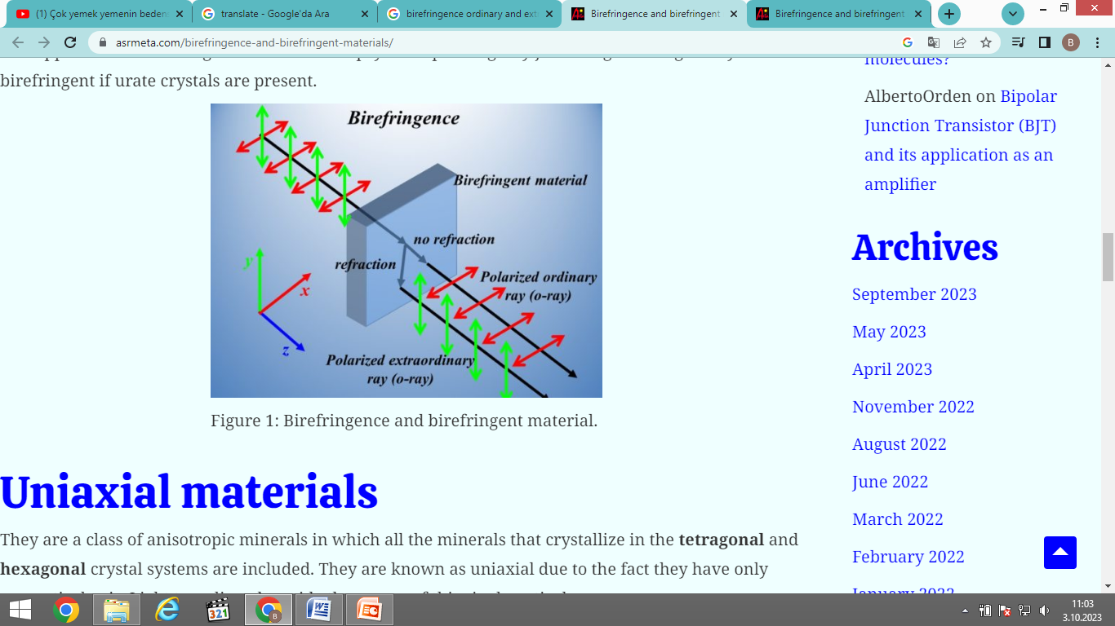
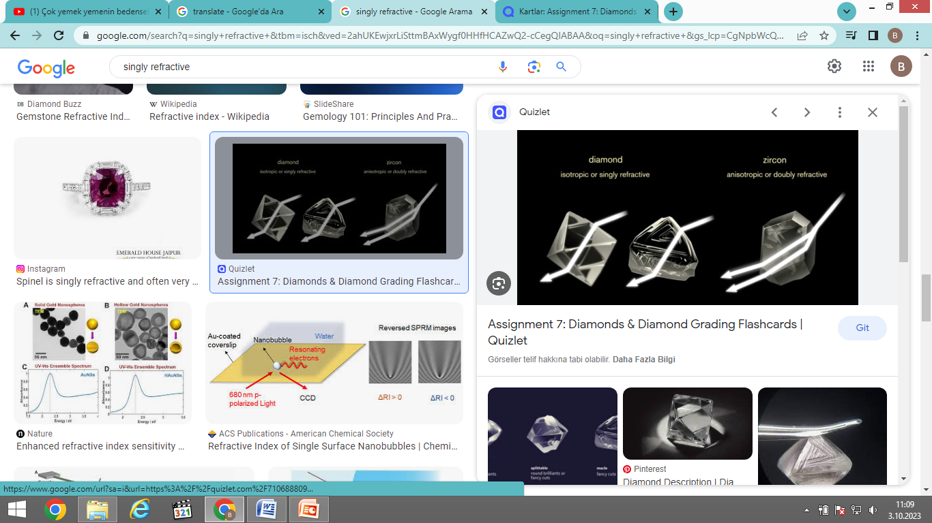
- Singly refracting: Materials that fail to polarize transmitted light are said to be SINGLY REFRACTIVE (Some gemstones, such as opal, garnet and spinel, are singly refractive, and they have only one refractive index).
- Doubly refracting (birefingent): Double refraction, also called birefringence, an optical property in which a single ray of unpolarized light entering an anisotropic medium is split into two rays, each traveling in a different direction

Slide 6
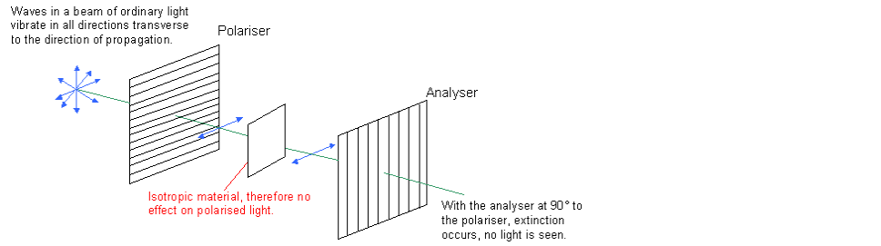
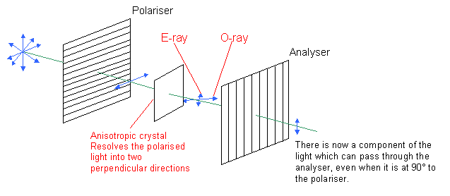
Isotropic & Unistoropic material behavior in PLM system

Slide 7
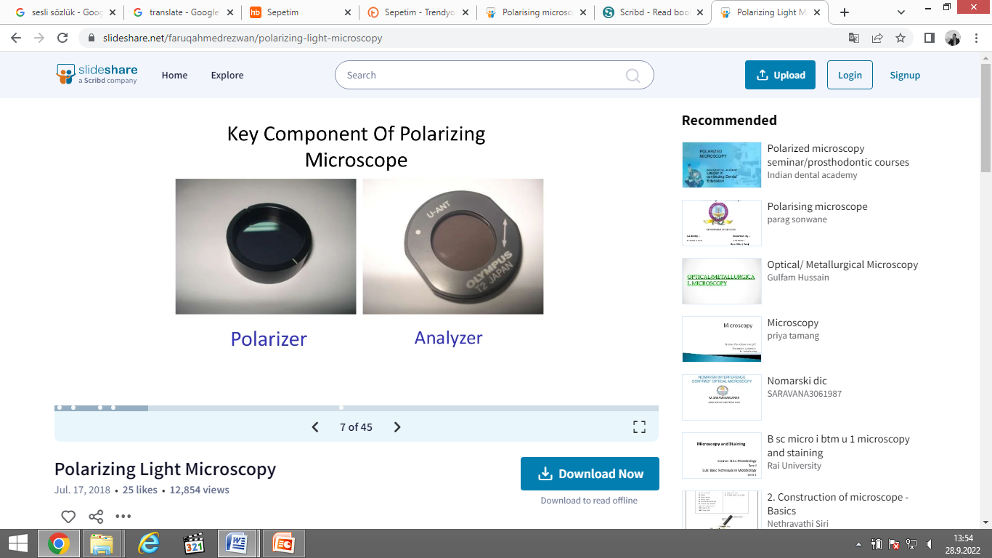
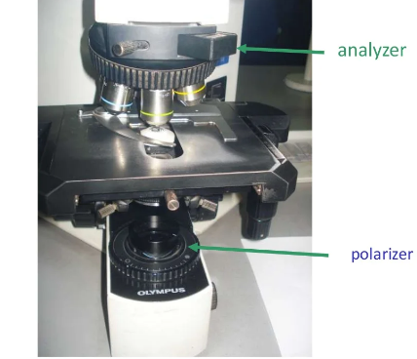
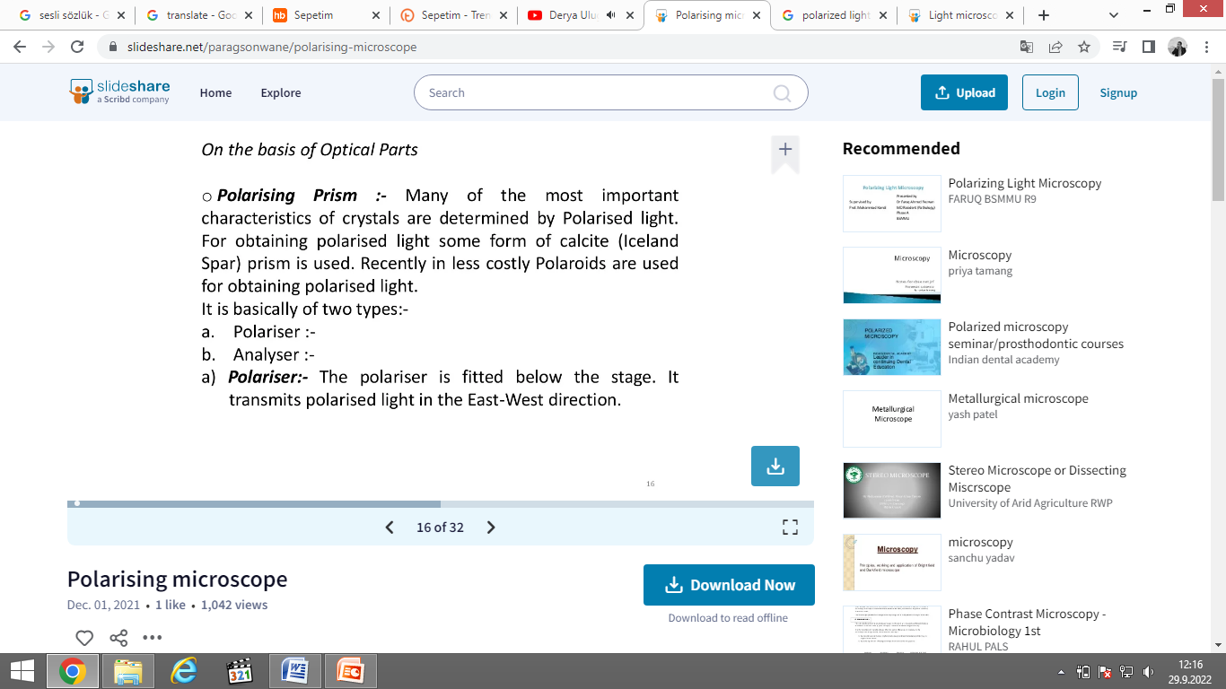
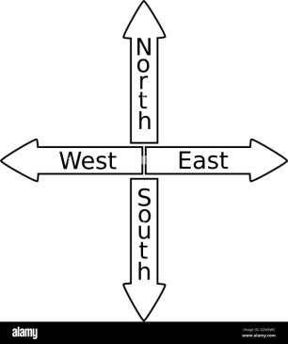
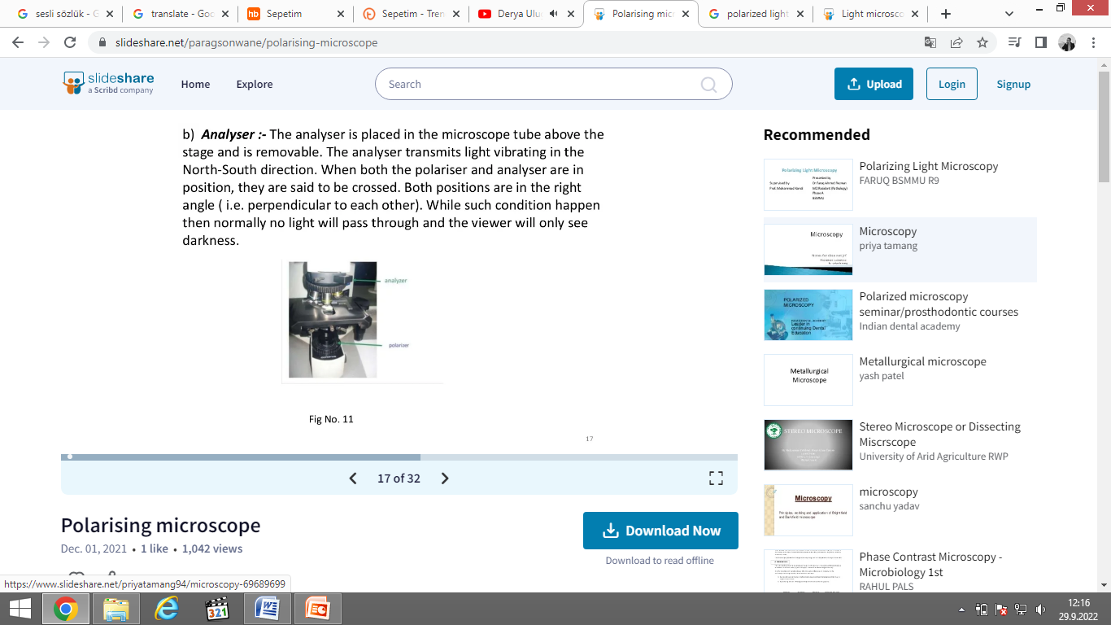
What are the most important parts of the PLM?

Slide 8
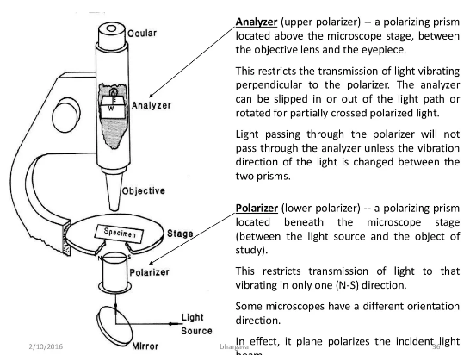
Placement of polarizer and analyzer on PLM

Slide 9
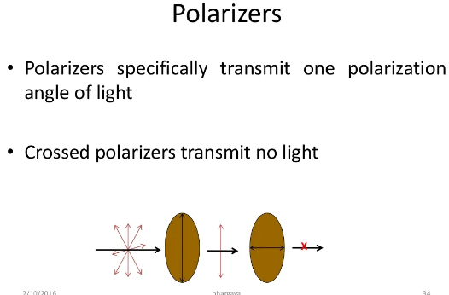
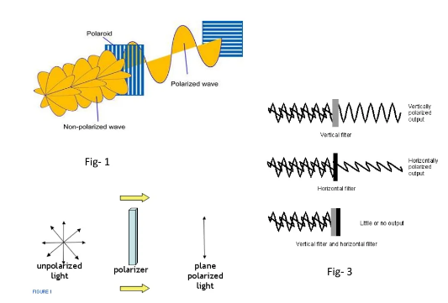
When using polarizers, there is no light transmission and dark area-background is obtained.
Any device capable of selecting polarized light from natural (unpolarized) white light is now referred to as a polar or polarizer.

Slide 10
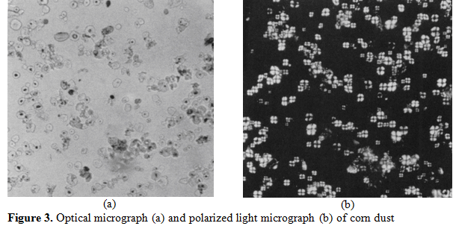
Light vs dark backround

Slide 11
Application of PLM
PLM involves to study in detecting, identifying, classifying, measuring and evaluating the significance of physical and cultural materials, their patterns and spatial relationship.
The technique can be used both qualitatively and quantitatively in the material sciences, geology, chemistry, biology, metallurgy, medicine and food analysis.

Slide 12
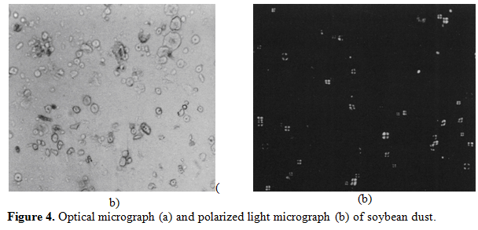
Optical micrograph (OM) vs Polarize light micrograph (PLM)
Observations:
OM: the starch content of the corn dust is greater than that of the soybean dust (Qualitative)
PLM: Relative amounts of starch is 43.5% for corn and 27.4% for soybean. (Quantitative)
*These percentages were calculated as total area of starch particles divided by total area of particles.

Slide 13
What is the difference between LM and PLM?
The polarizing microscope is used mainly in geological studies for geological specimens but also in medicine and biology. This type of microscope differs from the normal one by using a polarized light, in which the light waves vibrate in one direction.

Slide 14
Polarized Light Image Analyzing
Advantages
Disadvantages
quick and objective operation,
consistency, efficiency and cost effectiveness,
reduction of tedious human involvement,
automation of many labor intensive processes,
need for defined and consistent lighting,
calibration requirements;
the difficulties encountered with overlapping objects when both sides of a food need to be evaluated.

Slide 15
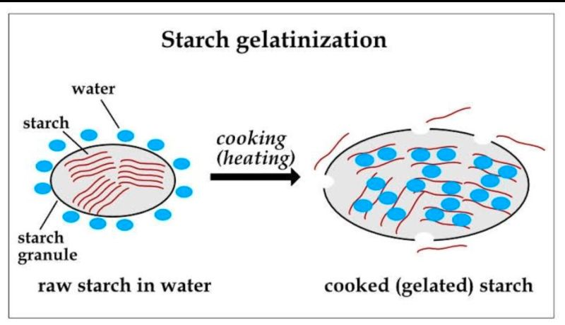
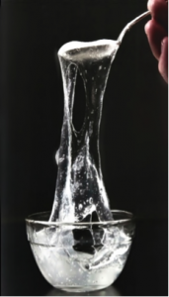
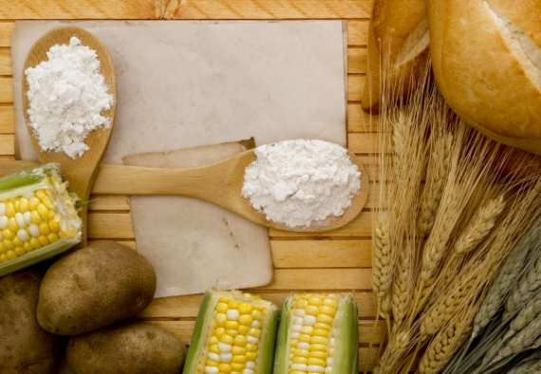
Starch granules are naturally anisotropic due to their semi-crystalline structure and display a distinct Maltese cross pattern under polarized light, resulting from the regular molecular alignment within the granule
Gelatinization is an irreversible phase transition in which starch loses its structural order under the influence of water and heat. During this process, the granule absorbs water and swells, hydrogen bonds break, and the crystalline regions collapse.
As gelatinization progresses, starch molecules become amorphous, leading to a gradual loss of birefringence. The disappearance of the Maltese cross under the microscope indicates that the starch is fully cooked and has become isotropic . PLM provides the most effective and visually interpretable method to monitor this structural transformation.

Slide 16
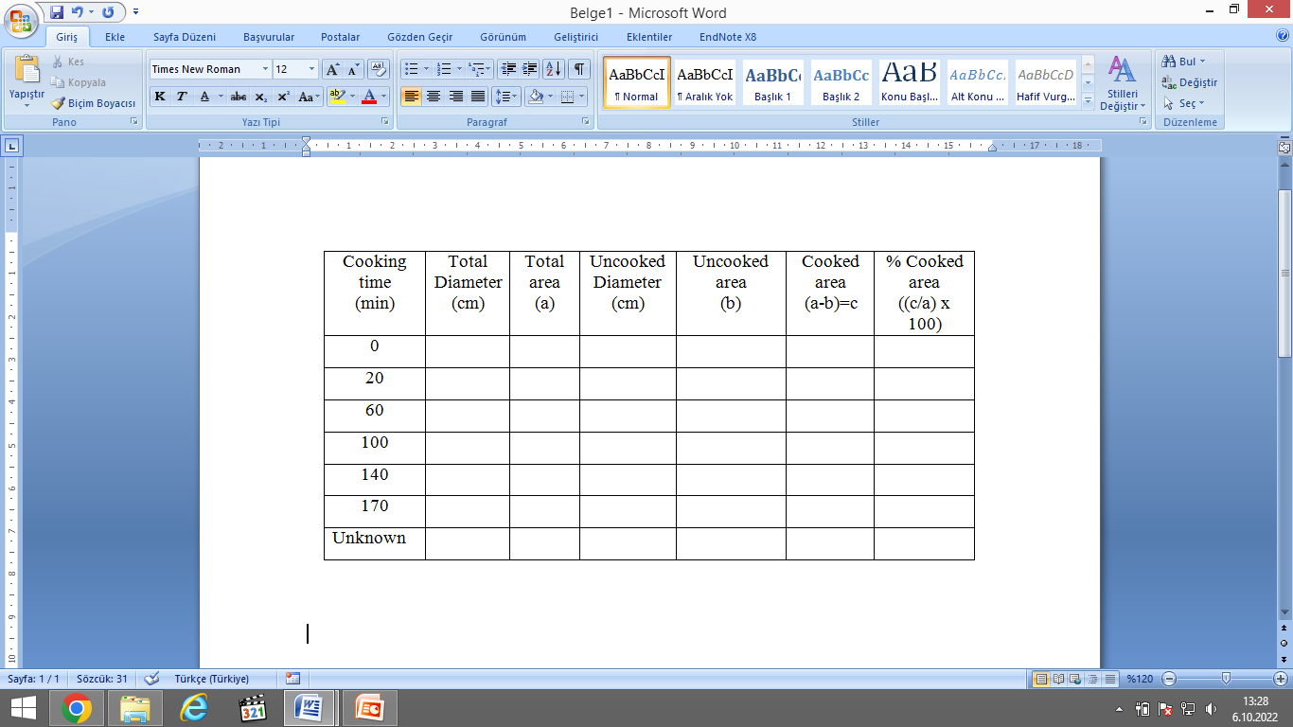
Experiment: Learning the sample analysis on optical and polarized light microscope
Collect the data as indicated on Table 1.
Calculate percent gelatinization (% cooked).
Draw a calibration curve by comparing cooked starch % versus cooking time using cooking data.
Standard deviation and a linear model will be derived.
Table 1. Starch gelatinization during cooking at 85ºC (1 cm=239.73 pixels)

Slide 17
Calculation and Discussion
Find the “Unknown Cooking Time” with the calibration curve, comment a little on the degree of gelatinization.
Give some more information and application samples about PLM in discussion part.
Group and printed report, 1 week time.
Good Luck =)

