Slide 1
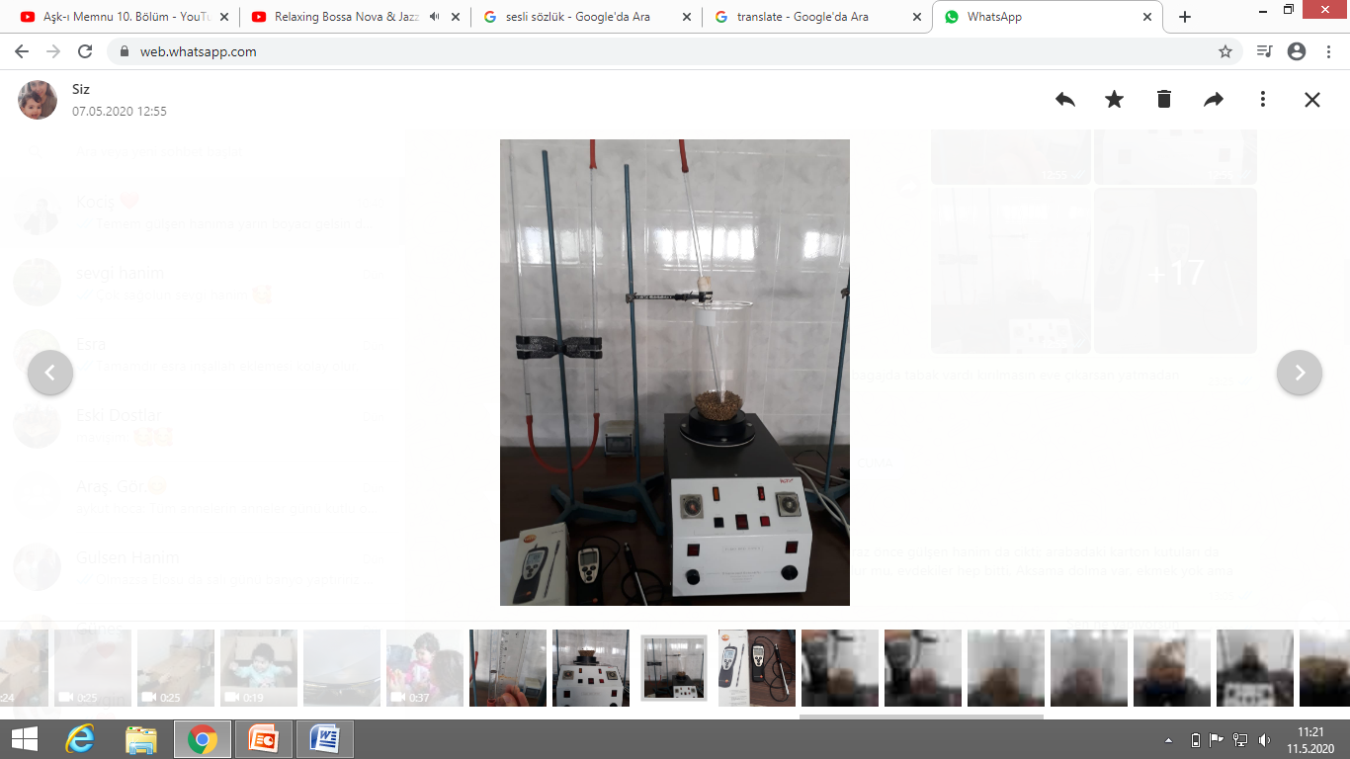
FE 483 Operation Laboratory
Fluidized Bed

Slide 2
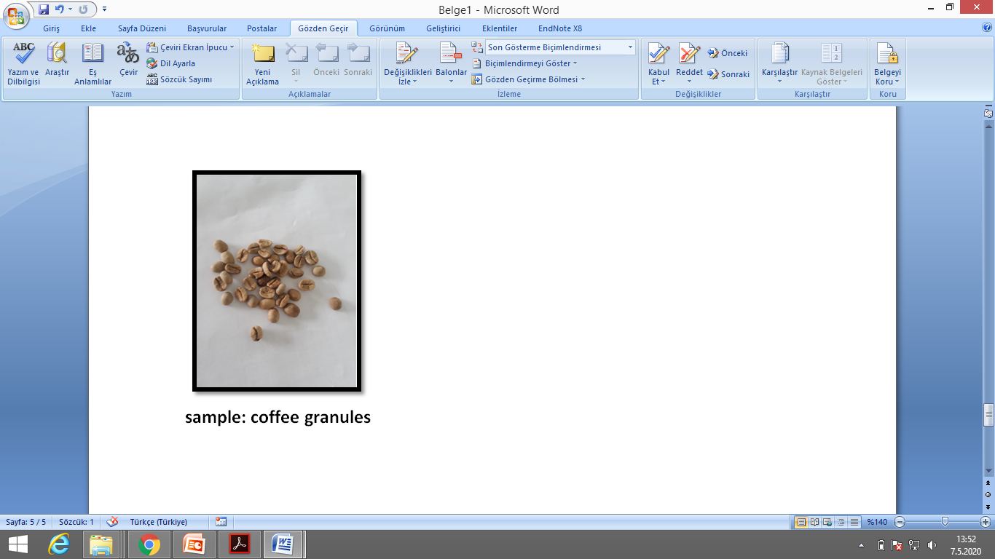
The aim of the experiment
The objective of the experiment is to investigate the fluidization phenomena with coffee granule sample,
to compare the experimental results for the variation of the pressure loss (∆P_{exp}) as a function of fluid velocity, with the theoretical value (∆P_{theo}) in a laboratory scale fluidized bed.

Slide 3
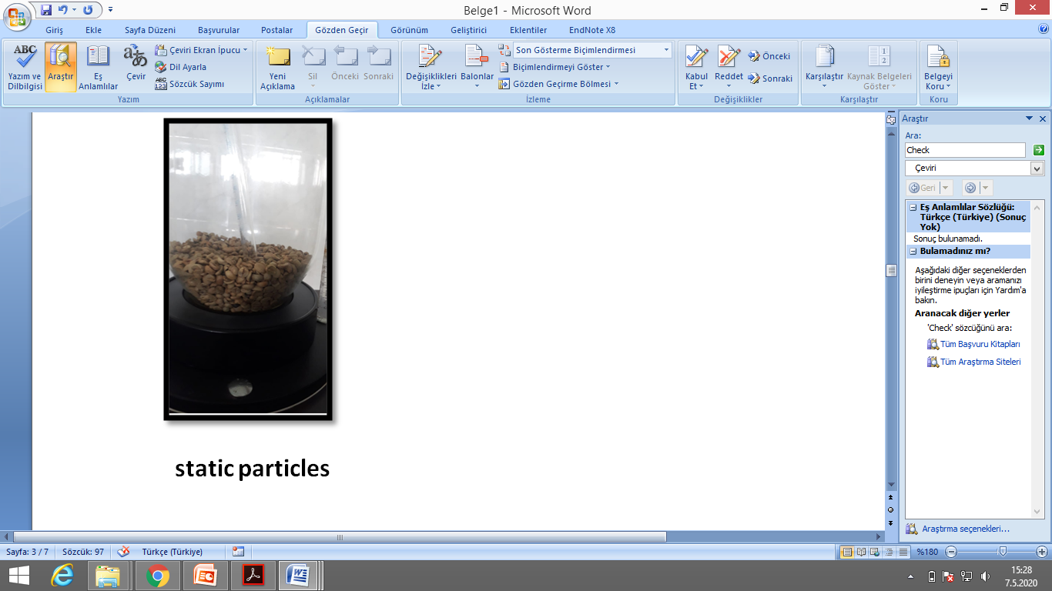
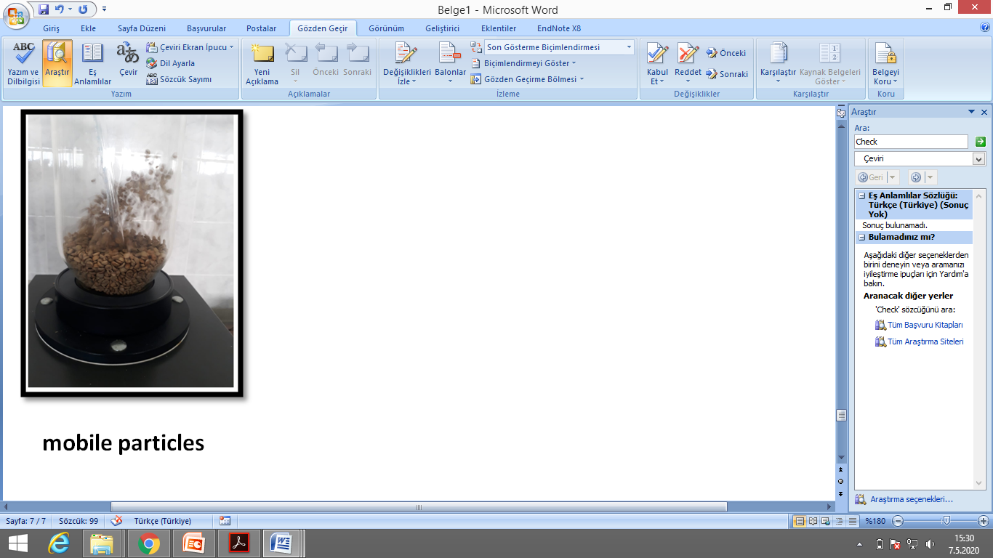
The principle of fluidized bed
The fluid bed work on the principle of fluidization, a process in which air is introduced into the spaces between solid particles. The solids are lifted from the bottom and causes the solids to behave as a fluid. When the particles just begin to move, this is the minimum fluidization velocity.
Briefly constant particles will became mobile.

Slide 4
Fluidization system
Fluidization system which is used in this experiment consist of;
a fan for supplying air to fluidized bed
a valve (blower) for adjusting to air speed
an inclined handmade manometer that measures pressure loss in the bed
an anemometer which is used for measuring air velocity.

Slide 5
Theory
During the experiment, the flow rate air was changed continuously by adjusting the air valve (blower). The pressure drop was recorded with manometer. Also the height of the bed was measured every flow rate of air. By using these data, the theoretical and experimental pressure drop in the bed, minimum fluidization velocity were calculated.

Slide 6
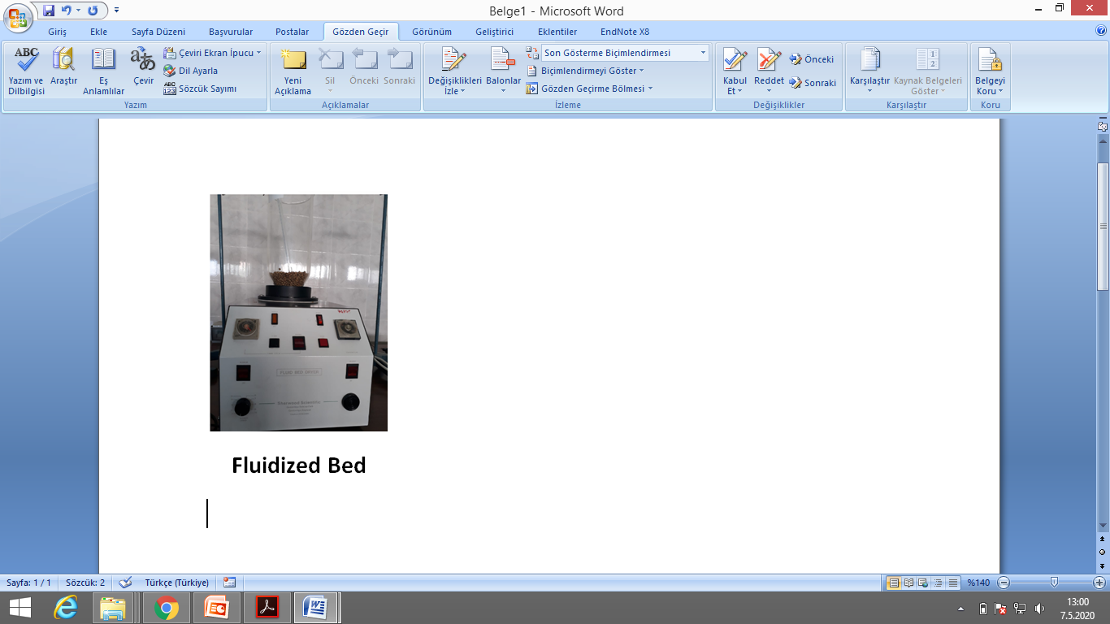
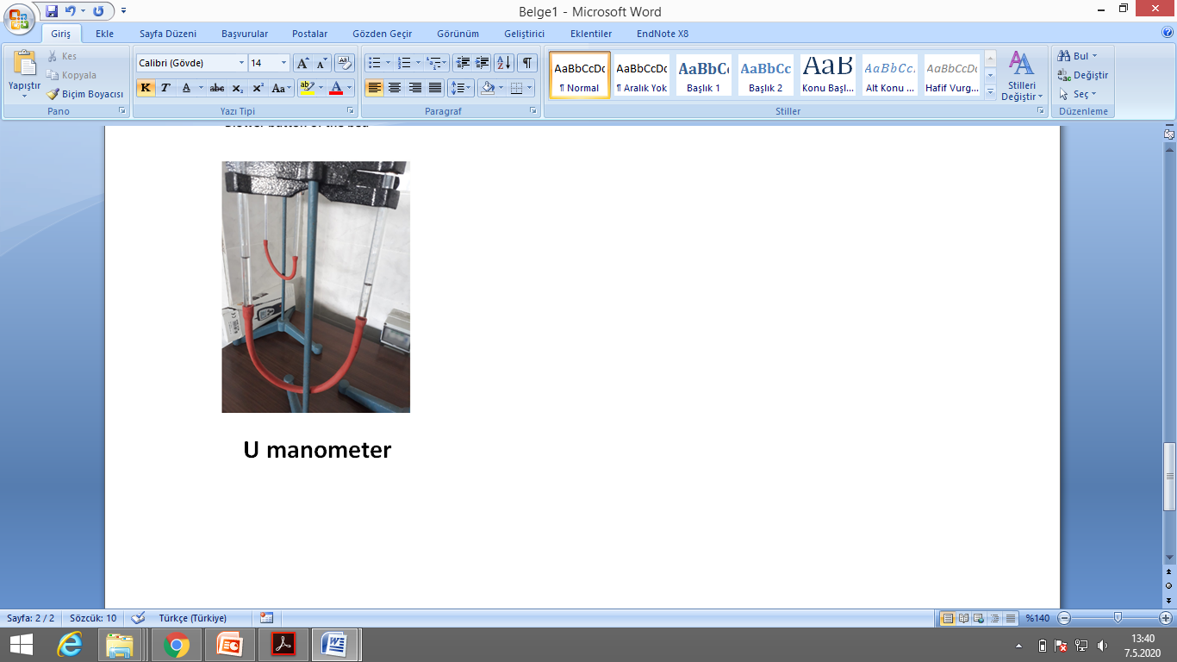
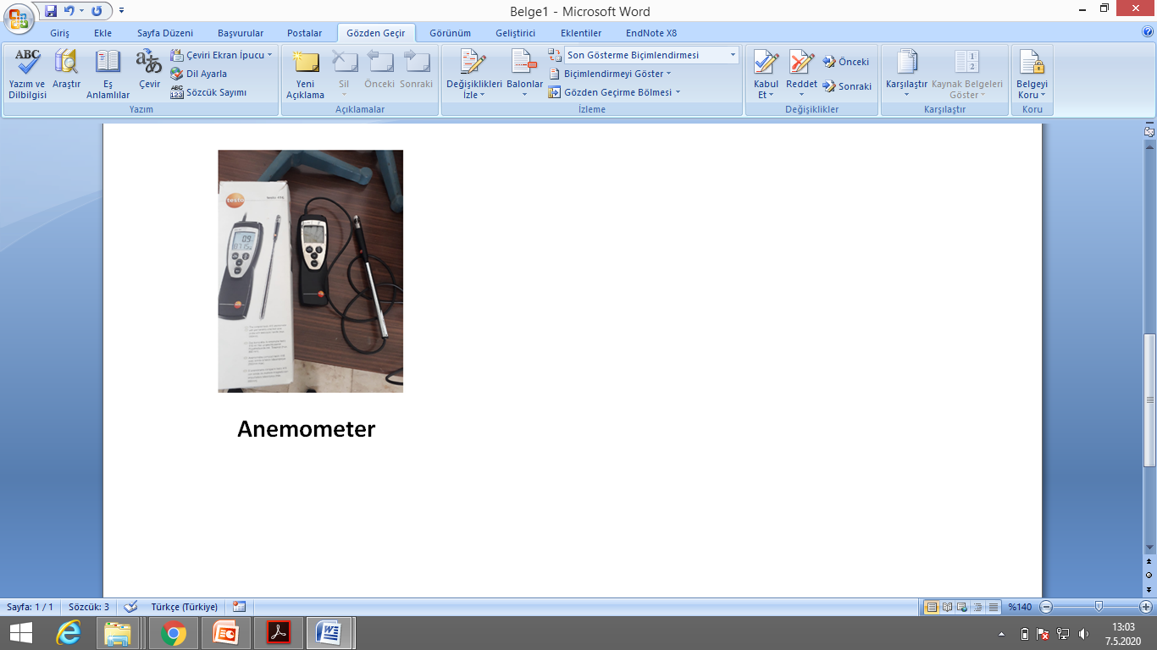
Apparatuses

Slide 7
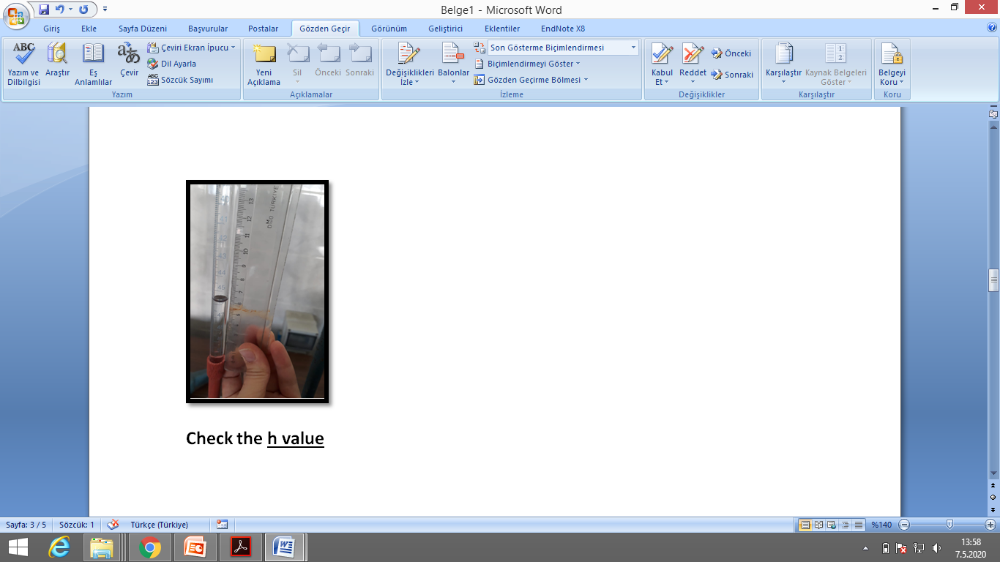
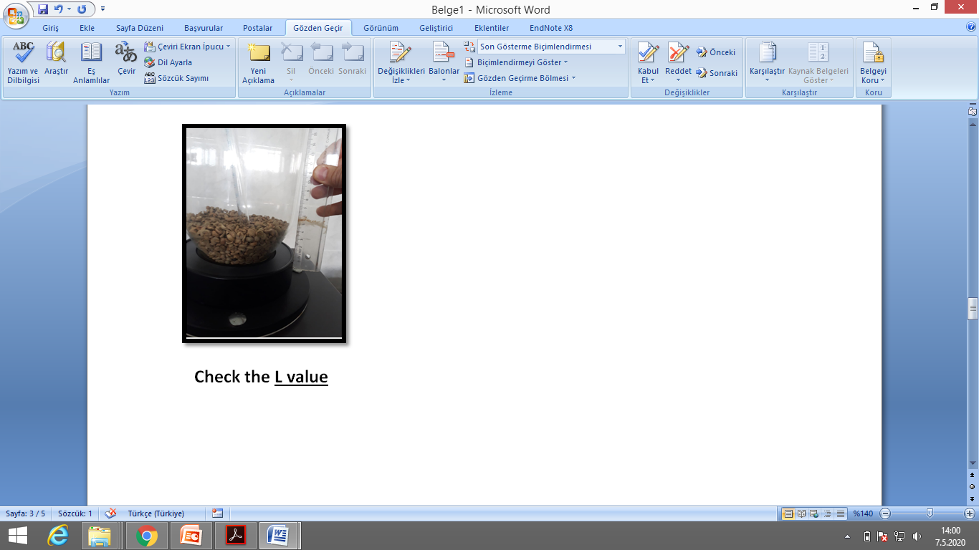

Procedure
Control the electrical connections of the fluidized bed and open the valve (blower) partially.
Control and record the level difference of the hand-made U type manometer (h value-pressure difference). Record the height of the bed (L value-length of the bed). Record the air velocity with anemometer (ν value-air velocity).
Open the blower gradually for 10 different positions and record the h, L and ν values for all valve levels.

Slide 8
DATA
Blower level | h value (m) | L value (m) | ν value (m/s)
1 | 0.019 | 0.045 | 0.7
2 | 0.020 | 0.046 | 0.7
3 | 0.027 | 0.046 | 0.7
4 | 0.041 | 0.047 | 0.8
5 | 0.044 | 0.053 | 1.3
6 | 0.046 | 0.057 | 2.1
7 | 0.048 | 0.120 | 2.3
8 | 0.054 | 0.130 | 2.6
9 | 0.057 | 0.140 | 2.7
10 | 0.057 | 0.160 | 2.9

Slide 9
Calculation
Find both experimental (∆P_{exp}) and theoritical (∆P_{theo}) pressure drops in bed for all 10 blower levels.
Plot the graph between logarithmic experimental pressure drop and air velocity in bed (log ∆P_{exp} vs log ν).
Plot the graph between logarithmic theoretical pressure drop and air velocity (log ∆P_{theo} vs log ν).
Calculate the theoretical minimum fluidization velocity (ν_{mf}) and compare it with experimental ν_{mf.}

Slide 10
Experimental pressure loss (∆P_{exp}) calculation
∆P_{exp} = q * g * h
q: density of water at 25°C, kg / m³
g: gravitational force, m²/s
h: take suitable h value for each blower level, m

Slide 11
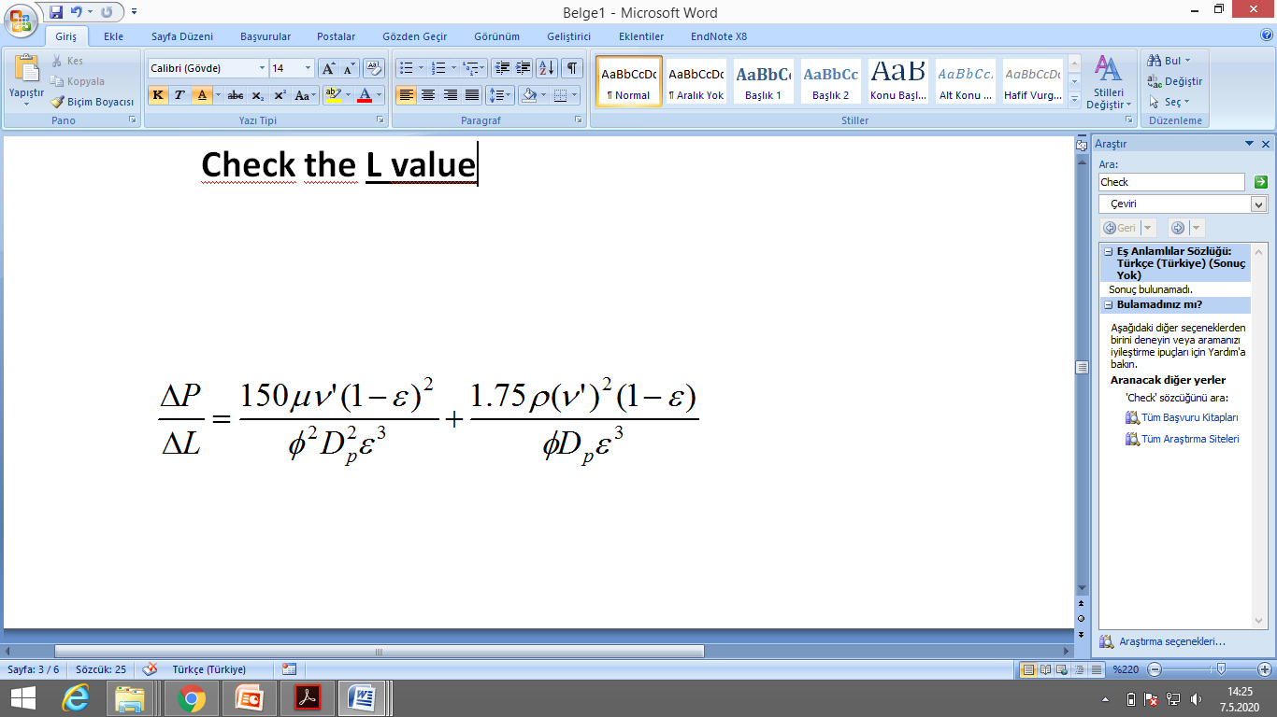
Theoritical pressure loss (∆P_{theo}) calculation
Use Ergun equation:
ΔP is theoritical pressure drop, Pa;
L is the length of the bed, m; (Take it from your data)
ν' is the velocity of the air m/s; (Take it from your data)
ε is the porosity, (See the next slide)
ρ is the density of the air at 25°C , kg/m³;
μ is the viscosity of the air at 25°C , kg/m.s;
D_{p} is the diameter of the particles, m (take D_{p} as 0.005 m)
ɸ is sphericity (See the next slide).

Slide 12
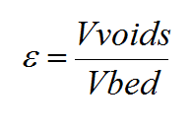
Porosity (ε) calculation
V_{voids} : V_{bed} – V_{particle}
V_{particle} = m_{particle} /ρ_{particle}
m_{particle :} 0.45 kg coffee granules
ρ_{particle :} 606.67 kg / m³
V_{bed} = A_{bed} * L_{bed}
A_{bed} : pi * r_{bed}²
r_{bed}: 0.08 m
L_{bed:} take it from data for each blower level

Slide 13
Sphericity (ɸ) calculation
Particles in fluidized bed are irregular in shape. The equivalent diameter of a particle is defined as the diameter of a sphere having the same volume as this particle. The sphericity shape factor Φ_{s} of a particle is the ratio of the surface area of this sphere having the same volume as the particle to the actual surface area of the particle. In this experiment we assumed our coffee granule particles as hemi-sphere.
V_{sphere} = V_{particle}
4/3 * pi * r_{sphere}³ = (4/3 * pi * r_{particle}³) / 2
r_{particle} : 0.0025 m
Find r_{sphere}
Φ = Surface area of sphere / Surface area of particle
Φ = (4*pi* r_{sphere}²) / (2*pi* r_{particle}² + pi* r_{particle}²)
!! ! Shape factor value must be between zero and one (0 < Φ < 1)

Slide 14
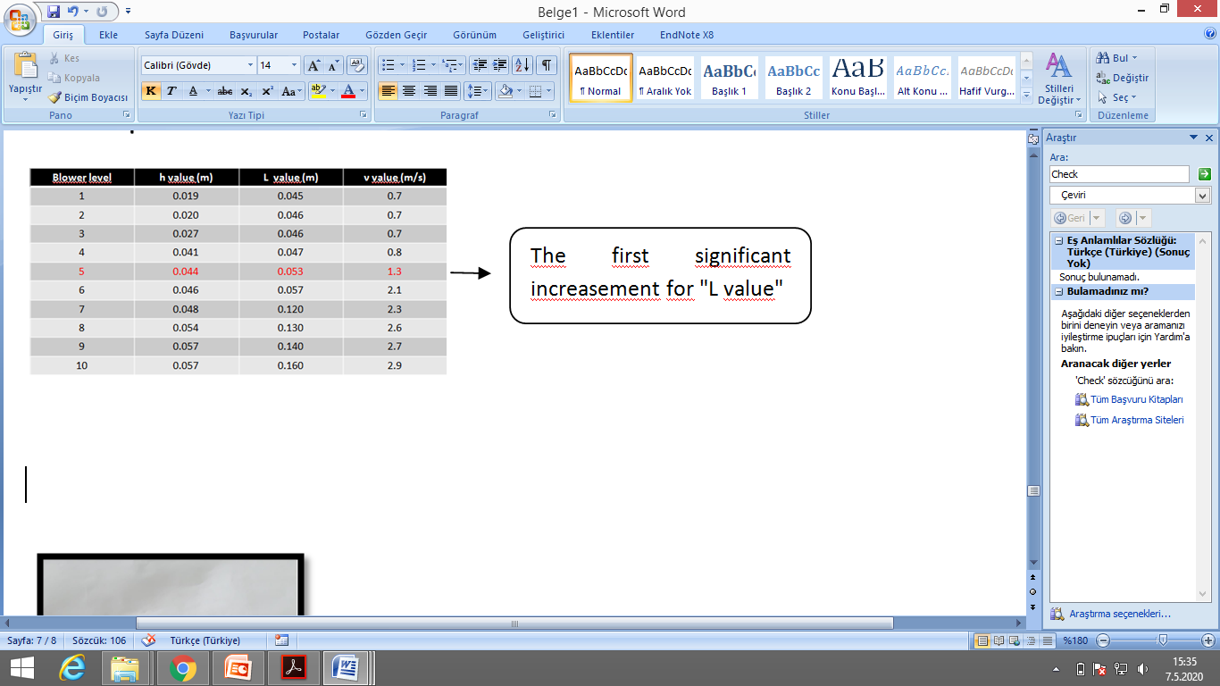
Minimum fluidization
Minimum fluidization is the first movement point of the static particles (For this experiment blower level 5).

Slide 15
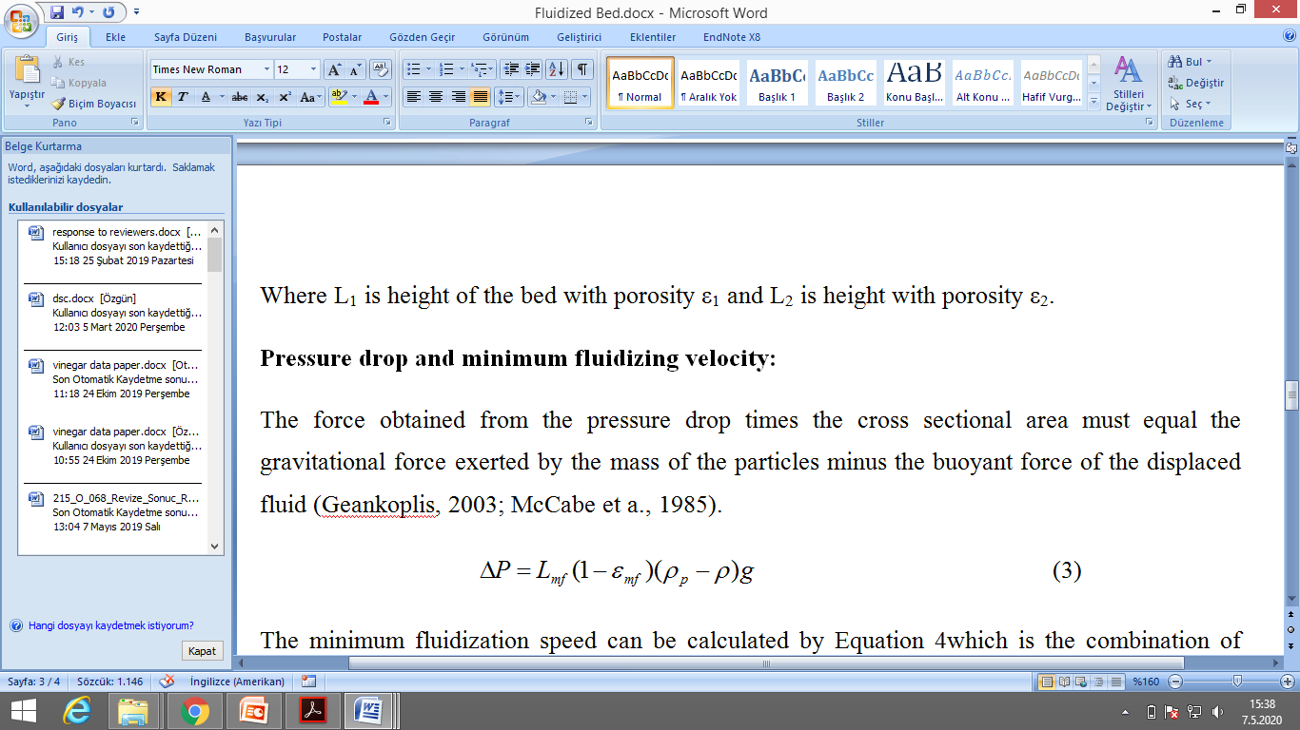
Pressure loss calculation for minimum fluidization point : ∆P_{mf}
L_{mf} : (from data)
ρ_{particle :} 606.67 kg / m³
ρ _{air} at 25°C, kg / m³
g: gravitational force, m²/s

Slide 16
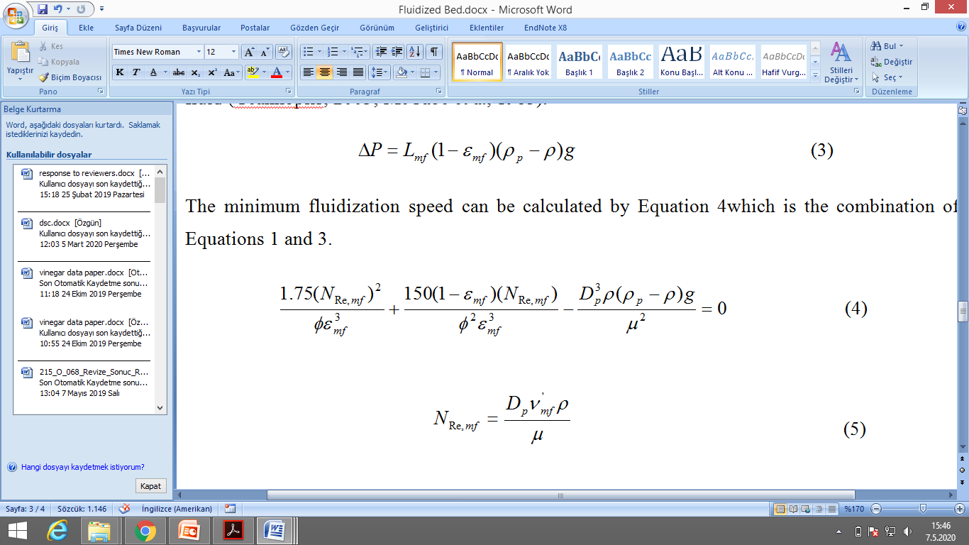
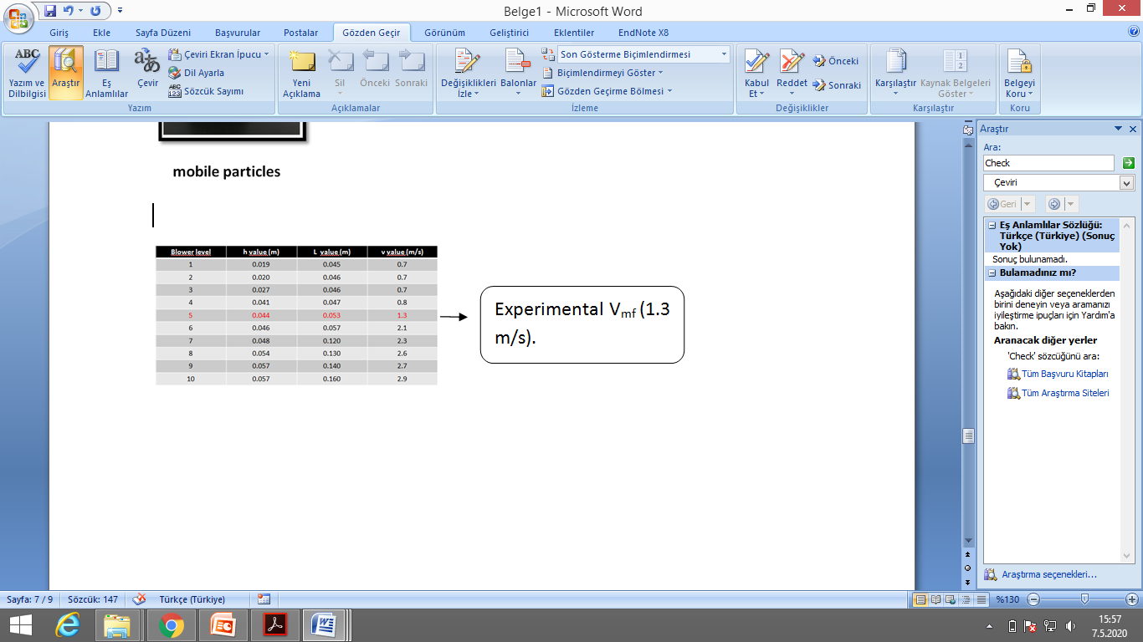
Theoritical minimum fluidization velocity calculation: ν_{mf}
Hint: Take N_{Re, mf} as "X" and therefore the above equation become ax² + bx - c, take discriminant and find X (means N_{Re, mf} ) easily, after that find V_{mf.} Compare this value with experimental V_{mf} (1.3 m/s).

Slide 17
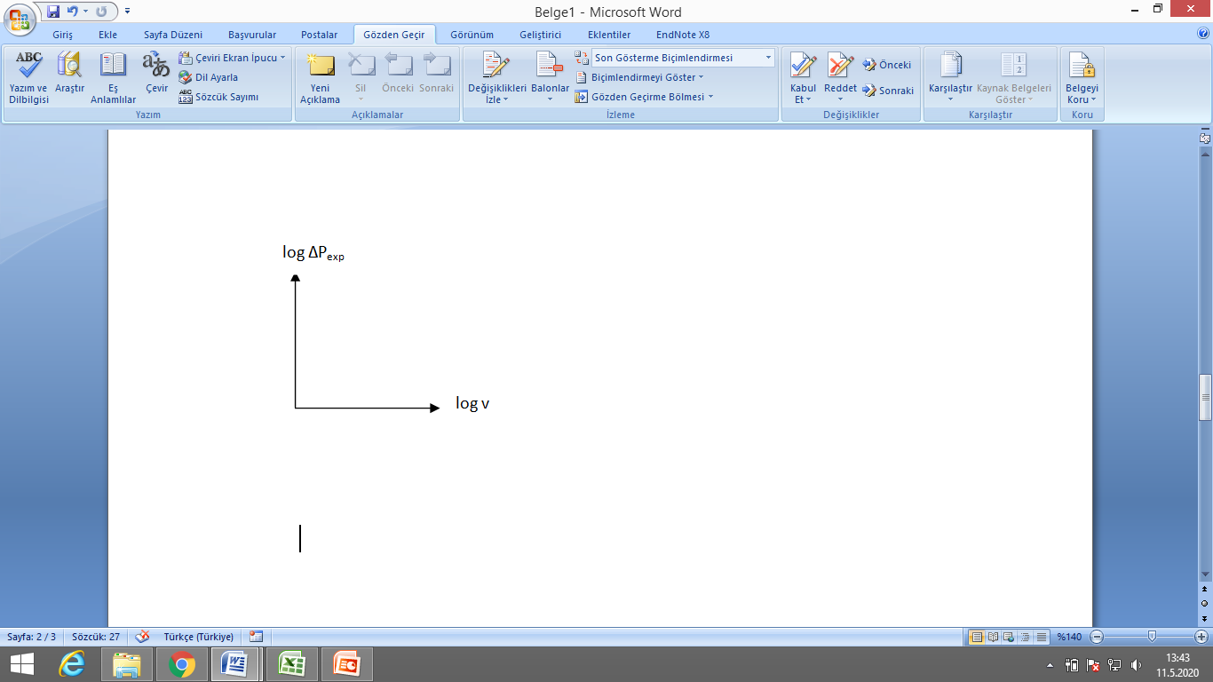
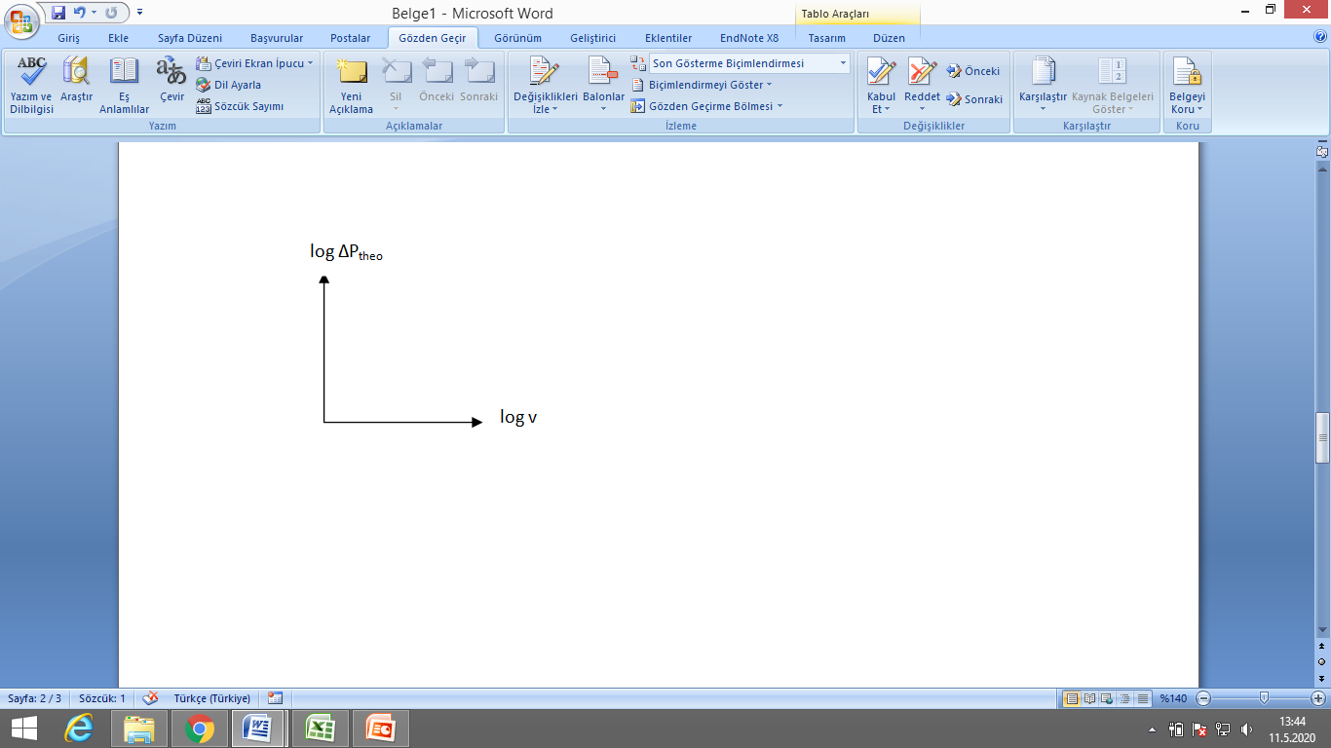
Observations
After making the calculations, you must have the data to fill all the spaces in the tables and graphs you see below.
Blower level | ∆P_{exp} | ∆P_{theo} | ε
1
2
3
4
5
6
7
8
9
10
sphericity (ɸ) shape factor
∆P_{mf}
(theoretical) ν_{mf}

Slide 18
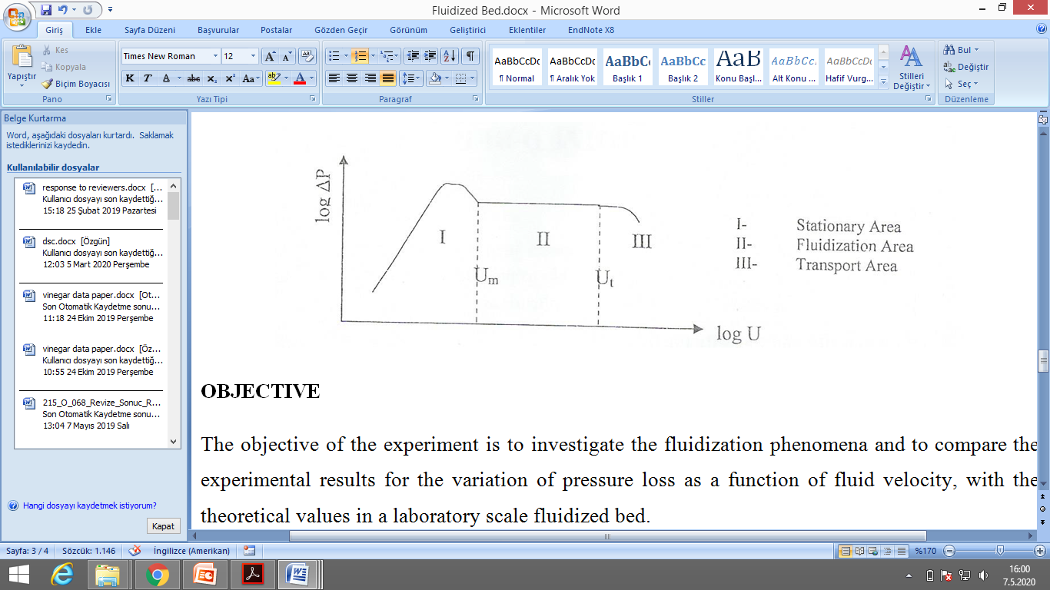
Plot the graph between logarithmic experimental pressure drop and air velocity in bed (log ∆P_{exp} vs log ν) with using all 10 blower levels.
Plot the graph between logarithmic theoretical pressure drop and air velocity (log ∆P_{theo} vs log ν) with using all 10 blower levels.
Your plots will be similar to above plot.

Slide 19
Good luck =)
Do not forget to write your group name, “Fluidized Bed Report” and education type.
You have 1 week for your experiment report preparation.

