Slide 1
FE 322 FOOD PRODUCTION MANAGEMENT
3. ORGANIZATION STRUCTURES

Slide 2
ORGANIZATION STRUCTURES
The result of an organization design is usually an organization chart that shows the formal relationships among functions and people responsible for those functions
Organization chart of a medium-sized company

Slide 3
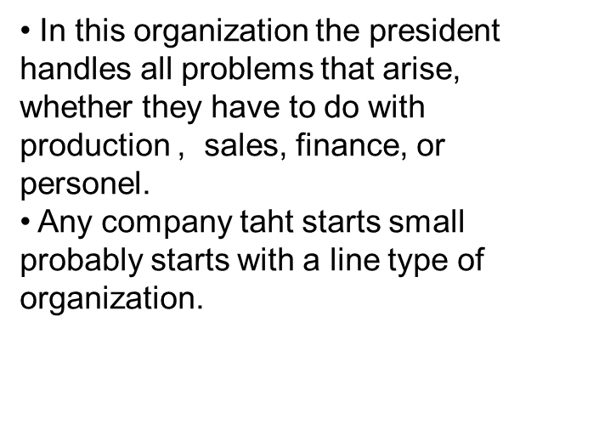
ORGANIZATION STRUCTURES
Line Organization
The simplest form of organizationis the straight line. The significant feature, as the name implies, is that the position listed on the organization chart are in a vertical line.

Slide 4
The Line and Staff Organization
The line and staff type organization in sipmlified form is
In this case the specialists are the chief engineer and sales manager, who are added in order to relive the president of some of his burden. Certain responsibilities are shared by the two specialists, but they report to president, who retains overall responsibility for the operation of the business.

Slide 5
It has mentioned earlier that staff people should be given a certain amount of authority and responsibility.
The question is
How much ?
Does a chief engineer make all decisions in regard to engineering matters and a sales manager all decisions in regard to sales ?
In a true line and staff organization the answer is “probably not”
The staff man only studies a situation and make recommendations to his supervisor. The superior makes the decision.
It is felt in many cases that the specialist should do more than recommend. He should have full authority over his particular function. This principle is followed in many companies and is called
“a line and functional staff type organization”.

Slide 6
Types of Staff Departments
Staff departments are not all alike and are generally to be of four kinds:
Advisory (Legal, public relations, labor relations...)
Control (Personel, credit, budgeting, accounting...)
Service (Construction, purchasingtraffic, insurance...)
Coordinating
Use of Committees
The purpose served by forming a committee at one level in the organization may be one or more of the following:
To coordinate various functions
To secure cooperation of various personel
To solve a problem
To train younger executives.

Slide 7
Functional Staff Organization
Staff Organization Based on Customer

Slide 8
Staff Organization Based on Products
Staff Organization Based on Region

Slide 9
Matrix Organization
Functional responsibility
Project responsibility

