Slide 1
FE 517 Edible films and coatings
Dr. Burcu GÖKKAYA ERDEM

Slide 2
Content
Food Packaging: Historical Background
The Main Functions of Food Packaging
The Importance of Biodegradable Packaging
Edible Films and Coatings: Definition, Historical Background And Requirements

Slide 3
Food Packaging: Historical Background
Packaging should provide successful protection against not only chemical but also physical challenges, thereby that means it has a crucial role for protecting both the safety and the quality of the food products. Packaging for food is part of human history and it has been developed more and more over thousands of years. During the early years of humanity, people just ate what they could find or hunt in their close surroundings. When humans started to stay in a sheltered area rather than a nomadic lifestyle, a need for containers to store the food increased. During the 18th century, some natural materials such as leaves, shells and woods had been used for holding the food, in that years no sophistication in packaging materials were exist.

Slide 4
Food Packaging: Historical Background
The Industrial Revolution brought the development of new manufacturing processes and new materials. One of the initially manufactured packaging materials was a metal can for snuff, because the metal can had ensured effective flavor and moisture preservation of the packed product. Later, they were used for the operation of canning that was discovered by an inventor (Nicolas Appert) when he found a way to increase the shelf life of the food for the army of French Emperor Napoleon Bonaparte(Risch, 2009). Nicholas Appert used glass bottles with corks secured with a wire as a lid to contain food while heating. However, fragility was an important problem for glass bottles but was not for metal cans. Metal can usage makes the heating process much more easier and extended shelf life was provided.

Slide 5
Food Packaging: Historical Background
The first usage of the paperboard was to manufacture folding cartons at the beginning of the 1800s. In the 1850s, corrugated boxes were produced which were widely used in the present time as a shipping container to hold some smaller packages. Actually, in the 1800s plastics such as vinyl chloride and cellulose nitrate were even discovered but not used actively until the 20th century. Their first uses were during World War II with commercialization for food packaging occurring after the war. Protection of food and food quality began to attack more attention after World War II. All packaging materials, including plastic, that developed during the war application found a place in the food packaging industry after the war. Polyethylene has several types that in use today such as low-density (LDPE) and high-density (HDPE). The first developed type was LDPE in the 1900s by Imperial Chemical Industries. All these packaging materials lead to chemical migration at a different rate in accordance with the characteristics they have into food products (Öksüztepe and Beyazgül, 2015). As a result of migration, the substances which are harmful to human health migrate from packaging material into food and due to that situation packaging material should be safe as the food product (Altuntaş, 2014).

Slide 6
The Main Functions of Food Packaging
The principal roles of food packaging can be summarized as protecting the food from environmental influences and damage, containing the food product, and providing information about ingredient and nutritional information to consumers (Coles et al., 2003). Also, traceability and convenience are other functions of increasing importance. Actually, the summarized target of food packaging is to contain food in a cost‐effective manner that satisfies both industry requirements and consumer desires, provides food safety, and minimizes environmental impact.

Slide 7
The Main Functions of Food Packaging
- Protection/preservation: Packaging can retard or resist food spoilage, retain the beneficial effects of processing, extend shelf‐life, and maintain the product quality and safety of food. To make them happen, the food product is protected from three main types of external influences as chemical, biological, and physical by packaging. *Chemical preservation hinders or decreases compositional changes triggered by environmental effects such as exposure to gases (e.g. oxygen), moisture migration, or light (e.g. UV). Many different packaging materials exist to provide a chemical barrier to food products. *As for biological protection, it provides a barrier to microorganisms (e.g. pathogens), insects and rodent, thereby preventing disease and deterioration. Additionally, these biological barriers maintain suitable conditions to control senescence. The functions of this kind of barriers can be summarized as to prevent access to product, to prevent transmission of odor and try to maintain the ideal internal environment of the package. *Physical protection keep safe the food from mechanical hazards (e.g. vibration encountered during distribution).

Slide 8
The Main Functions of Food Packaging
- Containment and waste reduction: It is an undeniable fact that, food packaging has a great effect on food waste control during its supply chain. Because unsuitable or inadequate preservation during the food storage and/or transportation period may be promoted of the waste amount. Appropriate packaging prolongs food products usability by extending their shelf life, thereby reduces the total solid waste.
- Marketing and information: The package is the first influencer agent for the product to be sold and before purchase it is the only thing that the consumer can be experienced. Briefly, the package which designed as both innovative and informative may boost the food product sales in even a competitive environment. For instance, it is crucial that a label contains some necessary knowledge about the product being sold such as identification of the food, its nutritional value, weight explanations and the information about the manufacturer.

Slide 9
The Main Functions of Food Packaging
- Traceability: The definition of traceability is "the ability for following the movement of a product through its fabrication, processing and distribution stages” (Marsh and Bugusu, 2007). Actually, 3 main objectives exist for traceability as *firstly improvement of supply management, *secondly facilitation of trace‐back for food safety and quality, thirdly *differentiation & marketing the food which has subtle or undetectable quality attributes (Golan et al., 2004). The companies of manufacturing identify unique codes to their food package labels and these codes are used for tracking their products throughout the all distribution process. Various formats can be used for codes such as printed barcodes and they may read manually or by a machine.

Slide 10
The Main Functions of Food Packaging
- Convenience: Package innovation affect by some convenience features. For example, accessibility, easy-handling, resealability or microwavability are some of them. Consequently, packaging greatly plays an important role to minimize necessary effort not only prepare but also serve the food products. Development in food packaging has facilitated the advances of modern retail formats that offer to consumers the convenience of 1‐stop shopping and the accessibility of food from around the world. These mentioned convenience features certainly add value and competitive advantages to food products but may also affect the amount and type of packaging waste requiring disposal.

Slide 11
The Importance of Biodegradable Packaging
Packing materials mainly are separated into two groups which are nondegradable (synthetic) and biodegradable (edible). Synthetic packings are usually petrochemical- based plastic materials such as polyesters or polyamides. These materials have been used for long years, due to their availability in large quantities at low cost and having desirable packaging functional characteristics such as high mechanical also barrier properties to oxygen and aroma compounds. On the contrary, they lead to environmental pollution and migration problems, which cause serious ecological problems. Hence, it is recommended that the usage of these type of packing should be reduced concerning waste disposal (Tharanathan and Saroja, 2001).

Slide 12
The Importance of Biodegradable Packaging
For a few years, there is a paradigm shift arised by the increasing environmental awareness by all to look for biodegradable coating and film processes, that are edible and thereof totally compatible with nature. It is a serious fact that, being biodegradable is a requirement for ensuring to keep the balance of nature. Therefore, the biodegradable concept consists of eco-friendly attributes and the raw materials for production are derived from waste and/or by-products of different food industries such as agricultural, marine, soy, cheese, etc. Briefly, edible packaging capitalizes on totally natural resource conservation with an underpinning on eco-friendly and safe atmosphere. An additional advantage of biodegradable packaging materials is that on biodegradation or disintegration and composting they may act as fertilizer and soil conditioner, facilitating higher yield of the crops. In conclusion, biopackaging is both human and nature need for obtaining healthier tomorrows and value-added products

Slide 13
Edible Films and Coatings: Definition, Historical Background And Requirements
Edible film and coating is a primary package produced from natural raw components. These biodegradable packaging materials can be applied on food either firstly formed into a film and wrapped the product or they directly applied as a thin layer on the product. Improved oxygen and moisture barrier, enhanced mechanical attributes, protection against microorganisms and extend shelf life of the different types of foods are some of the functions of the biobased edible films and coatings (Krochta, 2002). They also ensure a brighter and smoother appearance to food products therefore better sensorial properties are observed.

Slide 14
Edible Films and Coatings: Definition, Historical Background And Requirements
Besides, they are good carriers of antimicrobials, antioxidants, sweeteners, flavors and color materials. Actually, food preservation is one of the particular considerations for edible films and coatings due to their good ability to improve global food quality (Chillo et al., 2008). Indeed, biodegradable coatings and/or healthy-to-eat films were utilized from ancient times during food manufacturing to preserve them, thereof this approach is not a latest packaging method (Hassan et al., 2018). For example, citrus fruits has been coated with a lipid type material (wax) to delay the product dehydration since 12th century in China (Guilbert, 1986).

Slide 15
Edible Films and Coatings: Definition, Historical Background And Requirements
Another example for old applications is coating to cut meat with fat to prevent them from the shrinkage that has been the usual practice in the 16th century. In the 20th century, gelatin-coating began to suggest to meat and some other food types. Later in the last century, the preservation of meat and other foodstuffs by coating them with gelatin films was suggested. A traditional Asian edible film, Yuba (that produced from boiled soy milk skin), was used to protection of foodstuffs since the 15th century (Gennadios et al., 1993). In the nineteenth century, some snack foods such as nut, almond or hazelnut were coated with sucrose to prevent them from oxidative and rancidative spoilage during their storage periods. The years of the 1930s were the beginning for more important application approach of edible film and coating as being emulsion that made of oil in water to improve the food brightness, to preserve from fungicides, to maintain better ripening control and to retard moisture loss for treated fruits. Numerous studies exist in terms of fabrication, application and assessment of biodegradable films and coatings in literature, especially their numbers are increased over the last 60 years (Debeaufort et al., 1998).

Slide 16
Briefly..
All in all, biodegradable films and coatings have to include some requirements due to they are both a packaging material and a food component, and they are summarized as below:
• Having good sensorial properties,
• Having high barrier and mechanical properties,
• Being non-toxic and safe for human health,
• Having easy application technology,
• Being biodegradable,
• Being cost-effective of raw materials and processes.

Slide 17
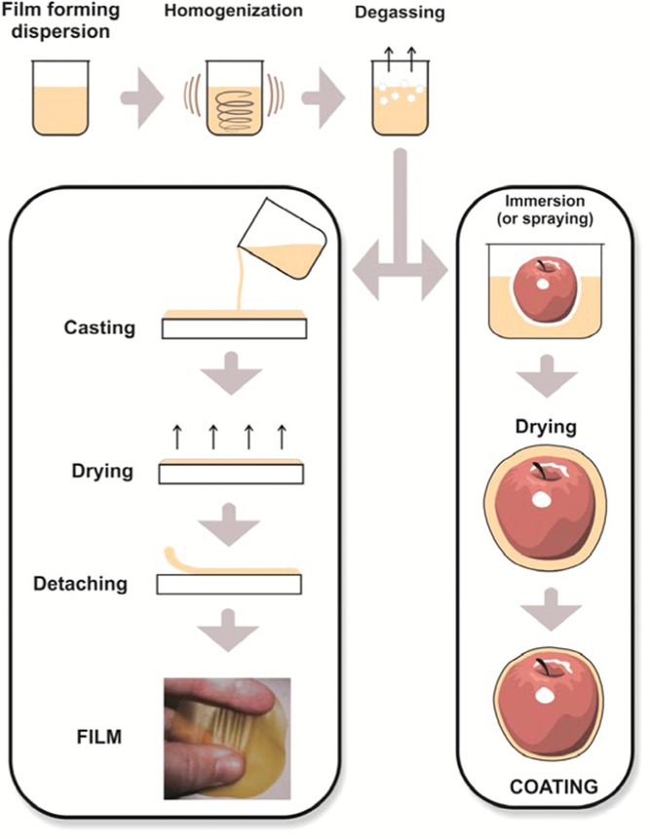
Schematic representation of production of films and coatings (Otoni et al., 2017)

Slide 18
The Functional Properties of Edible Films and Coatings
Edible films and coatings have similar functions as those of conventional packaging, including as barriers against water vapor, gases, and flavor compounds and improving structural integrity and mechanical-handling properties of foods. Although edible films and coatings are not meant to entirely replace conventional packaging, the efficiency of food protection can be enhanced by combining primary edible packaging and secondary non-edible packaging (Debeaufort et al., 1998). In most cases, the water barrier efficiency of films is desirable to retard the surface dehydration of fresh (meat, fruits, and vegetables) or frozen products. The water absorption inducing the loss of crispness in dried cakes, for example, could be delayed by coatings.

Slide 19
The Functional Properties of Edible Films and Coatings
The control of gas exchanges, particularly of oxygen, allows better control of the ripening of fruits or significantly reduce the oxidation of oxygen-sensitive foods and the rancidity of polyunsaturated fats, for example. Organic vapor transfers have to be diminished in the aim to retain aroma compounds in the product during storage or to prevent solvent penetration in foods, which can involve toxicity or off-flavors. The penetration of oil during frying and of sucrose or sodium chloride during osmotic dehydration can be limited by an edible film. One of the more interesting applications of edible films and coatings is their use inside a composite food to control mass transfers between the different compartments of the product, for example in order to reduce water migration in a pie from cream part to dough part. The effect of light and the effect of UV light that involves oxidation reactions in foods could be reduced. In the latter case, the efficiency of the film to prevent the light effect can be improved by the addition of pigments or light absorbers.

Slide 20
The Functional Properties of Edible Films and Coatings
Edible packagings can improve the mechanical properties of food to facilitate handling and carriage. The sensorial characteristics such as color, shininess and transparency of the coated food product can be improved because of the edible films or coatings own bright characteristic. Edible films and coatings enable to protect or separate small pieces or food portions for individual consumption, or to isolate pre-dosed quantities of food additives or ingredients with the aim of facilitating the formulation and the preparation of food in industrial plants. Functional efficiency strongly depends on the nature of components and film composition and structure. The choice of film forming substance and/or active additive is a function of the objective, of the nature of the food product and of the application method.

Slide 21
THANK YOU
Prepare a 2-3-4 page assignment/report related to this presentation.

