Slide 1
FE 322 FOOD PRODUCTION MANAGEMENT
1. INTRODUCTION TO MANAGEMENT SYSTEMS

Slide 2
INTRODUCTION TO MANAGEMENT SYSTEMS
Operations management may be defined as the planning, organizing, staffing, directing, and controlling the production system that creates the firm’s primary products and services ....
Marketplace
Corporate Strategy
Finance Strategy
Operations Strategy
Marketing Strategy
Operations management
Inputs:
Materials
Customers
Outputs:
Products
Services
People
Plants
Parts
Processes
Planning & control systems
Production System

Slide 3
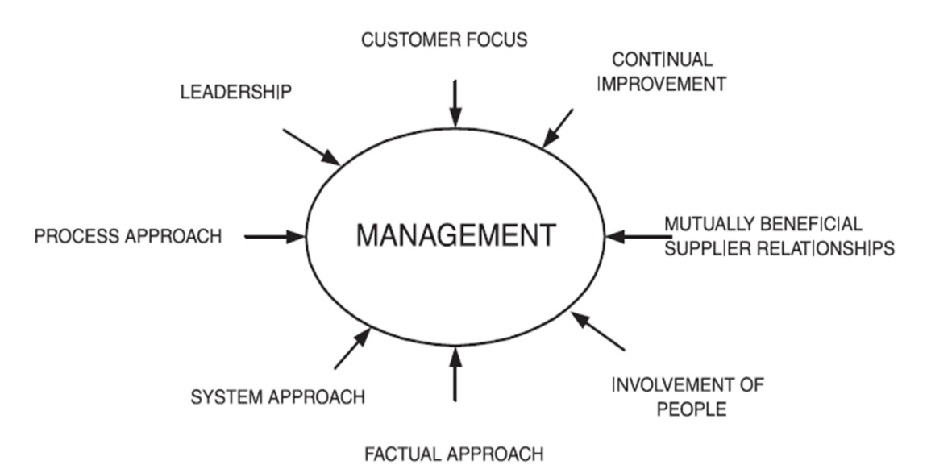
TQM - TOTAL QUALITY MANAGEMENT
The basic principles for the Total Quality Management (TQM) philosophy of doing business are to satisfy the customer, satisfy the supplier, and continuously improve the business processes. Organizations depend on their customers and therefore should understand current and future customer needs, should met customer requirements and strive to exceed customer expectations. Nearly every organized activity can be looked upon as a process. This process is supported by on organization consisting of people and their relations, resources and tools. Continuous improvement is an integral part of a total quality management system. Common tool to achieve to continuous improvement could be the plan-do-check-act (PDCA) cycle, often called the Deming Wheel, which conveys the sequential and continual of the continuous improvement process.

Slide 4

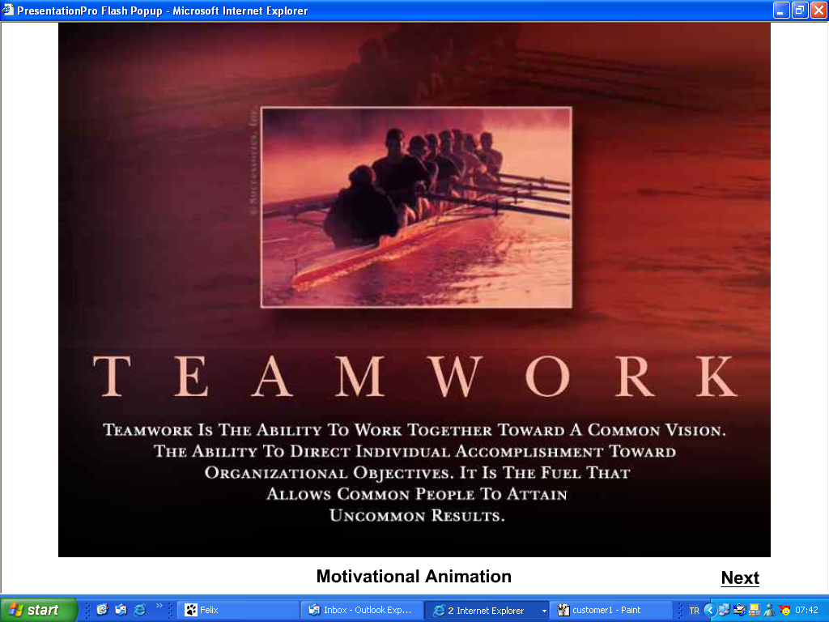

TQM - TOTAL QUALITY MANAGEMENT
Customer focus
Organizations depend on their customers and therefore should understand current and future customer needs, meet customer requirements and strive to exceed customer expectations.
Leadership
Leaders establish unity of purpose and direction for the organization. They should create and maintain the internal environment in which people can become fully involved in achieving the organization’s objectives.
Process approach
A desired result is achieved more efficiently when related resources and activities are managed as a process.

Slide 5
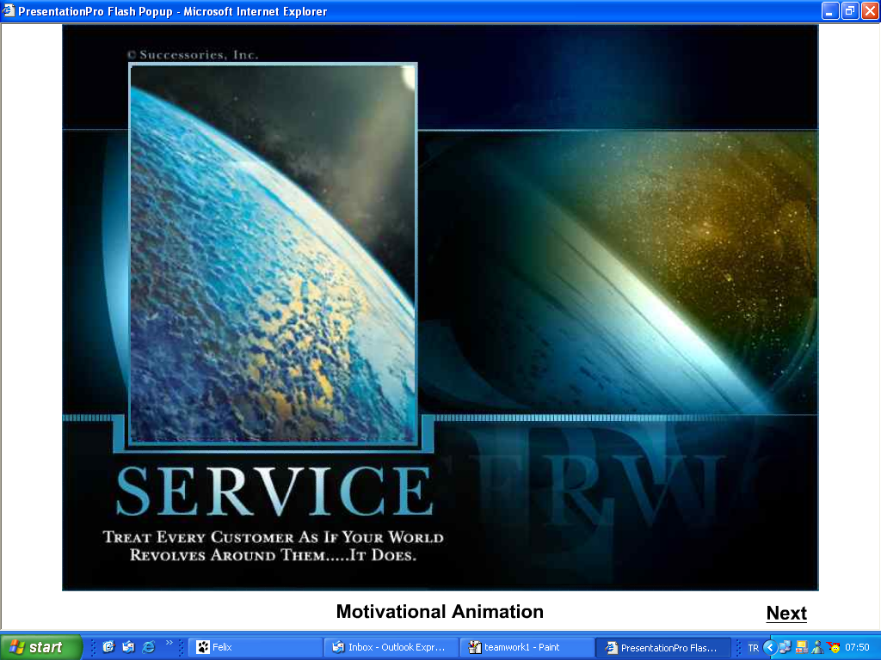
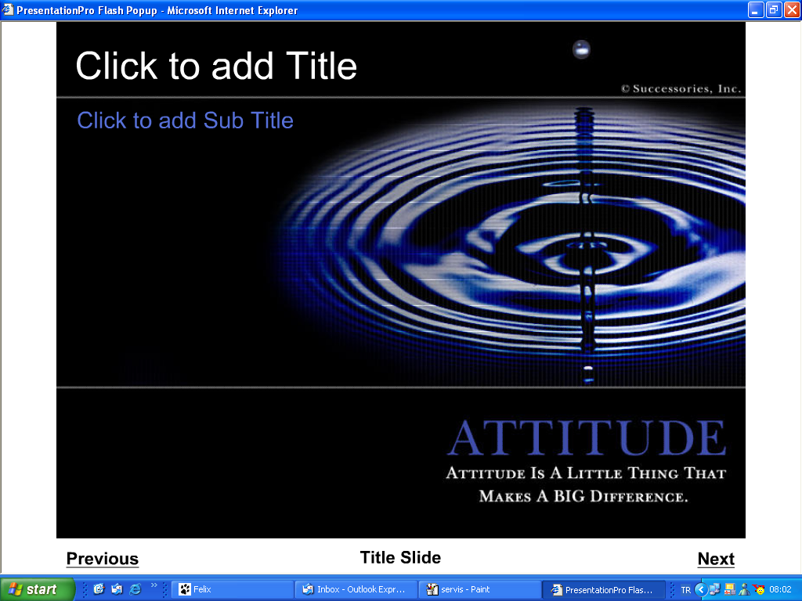
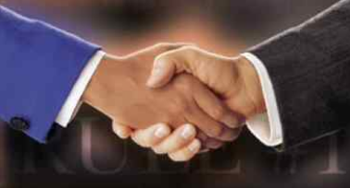
TQM - TOTAL QUALITY MANAGEMENT
System approach to management
Identifying, understanding and managing interrelated processes as a system contributes to the organization’s effectiveness and efficiency in achieving its objectives.
Continual improvement
Continual improvement of the organization’s overall performance should be a permanent objective of the organization.
Mutually beneficial supplier relationships
An organization and its suppliers are interdependent and a mutually beneficial relationship enhances the ability of both to create value.

Slide 6
CONTINUOUS IMPROVEMENT - Deming Cycle
Continuous improvement is a management philosophy that approaches the challenge of product and process improvement. Specifically, continuous improvement seeks continual improvement of machinery, materials, labor utilization, product quality and safety, and production methods through application of suggestions and ideas of team members
Deming Wheel (PDCA Cycle)
Plan (P): The plan phase of the cycle is an improvement area and a specific problem with it to be identified. In this phase, objectives and strategies are developed and necessary sources are determined.
Do (D): The do phase of the cycle deals with implementing the changes according to the plan.
Check (C): The check phase deals with evaluating data collected during implementation.
Act (A): During the act phase, the improvement is codified as the new standard procedure; necessary revisions are applied and replicated in similar processes throughout the organization.

Slide 7
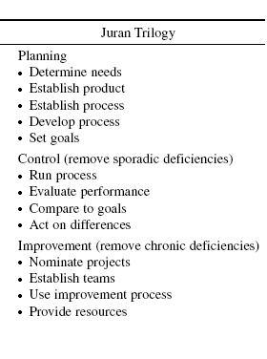
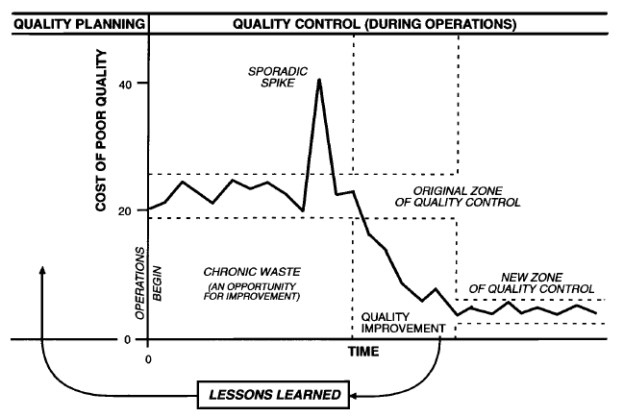
CONTINUOUS IMPROVEMENT - JURAN TRILOGY
To attain quality, it is well to begin by establishing the “vision” for the organization, along with policies and goals.
Conversion of goals into results (making quality happen) is then done through managerial processes—sequences of activities that produce the intended results. Managing for quality makes extensive use of three such managerial processes:
- Quality planning
- Quality control
- Quality improvement
These processes are now known as the “Juran trilogy.”

Slide 8
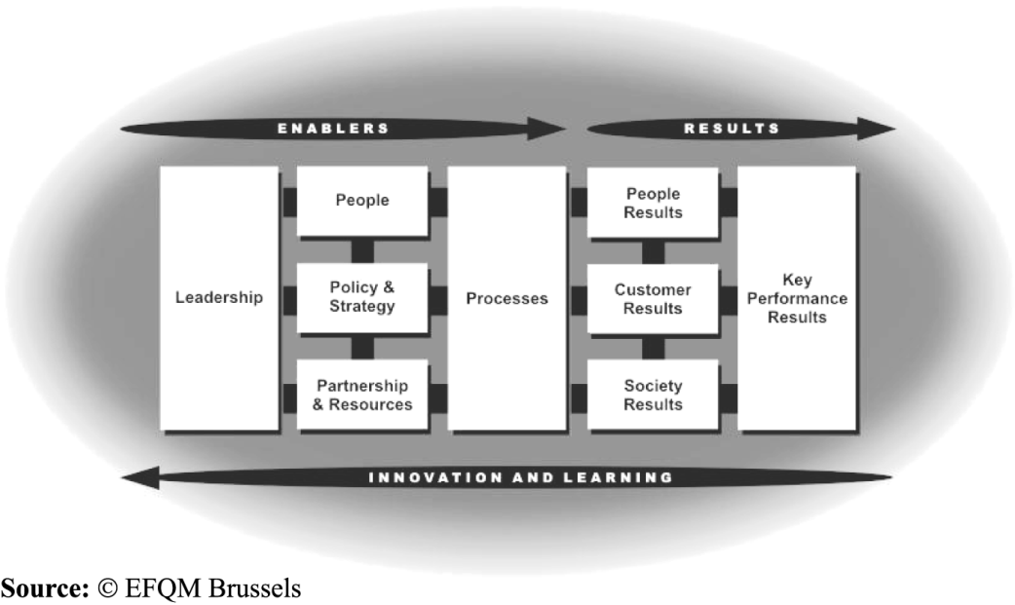
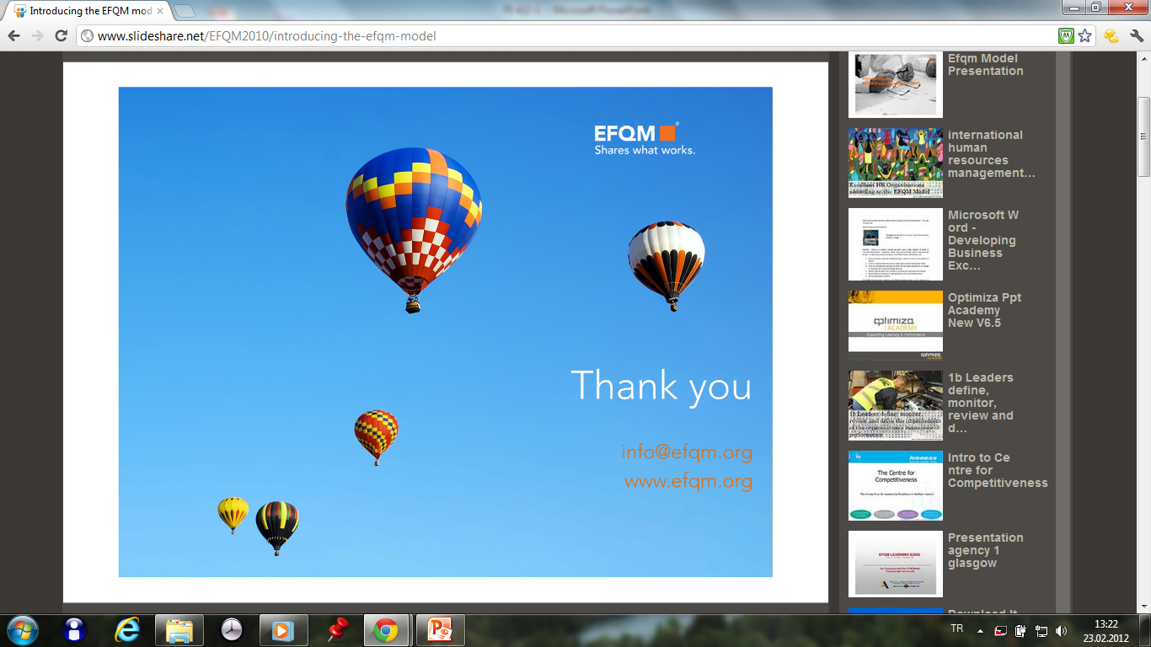
EFQM ( European Foundation for Quality Management)
EFQM (formerly known as the European Foundation for Quality Management) is a non-profit membership foundation based in Brussels. EFQM is the custodian of the EFQM Excellence Model, a non-prescriptive management framework that is widely used in public & private sector organisations throughout Europe and beyond.
EFQM Membership is open to organisations, rather than individuals. Members include: BMW, EDF, Grundfos, Philips, Ricoh, Robert Bosch, Solvay and Trimo.
EFQM runs the annual EFQM Excellence Award, which is designed to recognised organisations that have achieved an outstanding level of sustainable excellence.

Slide 9
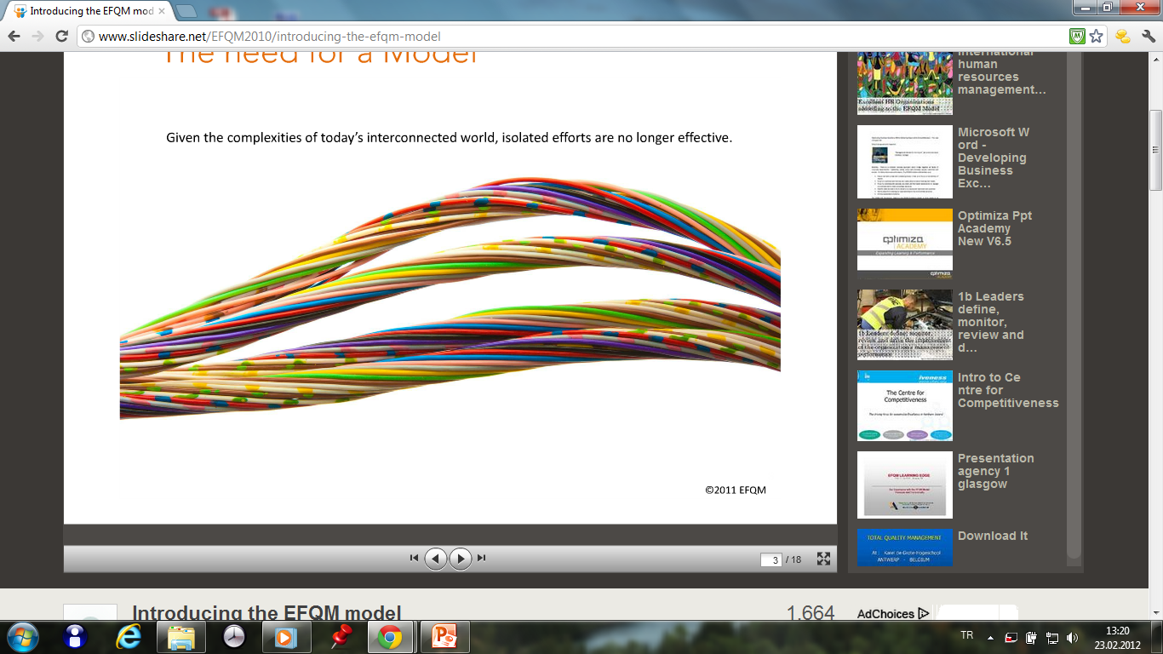
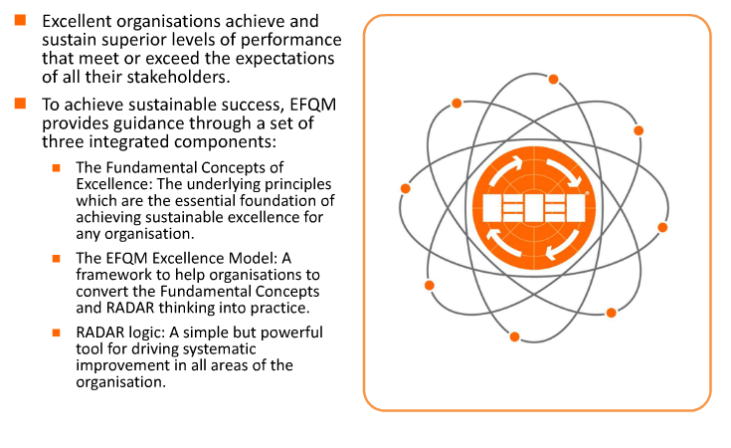

Slide 10
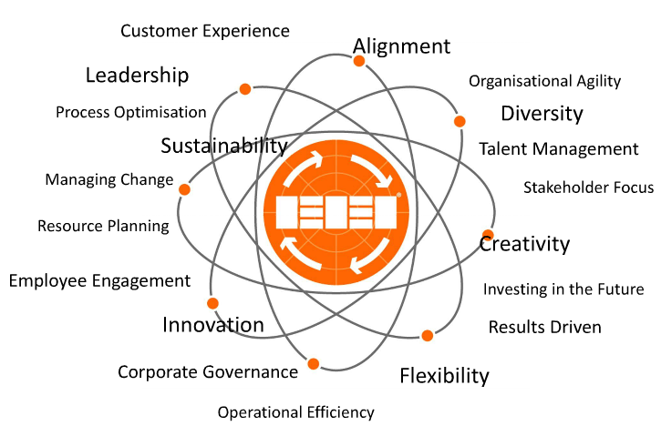
EFQM ( European Foundation for Quality Management)

Slide 11
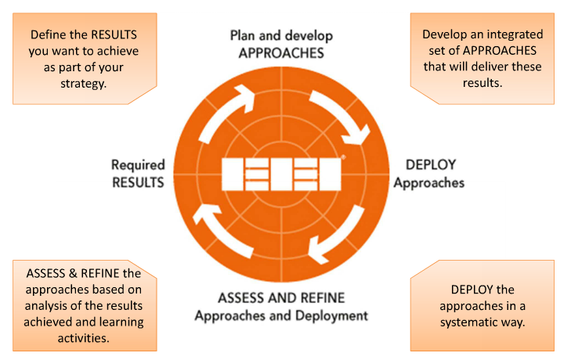
EFQM ( European Foundation for Quality Management)

Slide 12
ISO 9000-QUALITY MANAGEMENT SYSTEM STANDARD
ISO 9000:2000 is in fact families of standards developed to assist organizations implement and operate effective quality management systems (QMS). ISO 9000:2000 consisted of quality systems that focused on documenting all quality assurance and improvement processes in a company (ISO, 1999). Although the ISO 9000:2000 was originally developed for the manufacturing sector, it had been applied to many service organizations and was gaining some acceptance in the food industry.
The ISO 9000:2000 standard describes a basic set of 8 elements by which quality management system can be developed and implemented.

Slide 13
ISO 22000-FOOD SAFETY MANAGEMENT SYSTEM STANDARD
ISO 22000-2005 FSMS aims to harmonize the requirements for food safety management in food and food related business (ISO, 2005). ISO 22000-2005 FSMS assists the food manufacturers in the use of HACCP principles. Main elements in ISO 22000:2005 FSMS are compatible with ISO 9000:2000 QMS. Both models consist of 5 major elements.
The ISO 9000:2000 standard describes a basic set of 8 elements by which quality management system can be developed and implemented.

