Slide 1
FE 422 FOOD PRODUCTION MANAGEMENT
4. ISO 9000 Quality Management System Standards

Slide 2
Role, origins and application of ISO 9000
What is ISO 9000?
ISO 9000:2000 is a series of three International Standards for Quality Management Systems. They specify requirements and recommendations for the design and assessment of management systems. ISO 9000 is not a product standard. None of the standards in the family contain requirements with which a product or service can comply. There are no product acceptance criteria in ISO 9000 so you can’t inspect a product against the standard.

Slide 3
Role, origins and application of ISO 9000
What is the purpose of ISO 9000?
The purpose of these standards is to assist organizations of all types to implement and operate effective quality management systems. These standards provide a vehicle for consolidating and communicating concepts in the field of quality management that have been approved by an international committee of representatives from national standards bodies. It is not their purpose to fuel the certification, consulting, training and publishing industries. The primary users of the standards are intended to be organizations acting as either customers or suppliers.

Slide 4
Role, origins and application of ISO 9000
What is the ISO 9000 family of standards?
The three standards in the family are
ISO 9000 Quality management systems – Fundamentals and vocabulary
ISO 9001 Quality management systems – Requirements
ISO 9004 Quality management systems – Guidelines for performance improvements

Slide 5
Role, origins and application of ISO 9000
What is the purpose of these standards?
Each standard fulfils a different purpose.
The purpose of ISO 9000 is to provide an appreciation of the fundamental principles of quality management systems and an explanation of the terminology used in the family of standards.
The purpose of ISO 9001 is to provide requirements which if met will enable organizations to demonstrate they have the capability to consistently provide product that meets customer and applicable regulatory requirements. ISO 9001 states that the standard can be used to assess the organization’s ability to meet customer, regulatory and the organization’s own requirements.
The purpose of ISO 9004 is to provide guidance for improving the efficiency, effectiveness and overall performance of an organization.

Slide 6

Model of a process based quality management system

Slide 7
KEYS
Audits Audits of management system design, processes and conformity with ISO 9001 – no longer limited to procedure audits
Communication Processes for internal communication rather than systems of documentation
Continual improvement The effectiveness of the management system to be continually improved – not merely reviewed
Contract Review Replaced by a wide-ranging review of all product requirements including customer, organizational and regulatory requirements – no longer limited to contracts and tenders. The standard has moved away from the original intention of it being used in a contractual situation to one in which there might be no contract until after a product or service has been developed.
Customer satisfaction Customer perceptions of the organization’s performance to be monitored as one of the measures of management system performance
Design If the organization designs its own products and services, design and development processes must be included in the management system (see Exclusions below)

Slide 8
KEYS
Documentation Determined by the organization as necessary for effective operation of its processes – not simply as required by the standard
Linkages Organization purpose, policy, objectives, processes and results to be linked to demonstrate effective process management
Management review Top management to review the system for its effectiveness in enabling the organization to meet requirements of customers and other interested parties – no longer limited to a review of audit results and customer complaints
Marketing The processes employed to determine customer needs and expectations must form part of the management system – no longer limited to contract review activities
Measurement Required for all processes not only production, servicing and installation processes
Procedures Only six procedures specified as requirements, others as needed for effective operation and control of the processes
Processes All processes that serve the achievement of the organization’s objectives to comprise the management system – no longer limited to production, installation and servicing

Slide 9
KEYS
QMS To be designed around the organization’s processes not the elements and clauses of the standard
Quality Manual Needs to describe the interaction between processes – is not to be a response to each clause of the standard
Quality objectives Separate from the policy but consistent with it and established at relevant levels and functions – the driver of continual improvement in performance
Quality policy To be appropriate to the purpose of the organization and provides a framework for quality objectives – not a motherhood statement
Records As needed to provide evidence of effective operation – all types of records not simply those referred to as quality records
Requirements Commitment to meeting requirements of customer and other interested parties – no longer limited to the organization’s own requirements
System effectiveness To be measured, analysed and continually improved and judged by the degree to which customers are satisfied – not judged on conformity with standard
Top management Must be involved in establishing, developing, reviewing and improving the management system

Slide 10
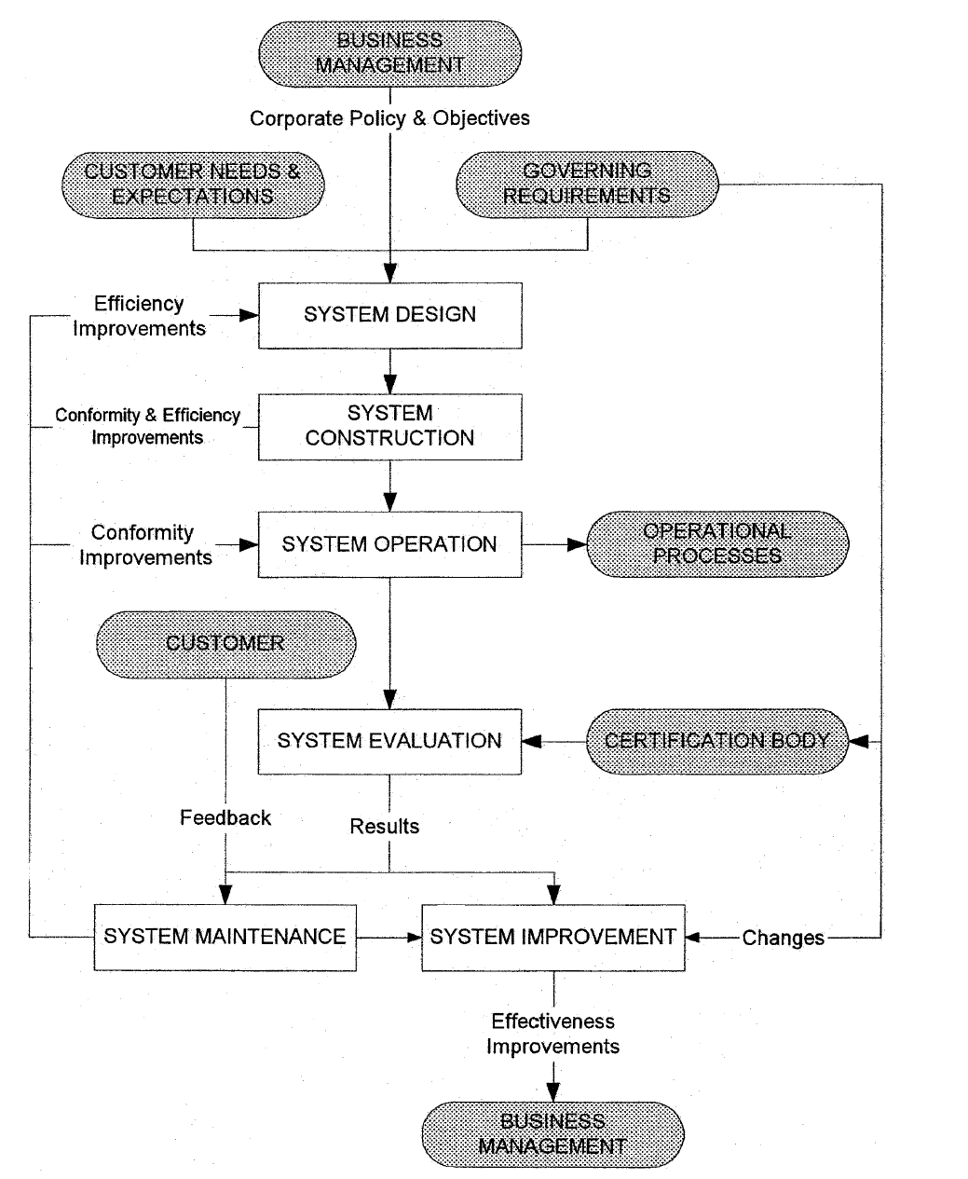
System management process model

Slide 11
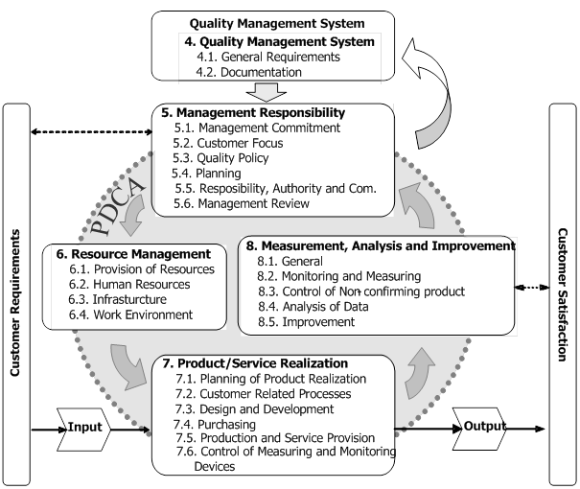
Clause 4.- Documenting a quality management system
The standard requires the organization to document a quality management system in accordance with the requirements of ISO 9001.
Clause 4.2.1 requires management system documentation to include 5 types of document:
(a) Quality policy and objectives
(b) Quality manual
(c) Documented procedures
(d) Documents needed to ensure the effective planning, operation and control of processes
(e) Records

Slide 12
FE 422 FOOD PRODUCTION MANAGEMENT
5. Quality Documentation

Slide 13
What is Documentation?
Documentation is much talked about. Sectors each have SOPs and maintains a Quality Systems Manual. Each facility has their own specific documentation (which must correlate with Sector and corporate documentation. There is also process documentation in the manufacturing areas.
Everyone uses documentation outside of work. If you buy something (like a clock), there are instructions in the box. That is documentation.
Think of documentation as instructions. Documentation explains how to do things.

Slide 14
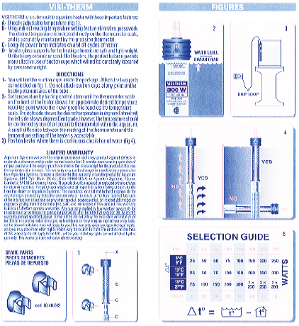
An Everyday Work Instruction
This is the ‘Work Instruction’ which comes with an aquarium heater. It gives the user some basic information. Note that there are graphics (several in multiple languages) in addition to the basic text. There is also a ‘selection’ guide for the purchaser.

Slide 15
What is Controlled Documentation?
A controlled document is typically one that is Revision sensitive - BUT - Not always!!
If a controlled document is changed, a record of the change has to be made. This means we must have a History of All Changes.
If a document is changed, people who use it must know about the change. This means there has to be a distribution list or other effective way to let everyone who uses it know the document has changed.
Every employee must know how to check to see if documentation they are using is the most current version.

Slide 16
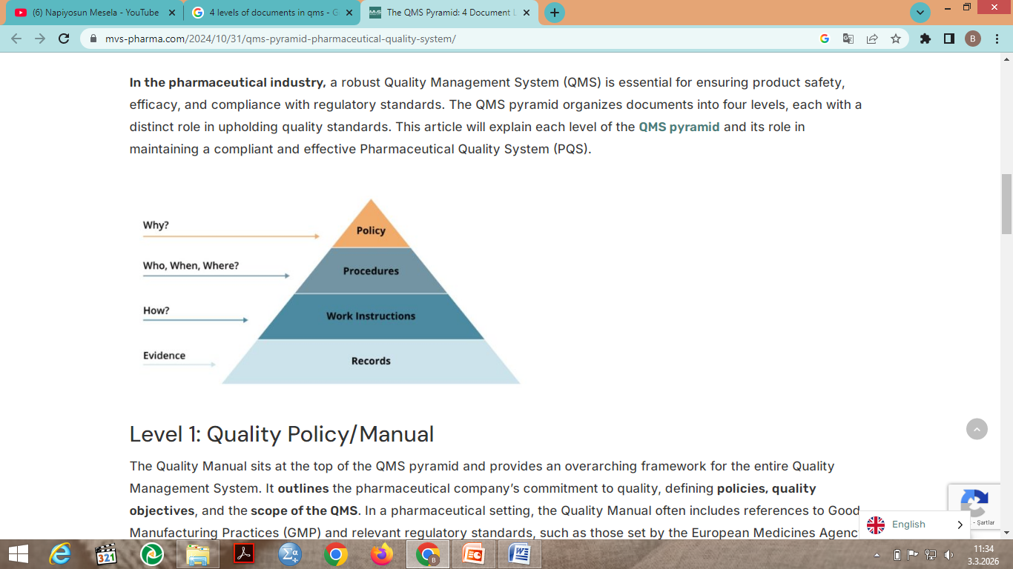
The QMS Pyramid: 4 Document Levels
What is the QMS Pyramid? The QMS documentation structure is a hierarchical organization of documents within the QMS. The documentation hierarchy makes it easy to understand, communicate, and visualize the documentation structure. Each documentation level in the structure builds upon the previous one and contributes to the overall effectiveness of the QMS.

Slide 17
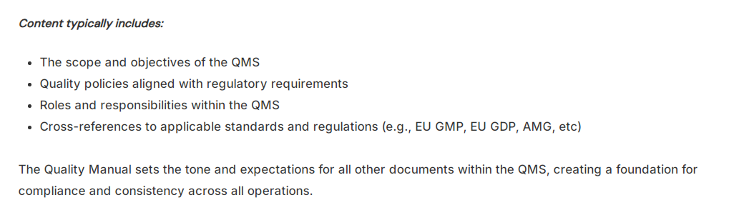
Level 1: Quality Policy/Manual
The Quality Manual sits at the top of the QMS pyramid and provides an overarching framework for the entire Quality Management System. It outlines the company’s commitment to quality, defining policies, quality objectives, and the scope of the QMS. For example, in a pharmaceutical setting, the Quality Manual often includes references to Good Manufacturing Practices (GMP) and relevant regulatory standards, such as those set by the European Medicines Agency (EMA) or the U.S. Food and Drug Administration (FDA).

Slide 18
Level 2: Procedures (QMS Pyramid)
Procedures represent the second level of the QMS pyramid and provide the “Who, When, Where” framework for critical processes within the organization. For instance pharmaceutical procedures cover a broad range of operations, including production workflows, document control, supplier qualification, training, and the management of non-conformances. They clearly define who is responsible for specific activities, the steps required, and any necessary approvals.

Slide 19
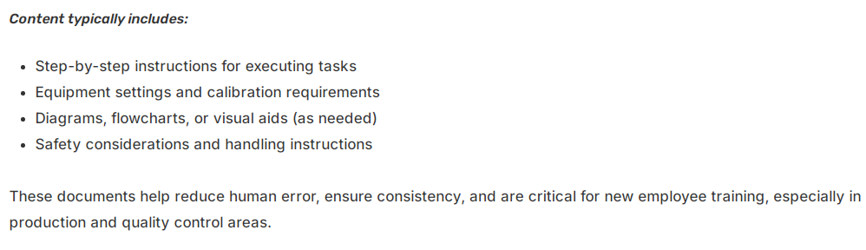
Level 3: Work Instructions
Work Instructions form the third level of the QMS pyramid. These documents provide “how-to”, detailed, task-specific guidance that builds on the general instructions outlined in Level 2 procedures. E.g. In the pharmaceutical industry, where accuracy and consistency are paramount, WIs serve as critical tools for training and daily operations.

Slide 20
Level 4: Records (QMS Pyramid)
The Records at the base of the QMS pyramid serve as evidence of compliance and proof that the processes are executed as prescribed. These documents act as records of activities and operations, capturing essential data for tracking, traceability, and auditing purposes.
E.g. In the pharmaceutical industry, maintaining accurate records is not only a best practice but a regulatory requirement. Records and forms provide the documentation needed for internal and external audits, regulatory submissions, and product release decisions. Examples include completed forms, batch records, validation reports, training logs, and inspection records.

Slide 21
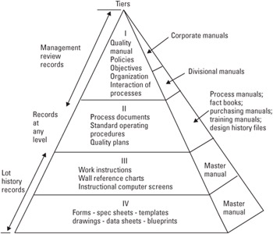

Slide 22
This is a ‘standard’ documentation pyramid.
Tier 1 = Policies
Tier 2 = Think of these as Overviews of major systems (e.g.: Nonconformance system, Purchasing system, etc.
Tier 3 = The actual systems in detail
Tier 4 = Objective evidence - Proof that the systems are functioning as well as a source of data for various evaluations (such as inspection & test data).

Slide 23
Documentation
Organization Charts
Procedures
Forms
Tags
Prints
Specifications
Statistical Data
Inspection & Test Results

Slide 24
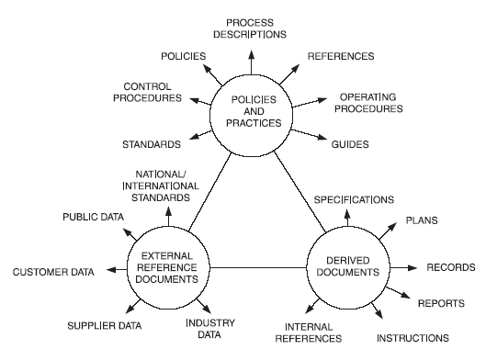
Documents that ensure effective planning, operation and control of processes
The standard requires management system documentation to include documents required by the organization to ensure the effective planning, operation and control of its processes.
Relationships between documents

Slide 25
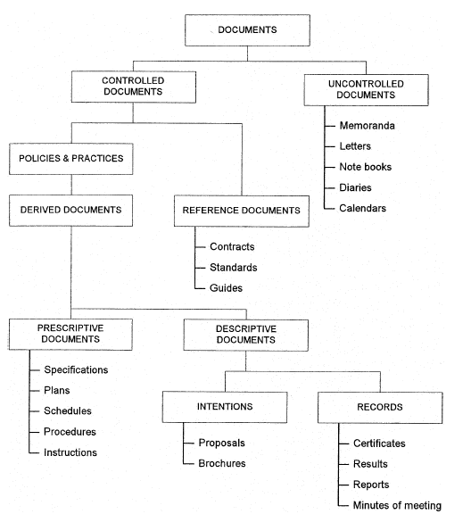
Classification of documents

Slide 26
Control of records
The standard requires records to be established and maintained to provide evidence of conformity to requirements and the effective operation of the quality management system.
Customer complaints
Warranty claims
Failure analysis reports
Process capability studies
Service reports
Concessions
Change requests
Subcontractor assessments
Performance analysis
Deviations and waivers
Contract change records
Quality cost data
External quality audit records

Slide 27


Briefly….
Documentation is a tool used to document and manage a company's business processes.
Accurate and up-to-date documentation ensures the effective implementation of business processes and helps prevent errors.
Furthermore, documentation facilitates information sharing within the company and helps employees perform their duties more effectively.

Slide 28
FE 422 FOOD PRODUCTION MANAGEMENT
6. Quality Planning

Slide 29
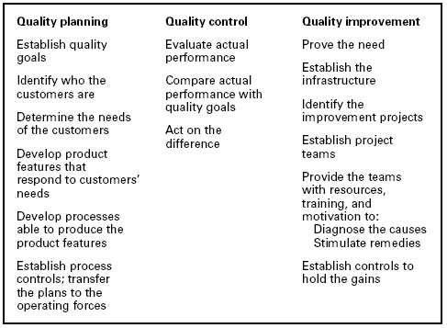
HOW TO MANAGE FOR QUALITY: THE JURAN TRILOGY

Slide 30
Quality Planning Process
“Quality planning,” as used here, is a structured process for developing products (both goods and services) that ensures that customer needs are met by the final result. The tools and methods of quality planning are incorporated along with the technological tools for the particular product being developed and delivered.
Quality planning steps;
Establish the project
Identify the customers
Discover the customer needs
Develop the product
Develop the process
Develop the controls and transfer to operations

Slide 31
A. Establish the Project
A quality planning project is the organized work needed to prepare an organization to deliver a new or revised product, following the steps associated with quality planning. Generally speaking, the following activities are associated with establishing a quality planning project:
Identify which projects are required to fulfill the organization’s strategy.
Prepare a mission statement for each project.
Establish a team to carry out the project.
Plan the project.

Slide 32
B. Identify the Customers
This step may seem unnecessary; of course, the planners and designers know who their customers are: the driver of the automobile, the depositor in the bank account, the patient who takes the medication. But these are not the only customers—not even necessarily the most important customers.
Customers comprise an entire cast of characters that needs to be understood fully. Generally, there are two primary groups of customers: the external customers—those outside the producing organization; and the internal customers—those inside the producing organization.

Slide 33
C. Discover the customer needs
The third step of quality planning is to discover the needs of both internal and external customers for the product. Some of the key activities required for effective discovery of customer needs include
-Plan to collect customers’ needs.
-Collect a list of customers’ needs in their language.
-Analyze and prioritize customers’ needs.
-Translate their needs into “our” language.
-Establish units of measurement and sensors.

Slide 34
Quality Planning Spreadsheets.
Quality planning generates a large amount of information that is both useful and necessary, but without a systematic way to approach the organization and analysis of this information, the planning team may be overwhelmed by the volume and miss the message it contains.
Although planners have developed various approaches for organizing all this information, the most convenient and basic planning tool is the quality planning spreadsheet. The spreadsheet is a highly versatile tool that can be adapted to a number of situations.

Slide 35
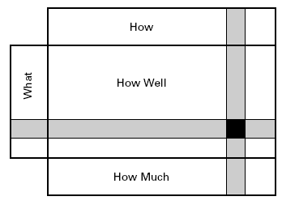
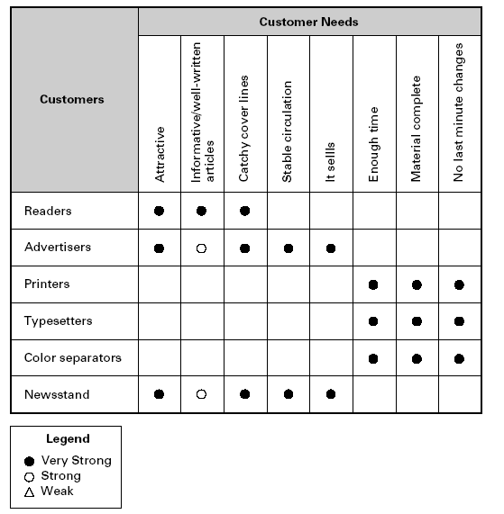
Spreadsheets in quality planning: A Spreadsheet is a digital tool that organises information in a grid of rows and columns, making it easy to calculate, analyse, and manage data.
Generic planning spreadsheet.

Slide 36
Customer needs spreadsheet for a magazine.

Slide 37
D. Develop the product
Once the customers and their needs are fully understood, we are ready to design the product that will meet those needs best. Product development is not a new function for a company. Most companies have some process for designing and bringing new products to market. In this step of the quality planning process, we will focus on the role of quality in product development and how that role combines with the technical aspects of development and design appropriate for a particular industry. Within product development, product design is a creative process based largely on technological or functional expertise.
There are six major activities in this step:
• Group together related customer needs.
• Determine methods for identifying product features.
• Select high-level product features and goals.
• Develop detailed product features and goals.
• Optimize product features and goals.
• Set and publish final product design.

Slide 38
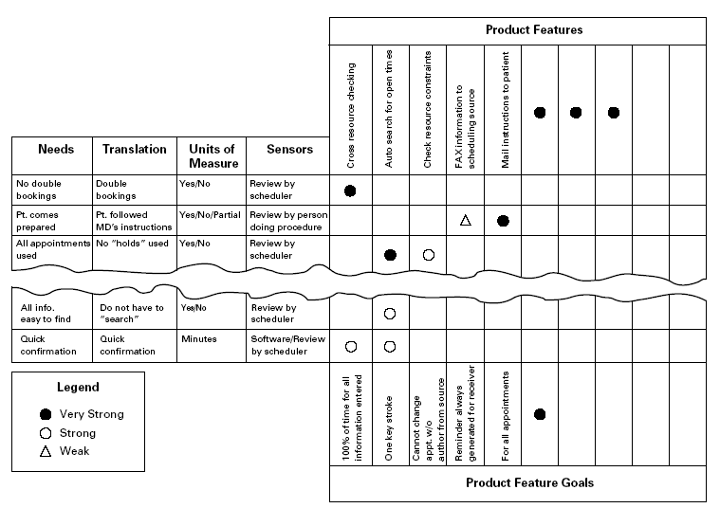
Product design spreadsheet for outpatient appointment function.

Slide 39
E. Develop the process
Once the product is developed, it is necessary to determine the means by which the product will be created and delivered on a continuing basis. These means are, collectively, the “process.” “Process development” is the set of activities for defining the specific means to be used by operating personnel for meeting product quality goals.
The eleven major activities involved in developing a process are
Review product goals.
Identify operating conditions.
Collect known information on alternate processes.
Select general process design.
Identify process features and goals.
Identify detailed process features and goals.
Design for critical factors and human error.
Optimize process features and goals.
Establish process capability.
Set and publish final process features and goals.
Set and publish final process design.

Slide 40
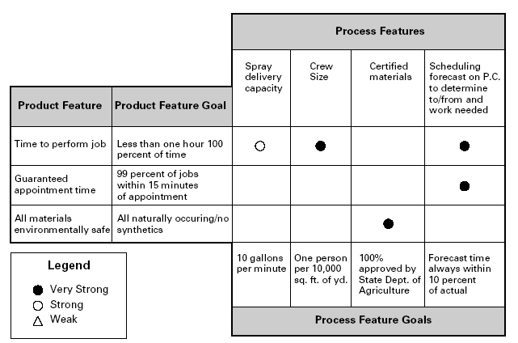
Process design spreadsheet for a lawn care service.

Slide 41
F. Develop the controls and transfer to operations
In this step, planners develop controls for the processes, arrange to transfer the entire product plan to operational forces, and validate the implementation of the transfer. There are seven major activities in this step.
Identify controls needed.
Design feedback loop.
Optimize self-control and self-inspection.
Establish audit.
Demonstrate process capability and controllability.
Plan for transfer to operations.
Implement plan and validate transfer.
Once planning is complete, these plans are placed in the hands of the operating departments. It then becomes the responsibility of the operational personnel to manufacture the goods or deliver the service and to ensure that quality goals are met precisely and accurately. They do this through a planned system of quality control.

Slide 42
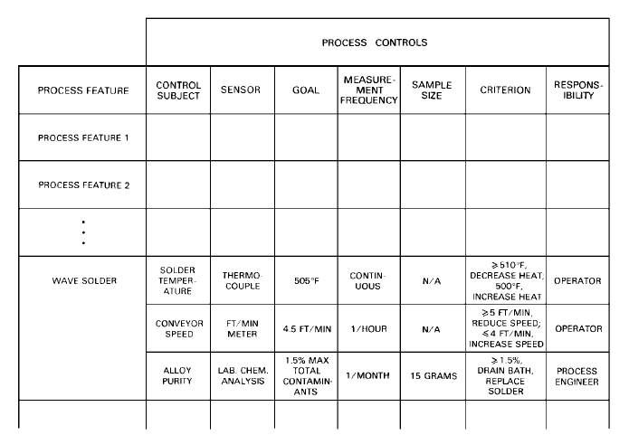
Control spreadsheet.

Slide 43
FE 422 FOOD PRODUCTION MANAGEMENT
7. Process Management

Slide 44
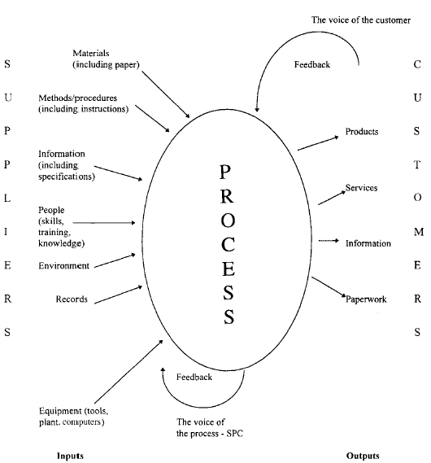
Process

Slide 45
Process Management
Process management is the ensemble of activities of planning and monitoring the performance of a process, especially in the sense of business process, often confused with reengineering. Process Management is the application of knowledge, skills, tools, techniques and systems to define, visualize, measure, control, report and improve processes with the goal to meet customer requirements profitably.

Slide 46
The PM Methodology
A PM effort is initiated when executive management selects key processes, identi­fies owners and teams, and provides them with process mission statements and goals. After the owners and team are trained in process methodology, they work through the three phases of PQM methodology: planning, transfer, and operational management.
The planning phase, in which the process design (or redesign) takes place, involves five steps:
Defining the present process.
Determining customer needs and process flow.
Establishing process measurements.
Conducting analyses of measurement and other data.
Designing the new process. The output is the new process plan.

Slide 47
Process Management

Slide 48
Transferring the New Process Plan to Operations
The transfer phase consists of three steps:
planning for implementation problems,
planning for implementation action, and
deploying the new process plan.
Operational Management Phase: Managing the New Process.
The Operational Management Phase begins when the process is put into operation. The major activities in operational management are:
process quality control,
process quality improvement, and
Periodic process review and assessment.

Slide 49
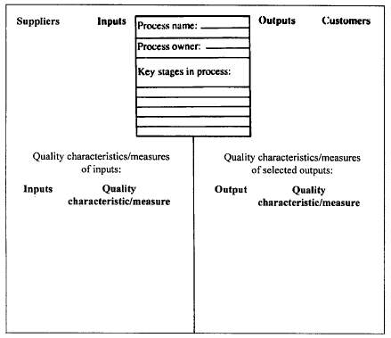
Describing the boundary of a process

Slide 50
Process mapping and flowcharting
Process mapping and flowcharting are very important first steps in improving a process. The flowchart ‘pictures’ will assist an individual or team in acquiring a better understanding of the system or process under study than would otherwise be possible. Gathering this knowledge provides a graphic definition of the system and the scope of the improvement effort. Process mapping, is a communication tool that helps an individual or an improvement team understand a system or process and identify opportunities for improvement.

Slide 51
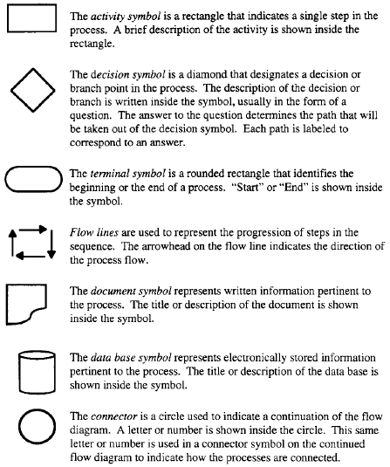

Symbols used in flow diagramming.

Slide 52
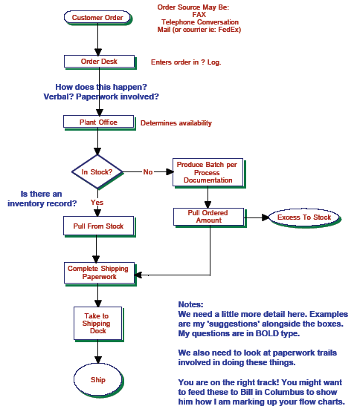
Order Flow

Slide 53
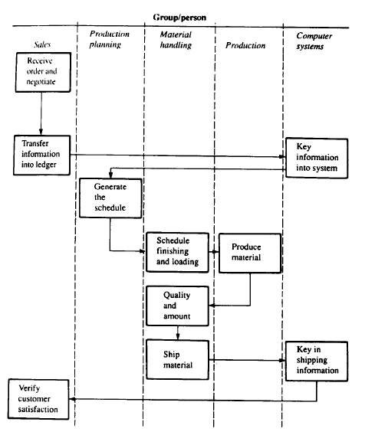

Slide 54
Process analysis
A flowchart is a picture of the steps used in performing a function. This function can be anything from a chemical process step to accounting procedures, even preparing a meal. Flowcharts provide excellent documentation and are useful trouble shooting tools to determine how each step is related to the others. By reviewing the flowcharts it is often possible to discover inconsistencies and determine potential sources of variation and problems. For this reason, flowcharts are very useful in process improvement when examining an existing process to highlight the problem area. A group of people, with knowledge about the process, should follow the simple steps:
Draw flowcharts of the existing process, ‘as is’.
Draw charts of the flow the process could or should follow, ‘to be’.
Compare the two sets of charts to highlight the sources of the problems or waste, improvements required, and changes necessary.

Slide 55
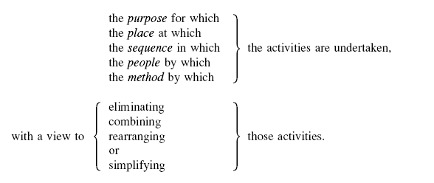
Process analysis
A critical examination of the first set of flowcharts is often required, using a questioning technique, which follows a well-established sequence to examine:

Slide 56
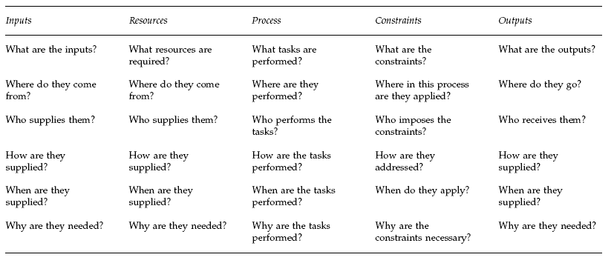
Kipling’s Law

Slide 57
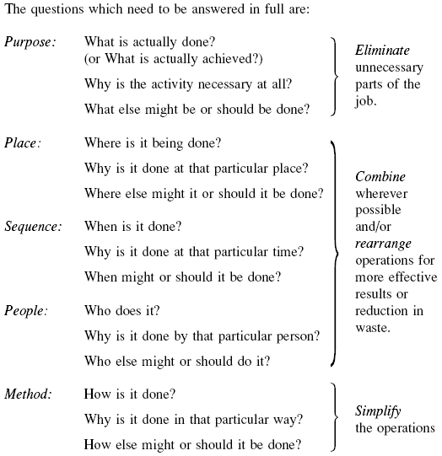

Slide 58
Steps of Process Analysis:
Document and map/flowchart the process – making visible the invisible through mapping/flowcharting is the first crucial step that helps an organization see the way work really is done and not the way one thinks or believes it should be done. Seeing the process ‘as is’ provides a baseline from which to measure, analyse, test and improve.
Identify process customers and their requirements; establish effectiveness measurements – recognizing that satisfying the external customer is a shared purpose, all internal and external suppliers need to know what customers want and how well their processes meet customer expectations.
Analyse the process; rank problems and opportunities – collecting supporting data allows an organization to weigh the value each task adds to the total process, to select areas for the greatest improvement and to spot unnecessary work and points of unclear responsibility.
Identify root causes of problems; establish control systems – clarifying the source of errors or defects, particularly those that cross department lines, safeguards against quick-fix remedies and assures proper corrective action.
Develop implementation plans for recommended changes – involving all stakeholders, including senior management, in approval of the action plan commits the organization to implementing change and following through the ‘to be’ process.
Pilot changes and revise the process – validating the effectiveness of the action steps for the intended effect leads to reinforcement of the ‘to be’ process strategy and to new levels of performance.
Measure performance using appropriate metrics – once the processes have been analysed in this way, it should be possible to develop metrics for measuring the performance of the ‘to be’ processes, sub-processes, activities, and tasks. These must be meaningful in terms of the inputs and outputs of the processes, and in terms of the customers of and suppliers.

Slide 59
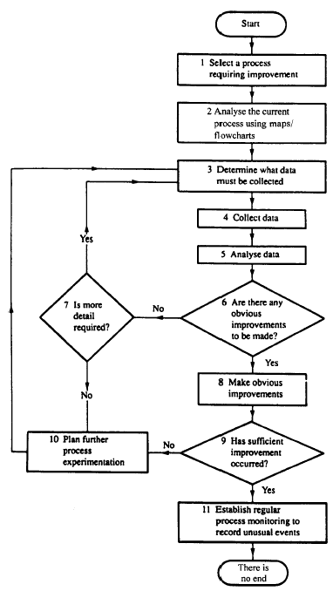
Steps of Process Analysis:

Slide 60
FE 422 FOOD PRODUCTION MANAGEMENT
8. Quality Cost

Slide 61
EVOLUTION OF QUALITY AND COSTS
During the 1950s there evolved numerous quality-oriented staff departments. The heads of these new departments were faced with “selling” their activities to the company managers. Because the main language of those managers was money, the concept of studying quality-related costs provided the vocabulary to communicate between the quality staff departments and the company managers.

Slide 62
The Language of Money Is Essential. Money is the basic language of upper management. Despite the prevalence of estimates, the figures provide upper managers with information showing the overall size of the quality costs, their prevalence in areas beyond manufacture, and the major areas for potential improvement. Without the quality cost figures, the communication of such information to upper managers is slower and less effective.
The Meaning of “Quality Costs.” The term “quality costs” has different meanings to different people. Some equate “quality costs” with the costs of poor quality (mainly the costs of finding and correcting defective work); others equate the term with the costs to attain quality; still others use the term to mean the costs of running the Quality department. In this handbook, the term “quality costs” means the cost of poor quality.

Slide 63
Quality Cost Measurement and Publication Does Not Solve Quality Problems. Some organizations evaluate the cost of poor quality and publish it in the form of a scoreboard in the belief that publication alone will stimulate the responsible managers to take action to reduce the costs. These efforts have failed. The realities are that publication alone is not enough. It makes no provision to identify projects, establish clear responsibilities, provide resources to diagnose and remove causes of problems, or take other essential steps. New organization machinery is needed to attack and reduce the high costs of poor quality

Slide 64
Scope of Quality Costs Is Too Limited. Traditionally, the measurement of quality cost focuses on the cost of nonconformities, i.e., defects in the goods or services delivered to external and internal customers. These are often called external and internal failure costs. An important cost that is not measured is lost sales due to poor quality (this is called a “hidden cost” because it is not easily measured). Another omitted cost is the extra cost in processes that were producing conforming output but which are inefficient. These inefficiencies are due to excess product or process variability (even though within specification limits) or inefficiencies due to redundant or non-value-added process steps.

Slide 65
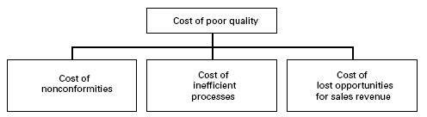
CATEGORIES OF QUALITY COSTS
Internal Failure Costs. These are costs of deficiencies discovered before delivery which are associated with the failure (nonconformities) to meet explicit requirements or implicit needs of external or internal customers. Also included are avoidable process losses and inefficiencies that occur even when requirements and needs are met. These are costs that would disappear if no deficiencies existed.

Slide 66
CATEGORIES OF QUALITY COSTS
External Failure Costs. These are costs associated with deficiencies that are found after product is received by the customer. Also included are lost opportunities for sales revenue. These costs also would disappear if there were no deficiencies.
Appraisal Costs. These are the costs incurred to determine the degree of conformance to quality requirements.
Prevention Costs. These are costs incurred to keep failure and appraisal costs to a minimum.

Slide 67
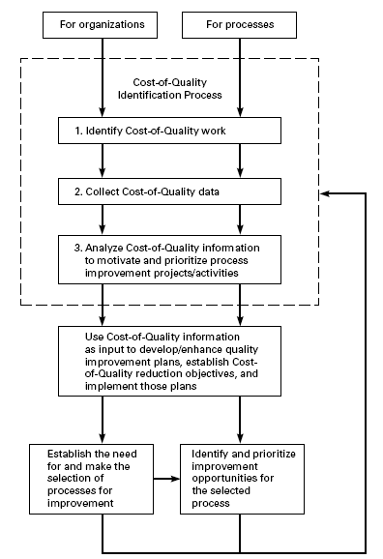
Cost of quality and quality improvement.

Slide 68
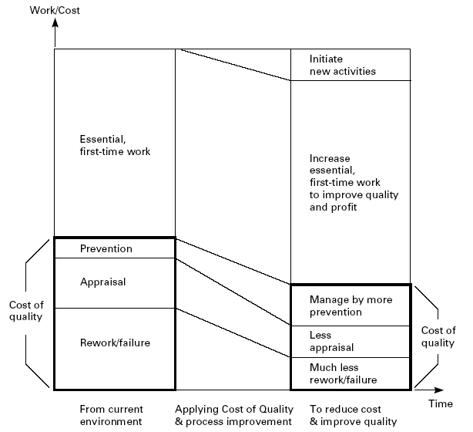
Effects of identifying cost of quality.

Slide 69
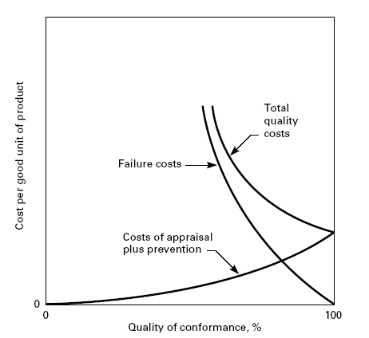
Model for optimum quality costs

Slide 70
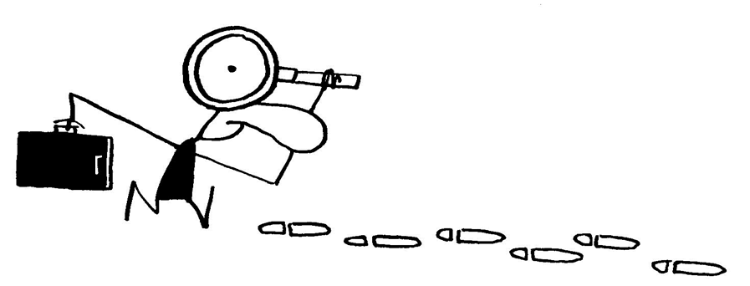
FE 322 FOOD PRODUCTION MANAGEMENT
9. Quality and safety audit systems

Slide 71
Types of Audit
(a) First party audit
It’s the tool by which the “business” is monitoring adherence to the documented HACCP system. It provides detailed information about failures of the system and highlights the potentiality of improvement. The auditors are chosen within the company but not strictly related to the area, function or procedures being audited.
(b) Second party audit
It is the tool through which the customer can directly evaluate if the process/product of his supplier satisfies its request. In this case the auditor usually belongs to the customer’s staff. Sometimes the supplier can choose one person among the personnel who can act as a “representative” of the customer. In many cases the customer is hiring an independent expert to do the Auditing for him.

Slide 72
Types of Audit
(c) Third party audit (another pair of eyes)
It is performed by agencies, independent of both customer and suppliers, recognised as competent to assess system against a standard. For quality management system, third party audit is carried out by internationally recognised agencies; it’s volunteer and the company will achieve certification related to the quality standard met. Regulatory Audit complies with this type of audit.
(d) Vertical audit
It is used to look in depth a particular function or department. It permits to monitor the use of all relevant procedures as they are used to support this function or department.
(e) Horizontal audit
It is used to follow a process from the start to the end. This kind of audit would look at procedures as they support the process itself and is likely to span many different functions or departments. Audits or assessment leading to certification are likely to be horizontal.

Slide 73
Types of Audit
(f) Partial audit
It consists of an assessment of a part of the system. The partial audit goal may be focused on:
- selected components or areas of HACCP system;
- follow-up to previous full or partial audit;
- concerns detected through consumer complaints;
- company’s HACCP system changes;
(g) Full audit
It consists of an assessment of both, prerequisite programmes and HACCP systems

Slide 74
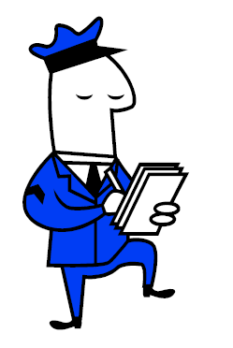
Auditor
Auditor
An auditor generally should be a person with abilities and deep knowledge on the subject. It is important that he will be able to show tact and ability to put Auditees at ease. He should also be a good listener and aware questioner. From the technical point of view he should have a suitable technical background to really understand the process being audited and of course some knowledge of quality management.

Slide 75
Audit procedure
Audit procedure
The audit procedure and the related forms belong to the HACCP system documents. It will include surveillance activities and checks on monitoring data to assure the respect of critical limits as well as systematic and independent measures (control and test on products and processes). The reason for that is to achieve objective evidence that the food processing plant own-checks-system complies with the standards. All the results will be filed in order to qualify and assure that the audit will be conducted on the basis of previously established rules, which will define methods, tools, frequency, responsibility and proper record keeping.

Slide 76
Audit procedure
Frequency of auditing
The frequency of auditing has to assure that the System will not loose efficacy with time. Therefore special audits out-of-schedule, should take place when there are changes related to raw material (new supplier for example) or to the product (changes in processing conditions, purchase of new equipment, new packaging material, extra cleaning and sanitising, etc). Other reasons for extra (out-of-schedule) audits are: change in storage conditions, consumer use, receipt of any information on a new hazard associated with the product, evidence or suspect of non compliance, previous audit findings, etc. Frequency is strictly related to the risks presented by a product and processes and to the ability of the establishment to adhere to its HACCP system. The risks of the establishment can be classified under three categories:

Slide 77
Audit procedure
Category I: includes all the factories whose process includes a “kill step” or other kind of process step, able to reduce or eliminate specific microbial contaminants. Many of the products are “ready-to-eat”. Therefore, the loss of control within these establishments could mean a significantly high health risk.
Examples:
- Pasteurisation, heat treatment, drying, freezing dairy products, and
processed eggs
- Thermal processing of low acid /acidified low acid canned food
- Assembling, packaging and cooking of infant food

Slide 78
Audit procedure
Category II: includes the establishments whose process generally don’t include any kill steps. The processing control doesn’t minimise the potential hazards through proper sanitation or temperature control as in category I. So the quality of raw product entering has to be considered a crucial factor and requires a special consideration in order to permit manipulation without significantly increasing risk. In category II, specific handling and storage instructions are required in order to protect the consumer
Examples:
- Washing, grading, packing shell eggs
- Fresh cutting, modified atmosphere packaging vegetables
- Freezing vegetables
- Cutting, packaging cheese

Slide 79
Audit procedure
Category III: consists of establishments preparing products which do not pose significant health hazards and the food processing to which they are exposed represents little or no additional risk.
Examples:
- Thermal processing, aseptic processing high acid foods
- Maple processing
- Honey processing
- Freezing, drying, packaging fruits
- Drying, packaging vegetables

Slide 80
Audit procedure
Audit preparation
According to the HACCP plan there are certain activities that lead to a proper auditing. These activities constitute the “audit plan” and can be summarised as following:
Audit scope: There should be always a definition of the boundaries of an audit (i.e. what is going to be audited). It may depend by factors such as results of previous audits, establishment profile, consumer complaints and other information.
Identification of the Chief auditor and the team members (if it is applicable): The number of auditors required depends on the size of the company and the diversity of the functions carried out within the establishment. The audit team members are selected in relation to specified requirements (training, experiences, etc). They can belong to the plant staff or to an external structure. The auditors must be independent of the function and the department being audited. This is absolutely necessary to prevent conflict of interest.

Slide 81
Audit procedure
In order to avoid the possibility to obtain insufficient or incomplete data, the auditor/auditing team will choose and elaborate all necessary tools. This necessary documentation to facilitate the auditor’s work and to document and record all results must include:
􀂃 Check list to evaluate HACCP system elements and elaborate a specific segment of the system;
􀂃 forms to record all findings collected;
􀂃 forms to document the objective evidence in order to support the auditors final conclusion

Slide 82
Audit
Opening meeting
It is necessary for the members of the audit team to be introduced to the management representatives so they can review together the key areas of the planned audit. This meeting allows the establishment of official communication links between the audit team and the management of the plant and confirms that the resources and facilities needed are available for the team. Furthermore it is the proper time and place when all necessary written prerequisite programmes and HACCP plans will be made available to the team.

Slide 83
Audit
Gathering information
The audit is necessary to obtain evidence that procedures, documents and other information describing HACCP system are kept up to date, are adequate in order to achieve the required food safety objectives and they meet regulatory requirements. For this reason, the auditor should conduct a series of activities such as questioning, observing, examining records etc.

Slide 84
Audit
Results
The data provided by audit, need to be analysed in order to discover trends and confirm improvements, to highlight difficulties in the application of procedures or in particular activities or step of the process, and finally to give right information on what types of corrective actions have being carried out and how long corrective actions take to be implemented

Slide 85
Audit
Closing meeting
The auditor will communicate all findings to the HACCP co-ordinator. Prior to preparing the audit report, the audit team will meet with management representatives and present the audit findings. In relation to the evaluation of non-conformities identified, the audit team will propose the Corrective Action request and the timetable to solve them. The auditor should be sure that the results of the audit are clearly understood.

Slide 86
Audit
Audit report
The audit report has to include the scope of the audit, the identification of the chief auditor and audit members, the identification of the establishment representatives, the identification of the reference documents against which the audit was conducted and of course the audit findings. The audit findings have to be supported by the “evidence”. This means that the auditor has to report “what” and “where” he detected the non-conformity.

Slide 87
FE 322 FOOD PRODUCTION MANAGEMENT
10. Statistical process control

Slide 88
Statistical Process Control (SPC)
Statistical process control (SPC) is defined as the application of statistical techniques to control a process. SPC is concerned with quality of conformance. There are a number of tools available to the quality engineer that is effective for problem-solving process. The seven quality tools are relatively simple but very powerful tools which every quality engineer. The tools are:
flow chart,
run chart,
process control chart,
histograms,
Pareto diagram,
cause and effect diagram,
and scatter diagram

Slide 89
Improvement of Food Safety and Quality by Statistical Process Control (SPC)
Flow charts;
Flow charts are defined as the graphical representation of the steps of in a process. Flow charts facilitate an analysis of the steps in a process to determine relationships between the steps.

Slide 90
Improvement of Food Safety and Quality by Statistical Process Control (SPC)
Cause and effect diagrams
Cause and effect diagrams (CED) are simple techniques for dissecting a problem or a process. CED identifies all possible relationships among input and output variables, that is, the five categories on the following skeleton (materials, machines, man, methods, and environment).

Slide 91
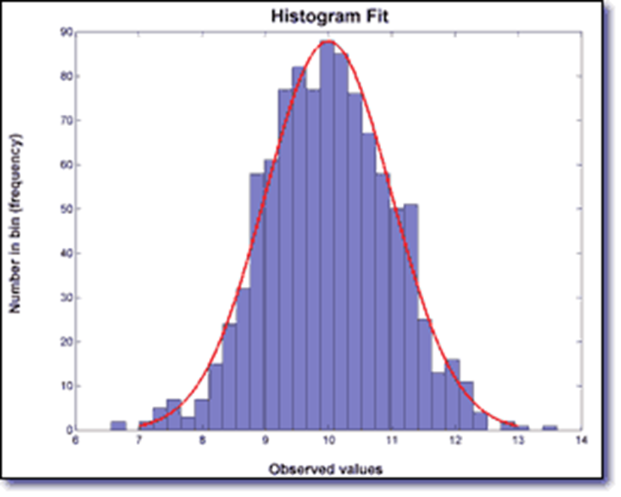
Improvement of Food Safety and Quality by Statistical Process Control (SPC)
Histograms
A histogram is a bar chart showing the variation or distribution of the observations from a set of data.

Slide 92
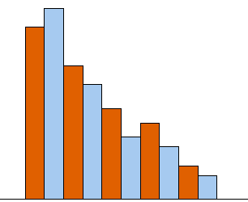
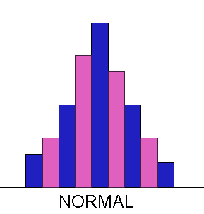
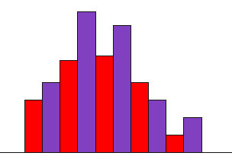
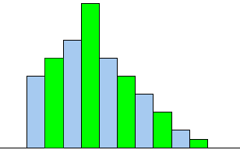
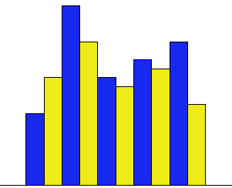
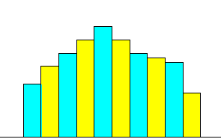
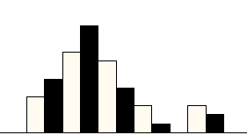
Improvement of Food Safety and Quality by Statistical Process Control (SPC)
Histograms
A histogram is a bar chart showing the variation or distribution of the observations from a set of data.

Slide 93
Improvement of Food Safety and Quality by Statistical Process Control (SPC)
Pareto charts
The pareto chart is a form of bar chart with each bar representing a cause of a problem and always arranged so that the most influential cause of a problem can be easily recognized, that is, arranging the problems in descending order. This information is helpful in focusing attention on the highest-priority category.

Slide 94
Improvement of Food Safety and
Quality by Statistical Process Control (SPC)
Scatter diagrams
Scatter diagramming is a tool to study how different variables relate to each other or how they correlate. A scatter diagram demonstrates the results of a series of experiments which is conducted to document the relationship between the variables. Table 4. represents the mathematical models.

Slide 95
Process control charts
Variable control charts
The primary function of a control chart is to determine which type of variation is present and whether adjustments need to be made to the process. Variables data are those data which can be measured on a continuous scale. Variable data are plotted on a combination of two charts- usually an x-bar (x) chart and a range (R) chart. The x-bar chart plots sample means. It is a measure of between-sample variation and is used to asses the centering and long term variation of the process. The range chart measure the within sample variation and asses the short term variation of the process.

Slide 96
Improvement of Food Safety and Quality by Statistical Process Control
Variable control charts

Slide 97
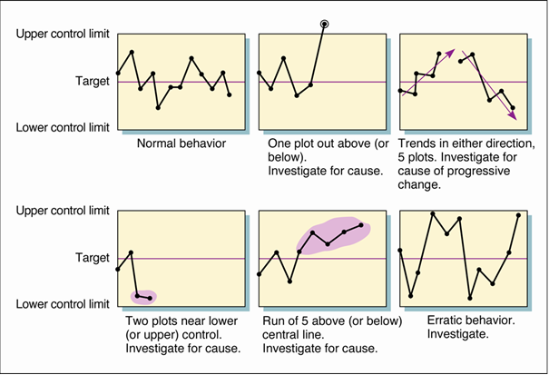

Slide 98
Corrective action
Preventive action
Upper control limit (Critic)
Upper target level
Center line
Lower target level
Lower control limit (Critic)

Slide 99
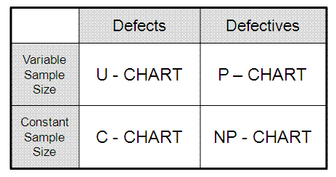
Process control charts
Attribute control charts
Attribute charting is used for various types of defects, primarily by counting the number of nonconforming units or the nonconformities per units. The most commonly used attribute control chart is p-chart or the percentage of defective unit with variable sample size. The npchart is used to monitor the percentage defective unit for constant sample size. The c-chart is used to monitor the number of defects on an item for constant sample size. The u-chart is for number of unlimited defects in variable sample size.

Slide 100
Control Chart Types
Attributes
  A quality characteristic measured by number of defects.
  p and np charts
  c and u charts
Variables
  A quality characteristic such as weight, length, time, temperature, voltage, etc.
  X-bar and R charts
  Chart for individual measurements.

Slide 101
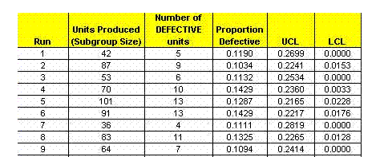
Development of p Chart
In statistical quality control, the p-chart is a type of control chart used to monitor the proportion of nonconforming units in a sample, where the sample proportion nonconforming is defined as the ratio of the number of nonconforming units to the sample size,
Select at least 20 samples of size n (where np ≥ 3).
Calculate trial centerline

Slide 102
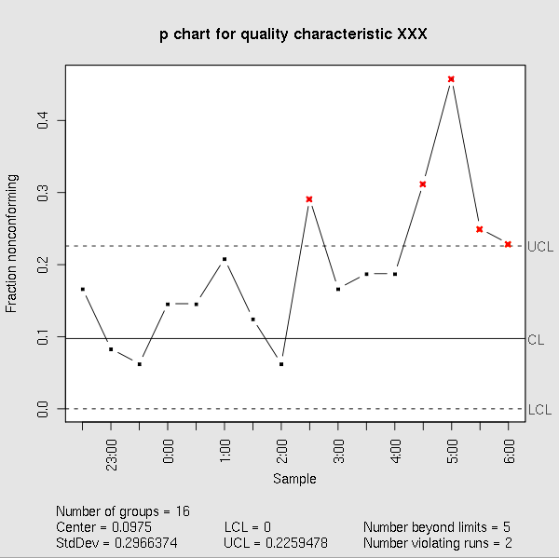
Development of p Chart
Calculate trial control limits

Slide 103
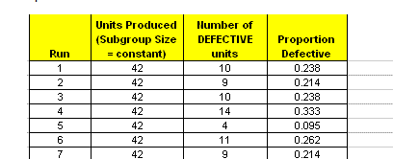
Calculations for an np Chart
In statistical quality control, the np-chart is a type of control chart used to monitor the number of nonconforming units in a sample. It is an adaptation of the p-chart and used in situations where personnel find it easier to interpret process performance in terms of concrete numbers of units rather than the somewhat more abstract proportion.
The np-chart differs from the p-chart in only the three following aspects:
The control limits are , where n is the sample size and is the estimate of the long-term process mean established during control-chart setup.
The number nonconforming (np), rather than the fraction nonconforming (p), is plotted against the control limits.
The sample size, , is constant.

Slide 104
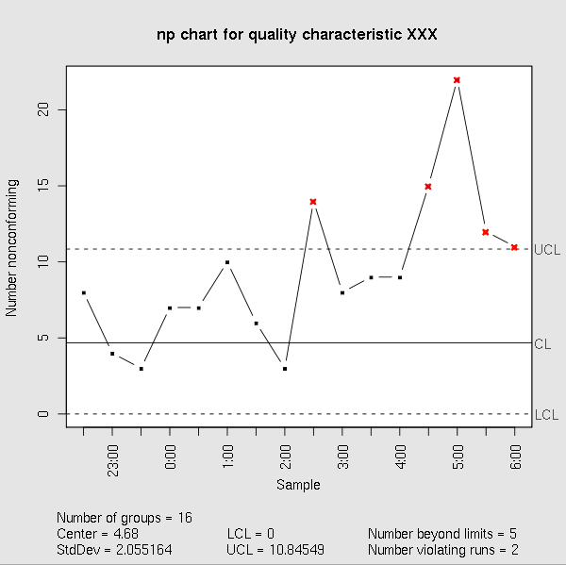
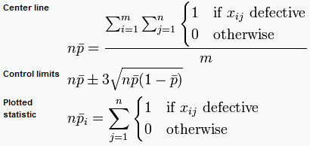

Slide 105
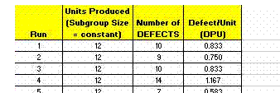
c Chart Calculations
In statistical quality control, the c-chart is a type of control chart used to monitor "count"-type data, typically total number of nonconformities per unit.[1] It is also occasionally used to monitor the total number of events occurring in a given unit of time.
The c-chart differs from the p-chart in that it accounts for the possibility of more than one nonconformity per inspection unit, and that (unlike the p-chart and u-chart) it requires a fixed sample size. The p-chart models "pass"/"fail"-type inspection only, while the c-chart (and u-chart) give the ability to distinguish between (for example) 2 items which fail inspection because of one fault each and the same two items failing inspection with 5 faults each; in the former case, the p-chart will show two non-conformant items, while the c-chart will show 10 faults.

Slide 106
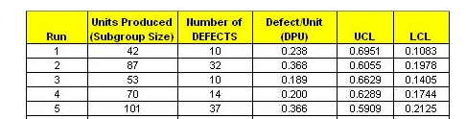
u Chart Calculations
In statistical quality control, the u-chart is a type of control chart used to monitor "count"-type data where the sample size is greater than one, typically the average number of nonconformities per unit.
The u-chart differs from the c-chart in that it accounts for the possibility that the number or size of inspection units for which nonconformities are to be counted may vary. Larger samples may be an economic necessity or may be necessary to increase the area of opportunity in order to track very low nonconformity levels.

Slide 107
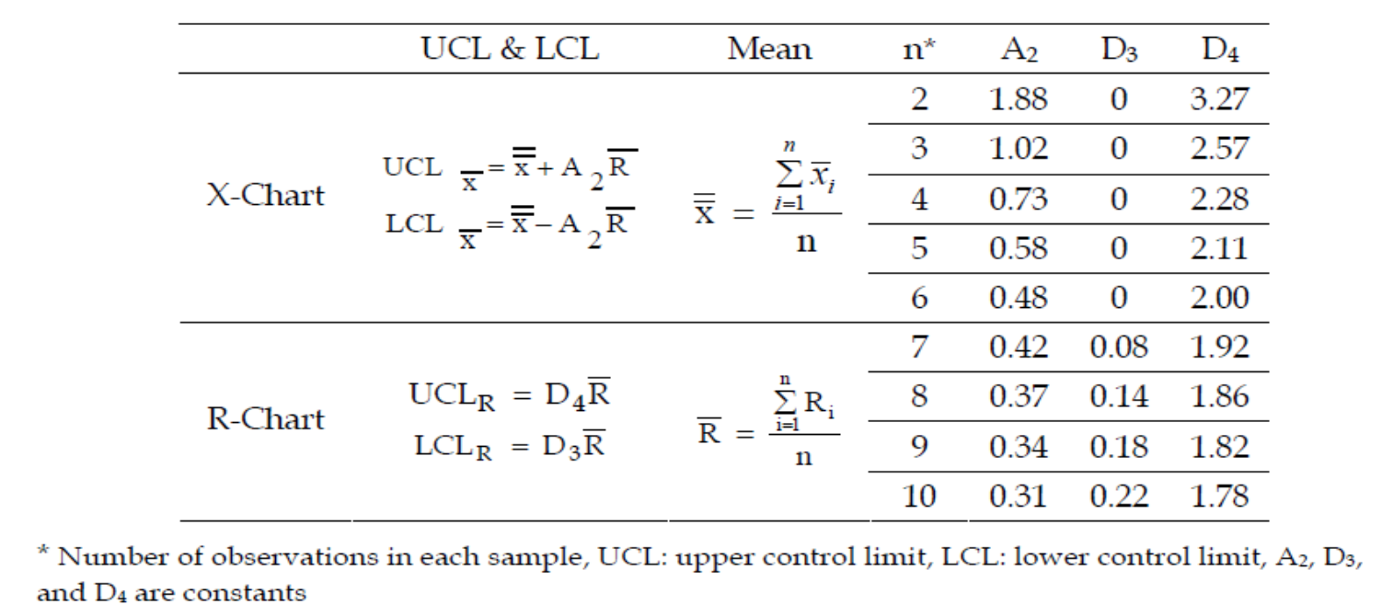
TUTORIAL-1
The amount of moisture in the production of sucuk is one of the quality parameters. Moisture content should be around 40%. The X-bar (x) and R-chart graphics are created from the moisture contents of 5 samples of 10 runs.

Slide 108
