Slide 1
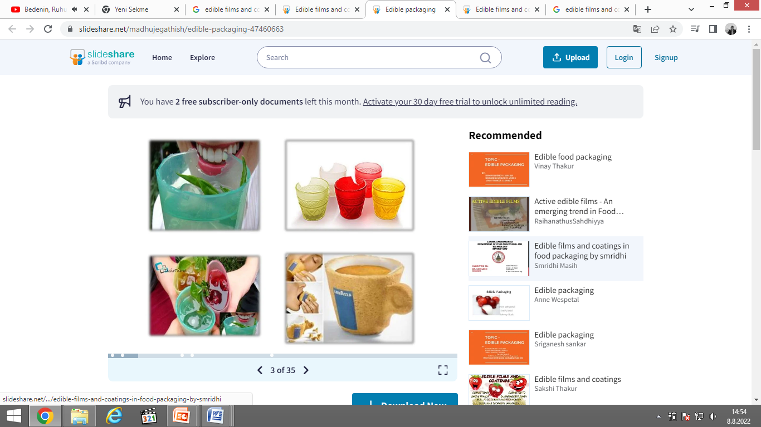
FE 517
Edible Films and Coatings
Dr. Burcu GÖKKAYA ERDEM

Slide 2
COURSE CONTENT
The importance of food packaging
What is edible packaging?
Edible films and edible coatings
Components of edible films and coatings
EF and EC formation methods
Bioactive EFs and ECs
Functional properties, requirements and drawbacks
Mechanical, thermal, optical, barrier and physical properties
Application

Slide 3
Midterm (Presentation (ppt, 25-30 slides) and report(8-10 pages))
Final exam (examination)
Attendance

Slide 4
Edıble Fılms and Coatıngs – Assıgnment Topıcs
Edible Films and Coatings: What, How, and Why?
Yenilebilir film ve kaplamalar: Nedir, nasıl üretilir ve neden kullanılır?
→ Temel kavramlar, üretim yöntemleri, avantajlar, sınırlılıklar ve kullanım amaçları.
Biopolymers Used in the Production of Edible Films and Coatings
Yenilebilir film ve kaplama üretiminde kullanılan biyopolimerler
→ Proteinler, polisakkaritler, lipitler ve kompozit sistemler.
3. Active Edible Films and Coatings
Aktif yenilebilir film ve kaplamalar
→ Antioksidan, antimikrobiyal, UV bariyeri, aroma vb. fonksiyonel bileşenlerin kullanımı.
Edible Films and Coatings: Applications in the Bakery Industry
Yenilebilir film ve kaplamaların fırıncılık sektöründe uygulamaları
→ Ekmek, kek, bisküvi ve diğer fırıncılık ürünleri.
Edible Films and Coatings: Applications in the Meat Industry
Yenilebilir film ve kaplamaların et sektöründe uygulamaları
→ Et, kanatlı ve işlenmiş et ürünlerinde raf ömrü ve kalite korunumu.
Edible Films and Coatings: Applications in the Dairy Industry
Yenilebilir film ve kaplamaların süt ve süt ürünleri sektöründe uygulamaları
→ Peynir, yoğurt ve diğer süt ürünleri.
Edible Films and Coatings: Applications for Fruits and Vegetables
Yenilebilir film ve kaplamaların meyve ve sebzelerde uygulanması
→ Taze ve taze-kesilmiş ürünlerde kalite ve raf ömrünün korunması.
Edible Films and Coatings: Characterization Methods
Yenilebilir film ve kaplamalarda karakterizasyon yöntemleri
→ Mekanik, bariyer, optik, termal, morfolojik ve kimyasal özelliklerin belirlenmesi.
Antimicrobial Edible Films and Coatings
Antimikrobiyal yenilebilir film ve kaplamalar
→ Antimikrobiyal ajanlar, etki mekanizmaları, hedef mikroorganizmalar ve gıda uygulamaları.
Sustainable Edible Films and Coatings: Current Trends and Future Perspectives
Sürdürülebilir yenilebilir film ve kaplamalar: Güncel eğilimler ve gelecek perspektifleri
→ Gıda yan ürünleri/atıkları, doğal kaynaklar, biyobozunurluk, sürdürülebilir üretim ve gelecekteki uygulamalar.

Slide 5
1. Edible Films and Coatings: What, How, and Why?
Definition and basic concepts
Difference between edible films and edible coatings
Raw materials and formulation components
Production methods
Advantages and limitations
Applications in the food industry
Current trends and future perspectives
2. Biopolymers Used in the Production of Edible Films and Coatings
Classification of biopolymers
Polysaccharides used in edible films
Proteins used in edible films
Lipids and waxes
Composite film-forming materials
Effect of biopolymer type on film properties
Advantages and limitations of different biopolymers
3. Active Edible Films and Coatings
Definition and principles of active packaging
Types of active compounds
Antioxidant agents
Antimicrobial agents
Essential oils and plant extracts
Controlled release of active compounds
Food applications and current developments

Slide 6
4. Edible Films and Coatings: Applications in the Bakery Industry
Characteristics and quality problems of bakery products
Objectives of edible film/coating applications
Materials used for bakery applications
Effects on moisture migration and texture
Effects on oxidation and microbial spoilage
Applications in bread, cakes, biscuits and other bakery products
Advantages and limitations
5. Edible Films and Coatings: Applications in the Meat Industry
Quality deterioration in meat and meat products
Objectives of edible coating applications
Film-forming materials used in meat products
Antimicrobial and antioxidant applications
Effects on lipid oxidation and microbial growth
Applications in fresh and processed meat products
Advantages and limitations
6. Edible Films and Coatings: Applications in the Dairy Industry
Quality and shelf-life challenges in dairy products
Film-forming materials used in dairy applications
Applications in cheese and other dairy products
Antimicrobial and antioxidant coatings
Effects on moisture migration and quality
Effects on shelf life
Advantages and limitations

Slide 7
7. Edible Films and Coatings: Applications for Fruits and Vegetables
Postharvest quality deterioration
Principles of edible coating application
Materials used for fruits and vegetables
Effects on respiration and moisture loss
Effects on color, texture and nutritional quality
Antimicrobial and antioxidant applications
Examples from recent studies
8. Edible Films and Coatings: Characterization Methods
Importance of characterization
Mechanical properties
Water vapor and gas barrier properties
Optical properties
Solubility and water resistance
Thermal properties
Structural and morphological characterization
Chemical and functional characterization

Slide 8
9. Antimicrobial Edible Films and Coatings
Foodborne microorganisms and spoilage organisms
Principles of antimicrobial films/coatings
Natural antimicrobial agents
Essential oils and plant extracts
Antimicrobial peptides and organic acids
Mechanisms of antimicrobial action
Applications in different food products
Advantages, limitations and safety considerations
10. Sustainable Edible Films and Coatings: Current Trends and Future Perspectives
Concept of sustainable food packaging
Renewable raw materials
Food processing by-products and waste as film ingredients
Biodegradability and environmental benefits
Circular economy and valorization
Current technological challenges
Industrial applications and commercialization
Future perspectives

Slide 9
50603111001 | FİLİZ | ÖZ
250603111003 | TAGHRİD | MUSTAFA
250603111004 | NURSENA | ALAN
250603111006 | SİTTİ PINAR | ÖZDEMİR
260603111063 | NURSENA | ÇELİKTÜRK
260603111064 | GÜLAY | BOZBAYINDIR
260603111065 | CEYLAN | OĞLAKCI
260603111066 | ÖMER FARUK | DEMİRKIRAN
260603111067 | GÜLNUR | ŞEKER
50603111001 | BEYZA | UYGUR

