Slide 1
FE 517 Edible films and coatings
Dr. Burcu GÖKKAYA ERDEM

Slide 2
Content
Classification of Edible Films and Coatings
Methods of Edible Film and Coating Formation

Slide 3
Classification of Edible Films and Coatings
Edible films and coatings are synthesized from different substances having film forming properties. Throughout manufacturing, film and coating substances are dissolved in some different kinds of solvents such as water, alcohol or combination of water and alcohol solvents (Bourtoom, 2008). Components used for the preparation of edible films and coatings can be classified into four categories: proteins, polysaccharides, lipids and composites.

Slide 4
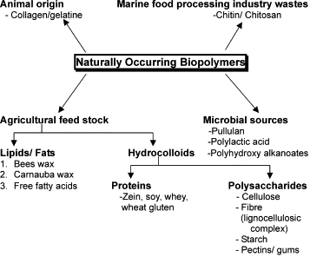
Naturally occurring biopolymers of use in biodegradable packaging films and composites (Rahman et al., 2020).

Slide 5
Protein Based Films and Coatings
Different kinds of protein have been used to produce healthy to eat films/coatings that comprise animal sources (such as casein, whey protein concentrate and isolate, collagen gelatin, and egg albumin) or plant sources (such as corn, soybean, wheat, cottonseed, peanut, and rice). Proteins typically occur as either fibrous proteins or globular proteins. Fibrous proteins are water insoluble and perform a function as the primary structural materials of animal tissues while globular proteins are water soluble as well as soluble in aqueous solutions of acids, bases or salts and perform various functions in living systems (Stellwagen, 1994). Typically, denaturation of the protein is done by use of acid, base, solvent and heat to shape the extra prolonged systems which can be required for film formation. As soon as prolonged, protein chains are linked through hydrogen, ionic and covalent bonding. Equal placement of polar groups alongside the polymer chain enhances the chance of the required interactions. Chain-to-chain interaction determines the strength of edible film, higher interactions yield stronger films but they less permeable to gases. Therefore, protein based films or coatings are considered to be highly effective oxygen blockers even at low relative humidity (Hassan et al., 2018).

Slide 6
Protein Based Films and Coatings
Protein-based films have good organoleptic and mechanical properties, they are easy to use and environmentally friendly resources. These films adhere well to hydrophilic surfaces, act as good barriers to non-condensable gases (CO₂ and N₂) and aromas. However, these films display high moisture adsorption, due to the hydrophilic nature of protein molecules. Casein and whey are the two common milk proteins that have been used in the manufacture of edible films. These proteins are desirable as components of these films because of their nutritional value, excellent mechanical and barrier properties, solubility in water, ability to act as emulsifiers, and because of their industrial surplus. However, it is a fact that the properties of the protein derived films are affected by the source of the protein, the pH of the protein solution, its plasticity, the preparation conditions and the addition of some ingredients to the film forming solution (Bourtoom, 2008).

Slide 7
Polysaccharide Based Films and Coatings
Polysaccharides are naturally occurring polymers, widely used to prepare edible films or coatings including starch, alginate, cellulose ethers, chitosan, carrageenan, pectin or gums and these compounds impart hardness, crispness, compactness, thickening quality, viscosity, adhesiveness, and gel forming ability to a variety of films. Polysaccharides based edible films have excellent mechanical and structural properties. These films exhibit excellent gas permeability properties, resulting in desirable modified atmospheres that enhance the shelf life of the product without creating anaerobic conditions. Polysaccharide coatings are colorless, have an oily-free appearance and a minor caloric content and can be applied to prolong the shelf life of fruits, vegetables, shellfish or meat products by significantly reducing dehydration, darkening of the surface and oxidative rancidity but their hydrophilic nature makes them poor barriers for water vapor(Fagundes et al., 2015).

Slide 8
Lipid Based Films and Coatings
A wide range of hydrophobic compounds has been used to produce lipid based edible films and coatings, including animal and vegetable oils and fats, waxes, natural resins, essential oils and extracts, and emulsifiers and surface active agents. There are several advantages for coating foods with lipids. Lipids not only impart hydrophobicity, cohesiveness, and flexibility, but they also make excellent moisture barriers due to the tightly packed crystalline structure of lipids that naturally restricts the passage of water vapor molecules. They also increase the visual appeal of the food products they are applied to and provide brightness. Despite these advantages, lipid-based films are vulnerable to oxidation and at higher storage temperatures these films may exhibit lower permeability to gases such as oxygen, carbon dioxide, and ethylene, leading to potentially anaerobic conditions which may present food safety issues, as well as lack structural integrity, and poor adherence to hydrophilic surfaces. Thus, it will be better for lipids to form composite films with hydrocolloids or proteins rather than alone.

Slide 9
Composite Films and Coatings
Composite films are defined as films or coatings with heterogeneous structures. In composite formulations, two or more materials are combined to improve mechanical properties and/or gas exchange, adherence to coated products, or moisture vapor permeability properties. Composite films consisting of lipids and a mixture of proteins or polysaccharides take advantage of the individual component properties (Galus, 2018). While the hydrocolloid (protein or polysaccharide) component in the coating formulation provides selective resistance against carbon dioxide and oxygen in the food it is applied to, and a supporting matrix; the lipid component is also resistant to water vapor transmission. The water vapor permeability depends on the ratio of the hydrophilic and hydrophobic parts of the film component. Generally, water vapor permeability occurs in the hydrophilic part of the film. Water vapor permeability, depending on the water absorption properties of the polar part of the film; the polarity, unsaturation, and the degree of branching of the lipids increase as the degree of branching of the lipids increases.

Slide 10
Composite Films and Coatings
Generally, a component forming the edible film either shows good barrier property or shows good mechanical properties; however, it cannot show both. However, composite films can be formed to combine the desired properties of different components. Polysaccharides and proteins allow polymer interaction to take place and improve mechanical properties. However, due to their hydrophilic structure, they cannot show an effective resistance against water vapor transmission. On the contrary, lipids can effectively resist water vapor transmission due to their hydrophobic character. But films made only of lipids are often very fragile. Composite formulations can be applied as emulsions or bilayer films. The main drawback of bilayers films and coatings is that the preparation method involves four stages: two casting and two drying stages. Due to this reason laminated films are fewer popular in the food industry regardless of providing good barrier properties against water vapor. The emulsified components are acquired during only one casting and one drying process. Their functional properties depend on the preparation method, type and amount of components (hydrocolloid and lipid) and their compatibility (Debeaufort and Voilley, 1995).

Slide 11
Composite Films and Coatings
(Debeaufort and Voilley, 1995). In a study, it was determined that the water vapor permeability of the composite film is lower than chitosan (polysaccharide source) or chitosan-quinoa protein mixture alone due to the nonpolar property of lipids in the composite film obtained from quinoa protein-chitosan and sunflower oil (Valenzuela et al., 2013). In another study, it was observed that both the mechanical properties and the barrier properties of the composite film obtained from chitosan and olive oil emulsion became stronger by making it composite (Pereda et al., 2012). Thanks to the emulsifying feature of chitosan, a homogeneous, thin, translucent composite film was obtained. It has been determined that all tensile properties (elongation without rupture) increase with the olive oil concentration, and moisture sorption and water vapor permeability decrease as the lipid concentration increases due to the non-polar feature of the lipids.

Slide 12
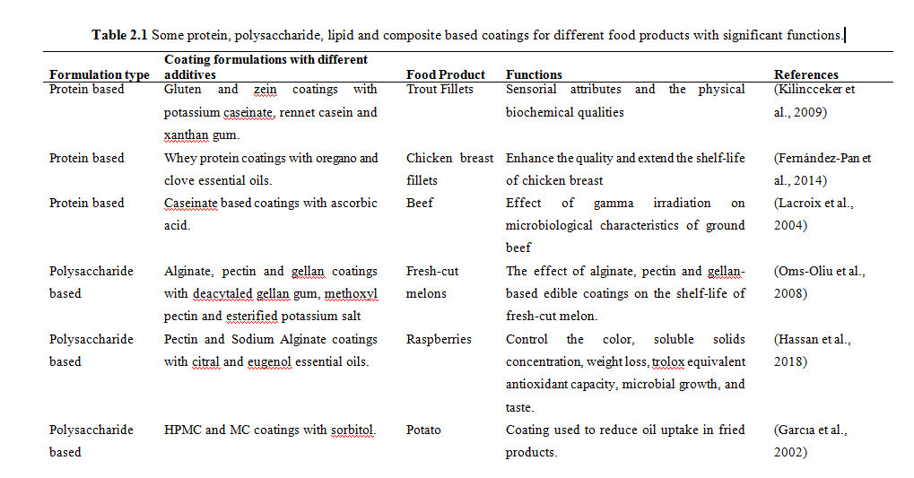

Slide 13
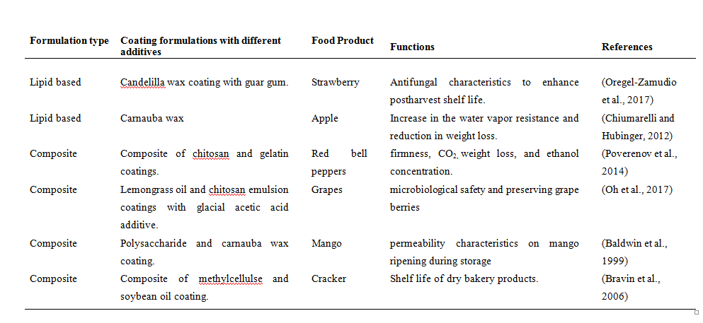

Slide 14
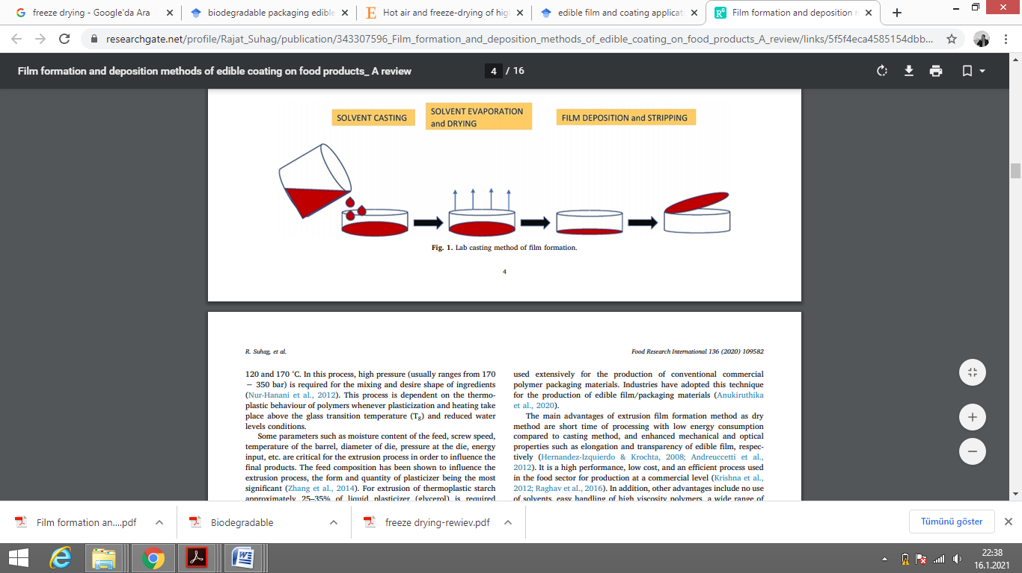
Methods of Edible Film and Coating Formation
There are different application methods of edible films and coatings. Some of these methods are described below:
Methods of Film Formation
Casting Method
Casting method for edible film formation (Suhag et al., 2020).

Slide 15
Solvent casting method is one of the most preferred methods for edible film production at both pilot or laboratory scales. 3 main steps exist for this method, firstly a suitable solvent is used to soluble the film forming component, secondly casting is made into a mould and lastly drying is performed to casted solution (Rhim et al., 2006). Determination of biopolymer or biopolymer mixture which forms the film structure is one of the important stage for obtaining successful edible film formulation. Solubilisation can be carried out with different solvents such as ethanol or water and suitably selected polymer combinations for them. The biopolymer is dissolved in a solvent, for instance, water is used to dissolve whey protein isolate biopolymer or ethanol is utilized to disperse soy protein isolate biopolymer; this process is named solubilisation (Jensen et al., 2015). Rather than melting of the biopolymer, mainly its solubility is affected the film formation in the casting method. In this method, the prepared film forming solution is poured into predefined plates (such as a teflon coated glass plate) (Figure 2.4). Sufficient drying time is necessary for enough evaporation of the solvent which occurs a polymer film that adheres to the plate. Various types of dryers such as microwave, vacuum or tray may used for easy evaporation of the solvents (Cha et al., 2003). The drying step is a crucial process for enhancing the intramolecular relationship between the polymer chains and having a smooth surface for the film. However, using quick-drying methods has shown some negative effects on physical or microstructural film properties (Velaga et al., 2018).

Slide 16
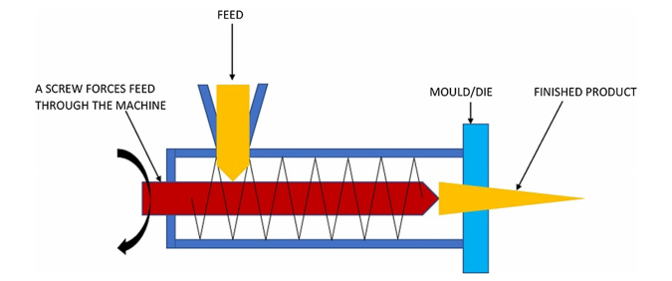
Methods of Film Formation - Extrusion Method
The other one of the polymeric film production method which is presently used in commercial scale is extrusion (Hernandez-Izquierdo and Krochta, 2008). The structure of the extruded material changes and are improved its physicochemical properties by this method (Fitch-Vargas et al., 2016). Generally, the process of extrusion contains three zones as firstly the feeding zone, secondly the kneading zone and lastly the heating zone at the exit from the device (Calderón-Castro et al., 2018).
Extrusion method for edible film formation (Suhag et al., 2020)

Slide 17
Methods of Film Formation - Extrusion Method
The film forming mixture carries into the first zone of feeding and is compressed with air. This method requires high pressure between 170 − 350 bar to mix and to achieve the desired shape of ingredients. Moisture content of the feed, screw speed, die diameter, die pressure, temperature of the barrel are some of the critical parameters for the extrusion process that can be influenced the final product quality.

Slide 18
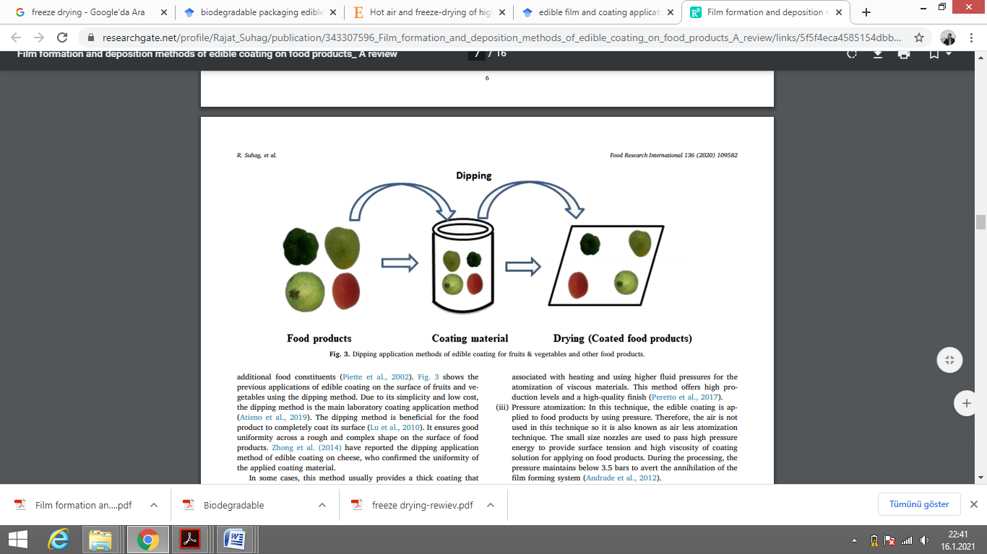
Methods of Coating Formation Dipping Method
In this method, the products are immersed in liquid coating materials, and then the excess material is removed from the product to dry and solidify. The products are kept under room conditions after dipping or by using a dryer to remove the solvent and form the coating structure.
Dipping method for edible coating application (Suhag et al., 2020).

Slide 19
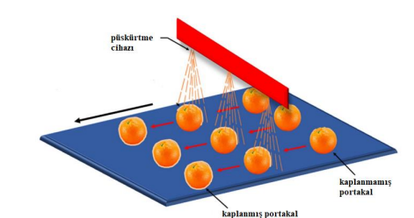
Methods of Coating Formation
Spraying Method
Spraying method, if a certain part of the product is to be coated or if a uniform thin layer is to be obtained, the edible coating is applied to the product by spraying. This method is recommended for fruit and vegetable coating, especially with the development of high pressure spray applicators or air blowing systems.

Slide 20
Methods of Coating Formation
Dripping Method
It is made by applying the coating material to the product in drops from above. Then the product is sent to the rotating brush bearings for a uniform coating and the coating is dried with the fans on the brushes. As the coating thickness can be controlled by spreading with brushes, the coatings can also be formed as a mold. Attention should be paid to the thickness of the coating, if it is too much or too little, it may cause problems (cracking, breaking, adhesion, etc.) during storage.

Slide 21
Methods of Coating Formation
Brushing Method
It is the method performed by coating the solution in fluid form with the help of a brush and coating the product (Figure 2.8). This method, also known as spreading, consists of the controlled spreading of a suspension onto the material surface to be further dried. This method is considered a valid alternative for the preparation of films with dimensions larger than those prepared by casting procedures. This method can be applied to the production of polysaccharides and protein-based films. Spreading is affected by several factors, such as the substrate properties (surface roughness and geometry), system conditions, such as temperature and relative humidity, and liquid properties (viscosity, surface tension and density). Viscosity was found to have a major effect as it defines the resistance of a liquid to spreading on solid surfaces. Therefore, spreading of highly viscous liquids is more difficult than liquids with low viscosity (Valdés et al., 2017).

Slide 22
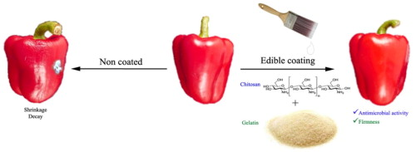
Brushing method for edible coating application (Poverenov et al., 2014).

Slide 23
THANK YOU
Prepare a 2-3-4 page assignment/report related to this presentation.

