Slide 1
FE 422 FOOD PRODUCTION MANAGEMENT
Forecasting

Slide 2

Demand Management
Forecasting is the process of making statements about events whose actual outcomes (typically) have not yet been observed. A commonplace example might be estimation for some variable of interest at some specified future date. Prediction is a similar, but more general term. Both might refer to formal statistical methods employing time series, cross-sectional or longitudinal data, or alternatively to less formal judgmental methods.
The purpose of demand management is to coordinate and control all of the sources of demand so the productive system can be used efficiently and the product delivered on time.

Slide 3
Categories of forecasting methods
Qualitative vs. Quantitative Methods
Qualitative forecasting techniques are subjective, based on the opinion and judgment of consumers, experts; appropriate when past data is not available. It is usually applied to intermediate-long range decisions.
Informed opinion and judgment
Delphi method
Market research
Historical life-cycle Analogy.
Quantitative forecasting models are used to estimate future demands as a function of past data; appropriate when past data is available. It is usually applied to short-intermediate range decisions.
Last period demand
Arithmetic Average
Simple Moving Average (N-Period)
Weighted Moving Average (N-period)
Simple Exponential Smoothing
Multiplicative Seasonal Indexes
5
Notes:
5

Slide 4
Components of Demand
What’s going on here?
x
x
x
x
x
x
x
x
x
x
x
x
Sales
x
x
x
x
x
x
x
x
x
x
x
x
x
x
x
x
x
x
x
x
x
x
x
x
x
x
x
x
x
x
x
x
x
x
x
1
2
3
4
Year
6
Notes:
6

Slide 5
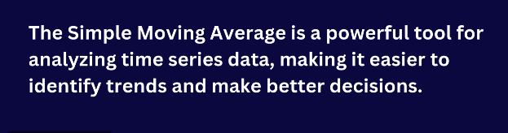
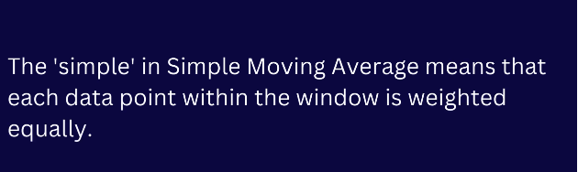
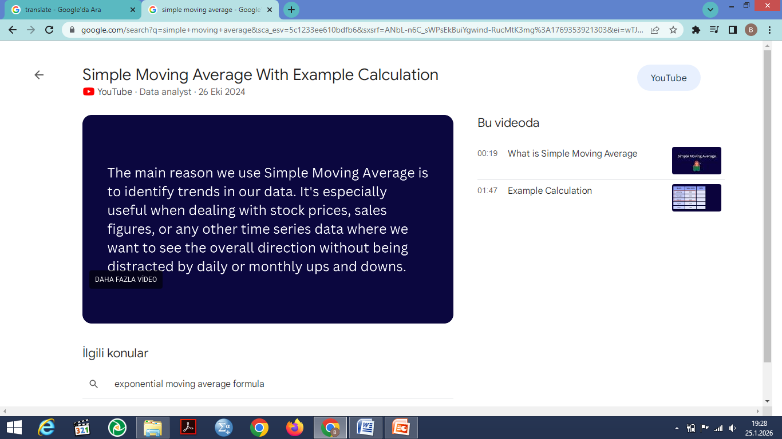
**Simple Moving Average (SMA)

Slide 6
Simple Moving Average
Let’s develop 3-week and 6-week moving average forecasts for demand.
Assume you only have 3 weeks and 6 weeks of actual demand data for the respective forecasts
15
Notes:
15

Slide 7
16
Notes:
16

Slide 8
* *The weighted moving average (WMA)
The weighted moving average (WMA) is a technical indicator that assigns a greater weighting to the most recent data points, and less weighting to data points in the distant past. The WMA is obtained by multiplying each number in the data set by a predetermined weight and summing up the resulting values.

Slide 9
Weighted Moving Average
Determine the 3-period weighted moving average forecast for period 4.
Weights:
t-1 .5
t-2 .3
t-3 .2
20
Notes:
20

Slide 10
Solution
21
Notes:
21

Slide 11
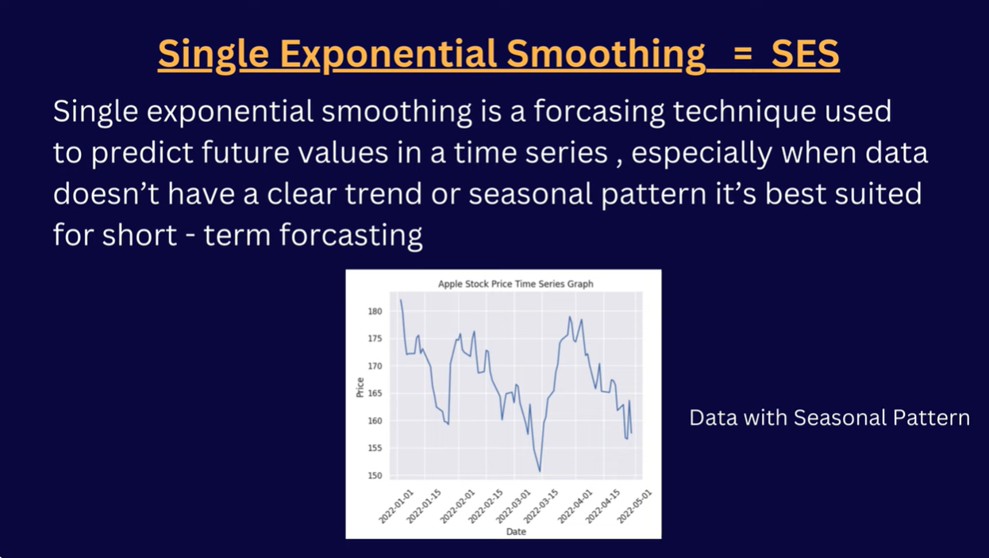
**Single Exponential Smoothing

Slide 12
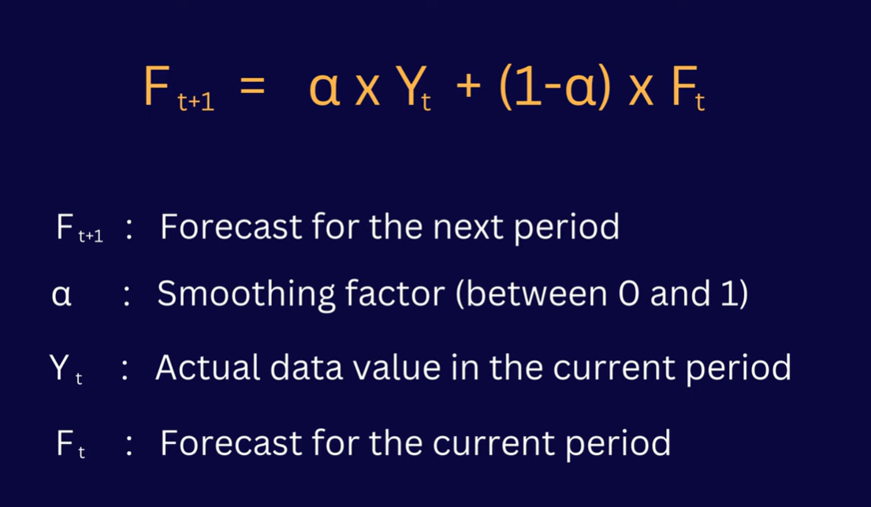

Slide 13
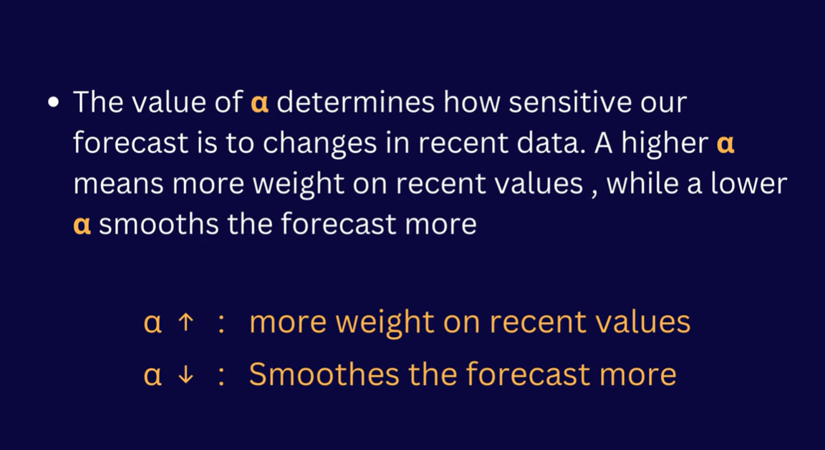
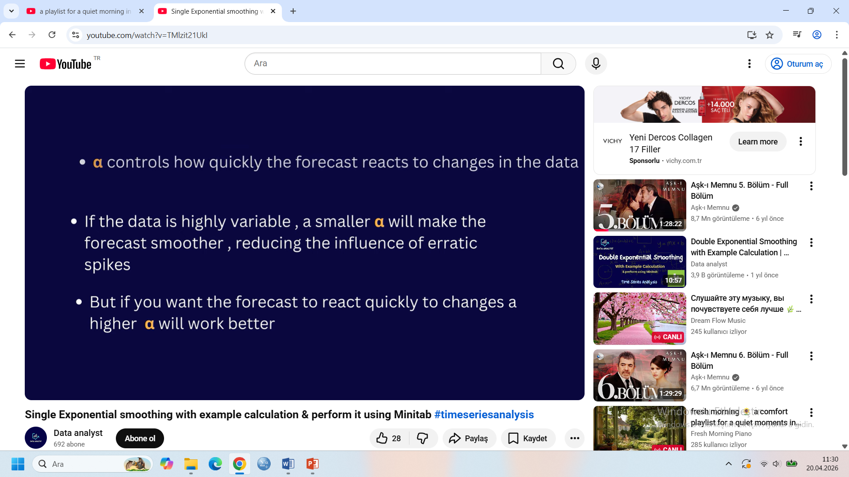

Slide 14


Example Calculation

Slide 15
Exponential Smoothing Example
Determine exponential smoothing forecasts for periods 2-10 using α=.10 and α=.60.
Let F₁=A₁
25
Notes:
25

Slide 16
Irwin/McGraw-Hill
26
The McGraw-Hill Companies, Inc., 1998
Notes:
26

Slide 17
Simple Linear Regression Model
Y_{t} = a + bx
Y
0 1 2 3 4 5 x (weeks)
b is similar to the slope. However, since it is calculated with the variability of the data in mind, its formulation is not as straight-forward as our usual notion of slope
35
Notes:
35

Slide 18
Calculating a and b
36
Notes:
36

Slide 19
Regression Equation Example
Develop a regression equation to predict sales
based on these five points.
37
Notes:
37

Slide 20
38
Irwin/McGraw-Hill
The McGraw-Hill Companies, Inc., 1998
Notes:
38

Slide 21
y = 143.5 + 6.3t
180
175
170
165
160
Sales
Sales
155
Forecast
150
145
140
135
1
2
3
4
5
Period
39
Irwin/McGraw-Hill
The McGraw-Hill Companies, Inc., 1998
Notes:
39

