Slide 1
FE 322 FOOD PRODUCTION MANAGEMENT
2. PROJECT MANAGEMENT AND PRODUCT DEVELOPMENT

Slide 2
PROJECT MANAGEMENT AND PRODUCT DEVELOPMENT
What is Project Management?
a method for organizing tasks
a structured framework to help a group work productively
tools to aid in task sequencing, dependency analysis, resource allocation, scheduling, etc.
tools to track progress relative to plan

Slide 3
PROJECT MANAGEMENT AND PRODUCT DEVELOPMENT
Why Need Project Management?
Complex project needs coordination of:
Multiple people
Multiple resources (labs, equipment, etc.)
Multiple tasks – some must precede others
Multiple decision points – approvals
Phased expenditure of funds
Matching of people/resources to tasks

Slide 4
PROJECT MANAGEMENT AND PRODUCT DEVELOPMENT
Task Dependencies and the Critical Path
Sometimes task B cannot be started before task A is completed
Other types of constraints – calendar, lags, etc.
Critical path – any slippage slips whole project
Helpful to know what tasks are on the critical path
Useful to try to shorten the critical path

Slide 5
PROJECT MANAGEMENT AND PRODUCT DEVELOPMENT
Suggested Steps in Project Management
1. Generate a formal definition of the project, with goals, constraints, assumptions
2. Identify project start/end dates, any mandatory milestones, including reports, signoffs, deliverables, etc.
3. List constraints – money, equipment availability, holidays, etc.
4. Identify tasks to be accomplished – high level (i.e., by categories), then details within each, using brainstorming method – green light
5. Refine detailed task list, dropping/ combining, adding things omitted
Then, for each task in list:
A. Estimate time (person hours, calendar period)
B. Identify dependencies among tasks
Identify resources (people, money, parts, etc.)
6. Organize task groups roughly by starting date
7. List dependencies that should or MUST hold
8. Make a GANTT chart
9. First capture tasks and task groups, milestones
10. Identify critical path, see if it can be shortened (get more “slack”)
11. Assign person-hours and specific team member(s) to each task – identify “task leads”
As project progresses:
A. Monitor, record progress on all tasks, at least weekly – use “Tracking Gantt Chart”
B. Pay particular attention to those on critical path
C. Revise plan as needed to take into account changes, adapt to meet milestones

Slide 6
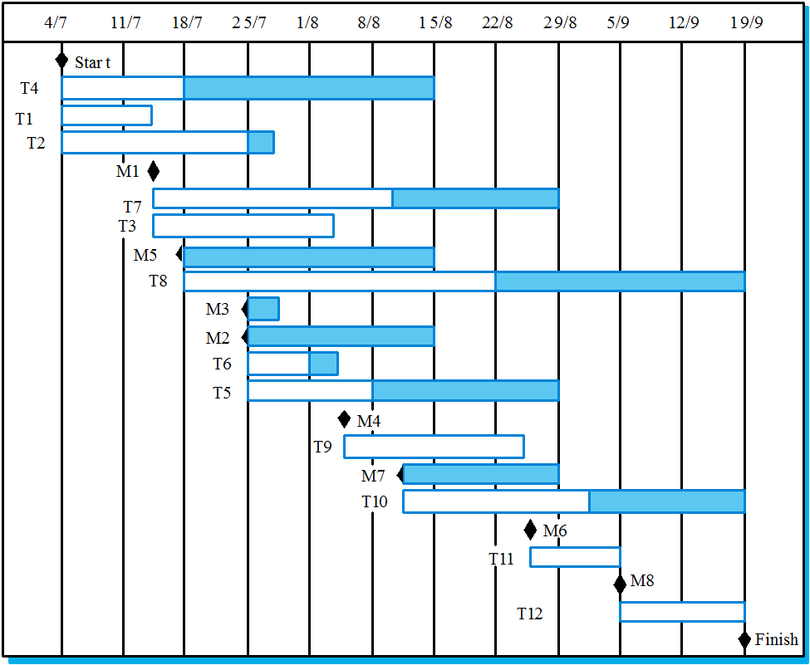
PROJECT MANAGEMENT AND PRODUCT DEVELOPMENT
GANTT Chart

Slide 7
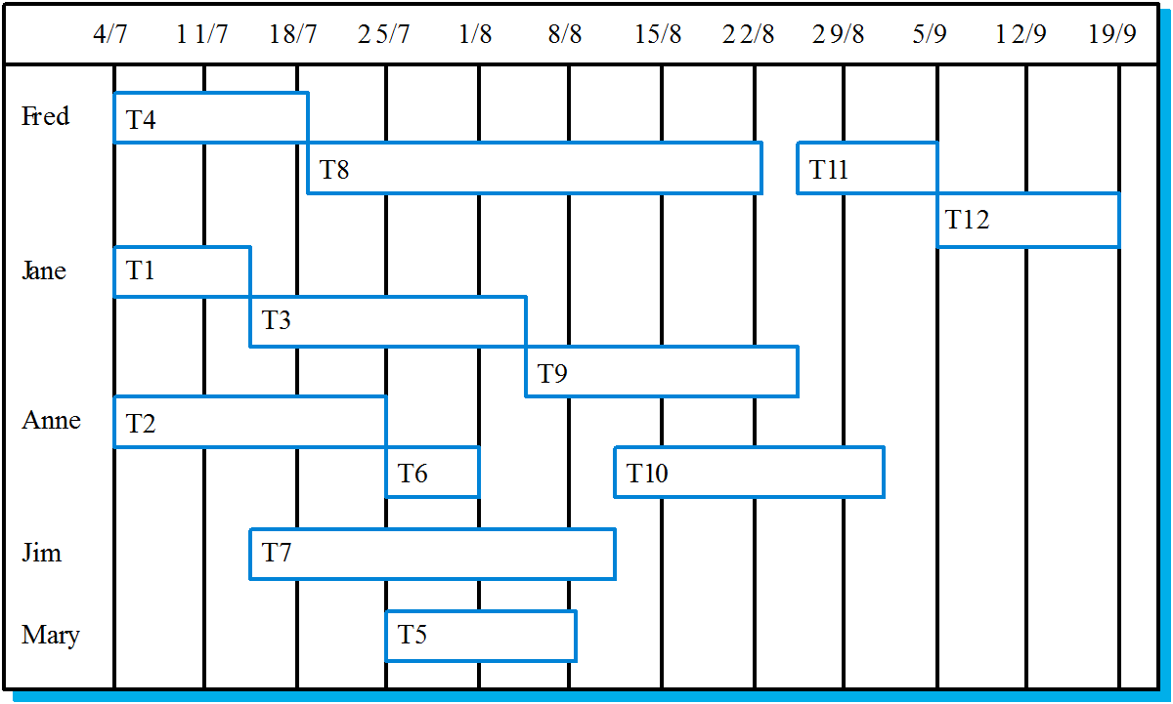
PROJECT MANAGEMENT AND PRODUCT DEVELOPMENT
Staff allocation

Slide 8
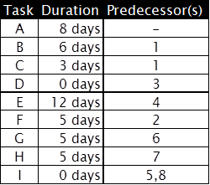
PROJECT MANAGEMENT AND PRODUCT DEVELOPMENT
Network Diagrams and Critical Path Analysis
Once you’ve determined the activities for the project and estimated their durations, network diagrams are the next step for creating the project schedule.
Two Types:
Activity on Arrow (AOA)—nodes on the diagram connect arrows and represent activities
Activity on Node (AON)—nodes represent activities that are connected by arrows showing the precedence of activities
Network Diagram Example Activity on Arrow (AOA)
Critical path is A-B-F-G-H-I, with total duration of 29 days.
There is one non-critical path A-C-D-E-I, with total duration of 23 days. NOTE: Task A has no slack because it is on the critical path.

Slide 9
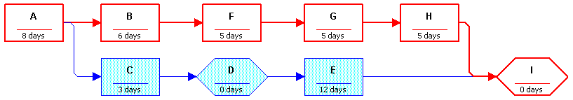
PROJECT MANAGEMENT AND PRODUCT DEVELOPMENT
Network Diagram Example Activity on Node (AON)
Once again, the critical path is A-B-F-G-H-I, with total duration of 29 days.
There is one non-critical path A-C-D-E-I, with total duration of 23 days. NOTE: Task A has no slack because it is on the critical path.

Slide 10
PROJECT MANAGEMENT AND PRODUCT DEVELOPMENT

Slide 11
PROJECT MANAGEMENT AND PRODUCT DEVELOPMENT

Slide 12
CPM with Single Time Estimate
Consider the following consulting project:
Activity
Designation
Immed. Pred.
Time (Weeks)
Assess customer's needs
A
None
2
Write and submit proposal
B
A
1
Obtain approval
C
B
1
Develop service vision and goals
D
C
2
Train employees
E
C
5
Quality improvement pilot groups
F
D, E
5
Write assessment report
G
F
1
Develop a critical path diagram and determine the
duration of the critical path and slack times for all
activities
17
Notes:
17

Slide 13
First draw the network
D, 2
A, 2
B, 1
F, 5
G, 1
C, 1
E, 5
18
Notes:
18

Slide 14
Determine early start and early finish times
ES=4
EF=6
D, 2
ES=0
EF=2
ES=2
EF=3
ES=3
EF=4
?
A, 2
B, 1
C, 1
F, 5
G, 1
ES=4
EF=9
E, 5
19
Notes:
19

Slide 15
When I can start depends on when predecessors finish
ES=4
EF=6
D, 2
ES=0
EF=2
ES=2
EF=3
ES=3
EF=4
ES=9
EF=14
ES=14
EF=15
A, 2
B, 1
C, 1
F, 5
G, 1
ES=4
EF=9
E, 5
20
Notes:
20

Slide 16
Determine late starts and late finish times
ES=4
EF=6
D, 2
ES=0
EF=2
ES=2
EF=3
ES=3
EF=4
ES=9
EF=14
ES=14
EF=15
LS=7
LF=9
A, 2
B, 1
C, 1
F, 5
G, 1
ES=4
EF=9
?
LS=9
LF=14
LS=14
LF=15
E, 5
LS=4
LF=9
21
Notes:
21

Slide 17
Don’t delay the project
ES=4
EF=6
D, 2
ES=0
EF=2
ES=2
EF=3
ES=3
EF=4
ES=9
EF=14
ES=14
EF=15
LS=7
LF=9
A, 2
B, 1
C, 1
F, 5
G, 1
ES=4
EF=9
LS=0
LF=2
LS=2
LF=3
LS=3
LF=4
LS=9
LF=14
LS=14
LF=15
E, 5
LS=4
LF=9
22
Notes:
22

Slide 18
Critical Path & Slack
ES=4
EF=6
Slack=(7-4)=(9-6)= 3 Wks
D, 2
ES=0
EF=2
ES=2
EF=3
ES=3
EF=4
ES=9
EF=14
ES=14
EF=15
LS=7
LF=9
A, 2
B, 1
C, 1
F, 5
G, 1
ES=4
EF=9
LS=0
LF=2
LS=2
LF=3
LS=3
LF=4
LS=9
LF=14
LS=14
LF=15
E, 5
LS=4
LF=9
Duration = 15 weeks
23
Notes:
23

Slide 19
Example
Activity | Predecessors | Time (weeks)
A | - | 3
B | A | 4
C | A | 7
D | B, C | 13
E | B | 4
F | D | 5
G | C | 8
H | E, F,G | 3
Draw the network, determine ES, EF, LS, LF and slack times

Slide 20
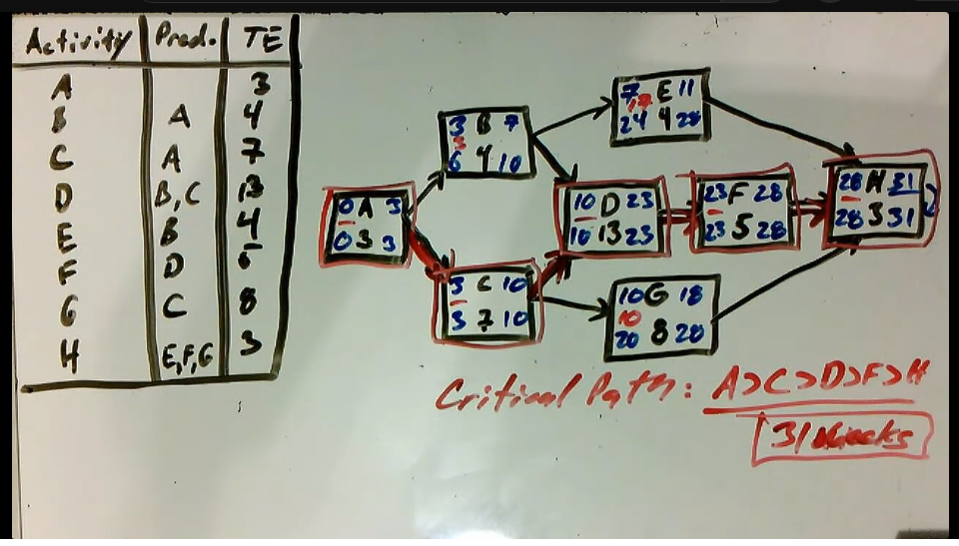
A-B-D-F-H (28 weeks) A-B-E-H (14 weeks) A-C-D-F-H (31 weeks)-critical path A-C-G-H (21 weeks)

