Slide 1
FE 422 FOOD PRODUCTION MANAGEMENT
Inventory Management

Slide 2

Inventory Management
Inventory means a list compiled for some formal purpose, such as the details of an estate going to probate, or the contents of a house let furnished.
Inventory management is primarily about specifying the size and placement of stocked goods. Inventory management is required at different locations within a facility or within multiple locations of a supply network to protect the regular and planned course of production against the random disturbance of running out of materials or goods. The scope of inventory management also concerns the fine lines between replenishment lead time, carrying costs of inventory, asset management, inventory forecasting, inventory valuation, inventory visibility, future inventory price forecasting, physical inventory, available physical space for inventory, quality management, replenishment, returns and defective goods and demand forecasting.
Inventory management, a critical element of the supply chain, is tracking inventory from manufacturers to warehouses and from these facilities to the point of sale. Inventory management aims to have the right products in the right place at the right time.

Slide 3
Types of Inventory
Raw material
Work-in-progress
Maintenance/repair/operating supply
Finished goods

Slide 4
The Functions of Inventory
To ”decouple” or separate various parts of the production process
To provide a stock of goods that will provide a “selection” for customers
To take advantage of quantity discounts
To hedge against inflation and upward price changes

Slide 5
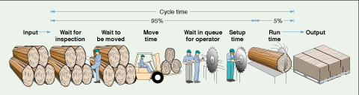
The Material Flow Cycle

Slide 6
Disadvantages of Inventory
Higher costs
Item cost (if purchased)
Ordering (or setup) cost
Costs of forms, clerks’ wages etc.
Holding (or carrying) cost
Building lease, insurance, taxes etc.
Difficult to control
Hides production problems
Notes:
Of the items listed on this slide, the least obvious to most students is the manner in which inventory can be used to hide production problems.

Slide 7
Inventory Classifications
Inventory
© 1984-1994 T/Maker Co.
Process stage
Number & Value
Demand Type
Other
Raw Material WIP Finished Goods
A Items
B Items
C Items
Maintenance Dependent Operating
Independent Dependent

Slide 8
The Material Flow Cycle
Other
Wait
Time
Move
Time
Queue
Time
Setup
Time
Run
Time
Input
Output
Cycle Time
Run time: Job is at machine and being worked on
Setup time: Job is at the work station, and the work station is being "setup."
Queue time: Job is where it should be, but is not being processed because other work precedes it.
Move time: The time a job spends in transit
Wait time: When one process is finished, but the job is waiting to be moved to the next work area.
Other: "Just-in-case" inventory.
Notes:
This slide provides a more detailed view of the material flow cycle. Students might be asked to comment on the impact of each element on the overall time. Questions such as:
- why do we need these times?
- how can they be reduced?
- would we wish to eliminate these elements entirely?
might be helpful.

Slide 9
Inventory Costs
Holding costs - associated with holding or “carrying” inventory over time
Ordering costs - associated with costs of placing order and receiving goods
Setup costs - cost to prepare a machine or process for manufacturing an order

Slide 10
Inventory Models
Fixed order-quantity models
Economic order quantity
Production order quantity
Quantity discount
Probabilistic models
Fixed order-period models
Help answer the inventory planning questions!
© 1984-1994 T/Maker Co.
Notes:
This slide simply introduces some of the available models. Additional details are provided in subsequent slides.

Slide 11
EOQ Model How Much to Order?
Economic order quantity is an inventory management technique that helps make efficient inventory management decisions. It refers to the optimal amount of inventory a company should purchase in order to meet its demand while minimizing its holding and storage costs.
Annual Cost
Total Cost Curve
Holding Cost Curve
Order (Setup) Cost Curve
(EOQ) Optimal Order Quantity (Q*)
Order Quantity

Slide 12
Deriving an EOQ
Develop an expression for setup or ordering costs (Setup cost refers to the expenses associated with starting a new operation, preparing for a new process, or initiating a production run.)
Develop an expression for holding cost (holding costs refer to the amount of money that needs to be paid in order to store unsold inventory )
Set up cost equal to holding cost
Solve the resulting equation for the best order quantity
Notes:
Students may find it helpful if you actually go through each of these steps - at least through writing the equation, and setting setup cost equal to holding cost.

Slide 13
EOQ Model When To Order
ROP is the level of inventory at which a business should place a new order or run the risk that stock will drop below a comfortable level, or even down to zero — leaving customers unhappy and orders unfulfilled.
(EOQ) Optimal order quantity, also known by the formula economic order quantity (EOQ), represents the ideal amount of inventory a business should have at any given time to meet demand without holding too much excess stock.
Inventory Level
Optimal Order Quantity (Q*)
Average Inventory (Q*/2)
Reorder Point (ROP)
Time
Lead Time
Notes:
One should link this model to the assumptions. You should also explore, at least briefly, how this picture would change if the assumptions were not met.

Slide 14
EOQ Model Equations
2
×
D
×
S
Optimal Order Quantity
=
Q*
=
H
D
=
=
Expected Number of Orders
N
Q*
Expected Time Between Orders
Working Days
/
Year
=
T
=
N
D
D = Demand per year
S = Setup (order) cost per order
H = Holding (carrying) cost
d = Demand per day
L = Lead time in days
d
=
Working Days
/
Year
ROP
=
d
×
L
Notes:
For some students, it is most important at this point to explain in detail the meaning and significance of each equation. It might be helpful to actually work through a numerical example.

Slide 15
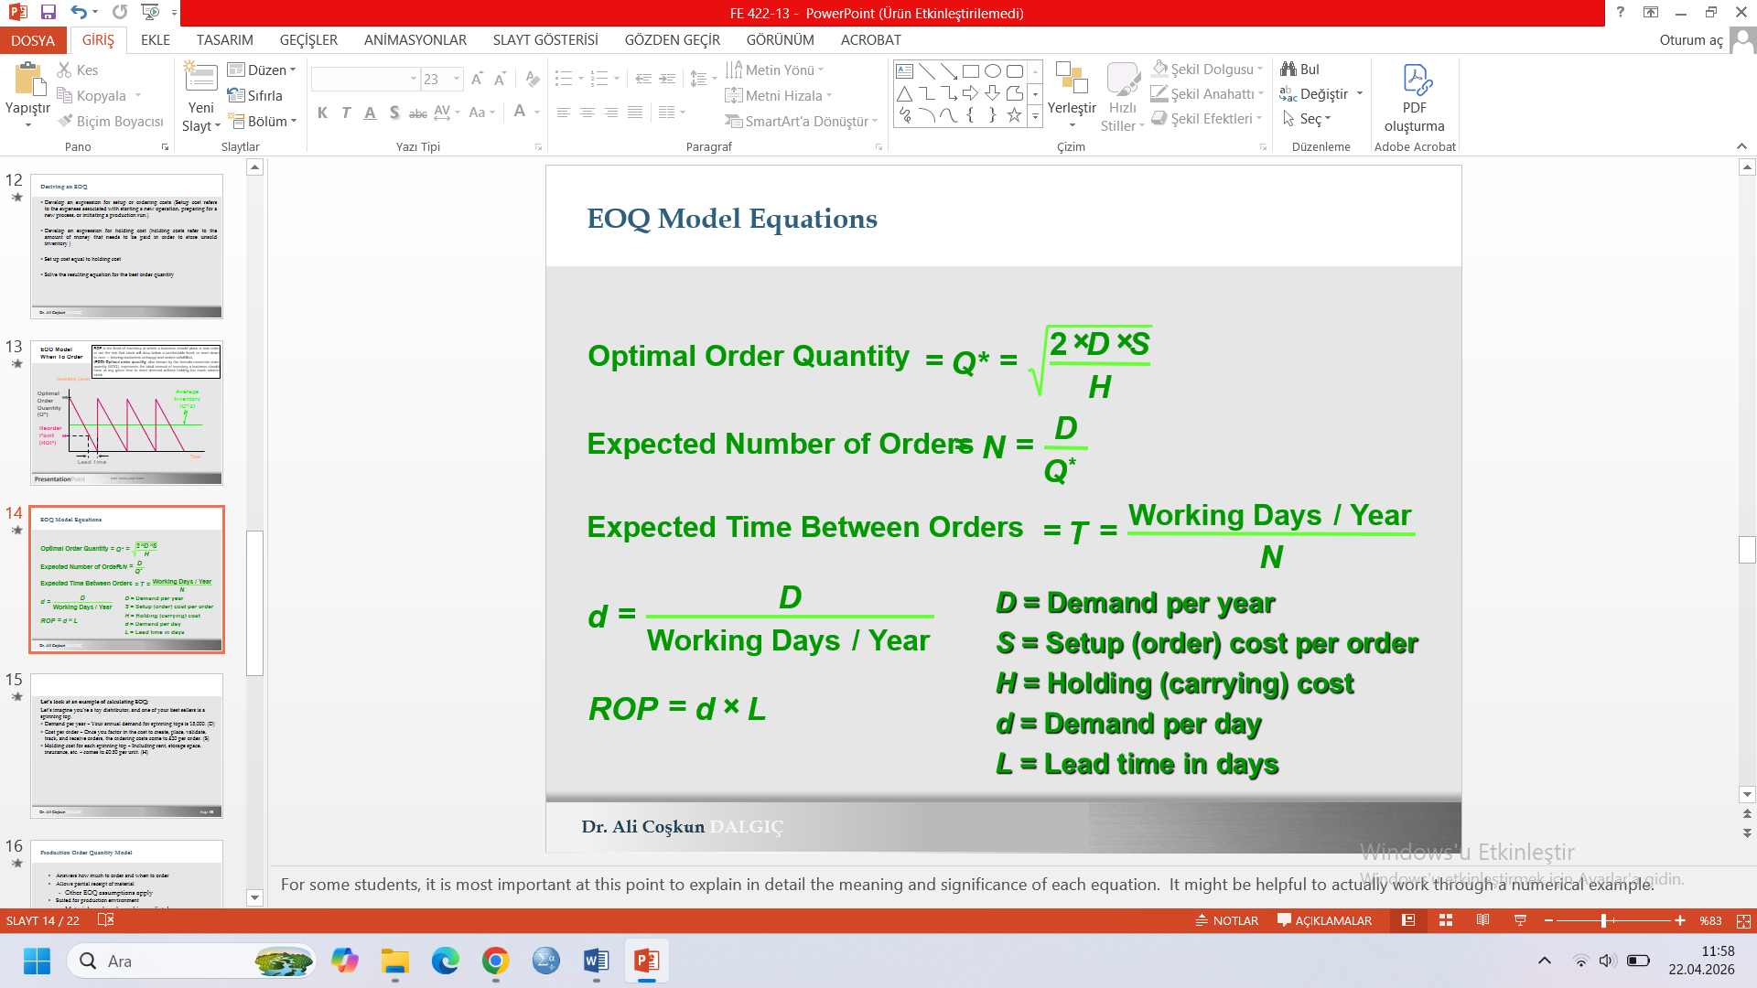
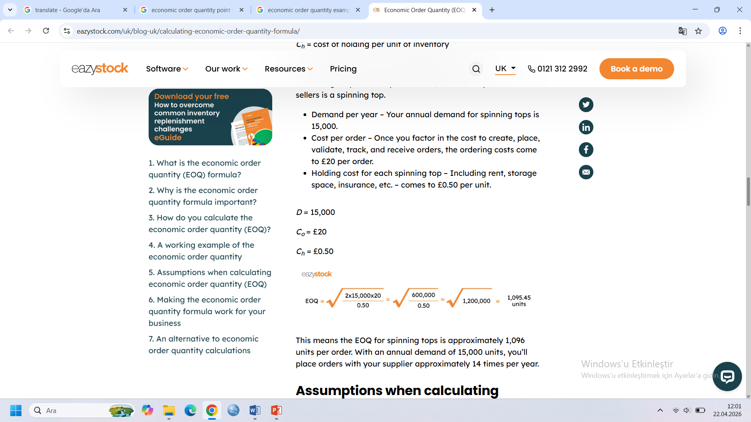
Let’s look at an example of calculating EOQ:
Let’s imagine you’re a toy distributor, and one of your best sellers is a spinning top.
Demand per year – Your annual demand for spinning tops is 15,000. (D)
Cost per order – Once you factor in the cost to create, place, validate, track, and receive orders, the ordering costs come to £20 per order. (S)
Holding cost for each spinning top – Including rent, storage space, insurance, etc. – comes to £0.50 per unit. (H)
This means the EOQ for spinning tops is approximately 1,096 units per order. With an annual demand of 15,000 units, you’ll place orders with your supplier approximately 14 times per year.

Slide 16
Production Order Quantity Model
Answers how much to order and when to order
Allows partial receipt of material
Other EOQ assumptions apply
Suited for production environment
Material produced, used immediately
Provides production lot size
Lower holding cost than EOQ model
Notes:
One way to approach this is as an EOQ model with the instantaneous replenishment assumption relaxed. The following slide (EOQ Model modified to show changes for POQ) allows you to do this if you wish. Otherwise, skip it and move on.

Slide 17
EOQ POQ Model When To Order
Inventory Level
Optimal Order Quantity (Q*)
Average Inventory
Reorder Point (ROP)
Time
Lead Time

Slide 18
POQ Model Inventory Levels
Inventory Level
Production portion of cycle
Demand portion of cycle with no supply
Time
Supply Begins
Supply Ends
Notes:
Given that students recognize that production takes place for only a portion of the cycle, you might ask how one determines the appropriate length of the production period. If they understand the model, they will perceive that the production period is determined by the POQ.

Slide 19
POQ Model Inventory Levels
Inventory Level
Inventory level with no demand
Production Portion of Cycle
Max. Inventory Q·(1- d/p)
Q*
Time
Supply Begins
Supply Ends
Demand portion of cycle with no supply

Slide 20
POQ Model Equations
2*D*S
Optimal Order Quantity
=
Q
*
=
p
(
)
d
H*
1
-
p
(
)
*
d
Maximum inventory level
=
Q
1
-
p
D
D = Demand per year
S = Setup cost
H = Holding cost
d = Demand per day
p = Production per day
Setup Cost
=
*
S
Q
(
)
d
Holding Cost
=
0.5 * H * Q
1
-
p
Notes:
Here again, it may be helpful to actually go through a numerical example, but it will probably be necessary to explain in detail the meaning and significance of each equation

Slide 21
Fixed Period Model
Answers how much to order
Orders placed at fixed intervals
Inventory brought up to target amount
Amount ordered varies
No continuous inventory count
Possibility of stockout between intervals
Useful when vendors visit routinely
Example: P&G representative calls every 2 weeks
Notes:
This represents a model in which orders are based upon time, not the quantity needed. The following slide provides a graphical representation.

Slide 22
Fixed Period Model When to Order?
Inventory Level
Target maximum
Time
Period
Period
Period

