Slide 1
FE 322 FOOD PRODUCTION MANAGEMENT
INTRODUCTION

Slide 2


FE 322 Food Production Management
Course Details
Introduction to management systems.
Design of food manufacturing facilities. Project management
Food manufacturing systems in steady state: production planning, inventory control and operation scheduling
Principles of total quality management system
Quality management systems. ISO 9000: Quality Management System Standard
Plant organization structures
Quality documentation and quality cost
Quality and safety audit systems
Statistical process control
Process management, flow lines and plant layouts
Prerequisite programs for food processing
Hazards, hazard analysis and risk assessment
HACCP plan and implementation
Food safety management systems. Principles of ISO 22000: Food Safety Management System Standard
E-Mail: dalgic@gantep.edu.tr
Course Description
Food manufacturing systems in steady state: production planning, inventory control and operation scheduling.
Principles of total quality management system.
ISO 9000: Quality Management System standard.
Food safety management systems.
Prerequisite programs for food processing.
HACCP plan and implementation.
Principles of ISO 22000: Food Safety Management System standard.
Documentation system.
Quality and safety audit system.

Slide 3
FE 322 Food Production Management
Course Organization
The aim of the course is to increase the information about food production management systems in food industry and to evaluate the applications of management system standards and basic principles of total quality management and HACPP systems.
Course Objectives

Slide 4


What is food production management?
Food production management refers to the set of activities involved in organising, planning, and controlling the operations of transforming raw materials into finished food products. It encompasses the coordination of human, material, and technical resources to ensure efficient, compliant, and profitable production.

Slide 5

💡 The central role of production management
Mastered production management directly impacts the overall performance of the company: cost reduction, improved customer service levels, guaranteed product quality, and preservation of brand image. It is the beating heart of any high-performing food processing plant.

Slide 6
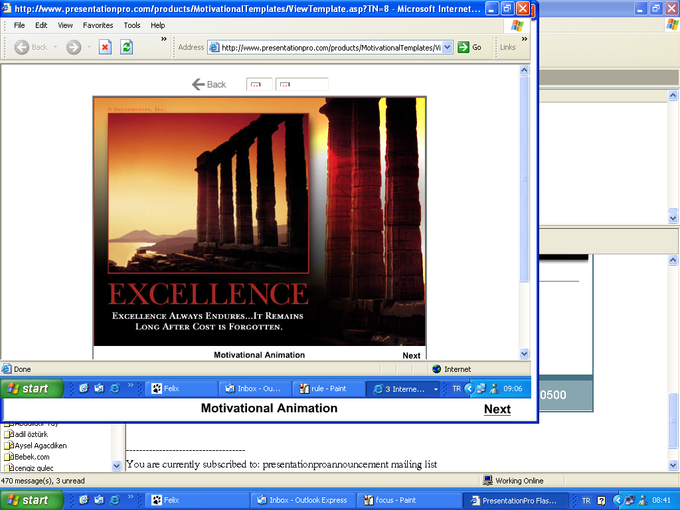
FE 322 Food Production Management
Grading Policy
Assessment Tool | Quantity | Percentage
Midterm Exam | 2 | 60
Final Exam | 1 | 40
Excellence always endures…
It remains long after cost is forgotten
Reference Books
J.M. Juran, A.Blanton Godfrey | Juran's Quality Handbook | McGraw-Hill | 2000 | 978-0071165396
David Smith, Tracey Jackson-Smith, Rob Politowski | ISO 22000 Food Safety: Guidance and Workbook for the Manufacturing Industry | BSI Standards | 2007 | 978-0580499890
David Hoyle | ISO 9000 Quality Systems Development Handbook: A Systems Engineering Approach | Butterworth-Heinemann | 1998 | 978-0750625623
Richard B. Chase Nicholas J. Aquilano F. Robert Jacobs | Production and Operations Management: Manufacturing and Services | Richard D Irwin; 8th Inst M edition | 1998 | 978-0256269215

