Slide 1
CHAPTER 1
INTRODUCTION TO STATICS
Lecturer:
Dr. Ö. Yavuz BOZKURT
Mechanical Engineering Department
3 rd Floor Office No: 303
oybozkurt@gantep.edu.tr
0342 317 1200- 2525
Office Hours:
Friday: 10:30- 11:30
Thursday : 10:30- 11:30
By Duk.of.arch – www.flickr.com/photos/dukeofarch/Getty Images, Inc.

Slide 2
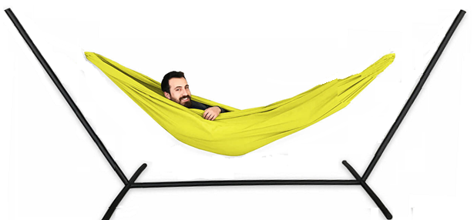
What practical benefits may I expect from this course?
φ d = ?
Hello.. Good luck in Statics!
Let's try to understand the answer to this question with an example:
The company you work for wants to manufacture a portable hammock set as shown in the figure.
As the R&D engineer, they asked you to determine the most suitable diameter (d) of the ropes to be used in the hammock. Because if the threads are too thin, they will break, if they are too thick, they will not break, but it will be expensive.
For this reason, as an engineer, if you can determine the minimum thickness (diameter) that the ropes can withstand human weight, we can also suggest for our company in the most beneficial way.
Now let's brainstorm: Let the hammock support a person weighing no more than 120 kg. But be twice as safe. In other words, the hammock should carry a maximum load of 240 kg (approximately 2400 N) in a stationary state.

Slide 3
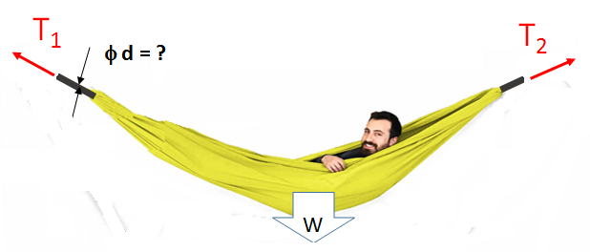
Motivation
Don’t forget: the minimum diameter (d) cannot be determined without knowing the rope forces (T₁, T₂).
Thus:
First step is to find the forces in the ropes(T₁, T₂)
Step 2 is to calculate the safe diameter (d) of the rope.
From statics
From strength of materials
As you can see, static and strength are two courses that complement each other.
In the strength course, dimension calculations (such as determining the diameter d) that can be applied directly to real life are made, and these calculations are expected from the engineers.
But before calculating the size, the forces need to be known. This is the main topic of the Statics course.
So, as an engineer, it is extremely important that we first learn static calculations well.

Slide 4
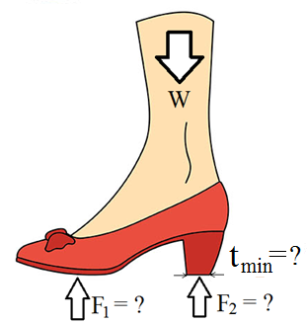
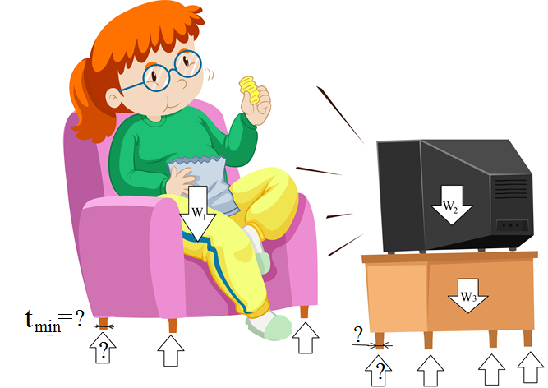
Motivation
Now take a look at the solid objects that are exposed to the effects of external loads around you. For example, chair, table, coffee table, bed, closet, elevator, bookcase, stairs, your shoes.
From strength
W
From statics

Slide 5

Motivation
You may think that by keeping these parts thin, you can save material and benefit your company economically. However, you should be aware that you are risking strength in this case. If we think about the opposite, you can thicken the parts and reduce the risk of strength, but in this case, you make the production more expensive because you need to use more material.
What is expected from you as an engineer is to make the calculations that will best meet these strength and economy conditions, which is called optimization and the result is the optimum solution.
In fact, our ultimate goal is to determine the minimum dimensions in terms of strength. This is possible with strength calculations. But as we said, without static calculations, Strength calculations cannot be made. For this reason, the Static course forms the basis of the Strength course. The main goal in statics is to determine the forces acting on solid objects at rest.

Slide 6
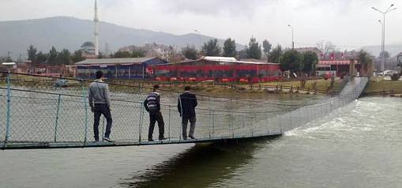
Motivation
It should also be noted that by changing the dimensions, the best solution can be found in terms of strength and economy, but at the same time, the functionality and usability of the system should not be comprimised. This appears as a third condition.
A bridge that could withstand loads but lost its functionality due to excessive deformation

Slide 7

Motivation
As a result, in the design phase of a new product or in the improvement activities of an existing product, it is necessary to provide the following 3 conditions at the best level so that the optimum solution can be obtained:
1- Strength
2- Economy
3- Functionality
By preventing the waste of material used in manufacturing, reducing the expenses of the enterprises and thus making more profit is only possible with engineers who have sufficient knowledge of static and strength issues and thus can make accurate optimization calculations.

Slide 8
2023-2024 FALL SEMESTER ME 201 GENERAL CONTENTS
INTRODUCTION TO STATICS | 2.10.2024
FORCE SYSTEMS | 08.10.2023
2D Forces, 2D Rectangular Components
2D Moments, Couple, Resultants | 09.10.2024
Problem Hour | 15.10.2024
3D Rectangular Components | 16.10.2024
3D Moment, Couple, Resultants | 22.10.2024
Problem Hour | 23.10.2024
EQUILIBRIUM | 29.10.2024
2D Equilibrium
3D Equilibrium | 30.10.2024
Problem Hour | 05.11.2023
STRUCTURES | 06.11.2023
Plane Trusses (Method of Joints)
Plane Trusses (Method of Section) | 12.11.2023
Problem Hour | 13.11.2023
1st MIDTERM | 19.11.2023
Frames and Machines | 20.11.2023
Problem Hour | 26.11.2023
DISTRIBUTED FORCES | 27.11.2023
Centroid
Problem Hour | 03.12.2023
Beams | 04.12.2023
Problem Hour | 10.12.2023
2nd MIDTERM | 11.12.2023
Area Moments of Inertia | 17.12.2023
Problem Hour | 18.12.2023
EXAMS
19.11.2024 First Examination
11.12.2024 Second Examination
Textbook
Engineering Mechanics Vol-1;Statics
By J. L. Meriam and L. G. Kraige
Auxiliary Books
Engineering Mechanics; Statics
By R.C. Hibbeler
Vector Mechanics for Engineers; Statics
By Ferdinand P. Beer and E. R. Johnston
Many books related with the Statics in the Library

Slide 9
Introduction
.
  Newton’s Laws
Law I
  A particle remains at rest or continues to move with uniform velocity (in a straight line with a constant speed) if there is no unbalanced force acting on it.
Law II
  The acceleration of a particle is proportional to the vector sum of forces acting on it and is in the direction of this vector sum.
Law III
  The forces of action and reaction between interacting bodies are equal in magnitude, opposite in direction, and collinear (they lie on the same line).

Slide 10
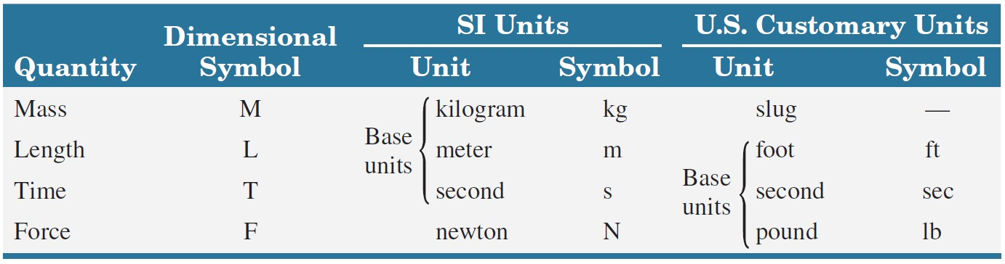
Introduction
.
Fundamental Quantities of Mechanics and their Units
$F=ma →$ 1 Newton force is the force value that accelerates a 1-kilogram mass by 1 m/s²

Slide 11
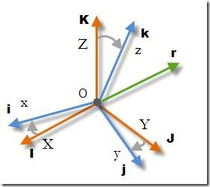
Scalars and Vectors

Slide 12
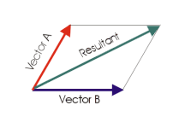
Importance of the vectors
1. Vectors
We will be able to calculate force, which is the main subject of statics, and we will be able to solve especially three-dimensional equilibrium problems more easily and practically.
Remember: What was the significance of calculating forces?
Strength calculations cannot be made without knowing the forces.
The minimum dimensions required for the piece to withstand the force are determined by strength calculations.
These minimum dimensions allow us to obtain data applicable to our daily lives. Because the dimensions must be larger than these values.

Slide 13
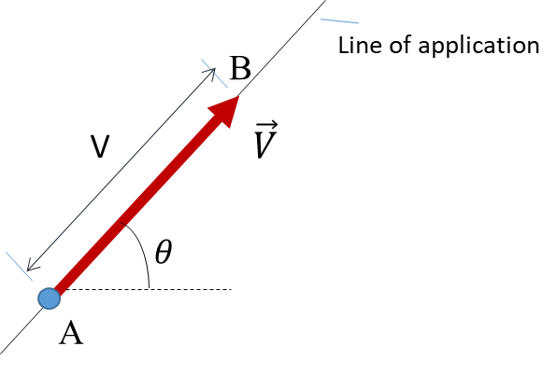

1. Vectors
Scalar Quantity
  A quantity with only a magnitude.
  Examples: time, volume, density, speed, energy, and mass
Vector Quantity
  Quantity with both a magnitude and a direction.
  Obeys the parallelogram law of addition.
  Examples: displacement, velocity, acceleration, force, moment, and momentum.
Vectoral form: $\vec{ V}$
Magnitude : V or I$\vec{ V}$I
Direction : from A to B
Application point: A
Reference angle: θ

Slide 14
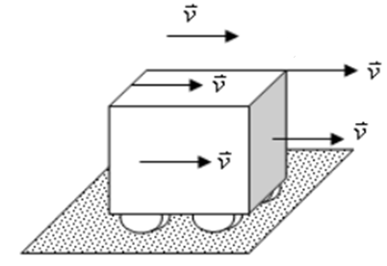
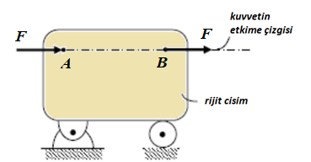

1. Vectors
Types of Vectors
  Free Vector – one whose action is not confined to or associated with a unique line in space. Example: velocity
  Sliding Vector – has a unique line of action in space but not a unique point of application.
  Fixed Vector – has a unique line of action and point of application.
line of action
rigid body
elastic rod

Slide 15
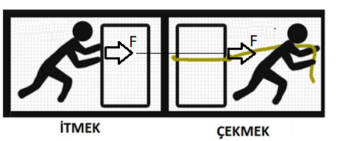
1. Vectors
Principle of transmissibility:
Provided that the strength and direction of the force acting on the rigid body remain the same, the point of application can be moved to any point on its direction and the effect on the object does not change as a result of this operation.
PUSHING
PULLING
Theoretically, the mechanical effect of these forces is the same whether we push an object from behind or pull it from the front with the same force in the same direction.

Slide 16
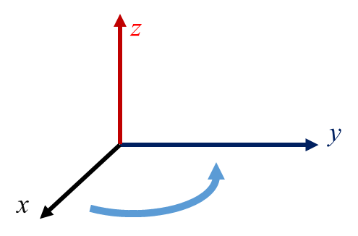
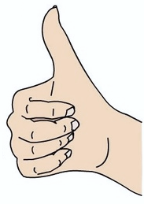
1. Vectors
Cartesian Coordinates:
It is a set of axes consisting of perpendicular (orthogonal) axes.
It contains the x and y axes in the two-dimensional (planar) case, and the x, y, and z axes in the three-dimensional (spatial) case.
Two of the axes are placed arbitrarily, the other depending on them.

Slide 17
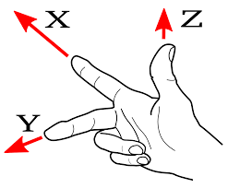
1. Vectors
How to place the axes?
the x and y axes are placed arbitrarily; but the direction of the z-axis can no longer be arbitrary.
The z axis is placed with the right-hand rule.
In other words, if we hold the x-axis with 4 fingers of our right hand and grab it on the y-axis, the direction of our thumb will show the + z-axis.
Always in this position taken by your right hand,
your index finger is x,
your middle finger y,
your thumb is in the z direction.

Slide 18
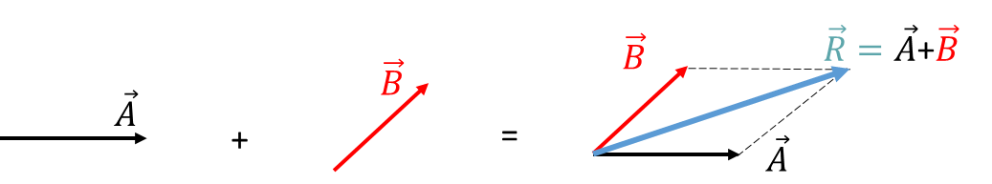
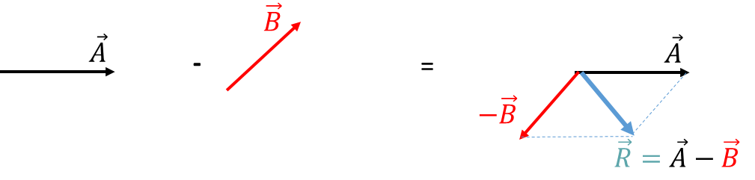
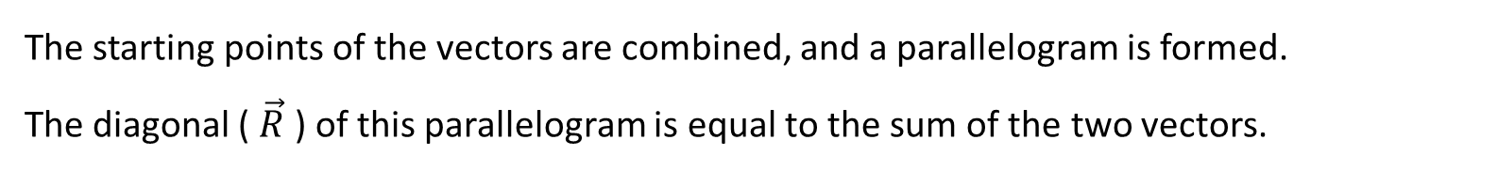
Vector Addition and Vector difference:
There are 2 methods for adding and subtracting vectors:
1. Parellogram method:
Addition:
The starting points of the vectors are combined, and a parallelogram is formed.
The diagonal ( $\vec{R}$ ) of this parallelogram is equal to the sum of the two vectors.
Vector difference:
The 2nd vector extracted is inverted 180 degrees and the addition operation is done exactly.

Slide 19
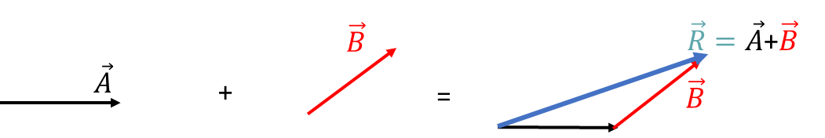
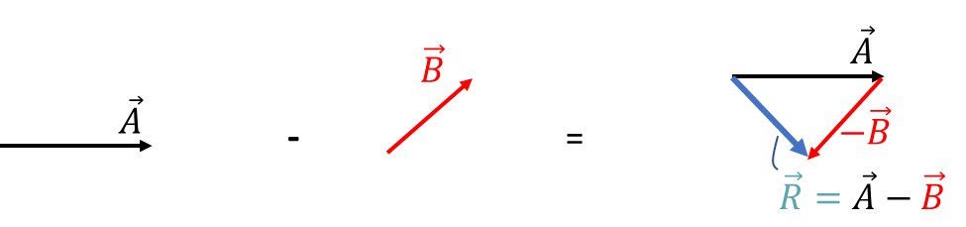
1. Vectors
2. Triangle Method:
Addition: The 2nd vector is added to the end (endpoint) of the 1st vector. The vector drawn from the beginning of the 1st vector to the ending point of the 2nd vector gives the sum vector (R).
Vector difference: The 2nd vector is rotated 180 degrees and the addition operation is applied exactly.

Slide 20
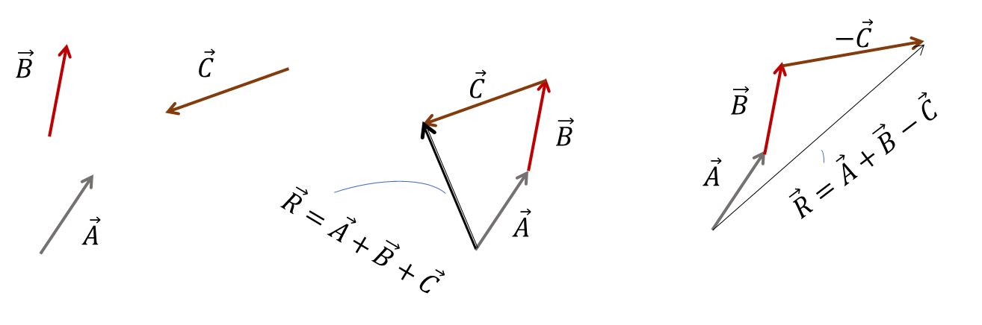
1. Vectors
* Addition or subtraction of multiple vectors: In this case, the triangle method is more practical. Vectors are added end-to-end and the vector drawn from the beginning of the first vector to the end of the last vector gives the resultant. The order of the vectors does not matter. If it has vectors to subtract, it is still flipped 180 degrees.

Slide 21
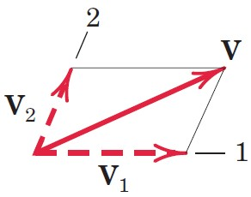
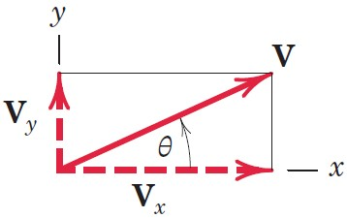
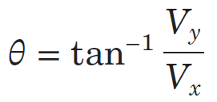
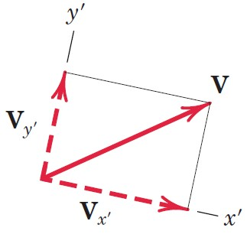
Vector Components
Rectangular Components (x-y)
Axis Orientation

Slide 22
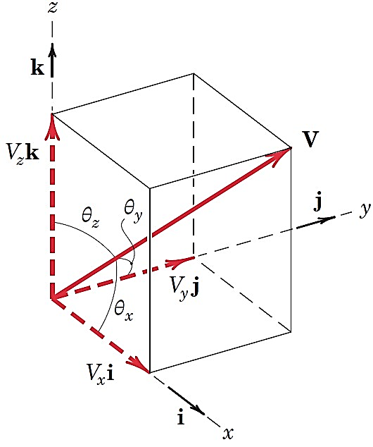
Unit Vector Representation, V = Vn
  A unit vector n has a magnitude of one (unity) and points in the direction of a vector.
Three-Dimensional Vectors and Direction Cosines
  V = V_{x}i + V_{y}j + V_{z}k
    V_{x} = V cos θ_{x} = Vl where l = cos θ_{x}
    V_{y} = V cos θ_{y} = Vm where m = cos θ_{y}
    V_{z} = V cos θ_{z} = Vn where n = cos θ_{z}
  Pythagorean Theorem (Vector Magnitude)
    V² = V_{x}² + V_{y}² + V_{z}²
    l² + m² + n² = 1

Slide 23
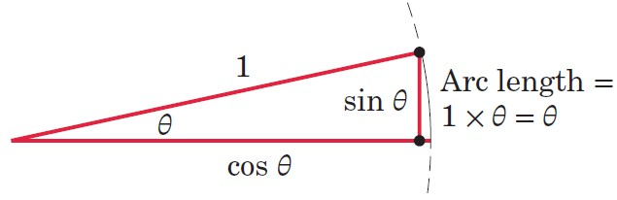
Small-Angle Approximations
Small Angle Approximations (with radians)
  sin θ ≅ tan θ ≅ θ and sin dθ ≅ tan dθ ≅ dθ
  cos θ ≅ 1 and cos dθ ≅ 1
  Sample Calculation
    1° = 0.017 453 rad, sin 1° = 0.017452, tan 1° = 0.017455, cos 1° = 0.999848
    The percent error for the sine function is only 0.51% at 10°.
  If more accuracy is required, retain the first two terms in the series expansion of the function.
  To convert from degrees to radians, multiply the angle in degrees by π/180°.

Slide 24
Problem Solving in Statics (1 of 4)
Dual Thought Process in Statics
  Think about the physical situation and the corresponding mathematical description.
Make Appropriate Assumptions
Use Graphics
  Representing a problem geometrically helps us with its physical interpretation. This is especially true for three-dimensional problems.
  Graphical solutions can often be obtained more readily than with a direct mathematical solution.
  Charts and graphs are valuable aids for representing results.

Slide 25
Problem Solving in Statics (2 of 4)
Formulating Problems and Obtaining Solutions
Formulate the problem
  State the given data.
  State the desired result.
  State your assumptions and approximations.
Develop the solution
  Draw any diagrams you need to understand the relationships.
  State the governing principles to be applied to your solution.
  Make your calculations.
  Ensure that your calculations are consistent with the accuracy justified by the data.
  Be sure that you have used consistent units throughout your calculations.
  Ensure that your answers are reasonable in terms of magnitudes, directions, common sense, etc.
  Draw conclusions.

Slide 26
Problem Solving in Statics (3 of 4)
The Free-Body Diagram
  Isolation of a Body from all other Interacting Bodies
  Developed Fully in Chapter 3
  Single Most Important Step in Equilibrium Problems
Numerical Values versus Symbols
  Symbolic Solutions Advantages
    Helps to focus attention on the connection between the physical situation and its related mathematical description.
    Can be used repeatedly for obtaining answers to the same type or problem but having different units or numerical values.
    Enables dimensional checks at every step to ensure dimensional homogeneity.

Slide 27
Problem Solving in Statics (4 of 4)
Solution Methods
Obtain mathematical solutions by hand, using either algebraic symbols or numerical values. We can solve most problems this way.
Obtain graphical solutions for certain problems.
Solve problems by computer. This is useful when a large number of equations must be solved, when a parameter variation must be studied, or when an intractable equation must be solved.

Slide 28
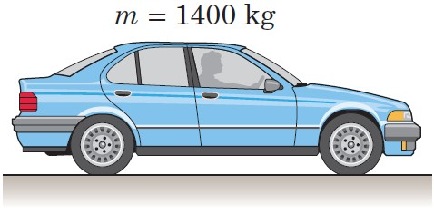
Sample Problem 1/1 (1 of 2)
  Determine the weight in newtons of a car whose mass is 1400 kg. Convert the mass of the car to slugs and then determine its weight in pounds.

Slide 29
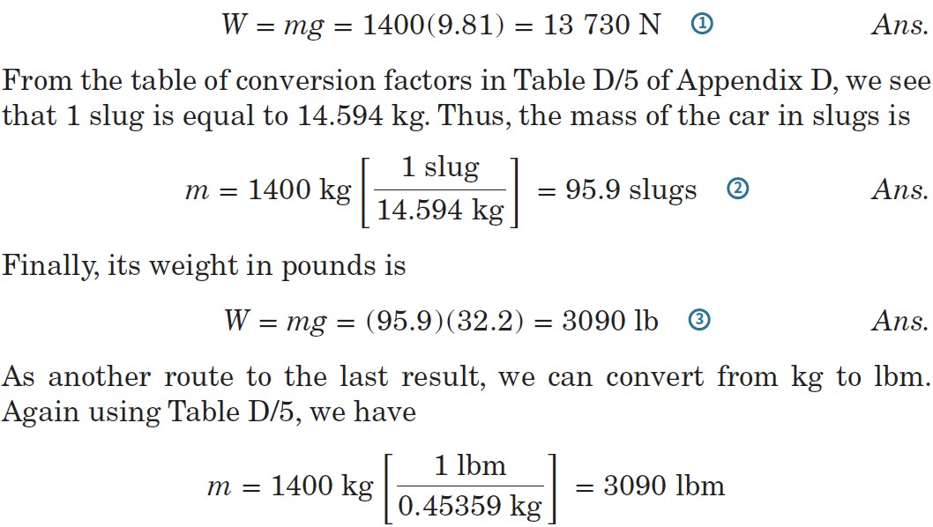
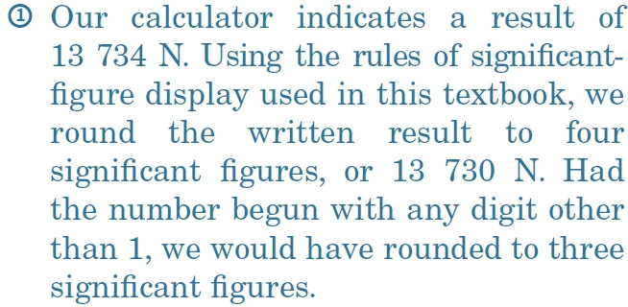
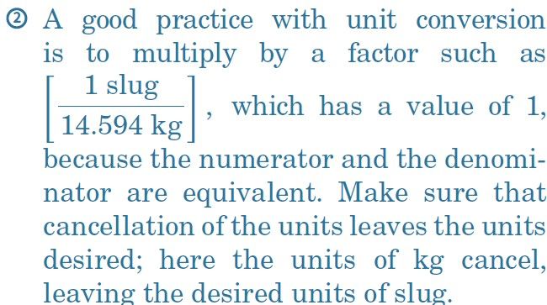
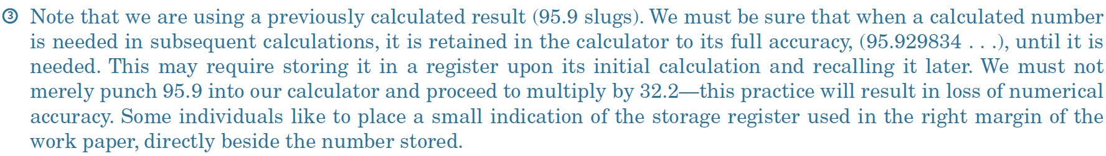
Sample Problem 1/1 (2 of 2)
Solution

Slide 30
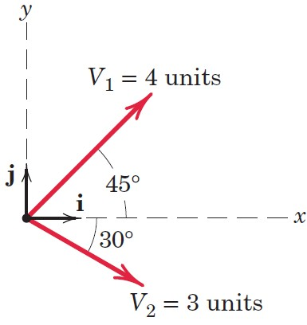
Sample Problem 1/3 (1 of 3)
  For the vectors V₁ and V₂ shown in the figure,
determine the magnitude S of their vector sum S = V₁ + V₂
determine the angle 𝛼 between S and the positive x-axis
write S as a vector in terms of the unit vectors i and j and then write a unit vector n along the vector sum S
determine the vector difference D = V₁ − V₂

Slide 31
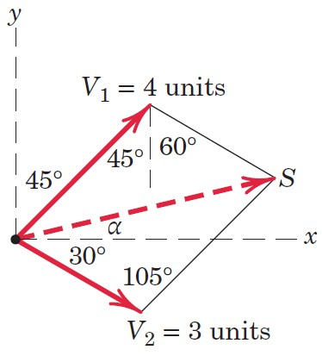
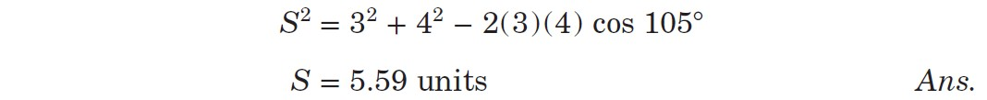
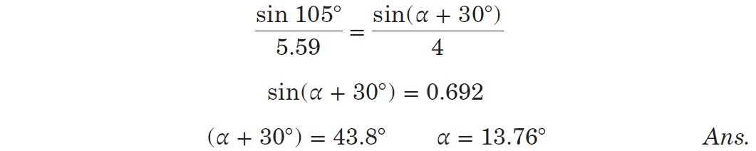
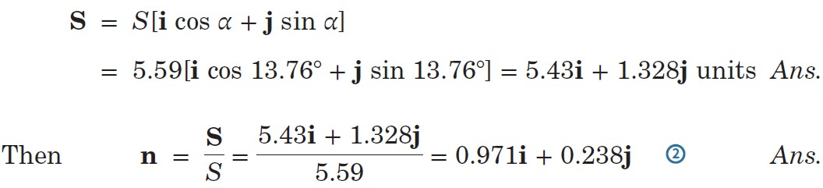
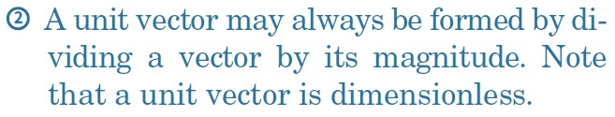
Article 1/9 – Sample Problem 1/3 (2 of 3)
Part a) – Magnitude of S (by using cosinus theorem)
Part b) – Angle Between S and x-axis (by using sinus theorem)
Part c) – Vector Expression for S and n

Slide 32
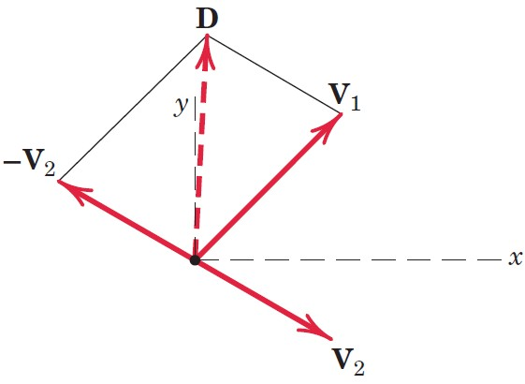
Article 1/9 – Sample Problem 1/3 (of 3)
Part d) – Vector Difference

