Slide 1
Macromechanical Analysis of a Lamina
Ömer Yavuz BOZKURT

Slide 2
Mechanics Terminology
How is a composite structure analyzed mechanically?
A composite material consists of two or more constituents; thus, the analysis and design of such materials is different from that for conventional materials such as metals.
Find the average properties of a composite ply from the individual properties of the constituents. Properties include stiffness, strength, thermal, and moisture expansion coefﬁcients. This is called the micromechanics of a lamina.

Slide 3
Develop the stress–strain relationships for a unidirectional/bidirectional lamina. This is called the macromechanics of a lamina.

Slide 4
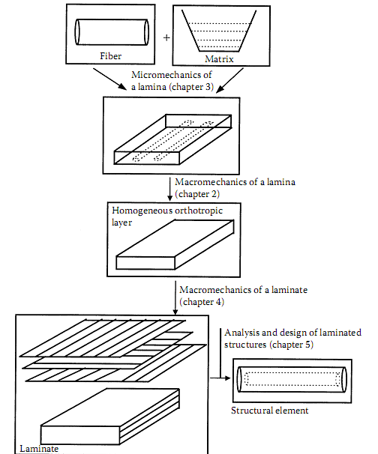

Slide 5
What is an isotropic body?
An isotropic material has properties that are the same in all directions. For example, the Young’s modulus of steel is the same in all directions.
What is a homogeneous body?
A homogeneous body has properties that are the same at all points in the body. A steel rod is an example of a homogeneous body.

Slide 6
What is an anisotropic material?
Materials whose properties vary with direction are called anisotropic materials.
Anisotropic materials show different mechanical behavior (stressing, deformation, etc.) depending on the direction, against thermal or mechanical loading.
Composite materials are anisotropic materials and are more specialized versions of them.
In order to understand the mechanics of composites, it is important to first know the more general mechanics of anisotropic materials.
In fact, isotropic materials are the most special form of anisotropic material.
What is a nonhomogeneous body?
A nonhomogeneous or inhomogeneous body has material properties that are a function of the position on the body.

Slide 7
E_{y1}
E_{x1}
E_{y2}
E_{x2}
if $E_{x1}=E_{y1} and{ E}_{x2}=E_{y2} →isotropic$
$\left\{\begin{matrix}\text{if} E_{x1}=E_{y1} and E_{x2}=E_{y2} \\ \text{if} E_{x1}=E_{x2} and E_{y1}=E_{y2} \end{matrix}\right\}→isotropic homogenous$
$\left\{\begin{matrix}\text{if} E_{x1}=E_{y1} and E_{x2}=E_{y2} \\ \text{if} E_{x1}≠E_{x2} and E_{y1}≠E_{y2} \end{matrix}\right\}→isotropic nonhomogenous$
if $E_{x1}≠E_{y1} and{ E}_{x2}≠E_{y2} →anisotropic$
$\left\{\begin{matrix}\text{if} E_{x1}≠E_{y1} and E_{x2}≠E_{y2} \\ \text{if} E_{x1}=E_{x2} and E_{y1}=E_{y2} \end{matrix}\right\}→anisotropic homogenous$
$\left\{\begin{matrix}\text{if} E_{x1}≠E_{y1} and E_{x2}≠E_{y2} \\ \text{if} E_{x1}≠E_{x2} and E_{y1}≠E_{y2} \end{matrix}\right\}→anisotropic nonhomogenous$

Slide 8
What is a hybrid laminate?
Hybrid composites contain more than one ﬁber or one matrix system in a laminate. The main four types of hybrid laminates follow.
Interply hybrid laminates contain plies made of two or more different composite systems. Examples include car bumpers made of glass/epoxy layers to provide torsional rigidity and graphite/epoxy to give stiffness.
Intraply hybrid composites consist of two or more different ﬁbers used in the same ply. Examples include golf clubs that use graphite and aramid ﬁbers.
An interply–intraply hybrid consists of plies that have two or more different ﬁbers in the same ply and distinct composite systems in more than one ply.
Resin hybrid laminates combine two or more resins instead of combining two or more ﬁbers in a laminate. Generally, one resin is ﬂexible and the other one is rigid.

Slide 9
Objectives (Macromechanical Analysis of a Lamina)
Review deﬁnitions of stress, strain, elastic moduli, and strain energy.
Develop stress-strain relationships for different types of materials.
Develop stress-strain relationships for a unidirectional/ bidirectional lamina.
Find the engineering constants of a unidirectional/bidirectional lamina in terms of the stiffness and compliance parameters of the lamina.
Develop stress-strain relationships, elastic moduli, strengths, and thermal and moisture expansion coefﬁcients of an angle ply based on those of a unidirectional/bidirectional lamina and the angle of the ply.

Slide 10
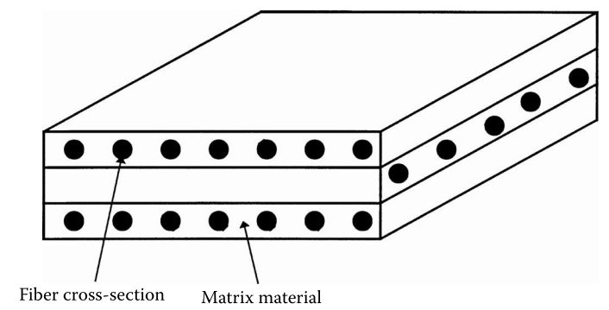
Lamina and Laminate
What is a lamina?
A lamina (also called a ply or layer) is a single ﬂat layer of unidirectional ﬁbers or woven ﬁbers arranged in a matrix.
What is a laminate?
A laminate is a stack of plies of composites. Each layer can be laid at various orientations and can be made up of different material systems.
Notes:
The design and analysis of such laminated structures demands knowledge of the stresses and strains in the laminate. Also, design
tools, such as failure theories, stiffness models, and optimization algorithms, need the values of these laminate stresses and strains.
However, the building blocks of a laminate are single lamina, so understanding the mechanical analysis of a lamina precedes understanding that
of a laminate. A lamina is unlike an isotropic homogeneous material.

Slide 11
The design and analysis of laminated structures demands knowledge of the stresses and strains in the laminate. Also, design tools, such as failure theories, stiffness models, and optimization algorithms, need the values of these laminate stresses and strains.
However, the building blocks of a laminate are single lamina, so understanding the mechanical analysis of a lamina precedes understanding that of a laminate.

Slide 12
A lamina is unlike an isotropic homogeneous material. For example, if the lamina is made of isotropic homogeneous ﬁbers and an isotropic homogeneous matrix, the stiffness of the lamina varies from point to point depending on whether the point is in the ﬁber, the matrix, or the ﬁber–matrix interface. Accounting for these variations will make any kind of mechanical modeling of the lamina very complicated. For this reason, the macromechanical analysis of a lamina is based on average properties and considering the lamina to be homogeneous.

Slide 13
Even with the homogenization of a lamina, the mechanical behavior is still different from that of a homogeneous isotropic material. For example, take a square plate of length and width w and thickness t out of a large isotropic plate of thickness t and conduct the following experiments.

Slide 14
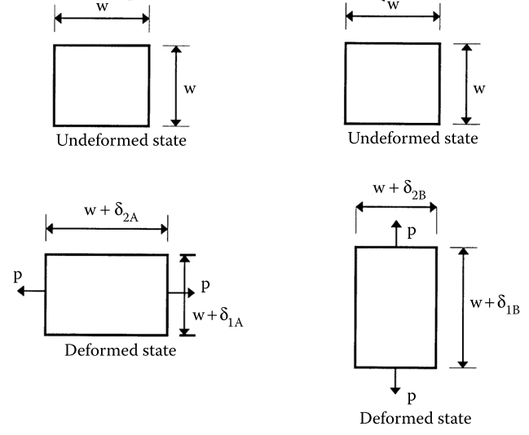
Case A: Subject the square plate to a pure normal load P in direction 1. Measure the normal deformations in directions 1 and 2, δ_{1A} and δ_{2A}, respectively.
Case B: Apply the same pure normal load P as in case A, but now in direction 2. Measure the normal deformations in directions 1 and 2, δ_{1B} and δ_{2B}, respectively.
δ_{1A}=δ_{2B}
δ_{2A}=δ_{1B}

Slide 15
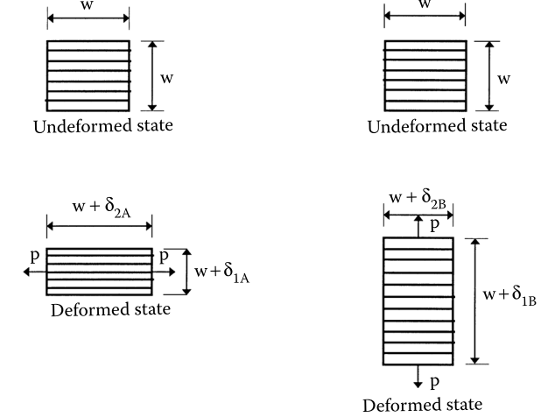
However, taking a unidirectional square plate of the same dimensions w × w × t out of a large composite lamina of thickness t and conducting the same case A and B experiments, note that the deformations
δ_{1A}≠δ_{2B}
δ_{2A}≠δ_{1B}
(the stiffness of the unidirectional lamina in the direction of ﬁbers is much larger than the stiffness in the direction perpendicular to the ﬁbers.)

Slide 16
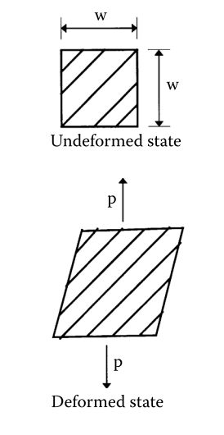
Thus, the mechanical characterization of a unidirectional lamina will require more parameters than it will for an isotropic lamina.
Also, note that if the square plate taken out of the lamina has ﬁbers at an angle to the sides of the square plate, the deformations will be different for different angles.
In fact, the square plate would not only have deformations in the normal directions but would also distort.
This suggests that the mechanical characterization of an angle lamina is further complicated.

Slide 17
Mechanical characterization of materials generally requires costly and time-consuming experimentation and/or theoretical modeling.
The goal is to ﬁnd the minimum number of parameters required for the mechanical characterization of a lamina.

Slide 18
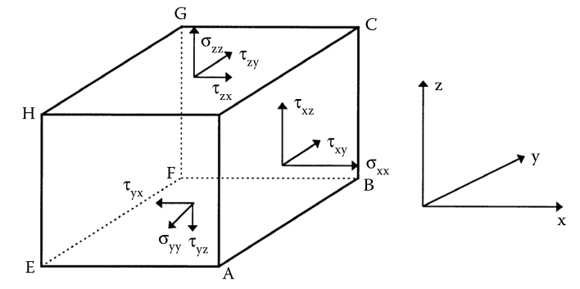
Review of Definitions
Stress
There are thus six independent stresses. The stresses $σ_{x}$, $σ_{y}$, and $σ_{z}$ are normal to the surfaces of the cuboid and the stresses $τ_{yz}$, $τ_{zx}$, and $τ_{xy}$ are along the surfaces of the cuboid.

Slide 19
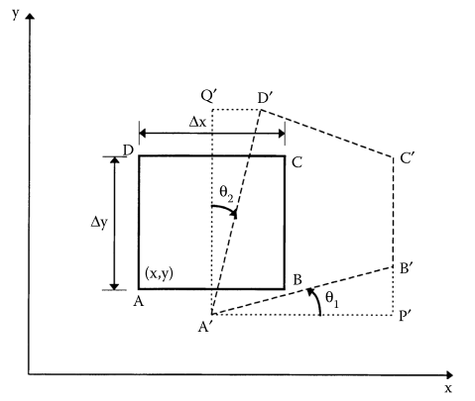
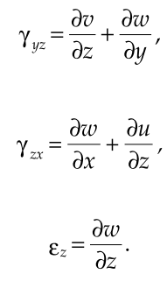
Review of Definitions
Strain
Under loads, the lengths of the sides of the inﬁnitesimal cuboid change. The faces of the cube also get distorted. The change in length corresponds to a normal strain and the distortion corresponds to the shearing strain.

Slide 20
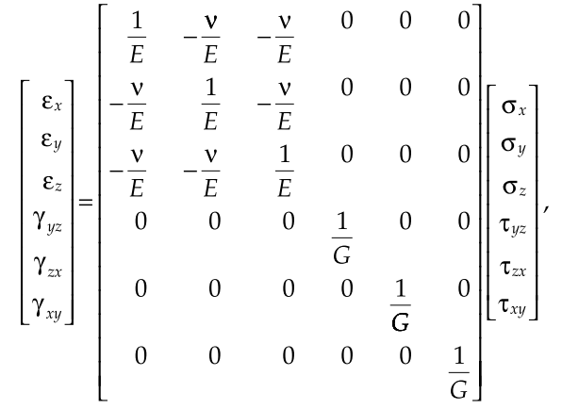
Review of Definitions
Elastic Moduli for isotropic homogeneous material;
The compliance matrix [S]

Slide 21
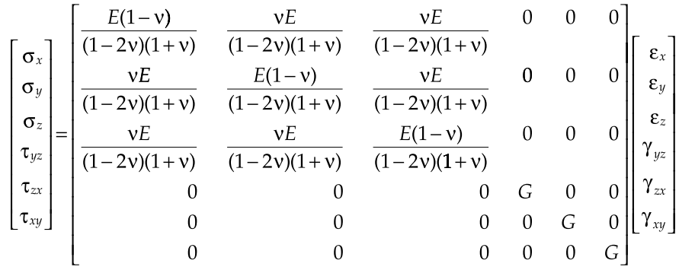
Review of Definitions
Elastic Moduli for isotropic homogeneous material;
The stiffness matrix [C]

Slide 22
Review of Definitions
Strain Energy;
Energy is deﬁned as the capacity to do work. In solid, deformable, elastic bodies under loads, the work done by external loads is stored as recoverable strain energy. The strain energy stored in the body per unit volume is then deﬁned as

Slide 23
Hooke’s Law for Different Types of Materials
The stress-strain relationship for a general material that is not linearly elastic and isotropic is more complicated than that of isotropic material.
Assuming linear and elastic behavior for a composite is acceptable; however, assuming it to be isotropic is generally unacceptable.
Thus, the stress–strain relationships follow Hooke’s law, but the constants relating stress and strain are more in number than seen in equations for an isotropic material.

Slide 24
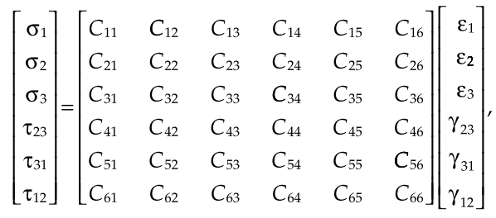
The most general stress–strain relationship is given as follows for a three-dimensional body in a 1–2–3 orthogonal Cartesian coordinate system:
where the 6 × 6 [C] matrix is called the stiffness matrix. The stiffness matrix has 36 constants.

Slide 25
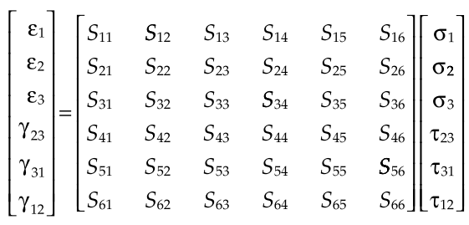
Inverting equation, the general strain–stress relationship for a three-dimensional body in a 1-2-3 orthogonal Cartesian coordinate system is
S matrix is called as compliance matrix

Slide 26
In the case of an isotropic material, one ﬁnds that the compliance matrix is related directly to engineering constants as
$$S_{11}=\frac{1}{E}=S_{22}=S_{33}$$
$$S_{12}=−\frac{ν}{E}=S_{13}=S_{21}=S_{23}=S_{31}=S_{32}$$
$$S_{44}=\frac{1}{G}=S_{55}=S_{66}$$
and $S_{ij}$, other than in the preceding, are zero.

Slide 27
It can be shown that the 36 constants in
equation actually reduce to 21 constants due to the symmetry of the stiffness matrix [C].

Slide 28
Anisotropic Material
The material that has 21 independent elastic constants at a point is called an anisotropic material. Once these constants are found for a particular point, the stress and strain relationship can be developed at that point.
Note that these constants can vary from point to point if the material is nonhomogeneous.
If the material is homogeneous (or assumed to be), one needs to ﬁnd these 21 elastic constants analytically or experimentally.
However, many natural and synthetic materials do possess material symmetry - that is, elastic properties are identical in directions of symmetry because symmetry is present in the internal structure.
Symmetry reduces the number of the independent elastic constants by zeroing out or relating some of the constants within the 6 × 6 stiffness [C] and 6 × 6 compliance [S] matrices. This simpliﬁes the Hooke’s law relationships for various types of elastic symmetry.
In terms of material properties, such an anisotropic material that does not have planes of symmetry is called Triclinic material.

Slide 29
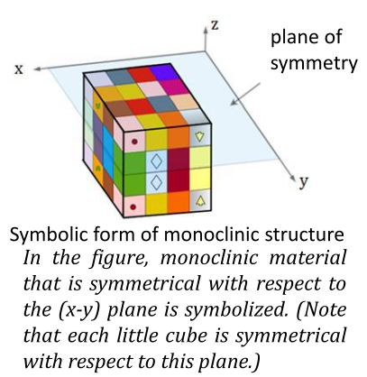
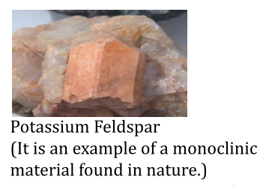
Monoclinic Material
Materials that, in addition to showing triclinic material properties, also have one plane of symmetry at the crystal or larger macro level are called monoclinic materials.

Slide 30
Physical material properties are symmetrical with respect to this plane.
In homogeneous structures, these symmetry planes at all points are parallel to each other.
Layered (laminated)composite materials can have planes of symmetry or planes of symmetry parallel to each other at much larger sizes than the crystal level (at the macro level that can be seen with the eye).

Slide 31
We think that there is material symmetry with respect to the 1-2 plane at some point in an anisotropic, elastic and monoclinic structure.
At this point, while there is normal stress ($σ_{1}$) only in direction 1, distortion will not occur in directions 1-3 and 2-3 due to symmetry. So: $γ_{23}=γ_{31}=0$.
$\left[\begin{matrix}\begin{matrix}ε_{1} \\ ε_{2} \\ ε_{3}\end{matrix} \\ \begin{matrix}γ_{23} \\ γ_{31} \\ γ_{12}\end{matrix}\end{matrix}\right]=\left[\begin{matrix}\begin{matrix}S_{11} & S_{12} & S_{13} \\ S_{21} & S_{22} & S_{23} \\ S_{31} & S_{32} & S_{33}\end{matrix} & \begin{matrix}S_{14} & S_{15} & S_{16} \\ S_{24} & S_{11} & S_{26} \\ S_{34} & S_{35} & S_{36}\end{matrix} \\ \begin{matrix}S_{41} & S_{42} & S_{43} \\ S_{51} & S_{52} & S_{53} \\ S_{61} & S_{62} & S_{63}\end{matrix} & \begin{matrix}S_{44} & S_{45} & S_{46} \\ S_{54} & S_{55} & S_{56} \\ S_{64} & S_{65} & S_{66}\end{matrix}\end{matrix}\right]\left[\begin{matrix}\begin{matrix}σ_{1} \\ σ_{2} \\ σ_{3}\end{matrix} \\ \begin{matrix}τ_{23} \\ τ_{31} \\ τ_{12}\end{matrix}\end{matrix}\right]$
when there is only $σ_{1}$, $\left(σ_{2}=σ_{3}=τ_{23}=τ_{31}=τ_{12}=0\right)$;
$γ_{23}=s_{14}σ_{2}=0→s_{14}=0$
$γ_{31}=s_{15}σ_{2}=0→s_{15}=0$

Slide 32
Similary, in the following cases, there will be no distortions in 1-3 and 2-3 directions
when there is only $σ_{2}$, $\left(σ_{1}=σ_{3}=τ_{23}=τ_{31}=τ_{12}=0\right)$;
$γ_{23}=s_{24}σ_{2}=0→s_{24}=0$
$γ_{31}=s_{25}σ_{2}=0→s_{25}=0$
when there is only $σ_{3}$, $\left(σ_{1}=σ_{2}=τ_{23}=τ_{31}=τ_{12}=0\right)$;
$γ_{23}=s_{34}σ_{3}=0→s_{34}=0$
$γ_{31}=s_{35}σ_{3}=0→s_{35}=0$
when there is only $τ_{12}$, $\left(σ_{1}=σ_{2}=σ_{3}=τ_{23}=τ_{31}=0\right)$;
$γ_{23}=s_{46}τ_{12}=0→s_{46}=0$
$γ_{31}=s_{56}τ_{12}=0→s_{56}=0$

Slide 33
In this case, for a monoclinic and elastic material, the independent material constants in the compliance and stiffness matrices are reduced to 13.

Slide 34
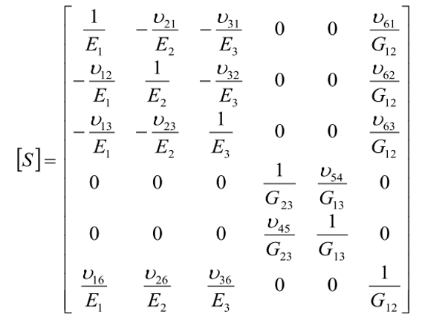
Below is shown the explicit expression of each term of the [S] compliance matrix for a monoclinic material.

Slide 35
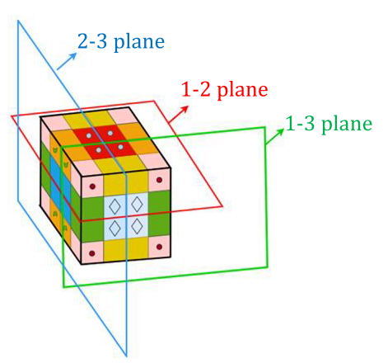
Orthotropic Material
In addition to the triclinic material feature, materials that have three planes of symmetry at the crystal or larger macro level are called orthotropic materials.
In other words, in the orthotropic material type, there are 2 more symmetry planes in addition to the monoclinic material.
At each point of the orthotropic material, there is symmetry with respect to all three planes 1-2, 2-3 and 1-3.
Continuous fiber reinforced composite layers show orthotropic properties.

Slide 36
If there is normal stress ($σ_{1}$) only in the direction-1, distortion will not occur in any of the symmetry planes. $γ_{23}=γ_{31}=γ_{12}=0$.
when there is only $σ_{1}$, $\left(σ_{2}=σ_{3}=τ_{23}=τ_{31}=τ_{12}=0\right)$;
$γ_{12}=S_{16}σ_{1}=0→S_{16}=0$
when there is only $σ_{2}$, $\left(σ_{1}=σ_{3}=τ_{23}=τ_{31}=τ_{12}=0\right)$;
$γ_{12}=S_{26}σ_{2}=0→S_{26}=0$
when there is only $σ_{3}$, $\left(σ_{1}=σ_{2}=τ_{23}=τ_{31}=τ_{12}=0\right)$;
$γ_{12}=S_{36}σ_{2}=0→S_{36}=0$

Slide 37
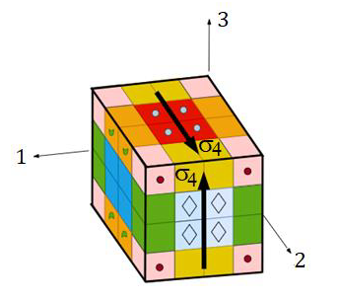
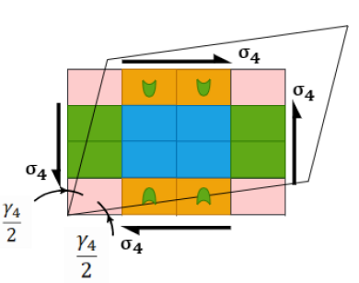
Additionally, while there are only $τ_{23}$stress in the material,
$γ_{23}=S_{44}τ_{23}=0→S_{44}=0$
Due to symmetry, a slip angle does not occur in other planes;
$γ_{31}=γ_{12}=0$
$γ_{31}=S_{45}τ_{23}=0→S_{45}=0$
(Note that $τ_{23}$ 𝑐𝑎𝑛 𝑎𝑙𝑠𝑜 𝑏𝑒 𝑟𝑒𝑝𝑟𝑒𝑠𝑒𝑛𝑡𝑒𝑑 𝑎𝑠 $σ_{4}$)

Slide 38
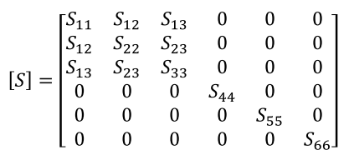
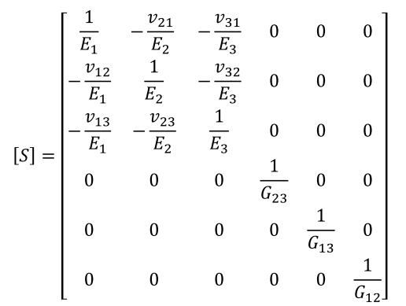
As a result, there are 9 independent material constants for an orthotropic material:
$E_{1}$, $E_{2}$, $E_{3}$, $ν_{23}$,$ν_{31}$,$ν_{12}$, $G_{23}$, $G_{31}$ and $G_{12}$

Slide 39
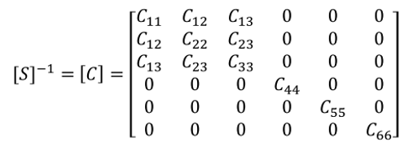
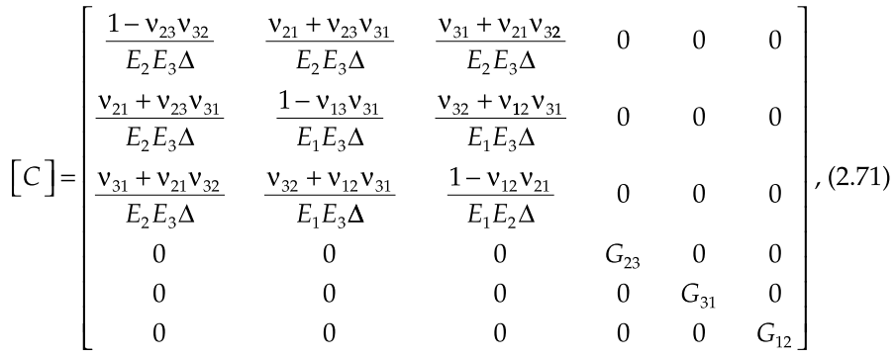
Stiffness [C] matrix for orthotropic material

Slide 40
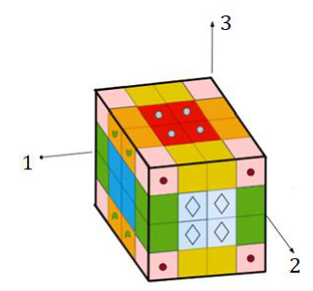
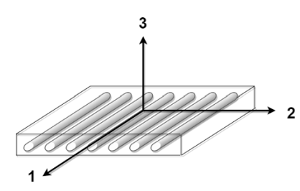
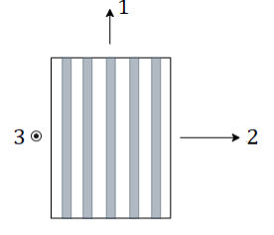
A fiber reinforced composite lamina is symmetrical with respect to all three planes at the macro level and can be considered as orthotropic material at the macro level.
However, while determining the material properties, care should be taken to ensure that the test sample to be removed from the lamina is also symmetrical with respect to 3 planes at the macro level.

Slide 41
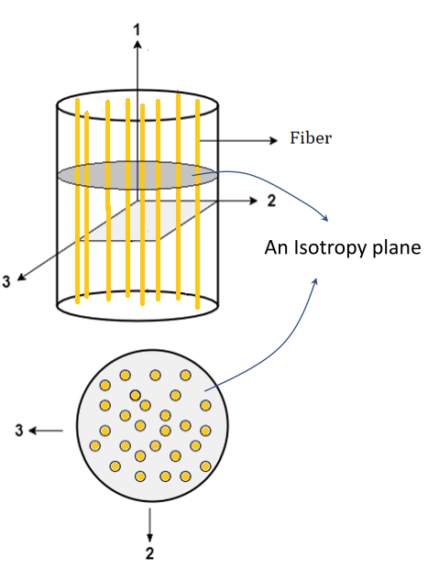
If there are isotropy planes parallel to each other at every point of the orthotropic material, these materials are called transversely isotropic materials.
Although the material properties are the same in all directions on that plane, they differ in the direction perpendicular to the plane.
Composite elements with rotational symmetry with respect to the fiber axis (1) are transversely isotropic materials. Because the features are approximately the same in every direction in the 2-3 plane. The features in line 1 are different.
There are infinite planes of symmetry, the normal of which is direction 1 and parallel to plane 2-3.

Slide 42
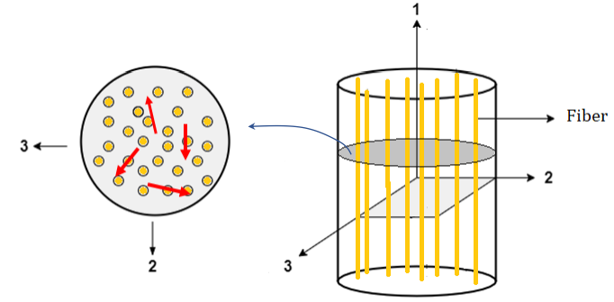
In composite materials with rotational symmetry with respect to fiber axis 1, material properties can be considered the same in all directions in sections parallel to plane 2-3.
Thus, the independent material constant is reduced from 9 to 5:
$E_{1}$, $E_{2}(=E_{3})$, $ν_{23}$,$ν_{31}(=ν_{12})$, $G_{31}$(=$G_{12}),G_{23}=\frac{E_{2}}{2(1+ν_{23})}$

Slide 43
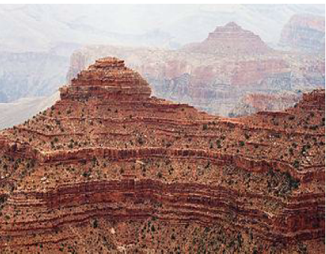
The transverse isotropy feature is seen in nature in layered sedimentary rocks with long wavelengths. Each layer has approximately the same properties in its plane (each layer is 2-3 planes). However, there are different properties along the thickness (from bottom to top, as the 1 axis). The plane of each layer is the isotropy plane and the perpendicular axis is the symmetry axis.

Slide 44
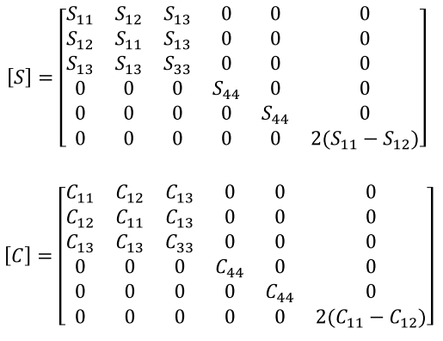
Material constants matrices for transversely isotropic materials:

Slide 46
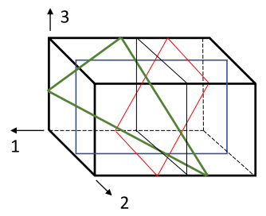
If there are an infinite number of isotropy planes parallel or angled to the axes in the structure, these types of materials are called isotropic materials.
In other words, the properties are the same in all directions parallel or at an angle to the axes in the material, so there are infinite directions.
All metallic materials such as steel, aluminum are isotropic.

Slide 47
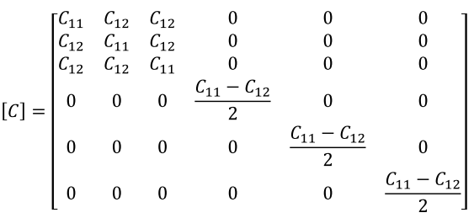
In this case, the elastic material constants are reduced from 5 to 2 ($E$ and $ν$)
$E_{1}=E_{2}=E_{3}, ν_{23}=ν_{31}=ν_{12}, G_{23}=G_{31}=G_{12}=\frac{E}{2(1+ν)}$

Slide 48
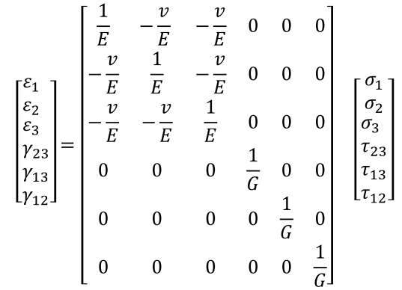
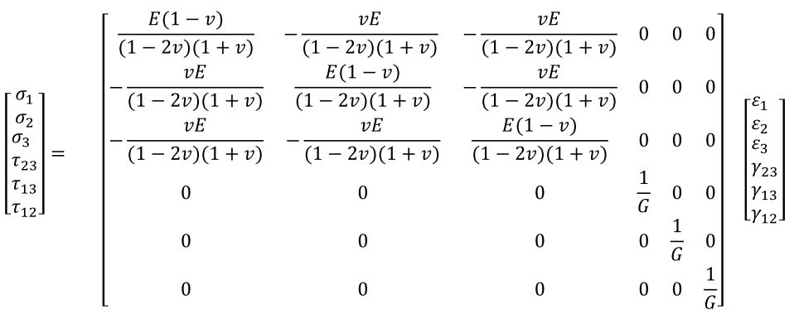

Slide 49
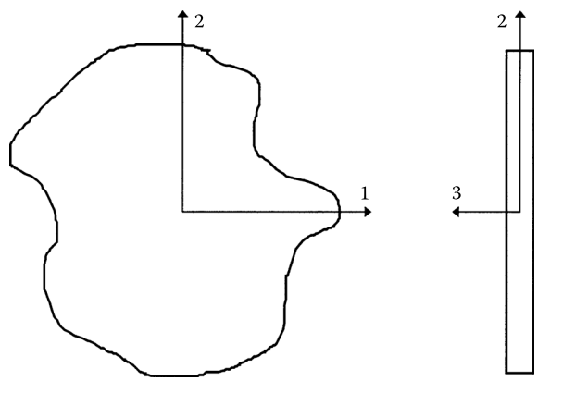
Plane Stress Assumption
A thin plate is a prismatic member having a small thickness and there are no out-of-plane loads, it can be considered to be under plane stress. If the upper and lower surfaces of the plate are free from external loads, then σ₃ = 0, τ₃₁ = 0, and τ₂₃ = 0. Because the plate is thin, these three stresses within the plate are assumed to vary little from the magnitude of stresses at the top and the bottom surfaces.

Slide 50
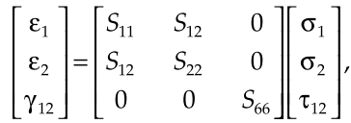
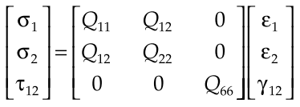

Slide 51
$E_{1}$ = longitudinal Young’s modulus (in direction 1)
$E_{2}$ = transverse Young’s modulus (in direction 2)
$ν_{12}$ = major Poisson’s ratio, where the general Poisson’s ratio, $ν_{ij}$ is deﬁned as the ratio of the negative of the normal strain in direction $j$ to the normal strain in direction $i$, when the only normal load is applied in direction $i$
$G_{12}$ = in-plane shear modulus (in plane 1-2)

Slide 52
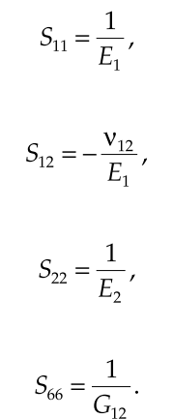
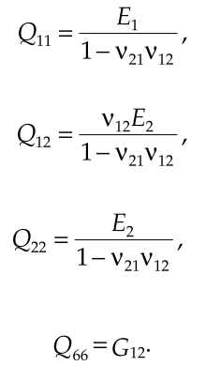
Coefficients of Compliance and Stiffness Matrices

Slide 53
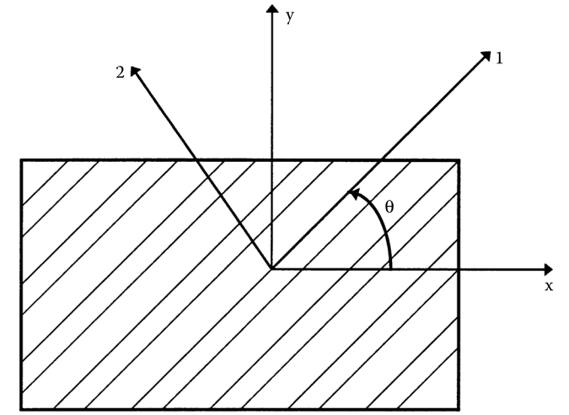
Hooke’s Law for a 2D Angle Lamina
Transverse direction
Longitudinal direction
Global axes, x, y
Local (1, 2) and global (x, y) axes of an angle lamina
Notes:
Generally, a laminate does not consist only of unidirectional laminae because
of their low stiffness and strength properties in the transverse direction.
Therefore, in most laminates, some laminae are placed at an angle. It is thus
necessary to develop the stress–strain relationship for an angle lamina.

Slide 54
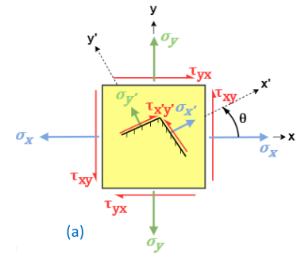
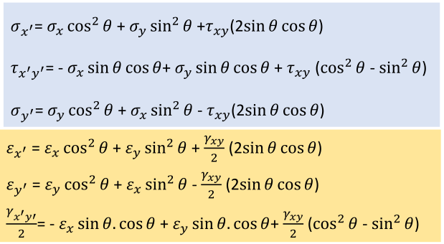

Slide 55
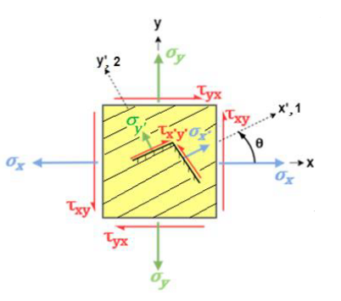
For an orthotropic layer, we consider 𝑥′ ≡ 1 axis, 𝑦′≡ 2 axis and $θ=orientation angle$.

Slide 56
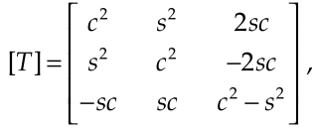
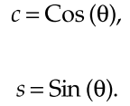
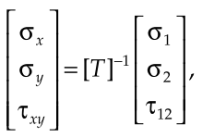
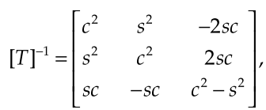
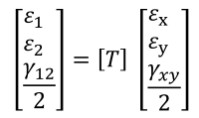
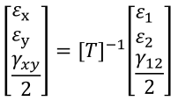
Now we will write these equations in matrix format, we define a transformation matrix;
where

Slide 57
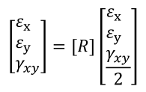
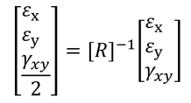
We want to substitute $γ_{12}$ for $\frac{γ_{12}}{2}$ and $γ_{xx}$ for $\frac{γ_{xy}}{2}$ into equations. If we define $R (Reuter matrix)$ matrix for this;

Slide 59
Global and Local Stresses

Slide 60
Transformed Reduced Stiffness Matrix

Slide 61
Global and Local Stresses
Inverting stress equation
Transformed reduced compliance matrix

Slide 62
Global and Local Stresses

Slide 63
Engineering Constants of an Angle Lamina
The engineering constants for a unidirectional lamina were related to the compliance and stiffness matrices. In this section, similar techniques are applied to relate the engineering constants of an angle ply to its transformed stiffness and compliance matrices.
1. For ﬁnding the engineering elastic moduli in direction x, apply

Slide 64
In an angle lamina, unlike in a unidirectional lamina, interaction also occurs between the shear strain and the normal stresses. This is called shear coupling. The shear coupling term that relates the normal stress in the x-direction to the shear strain is denoted by m_{x} and is deﬁned as
Note that m_{x} is a nondimensional parameter like the Poisson’s ratio.

Slide 65
2. Similarly, by applying stresses
The shear coupling term m y relates the normal stress σ_{y} to the shear strain γ_{xy} .

Slide 66
3. Also, by applying the stresses

Slide 67
Strain-Stress Equation of an Angle Lamina
The strain–stress equation of an angle lamina can also be written in terms of the engineering constants of an angle lamina in matrix form as

Slide 68
Engineering Constants of an Angle Lamina
The preceding six engineering constants of an angle ply can also be written in terms of the engineering constants of a unidirectional ply

Slide 70
Strength Failure Theories of an Angle Lamina
A successful design of a structure requires efﬁcient and safe use of materials. Theories need to be developed to compare the state of stress in a material to failure criteria. It should be noted that failure theories are only stated and their application is validated by experiments.
For a laminate, the strength is related to the strength of each individual lamina. This allows for a simple and economical method for ﬁnding the strength of a laminate.
Various theories have been developed for studying the failure of an angle lamina. The theories are generally based on the normal and shear strengths of a unidirectional lamina.
Notes:
A successful design of a structure requires efﬁcient and safe use of materials.
Theories need to be developed to compare the state of stress in a material
to failure criteria.

Slide 71
An isotropic material, such as steel, generally has two strength parameters: normal strength and shear strength. (based on ﬁnding the principal normal stresses and the maximum shear stresses)
However, in a lamina, the failure theories are not based on principal normal stresses and maximum shear stresses. Rather, they are based on the stresses in the material or local axes because a lamina is orthotropic and its properties are different at different angles, unlike an isotropic material.

Slide 72
In the case of a unidirectional lamina, the ﬁve strength parameters are
Unlike the stiffness parameters, these strength parameters cannot be transformed directly for an angle lamina. Thus, the failure theories are based on ﬁrst ﬁnding the stresses in the local axes and then using these ﬁve strength parameters of a unidirectional lamina to ﬁnd whether a lamina has failed.

Slide 73
Maximum Stress Failure Theory
According to this criterion, if all of the inequalities shown on below, for local stresses at a point of the composite are met, no damage will occur at that point.
In other words, if at least one of these three inequalities is not met according to this criterion, damage will occur at that point.
This criterion gives much better and more realistic results in detecting the fracture of brittle materials, especially at points where tensile stresses exist.

Slide 74
Maximum Strain Failure Theory
According to this criterion, if all of the inequalities shown on below for local strains at a point of the composite are met, no damage (failure) will occur at that point.
In other words, if at least one of these three inequalities is not met according to this criterion, damage will occur at that point.
Strains at the time of damage are calculated from Hooke's relations.
This criterion gives results much closer to reality in detecting the fracture of brittle materials and especially at points where tensile stresses occur.

Slide 75
Maximum Stress and Strain Failure Theories
The ultimate strains can be found from the ultimate strength parameters and the elastic moduli, assuming the stress-strain response is linear until failure.
For the maximum strain failure theory, no interactions occurs between various components of strain.
The maximum stress failure theory and the maximum failure strain theory give different results because the local strains in a lamina include the Poisson’s ratio.
If the Poisson’s ratio is zero in the unidirectional lamina, the two failure theories will give identical results.

Slide 76
Tsai-Hill Failure Theory
This criterion is an adaptation of the Von Mises distortion energy damage theory, which is valid for isotropic materials, to anisotropic materials.
This criterion gives very good results
in damage detection in composites with the same tensile and compressive strengths,
in composites with ductile behavior and
in points subject to tensile stress.
According to this criterion, for damage to occur in a layer, the following condition must be violated:

Slide 77
Since $σ_{3}=τ_{31}=τ_{23}=0$ in the case of 2-Dimensional (Plane) stress, equation turns into
In case of plane stress;
If there is a loading that will only create $σ_{1}$, at the time of damage:
If there is a loading that will only create $σ_{2}$, at the time of damage:

Slide 78
Assume that the strength values in directions 2 and 3 are considered the same and only $σ_{3}$ occurs during loading. At the time of damage:
If there is a loading that will only create $τ_{12}$, at the time of damage:
It is obtained from these four equations as

Slide 79
If these values
are substituted into
it turns into

Slide 80
Tsai-Hill Failure Theory
Unlike the maximum strain and maximum stress failure theories, the Tsai-Hill failure theory considers the interaction among the three unidirectional lamina strength parameter.
The Tsai-Hill failure theory does not distinguish between the compressive and tensile strengths in its equation. This can result in underestimation of the maximum loads that can be applied when compared to other failure theory.
Tsai-Hill failure theory underestimates the failure stress because the transverse strength of a unidirectional lamina is generally much less than its transverse compressive strength.

Slide 81
Modified Tsai-Hill Failure Theory
This criterion is a modified version of the Tsai-Hill criterion, taking into account compressive strength.
This criterion is a general criterion and can be used not only for brittle composite materials, but also for all orthotropic material types and all point stress states.

Slide 82
Tsai–Wu Failure Theory
This failure theory is based on the total strain energy failure theory of Beltrami. Tsai-Wu applied the failure theory to a lamina in plane stress. A lamina is considered to be failed if
is violated. This failure theory is more general than the Tsai–Hill failure theory because it distinguishes between the compressive and tensile strengths of a lamina.
The components H₁ – H₆₆ of the failure theory are found using the five strength parameters of a unidirectional lamina.
H₁₂ can only be calculated experimentally.

Slide 83
Components of Tsai-Wu Failure Theory
If there is a loading that will only create $+σ_{1}$(tensile) stress at the time of damage ($σ_{2}=τ_{12}=0$);
If there is a loading that will only create $−σ_{1}$(compression) stress at the time of damage ($σ_{2}=τ_{12}=0$);
Solution:

Slide 84
Components of Tsai-Wu Failure Theory
If there is a loading that will only create $+σ_{2}$(tensile) stress at the time of damage ($σ_{1}=τ_{12}=0$);
If there is a loading that will only create $−σ_{2}$(compression) stress at the time of damage ($σ_{1}=τ_{12}=0$);
Solution:

Slide 85
Components of Tsai-Wu Failure Theory
If there is a loading that will only create $+τ_{12}$(shear) stress at the time of damage ($σ_{1}=σ_{2}=0$);
If there is a loading that will only create $−τ_{12}$(shear) stress at the time of damage ($σ_{1}=σ_{2}=0$);
Solution:

Slide 86
Methods of Calculating the H₁₂ constant
1st Experimental Method
If there is a loading that will create equal tensile stress in the 1 and 2 directions at the examined point;
$σ_{1}=σ_{2}=σ$
$τ_{12}=0$
at the time of damage,
solution

Slide 87
Methods of Calculating the H₁₂ constant
The 𝜎 value at the time of damage is determined experimentally and substituted into
Since other constants are already found, $H_{12}$ is obtained. There may be different alternatives for the experimental setup. The important thing is that only normal stresses occur at the same intensity in directions 1 and 2 at the examined point.
Or any of the following combinations can be used in this method:

Slide 88
Methods of Calculating the H₁₂ constant
2nd Experimental Method
At the examined point of the 45° reinforced layer, loading is applied to create tensile stress ($σ_{x}$) only in the x direction ($σ_{y}=τ_{xy}=0$). At the time of damage, if $σ_{x}=σ$ using stress transformation equations
are found.
At the time of damage,
solution

Slide 89
3rd Method: Empirical Equations
Equations that generalize experimental measurement results or observational data are called empirical equations.
Three different empirical equations for $H_{12}$ are stated below:

Slide 90
Hoffman Criterion
According to this criterion, if the following inequality is violated, the material will be damaged:
This criterion gives better results
in composites with different tensile and compressive strengths,
especially in composites that exhibit brittle behavior.

Slide 91
Experimental Results and Failure Theories
Tsai compared the results from various failure theories to some experimental results. He considered an angle lamina subjected to a uniaxial load in the x-direction, σ_{x} .
The failure stresses were obtained experimentally for tensile and compressive stresses for various angles of the lamina.

Slide 92
Stresses and Strains in the Material Axes
(2.172)
(2.173)

Slide 93
Experimental Results and Failure Theories

Slide 97
Experimental Results and Failure Theories
The difference between the maximum stress and maximum strain failure theories and the experimental results is quite pronounced.
Tsai–Hill and Tsai–Wu failure theories’ results are in good agreement with experimentally obtained results.
The variation of the strength of the angle lamina as a function of angle is smooth in the Tsai–Hill and Tsai–Wu failure theories, but has cusps in the maximum stress and maximum strain failure theories. The cusps correspond to the change in failure modes in the maximum stress and maximum strain failure theories.

Slide 98
Hygrothermal Stress-Strain Relationship
Composite materials are generally processed at high temperatures and then cooled down to room temperatures.
Due to mismatch of the coefﬁcients of thermal expansion of the ﬁber and matrix, residual stresses result in a lamina when it is cooled down.
Also, the cooling down induces expansional strains in the lamina.
In addition, most polymeric matrix composites can absorb or de-absorb moisture. This moisture change leads to swelling strains and stresses similar to those due to thermal expansion.

Slide 99
Thermal Deformations in Free State
If the temperature of the fiber-reinforced orthotropic composite plate is increased by ΔT while it is free, changes in the dimensions of the plate occur. These size changes are called thermal deformations. We calculate them as follows:

Slide 100
Hygrothermal Stress-Strain Relationship
For a unidirectional lamina
Thermally induced strains:
α₁ and α₂ are the longitudinal and transverse coefﬁcients of thermal expansion,
ΔT is the temperature change.
Moisture induced strains:
β₁ and β₂ are the longitudinal and transverse coefﬁcients of moisture,
ΔC is the weight of moisture absorption per unit weight of
the lamina.

Slide 101
Hygrothermal Stress-Strain Relationship
For a unidirectional lamina

Slide 102
Hygrothermal Stress-Strain Relationship
For an angular lamina
Thermally induced strains:
Moisture induced strains:

Slide 103
Transformation of Coefficients

