Slide 1
CHAPTER 2 FORCE SYSTEMS
CHAPTER OUTLINE
2/1 Introduction
2/2 Force
SECTION A Two-Dimensional Force Systems
2/3 Rectangular Components
2/4 Moment
2/5 Couple
2/6 Resultants
SECTION B Three-Dimensional Force Systems
2/7 Rectangular Components
2/8 Moment and Couple
2/9 Resultants
Anze Bizjan/Shutterstock

Slide 2
Article 2/1 Introduction
Chapter Purpose
We study the effects of forces which act on engineering structures and mechanisms. The experience gained here will help you in the study of mechanics and in other subjects such as stress analysis, design of structures and machines, and fluid flow. This chapter lays the foundation for a basic understanding not only of statics but also entire subjects of mechanics, and you should master of this material thoroughly.
Importance of Chapter 2 Concepts
We will deal with two- and three-dimensional forces and their moments at a point.

Slide 3
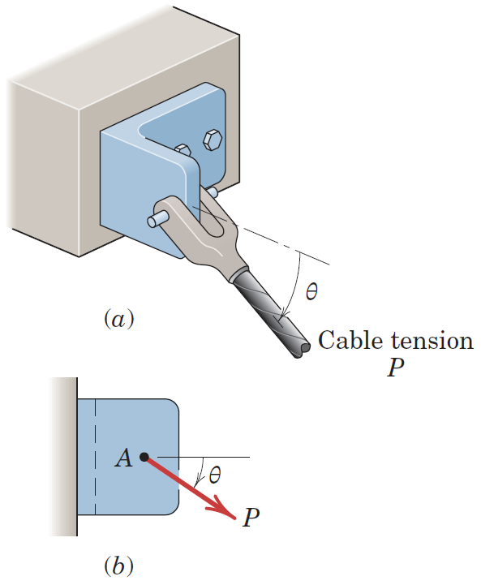
Article 2/2 Force
A force has been defined in Chapter 1 as an action of one body
on another.
A force is a vector quantity, because its effect depends on
the direction as well as on the magnitude of the action. Thus,
forces may be combined according to the parallelogram law
of vector addition.
We can separate the action of a force on a body into two effects,
­external and internal.

Slide 4
Article 2/2 Force
For the bracket in the figure the external effects of P to the bracket
are:
the reactive forces (not shown) exerted on the bracket by the
foundation and bolts because of the action of P.
Forces external to a body can be either applied forces or reactive forces.
The internal effects of P to the bracket are:
the resulting internal forces and deformations distributed
throughout the material of the bracket.
The relation between internal forces and internal deformations depends on the material properties of the body and is studied in strength of materials, elasticity, and plasticity.

Slide 5
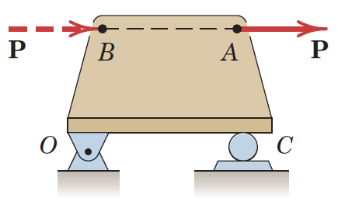
Article 2/2 – Principle of Transmissibility
A force may be applied at any point on its given line of action without altering the resultant effects of the force external to the rigid body on which it acts.
Whenever we are interested in only the resultant external effects of a force, the force may be treated as a sliding vector, and we need specify only the magnitude, direction, and line of action of the force, and not its point of application.
When dealing with the mechanics of a rigid body, we ignore defor­mations in the body and concern ourselves with only the net external ef­fects of external forces. In such cases, experience shows us that it is not necessary to restrict the action of an applied force to a given point.

Slide 6
Article 2/2 – Force Classification
Contact Force: A contact force is produced by direct physical contact
Body Force: A body force is generated by virtue of the position of a body within the force field such as gravitational field.
Concentrated Force: Every contact force is actually applied over a finite area and is a distributed force. But considering the application area of force is so small than the other dimensions of body. So that, we may consider the force to be concentrated at a point with negligible loss of accuracy.
Distributed Force: Force can be distributed over an area, as in the case of mechanical contact, over a volume when a body force such as weight is acting, or over a line, as in the case of the weight of a suspended cable.
Action and Reaction Pairs : According to Newton's third law, the action of a force is always ac­companied by an equal and opposite reaction.

Slide 7
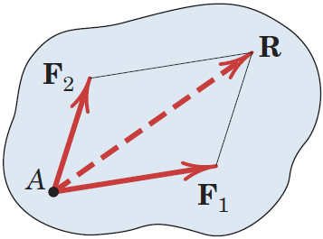
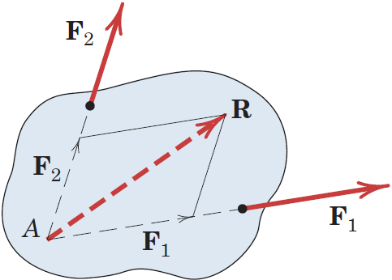
Article 2/2 – Concurrent Forces (1 of 2)
Bold face letters show a vector quantity!
Two or more forces are said to be concurrent at
a point if their lines of action intersect at that point.
The forces F₁ and F₂ shown in figure, have a common
point of application and are concurrent at the point A.
Thus, they can be added using parallelogram law in their common plane to obrain their sum or resultant R.
Suppose the two concurrent forces lie in the same plane but are ap­plied
at two different points as in given Figure.

Slide 8
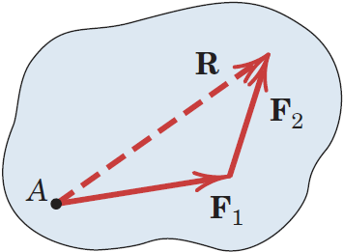
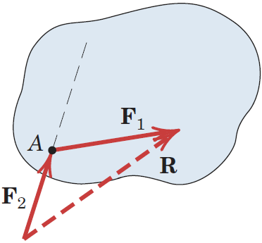
Article 2/2 – Concurrent Forces (2 of 2)
By the principle of transmissibility, we may move them along their lines
of action and complete their vector sum R at the point of concurrancy.
F₁ and F₂ forces can be replaced with resultant R without altering the
external effects on the body.
If we add two forces as shown in figure below, we correctly preserve the
magnitude and direction of the resultant R, but we lose the correct line of action,
Because the obtained R in this way does not pass thorough the point A.
Therefore, this type of combination should be avoided.
We can express the sum of the two forces mathematically by the
vector equation
R=F₁+ F₂

Slide 9
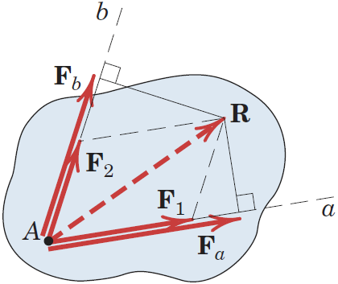
Article 2/2 – Vector Components
In addition to combining forces to obtain their resultant, we often need to
replace a force by its vector components in directions which are
convenient for a given application.
The vector sum of the components must be equal the original vector.
The relationship between a force and its vector components along
given axes must not be confused with the relationship between a force
and its perpendicular projections onto the same axes.
The figure shows the perpendicular projections F_{a} and F_{b} of R on to a and
b axes. We can understand that the components of a vector are not necessarily equal to the projections onto same axes.
Vector Components: F₁ and F₂
Vector Projections: F_{a} and F_{b}

Slide 10
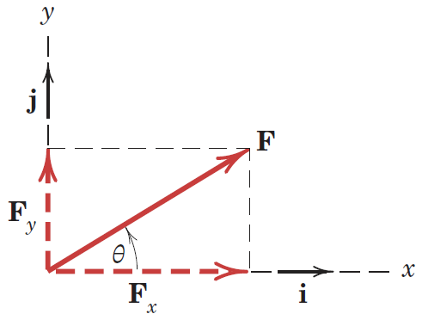
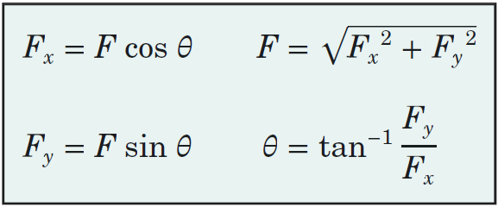
2/3 Rectangular Components
Vector Components: F = F_{x} + F_{y}
Scalar Components: F = F_{x}i + F_{y}j
Other Useful Relationships

Slide 11
2/3 Conventions for Describing Vector Components
Vector Magnitude, F
Lightface, Italic Font
Always Positive
Scalar Component, F_{x}
Lightface, Italic Font
Positive or Negative
Force Vector Depiction
Solid, Red Arrow
Component Vector Depiction
Dashed, Red Arrow

Slide 12
2/3 Determining the Components of a Force (1 of 2)
It is often the case that…
Dimensions or axes are not given in horizontal and vertical directions.
Angles are not measured counterclockwise from the x-axis.
Coordinates do not originate from the line of action of a force.
We still need to be able to find the components of a force vector!

Slide 13
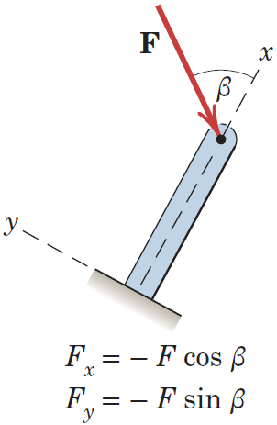
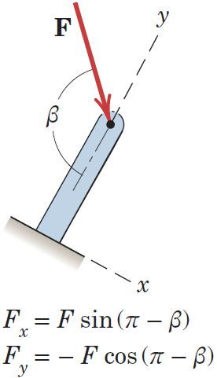
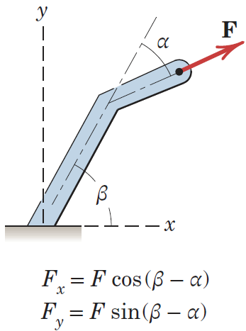
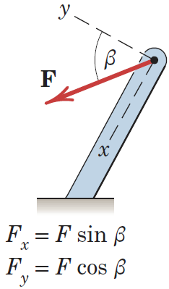
2/3 Determining the Components of a Force (2 of 2)
Some examples

Slide 14
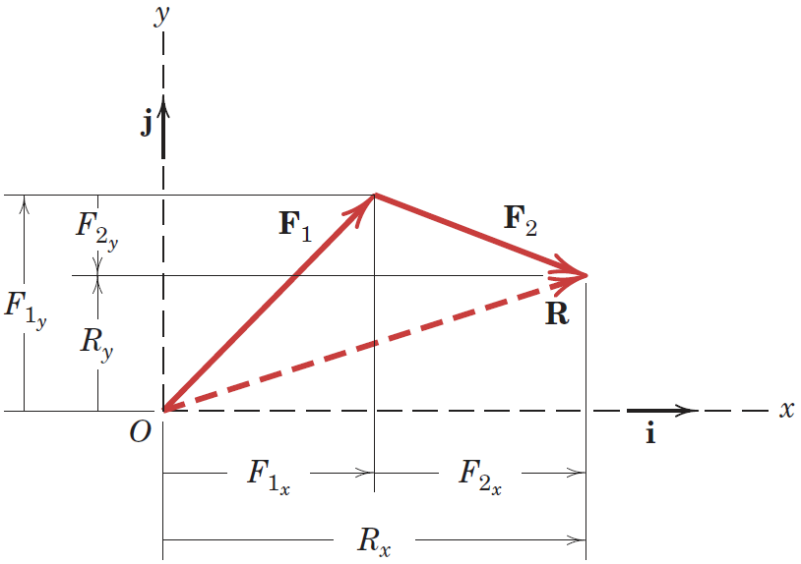
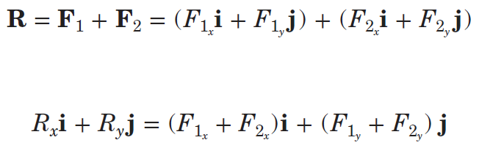
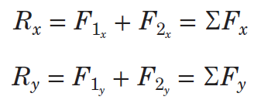
2/3 Finding Resultants using Components
Rectangular components are convenient for finding the resultant of two forces which are concurrent.

Slide 15
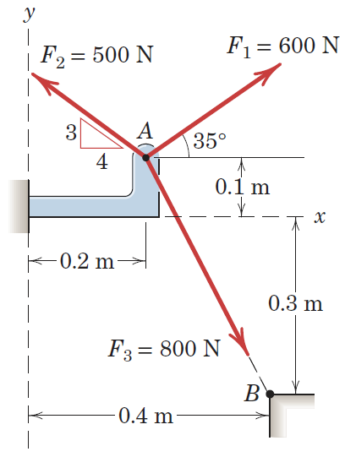
Article 2/3 – Sample Problem 2/1 (1 of 3)
The forces F₁, F₂, and F₃, all of which act on point A of the bracket, are specified in three different ways. Determine the x and y scalar components of each of the three forces.

Slide 16
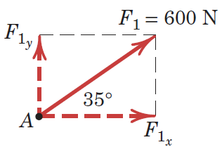
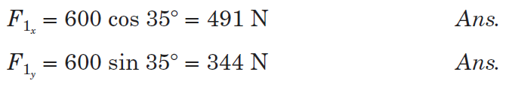
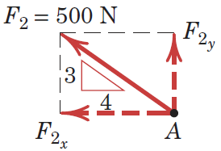
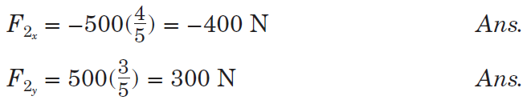
Article 2/3 – Sample Problem 2/1 (2 of 3)
Scalar Components of F₁
Scalar Components of F₂

Slide 17
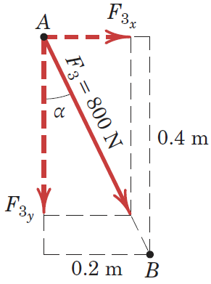
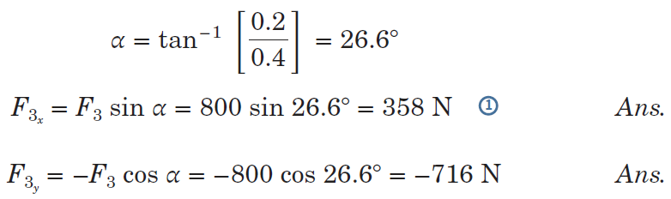
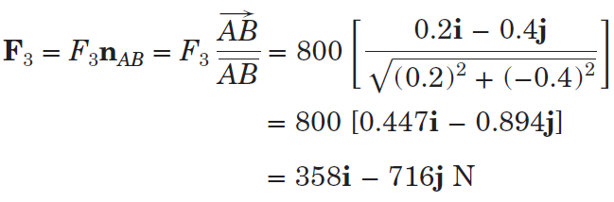
Article 2/3 – Sample Problem 2/1 (3 of 3)
Scalar Components of F₃
Alternative Calculation

Slide 18
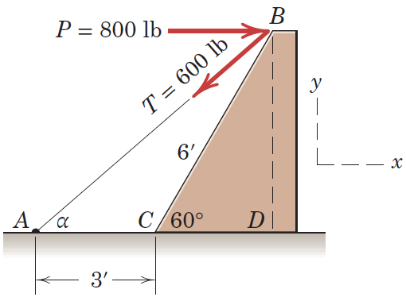
Article 2/3 – Sample Problem 2/2 (1 of 4)
Combine the two forces P and T, which act on the fixed structure at B, into a single equivalent force R.

Slide 19
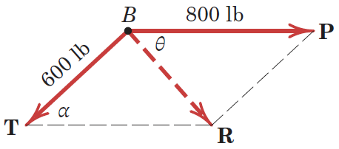
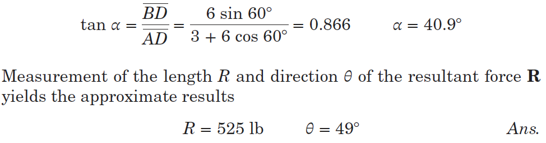
Article 2/3 – Sample Problem 2/2 (2 of 4)
Graphical Solution (Scaled Drawing)

Slide 20
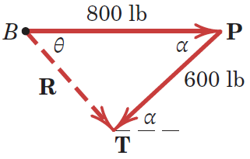
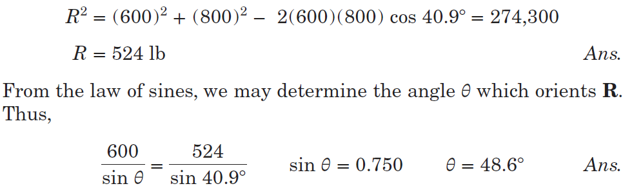
Article 2/3 – Sample Problem 2/2 (3 of 4)
Geometric Solution

Slide 21

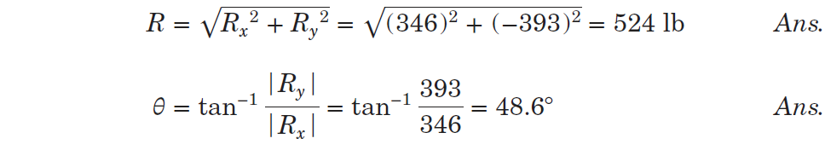
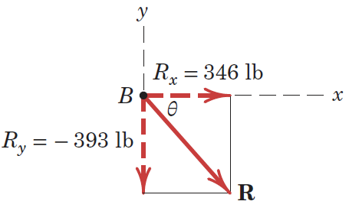
Article 2/3 – Sample Problem 2/2 (4 of 4)
Algebraic Solution
Vector Representation

Slide 22
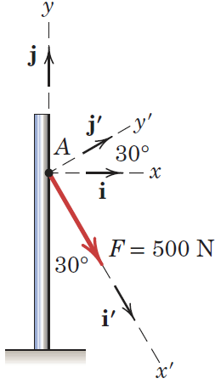
Article 2/3 – Sample Problem 2/3 (1 of 3)
The 500-N force F is applied to the vertical pole as shown. (1) Write F in terms of the unit vectors i and j and identify both its vector and scalar components. (2) Determine the scalar components of the force vector F along the x′- and y′-axes. (3) Determine the scalar components of F along the x- and y′-axes.

Slide 23
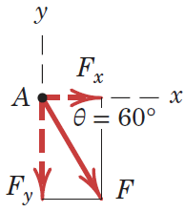
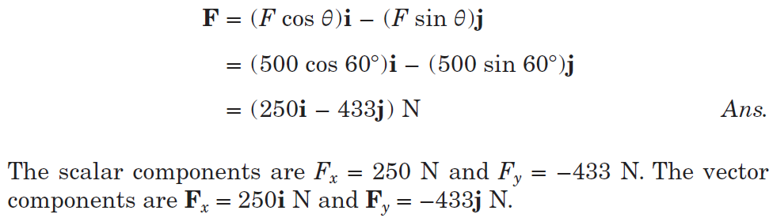
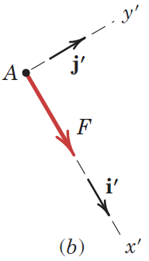
Article 2/3 – Sample Problem 2/3 (2 of 3)
Part 1 Solution
Part 2 Solution

Slide 24
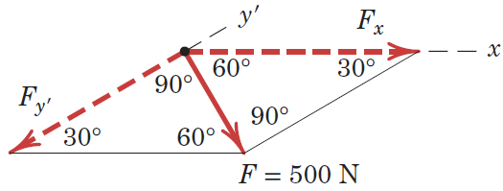
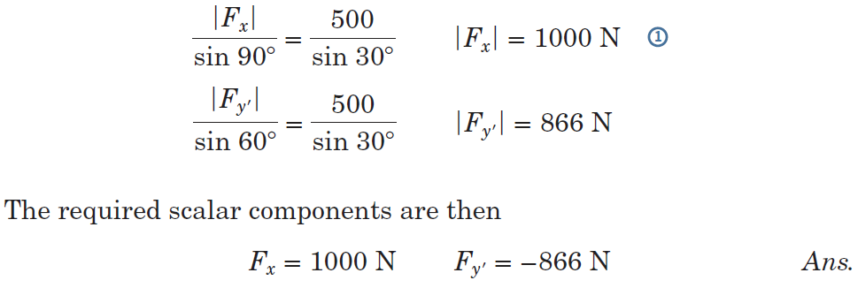

Article 2/3 – Sample Problem 2/3 (3 of 3)
Part 3 Solution

Slide 25
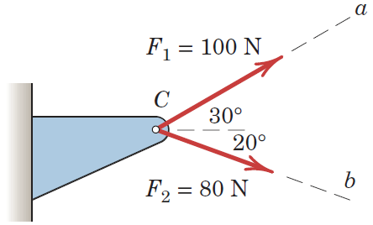
Article 2/3 – Sample Problem 2/4 (1 of 2)
Forces F₁ and F₂ act on the bracket as shown. Determine the projection F_{b} of their resultant R onto the b-axis.

Slide 26
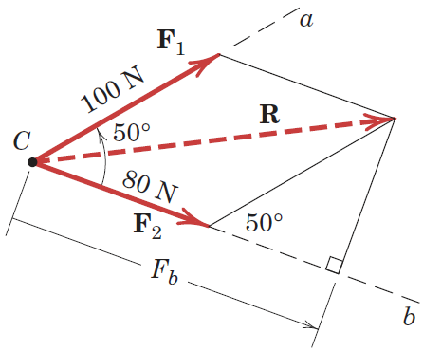
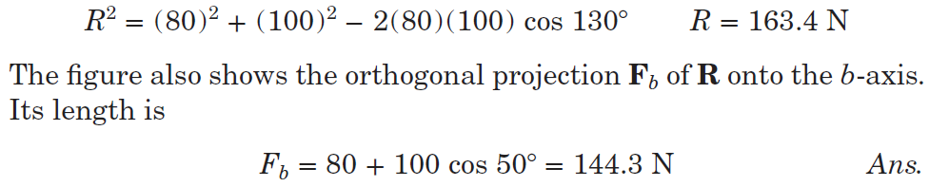
Article 2/3 – Sample Problem 2/4 (1 of 2)
Solution

Slide 27
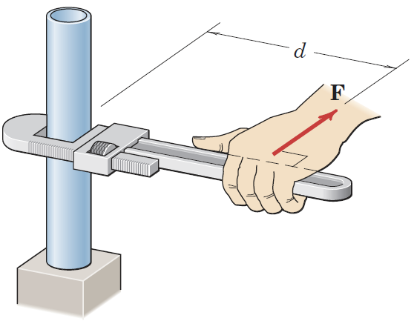
Article 2/4 Moment
A moment is the tendency of a force to rotate a body about an axis.
Things to Note
Direction and Orientation of the Force
Axis of Rotation
Direction of Rotation
Effective Length, d
Pipe Wrench

Slide 28
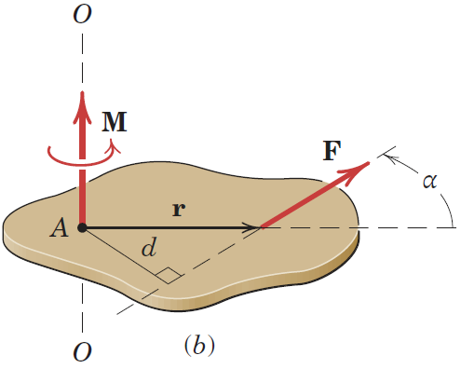
Article 2/4 – Moment about a Point (1 of 3)
Scalar Development
Moment Arm, d is the perpendicular distance from the axis to
the line of action of the force
Moment Vector, M is perpendicular to plane of body
Axis of Rotation, O-O
Moment Magnitude,
Direction of Rotation
Units
M = Fd
Notes:
The magnitude of the moment or tendency of the force to rotate the body about the axis 0-0 perpendicular to the plane of the body is proportional both to the magnitude of the force and to the mo­ment arm d, which is the perpendicular distance from the axis to the
line of action of the force.

Slide 29
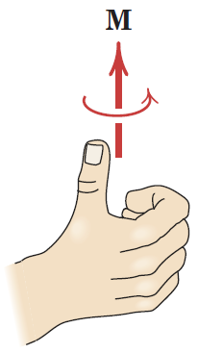
Article 2/4 – Moment about a Point (2 of 3)
The Right-Hand Rule
Position your right hand such that your fingers point in the same direction as the force.
Orient your hand such that the point you are computing the moment about is on the same side as your palm. From the figure at right, your hand is positioned such that the moment arm d intersects the middle of your palm.
Close your fingers to make a fist and extend your thumb straight up. From the figure at right, imagine closing your fist around line O-O, and your thumb would point in the direction of the moment vector. Curling your fingers about this line would represent the rotation of the moment about the axis.

Slide 30
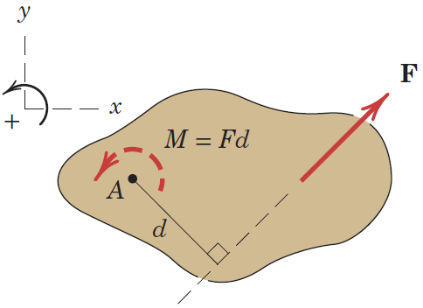
Article 2/4 – Moment about a Point (3 of 3)
Sign Conventions
Counterclockwise, CCW positive
Clockwise, CW negative
User-Defined
Two-Dimensional Representation
Notes:
Moment directions may be accounted for by using a stated sign con­vention, such as a plus sign ( +) for counterclockwise moments and a minus sign for clockwise moment, or vice versa.
Sign consistency is essential

Slide 31
Article 2/4 – The Cross Product
Vector Expression for Moments
Position Vector, r
Moment Vector, M = r × F
In some two-dimensional and many of the three-dimensional prob­lems to follow, it is convenient to use a vector approach for moment calculations.
Notes:
In some two-dimensional and many of the three-dimensional prob­lems to follow, it is convenient to use a vector approach for moment calculations.

Slide 32
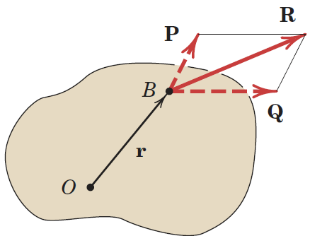
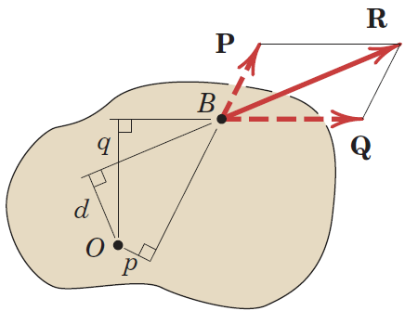
Article 2/4 – Varignon’s Theorem
The theorem states that the moment of a force about any point is equal to the sum of the moments of the components of the force about the same point.
R = P + Q
M_{O} = r × R = r × (P + Q) = r × P + r × Q
In Vectoral Form
M_{O} = Rd = pP - qQ (Assumes CCW +)
In Scalar Form
Notes:
One of the most useful principles of mechanics is Varignon's theo­rem

Slide 33
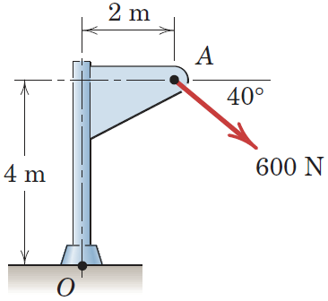
Article 2/4 – Sample Problem 2/5 (1 of 5)
Calculate the magnitude of the moment about the base point O of the 600-N force in five different ways.

Slide 34
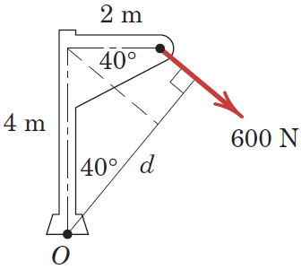
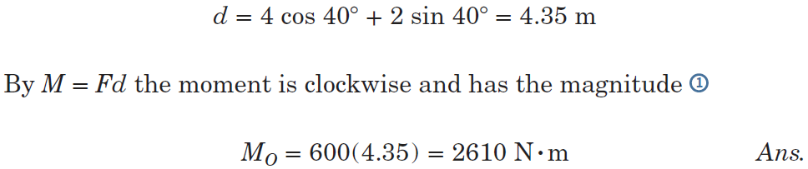
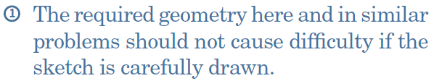
Article 2/4 – Sample Problem 2/5 (2 of 5)
Method 1: Use the Moment Arm (CW is +)

Slide 35



Article 2/4 – Sample Problem 2/5 (3 of 5)
Method 2: Use Components at A (CW is +)

Slide 36


Article 2/4 – Sample Problem 2/5 (4 of 5)
Methods 3 and 4: Alternative Moment Arms

Slide 37


Article 2/4 – Sample Problem 2/5 (5 of 5)
Method 5: Vector Approach

Slide 38

Article 2/4 – Sample Problem 2/6 (1 of 4)
The trap door OA is raised by the cable AB, which passes over the small frictionless guide pulleys at B. The tension everywhere in the cable is T, and this tension applied at A causes a moment M_{O} about the hinge at O. Plot the quantity M_{O} ∕ T as a function of the door elevation angle 𝜃 over the range 0 ≤ 𝜃 ≤ 90° and note minimum and maximum values. What is the physical significance of this ratio?

Slide 39



Article 2/4 – Sample Problem 2/6 (2 of 4)
Tension Vector

Slide 40


Article 2/4 – Sample Problem 2/6 (3 of 4)
Moment Vector

Slide 41


Article 2/4 – Sample Problem 2/6 (4 of 4)
Desired Expression and Plot

Slide 42

Article 2/5 Couple
The moment produced by two equal, opposite, and noncollinear forces is called a couple.
Note especially that the magnitude of the couple is indepen­dent of the distance a which locates the forces with respect to the moment center O.
It follows that the moment of a couple has the same value for all moment centers.
M_{O} = F(a + d) - Fa = Fd
Notes:
Consider the action of two equal and opposite forces F and -F a distance d apart. These two forces can’t be combined into a single force, bcs their sum is zero.
Their only effect is rotation.

Slide 43


Article 2/5 – Vector Algebra Method
The Couple is a Free Vector
M_{O} = r_{A} × F + r_{B} × (-F) = (r_{A} - r_{B}) × F = r × F

Slide 44

Article 2/5 – Alternative Representations of Couples
Two-Dimensional Representations
Because the couple vector M is always perpendicular to the plane of the forces which constitute the couple, in 2D analysis we can represent the sense of a couple vector as clockwise or counterclockwise by one of the conventions shown in Figure.

Slide 45

Article 2/5 – Equivalent Couples
Changing the values of F and d does not change a given couple as long as the product F.d remains the same.
Likewise, a couple is not af­fected if the forces act in a different but parallel plane.

Slide 46

Article 2/5 – Force-Couple Systems (1 of 2)
Principle of the Force-Couple System
The effect of a force acting on a body is the tendency to push or pull the body in the direction of the force and to rotate the body about any fixed axis which does not intersect the line of the force.
We can repre­sent this dual effect more easily by replacing the given force by an equal parallel force and a couple to satify for the change in the moment of the force.
Notes:
The effect of a force acting on a body is the tendency to push or pull the body in the direction of the force and to rotate the body about any fixed axis which does not intersect the line of the force. We can repre­sent this dual effect more easily by replacing the given force by an equal parallel force and a couple to satify for the change in the moment of the force.

Slide 47
Article 2/5 – Force-Couple Systems (2 of 2)
Steps to Create a Force-Couple System
Write the force as a vector.
Compute the moment or couple which the force creates about the point.
Redraw the force acting at the new location.
Sketch the couple acting at the new location.
Important Reminder
The force-couple system has the same effect on the body which the original force had. It is simply a different way to visualize the effect of the force acting at a new location.

Slide 48

Article 2/5 – Sample Problem 2/7 (1 of 2)
The rigid structural member is subjected to a couple consisting of the two 100-N forces. Replace this couple by an equivalent couple consisting of the two forces P and −P, each of which has a magnitude of 400 N. Determine the proper angle 𝜃.

Slide 49



Article 2/5 – Sample Problem 2/7 (2 of 2)
Solution

Slide 50

Article 2/5 – Sample Problem 2/8 (1 of 2)
Replace the horizontal 80-lb force acting on the lever by an equivalent system consisting of a force at O and a couple.

Slide 51


Article 2/5 – Sample Problem 2/8 (2 of 2)

Slide 52
Article 2/6 Resultants
The resultant of a system of forces is the simplest force combination which can replace the original forces without altering the external effect on the rigid body to which the forces are applied.
Equilibrium Condition: Equilibrium of a body is the condition in which the resultant of all forces acting on the body is zero.
Nonequilibrium Condition:When the resultant of all forces on a body is not zero, the acceleration of the body is obtained by equating the force resultant to the product of the mass and acceleration of body.

Slide 53



Article 2/6 – Planar Force System
We obtain the magnitude and direction of the resultant force R by forming the force polygon shown in part b of the figure, where the forces are added head-to-tail in any sequence.
Notes:
We obtain the magnitude and direction of the resultant force R by forming the force polygon shown in part b of the figure, where the forces are added head-to-tail in any sequence.

Slide 54

Article 2/6 – Algebraic Method (1 of 3)
Finding the Resultant and Line of Action
Choose a proper reference point and move all forces to that point. This process is depicted for a three-force system in Figs. (a) and (b) below where M₁, M₂, and M₃ are the couples resulting from the transfer of forces F₁, F₂, and F₃ from their respective original lines of action to lines of action through point O.

Slide 55

Article 2/6 – Algebraic Method (2 of 3)
Add all forces at O to form the resultant force R, and add all couples to form the resultant couple M_{O}. We now have the single force–couple system, as shown in Fig. (c).
Find the line of action of R by requiring R to have a moment of M_{O} about point O. Note that the force system in Fig. (d) is equivalent to the initial force system from Fig. (a) and that Σ(Fd) in Fig. (a) is equal to Rd in Fig. (d).

Slide 56


Article 2/6 – Algebraic Method (3 of 3)

Slide 57

Article 2/6 – Sample Problem 2/9 (1 of 4)
Determine the resultant of the four forces and one couple which act on the plate shown.

Slide 58



Article 2/6 – Sample Problem 2/9 (2 of 4)
Equivalent Force-Couple System

Slide 59

Article 2/6 – Sample Problem 2/9 (3 of 4)
Line of Action for the Resultant
Alternative Solution (Point C on x-axis)

Slide 60


Article 2/6 – Sample Problem 2/9 (4 of 4)
Vector Approach for the Line of Action

