Slide 1
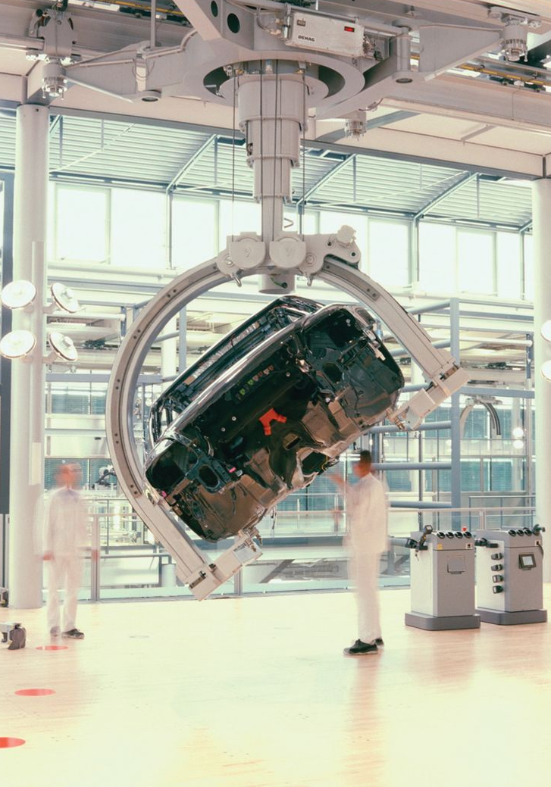
CHAPTER 3 EQUILIBRIUM
CHAPTER OUTLINE
3/1 Introduction
SECTION A Equilibrium in Two Dimensions
3/2 System Isolation and the Free-Body Diagram
3/3 Equilibrium Conditions
SECTION B Equilibrium in Three Dimensions
3/4 Equilibrium Conditions
Bialobrzeski/Iaif/Redux Pictures

Slide 2
Article 3/1 Introduction
Equilibrium Conditions (Eq. 3/1)
Force Balance: ΣF = 0
Moment Balance: ΣM = 0

Slide 3
Article 3/2 System Isolation and the Free-Body Diagram
System Isolation
Free-Body Diagram
The free-body diagram is the most important single step in the solution of problems in mechanics.

Slide 4
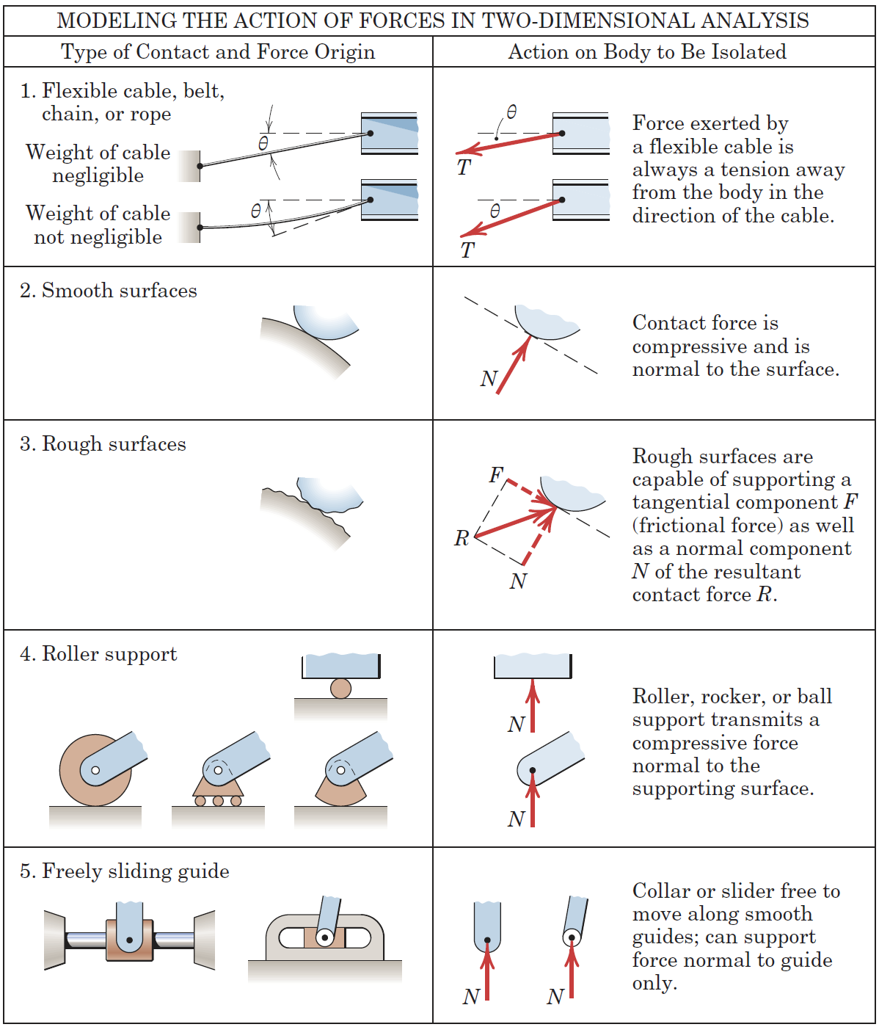
Article 3/2 – Modeling the Action of Forces (1 of 4)

Slide 5
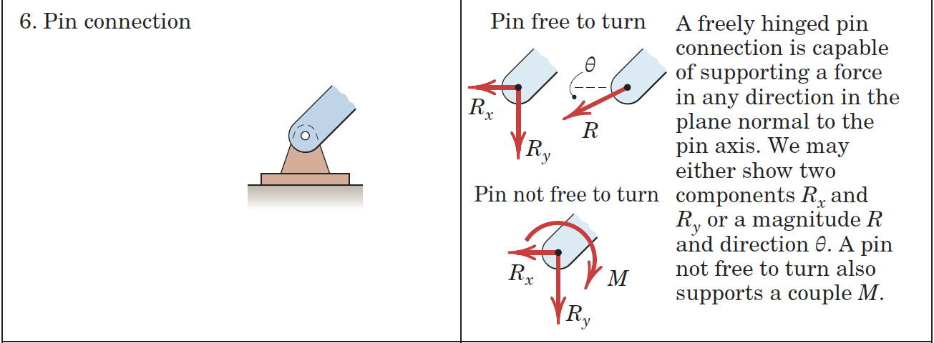
Article 3/2 – Modeling the Action of Forces (2 of 4)

Slide 6
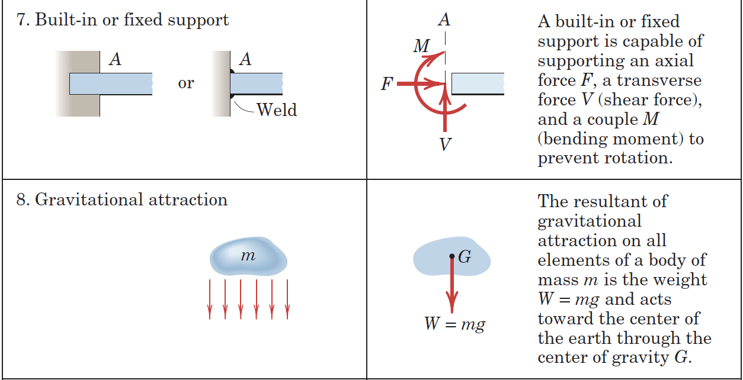
Article 3/2 – Modeling the Action of Forces (3 of 4)

Slide 7
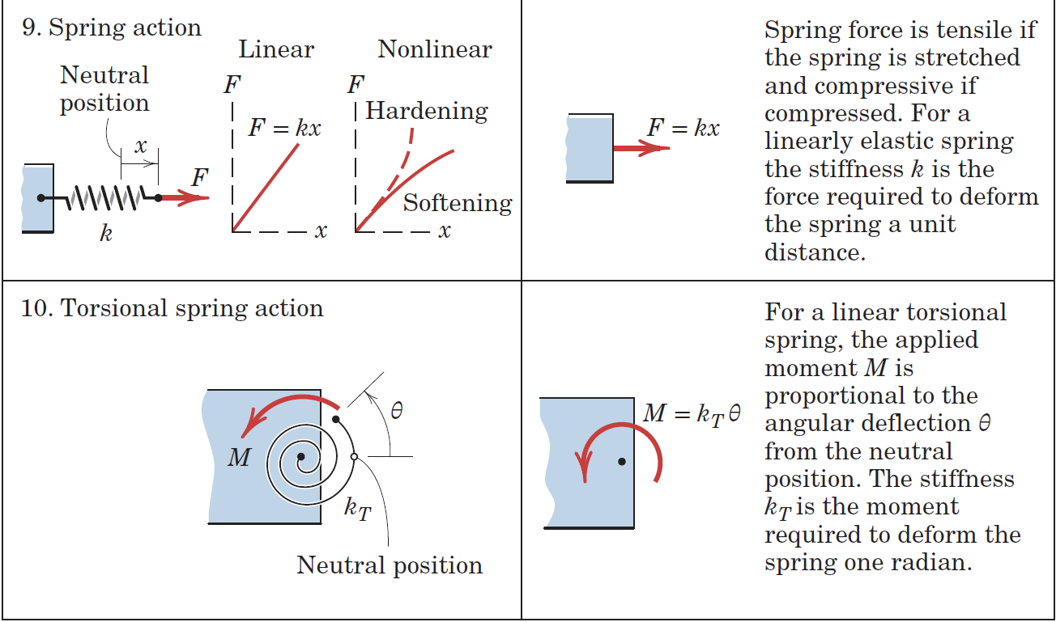
Article 3/2 – Modeling the Action of Forces (4 of 4)

Slide 8
Article 3/2 – Construction of Free-Body Diagrams
Step 1: Decide which system to isolate.
Step 2: Isolate the system by drawing a diagram which represents its complete external boundary.
Step 3: Identify all forces which act on the isolated system as applied by the removed contacting and attracting bodies, and represent them in their proper positions on the diagram of the isolated system.
Step 4: Show the choice of coordinate axes directly on the diagram.

Slide 9
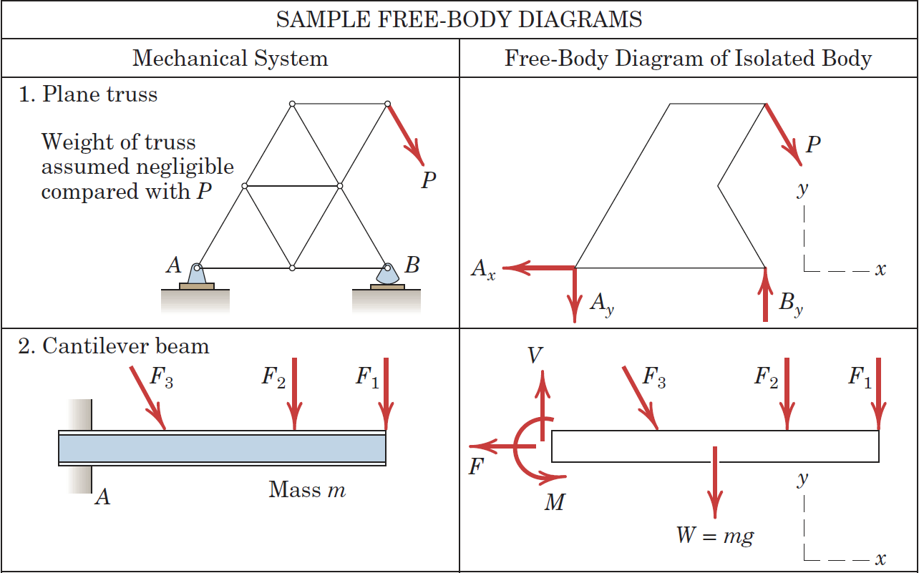
Article 3/2 – Examples of Free-Body Diagrams (1 of 2)

Slide 10
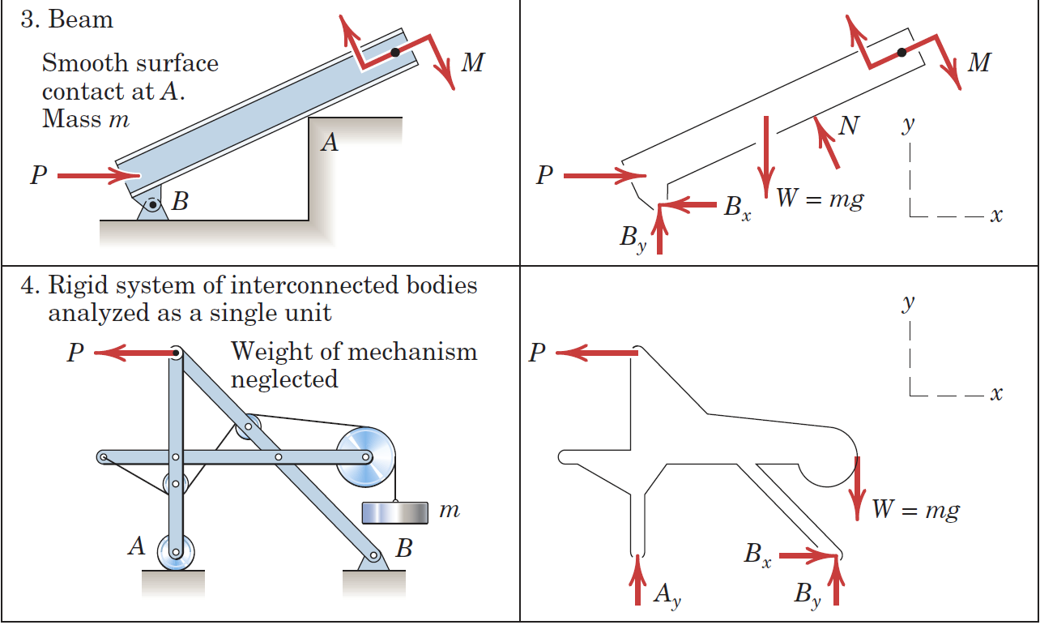
Article 3/2 – Examples of Free-Body Diagrams (2 of 2)

Slide 11
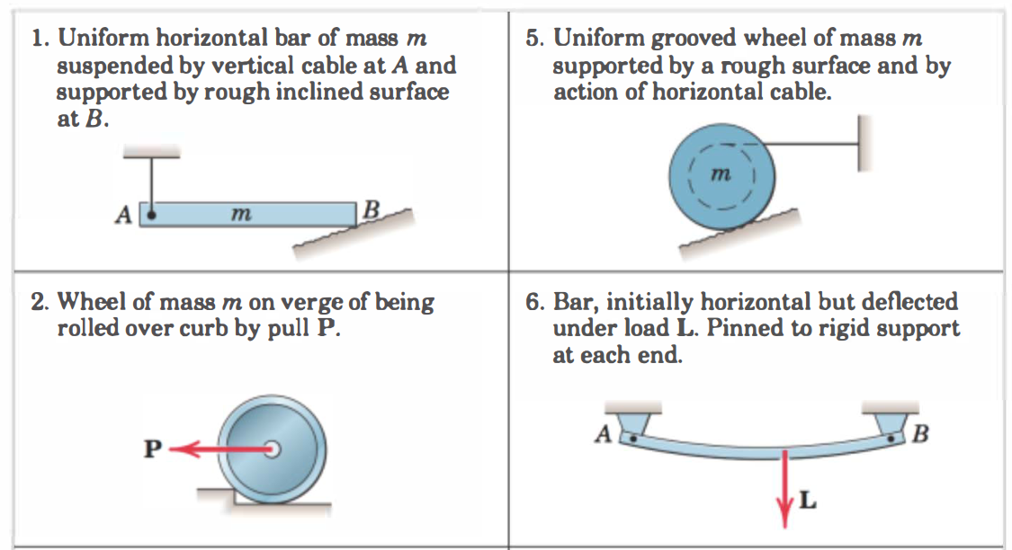
Examples

Slide 12
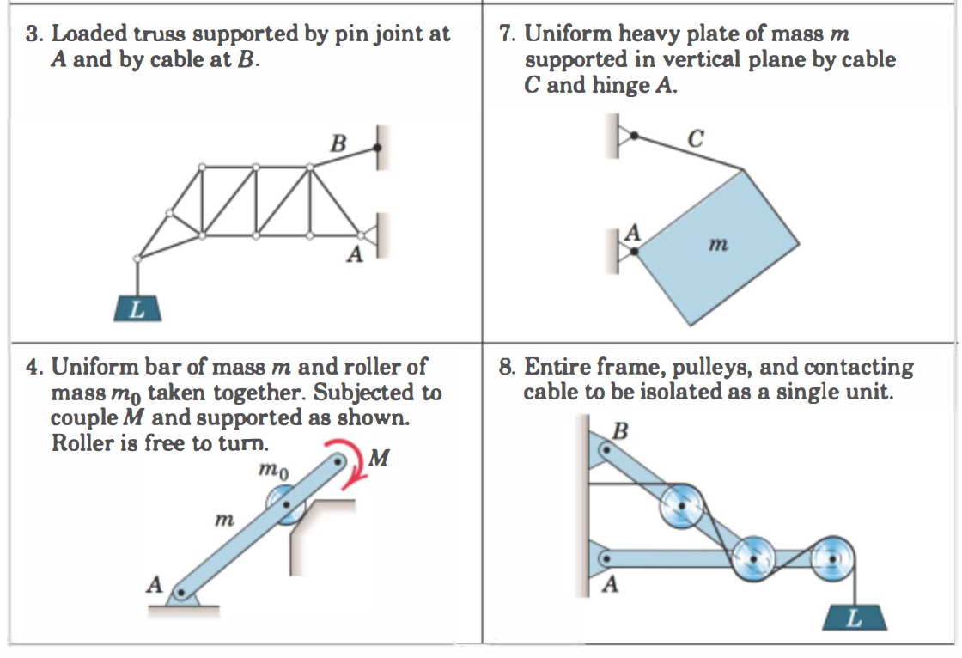
Examples

Slide 13
Article 3/3 Equilibrium Conditions
Scalar Format (Eq. 3/2)
ΣF_{x} = 0
ΣF_{y} = 0
ΣM_{O} = 0

Slide 14
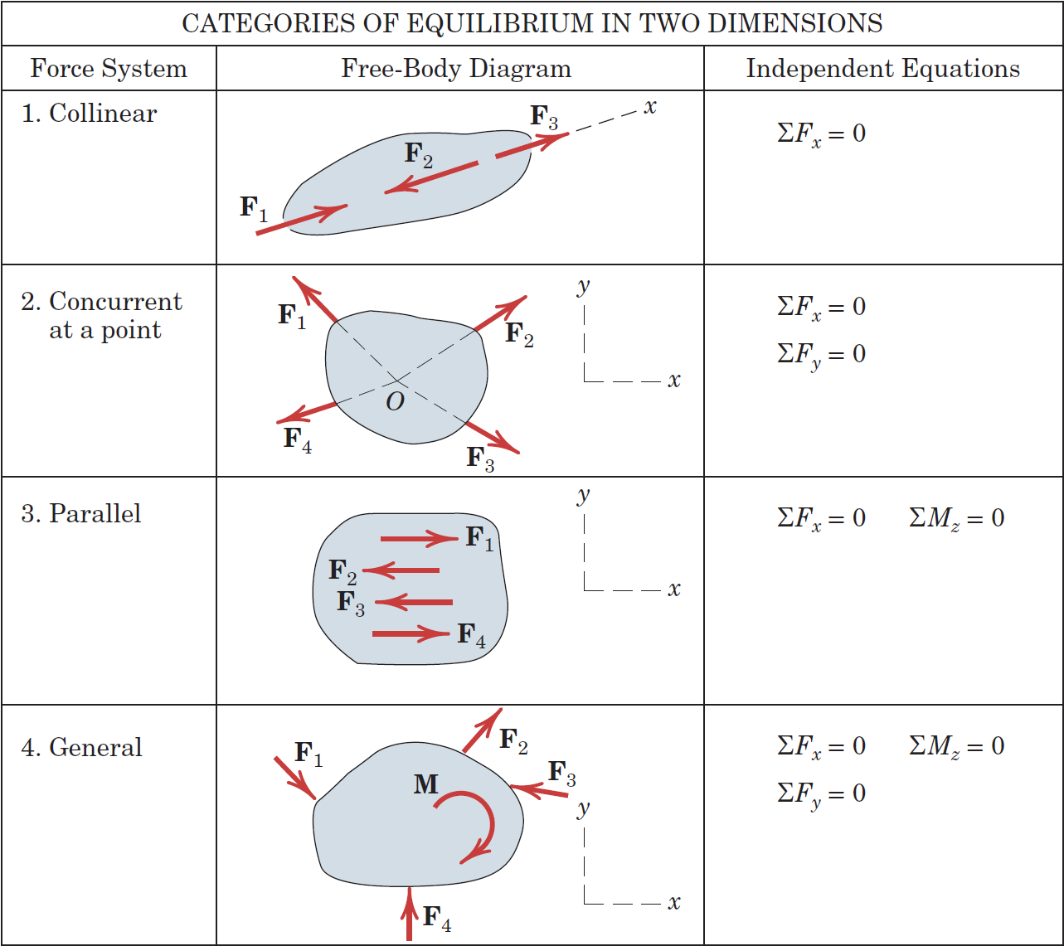
Article 3/3 – Categories of Equilibrium

Slide 15
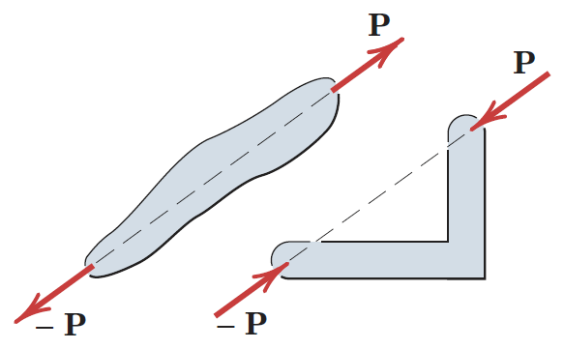
Article 3/3 – Two-Force Members
Definition
Occurs when a body is in equilibrium under the action of two forces only.
Forces are…
Equal
Opposite
Collinear
Independent of Object Shape

Slide 16
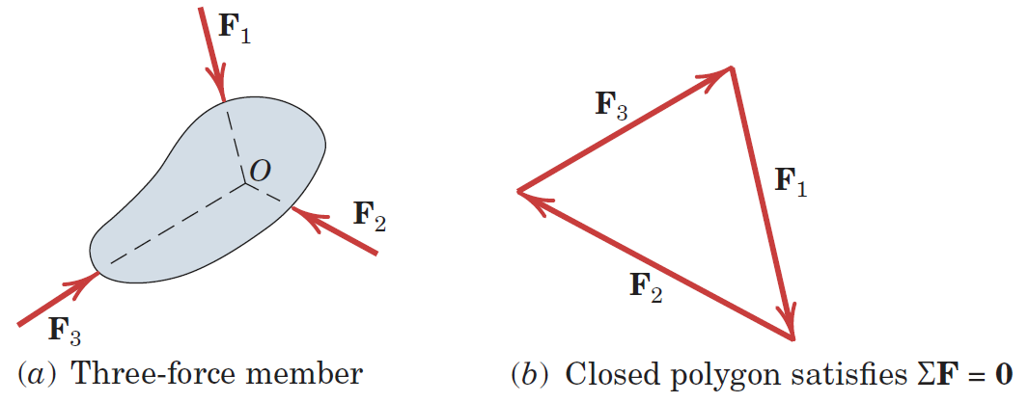
Article 3/3 – Three-Force Members
Definition
Occurs when a body is in equilibrium under the action of three forces only.
Forces are Concurrent
Case of Parallel Forces

Slide 17
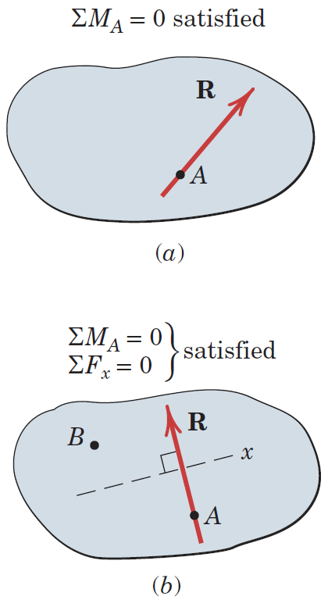
Article 3/3 – Alternative Equilibrium Equations (1 of 2)
Case 1: Use of Two Moment Equations
Case (a)
Resultant Intersects Point A
Case (b)
Resultant Intersects Point A
Resultant is Perpendicular to x-axis
Equilibrium Conditions
ΣF_{x} = 0
ΣM_{A} = 0
ΣM_{B} = 0

Slide 18
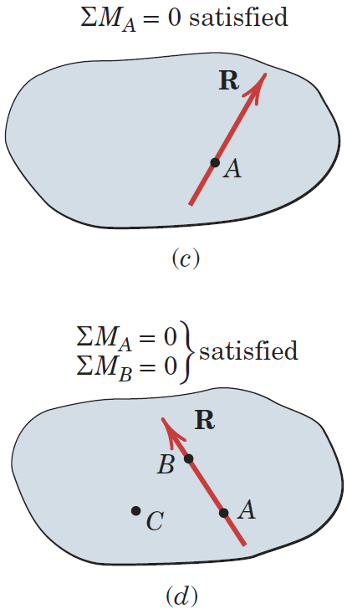
Article 3/3 – Alternative Equilibrium Equations (2 of 2)
Case 2: Use of Three Moment Equations
Case (c)
Resultant Intersects Point A
Case (d)
Resultant Intersects Point A
Resultant Intersects Point B
Equilibrium Conditions
ΣM_{A} = 0
ΣM_{B} = 0
ΣM_{C} = 0

Slide 19
Article 3/3 – Constraints and Statical Determinacy
Important Terms
Constraint
Statically Determinant
Statically Indeterminant
Redundancy
Degree of Statical Indeterminacy

Slide 20
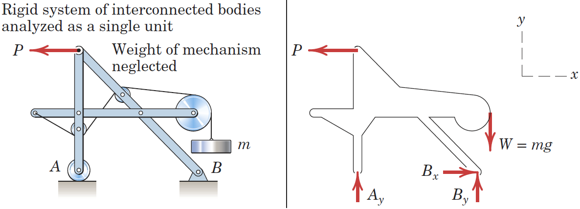
Article 3/3 – Illustration of Determinacy
Statically Determinant System
Statically Indeterminant System – Replace Roller A with a Pin

Slide 21
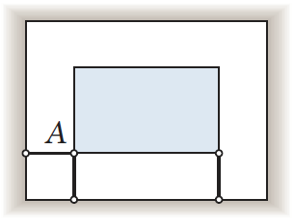
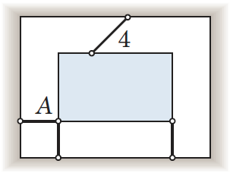
Article 3/3 – Adequacy of Constraints (1 of 2)
Complete Fixity (Adequate Constraints)
Excessive Fixity (Redundant Constraints)

Slide 22
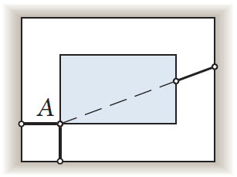
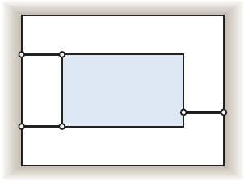
Article 3/3 – Adequacy of Constraints (2 of 2)
Incomplete Fixity (Partial Constraints)
Concurrent Reactions
Incomplete Fixity (Partial Constraints)
Parallel Reactions

Slide 23
Article 3/3 – Approach to Solving Problems
Identify clearly the quantities which are known and unknown.
Make an unambiguous choice of the body (or system) to be isolated and draw its complete free-body diagram.
Choose a convenient set of reference axes.
Identify and state the applicable force and moment equations which govern the equilibrium conditions of the problem.
Match the number of independent equations with the number of unknowns in the problem.
Carry out the solution and check the results.

Slide 24
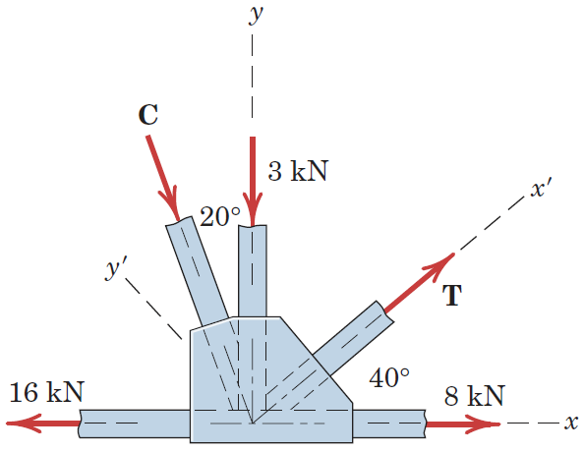
Article 3/3 – Sample Problem 3/1 (1 of 4)
Problem Statement
Determine the magnitudes of the forces C and T, which, along with the other three forces shown, act on the bridge-truss joint.

Slide 25
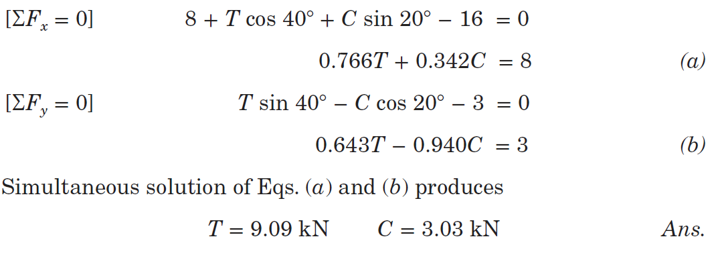
Article 3/3 – Sample Problem 3/1 (2 of 4)
Solution I (Scalar Algebra) with x-y axes

Slide 26
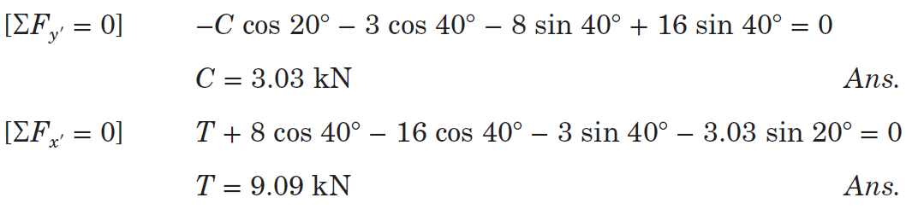
Article 3/3 – Sample Problem 3/1 (3 of 4)
Solution II (Scalar Algebra) with x′-y′ axes

Slide 27
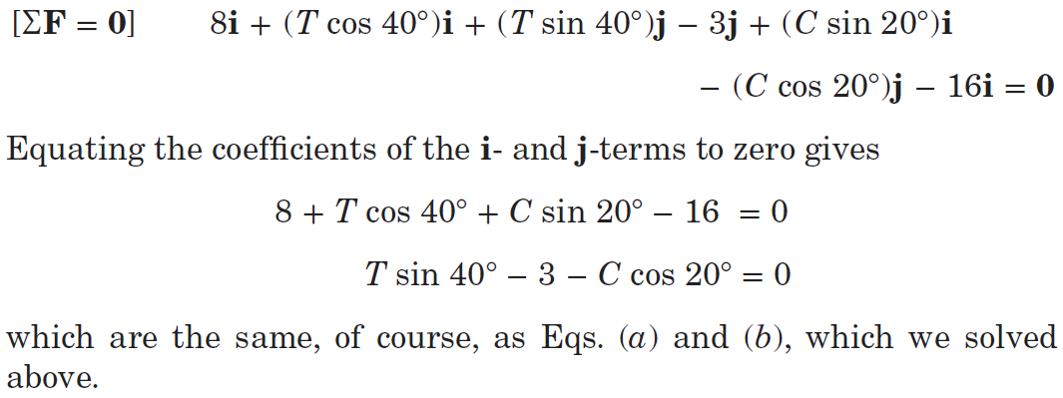
Article 3/3 – Sample Problem 3/1 (4 of 4)
Solution III (Vector Algebra) with x-y axes

Slide 28
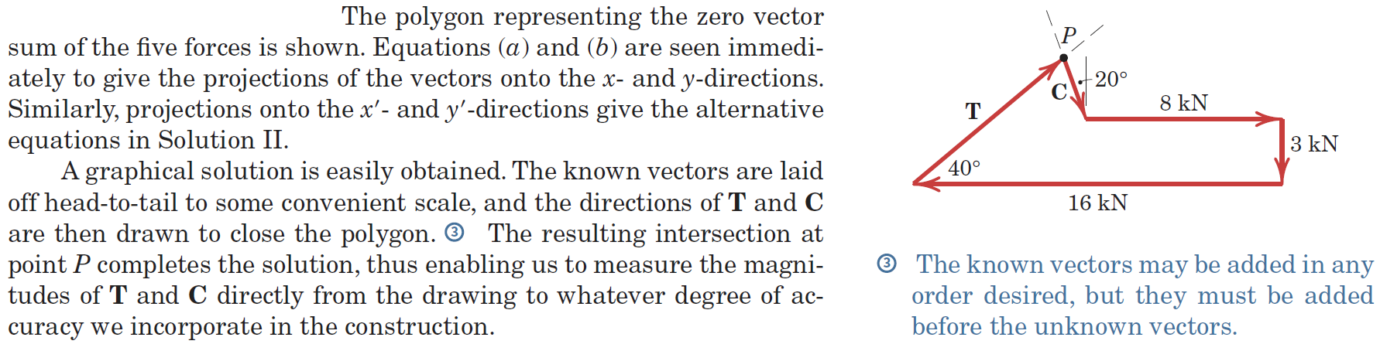
Article 3/3 – Sample Problem 3/1 (4 of 4)
Solution IV (Geometric)

Slide 29
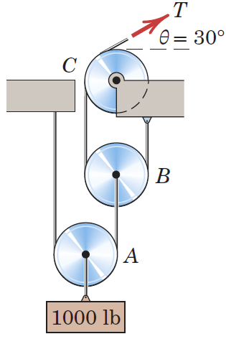
Article 3/3 – Sample Problem 3/2 (1 of 3)
Problem Statement
Calculate the tension T in the cable which supports the 1000-lb load with the pulley arrangement shown. Each pulley is free to rotate about its b earing, and the weights of all parts are small compared with the load. Find the magnitude of the total force on the bearing of pulley C.

Slide 30
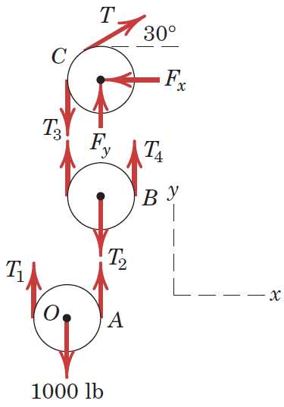
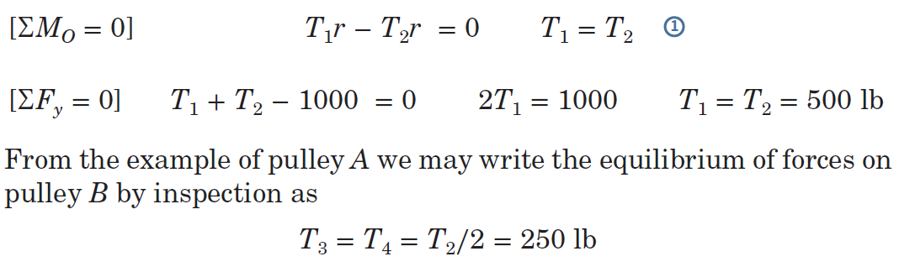
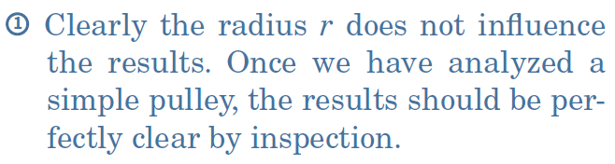
Article 3/3 – Sample Problem 3/2 (2 of 3)
Free-Body Diagrams
Equilibrium Conditions for Pulleys A and B

Slide 31
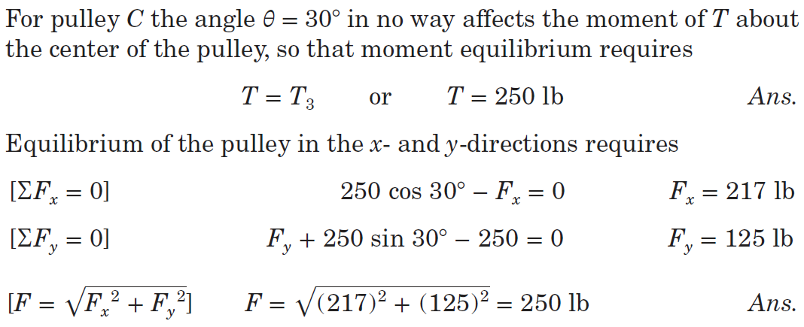
Article 3/3 – Sample Problem 3/2 (3 of 3)
Equilibrium Conditions for Pulley C

Slide 32
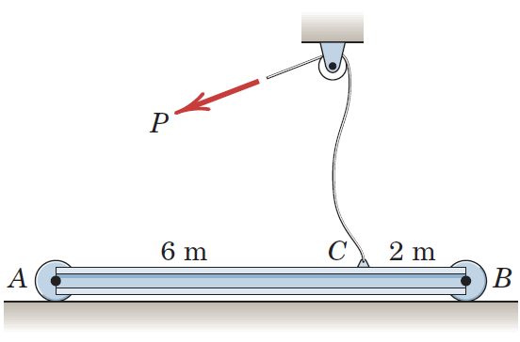
Article 3/3 – Sample Problem 3/3 (1 of 2)
Problem Statement
The uniform 100-kg I-beam is supported initially by its end rollers on the horizontal surface at A and B. By means of the cable at C, it is desired to elevate end B to a position 3 m above end A. Determine the required tension P, the reaction at A, and the angle 𝜃 made by the beam with the horizontal in the elevated position.

Slide 33
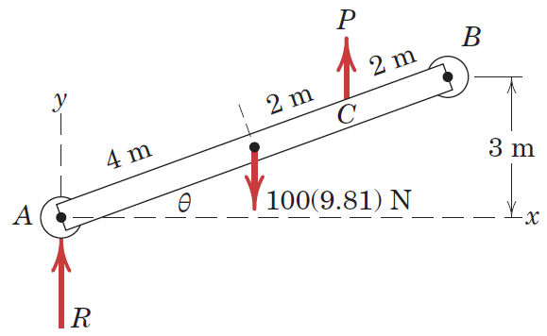
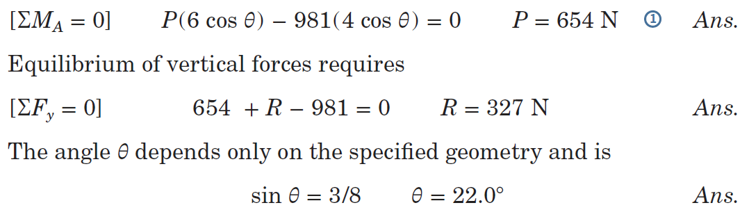

Article 3/3 – Sample Problem 3/3 (2 of 2)
Free-Body Diagram
Equilibrium Conditions

Slide 34
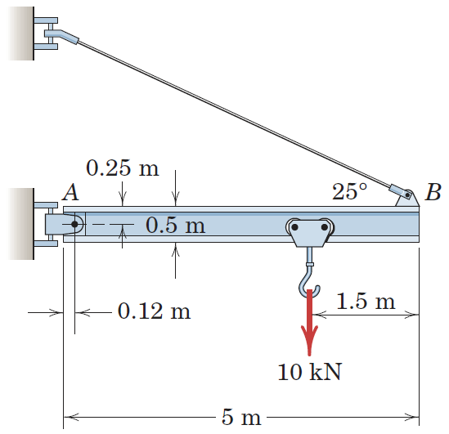
Article 3/3 – Sample Problem 3/4 (1 of 3)
Problem Statement
Determine the magnitude T of the tension in the supporting cable and the magnitude of the force on the pin at A for the jib crane shown. The beam AB is a standard 0.5-m I-beam with a mass of 95 kg per meter of length.

Slide 35
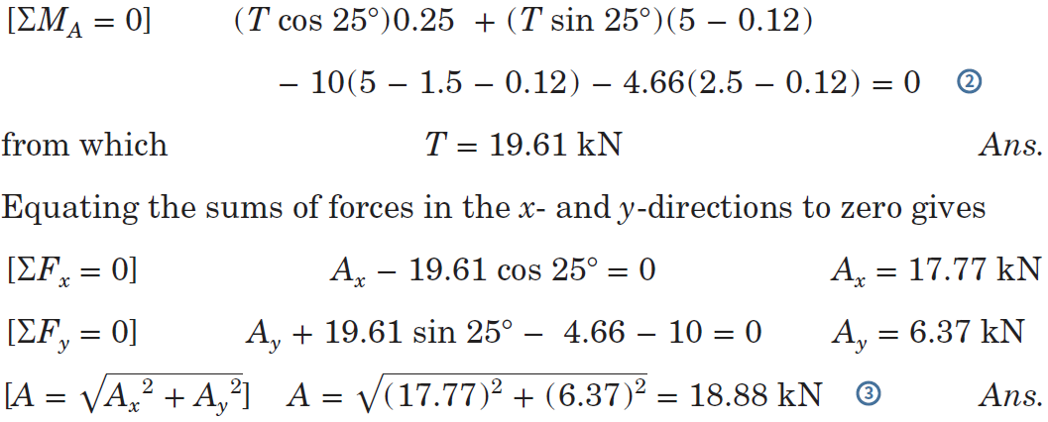
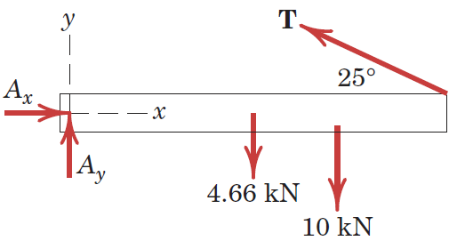
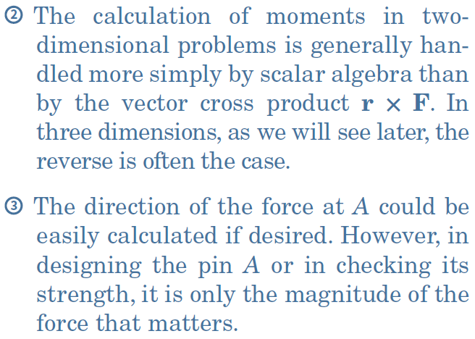
Article 3/3 – Sample Problem 3/4 (2 of 3)
Free-Body Diagram
Equilibrium Conditions

Slide 36
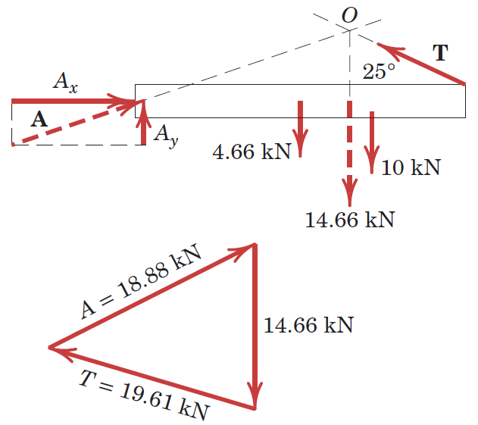
Article 3/3 – Sample Problem 3/4 (3 of 3)
Graphical Solution

Slide 37
Article 3/4 Equilibrium Conditions (3D)
Equilibrium Conditions (Eq. 3/1 extended)
Force Balance: ΣF = 0
ΣF_{x} = 0
ΣF_{y} = 0
ΣF_{z} = 0
Moment Balance: ΣM = 0
ΣM_{x} = 0
ΣM_{y} = 0
ΣM_{z} = 0
The moment sum is taken about any convenient reference point.

Slide 38
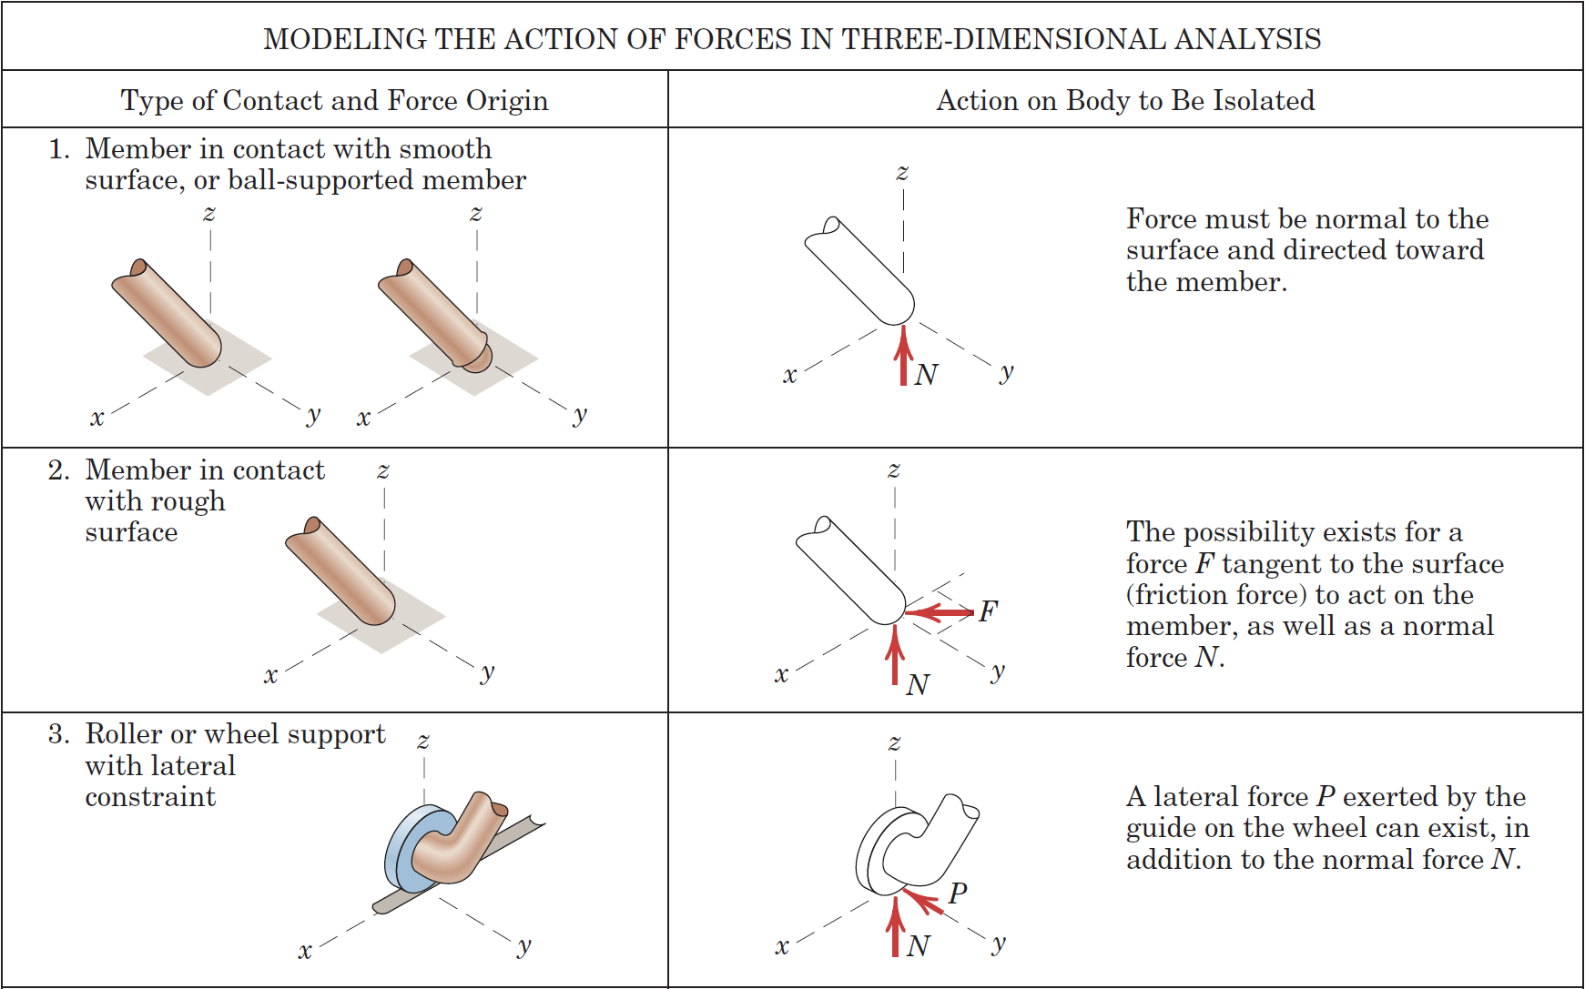
Article 3/4 – Modeling the Action of Forces (1 of 2)

Slide 39
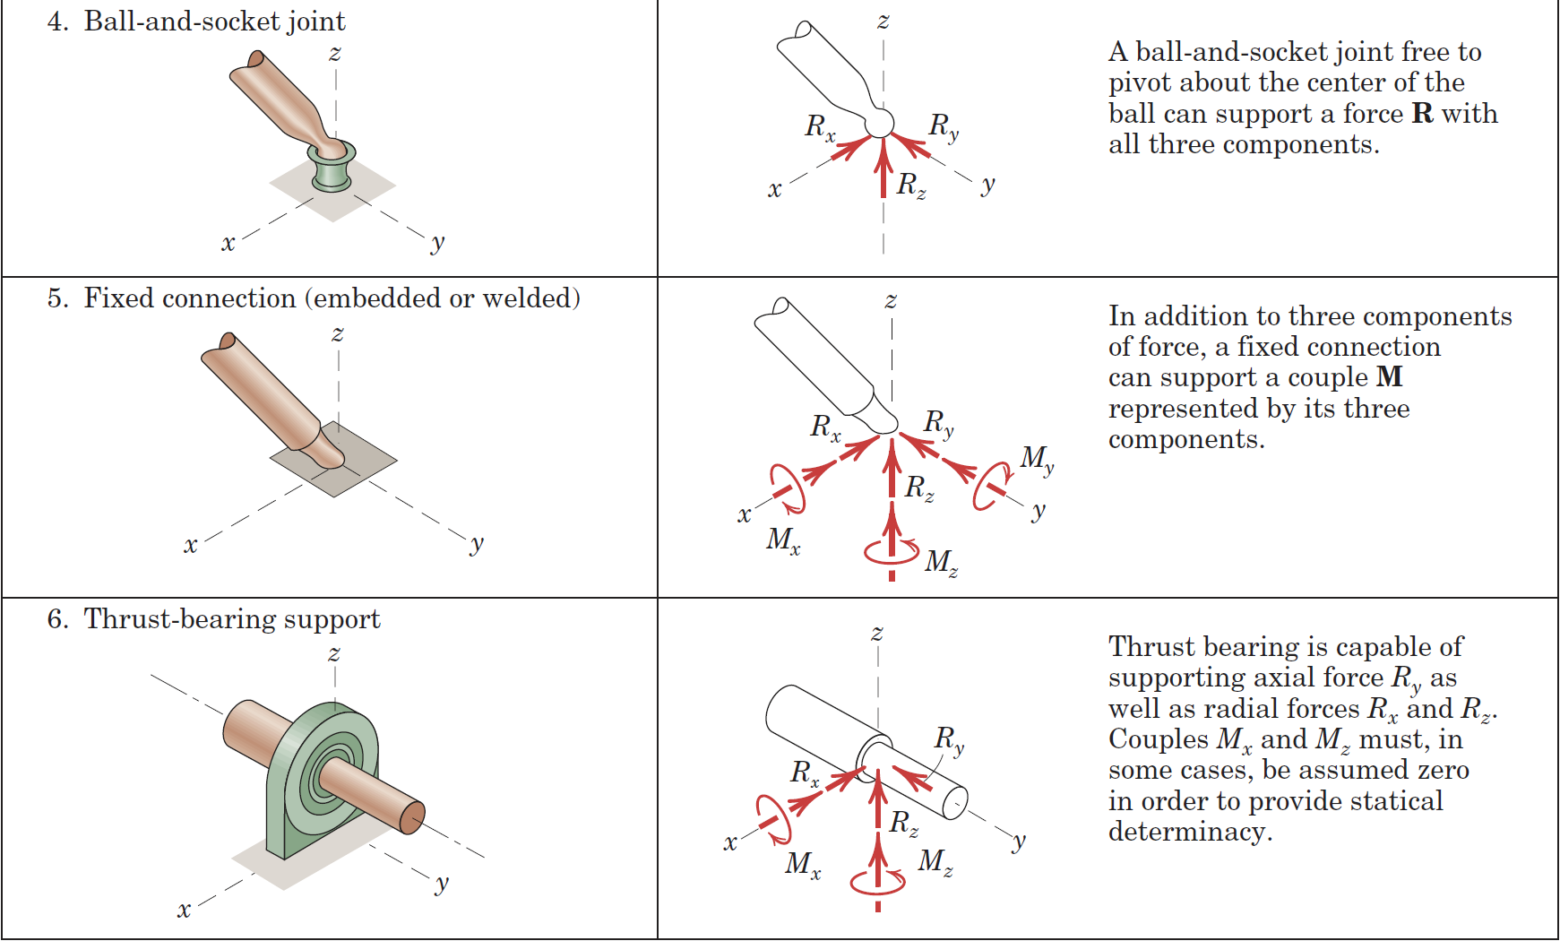
Article 3/4 – Modeling the Action of Forces (1 of 2)

Slide 40
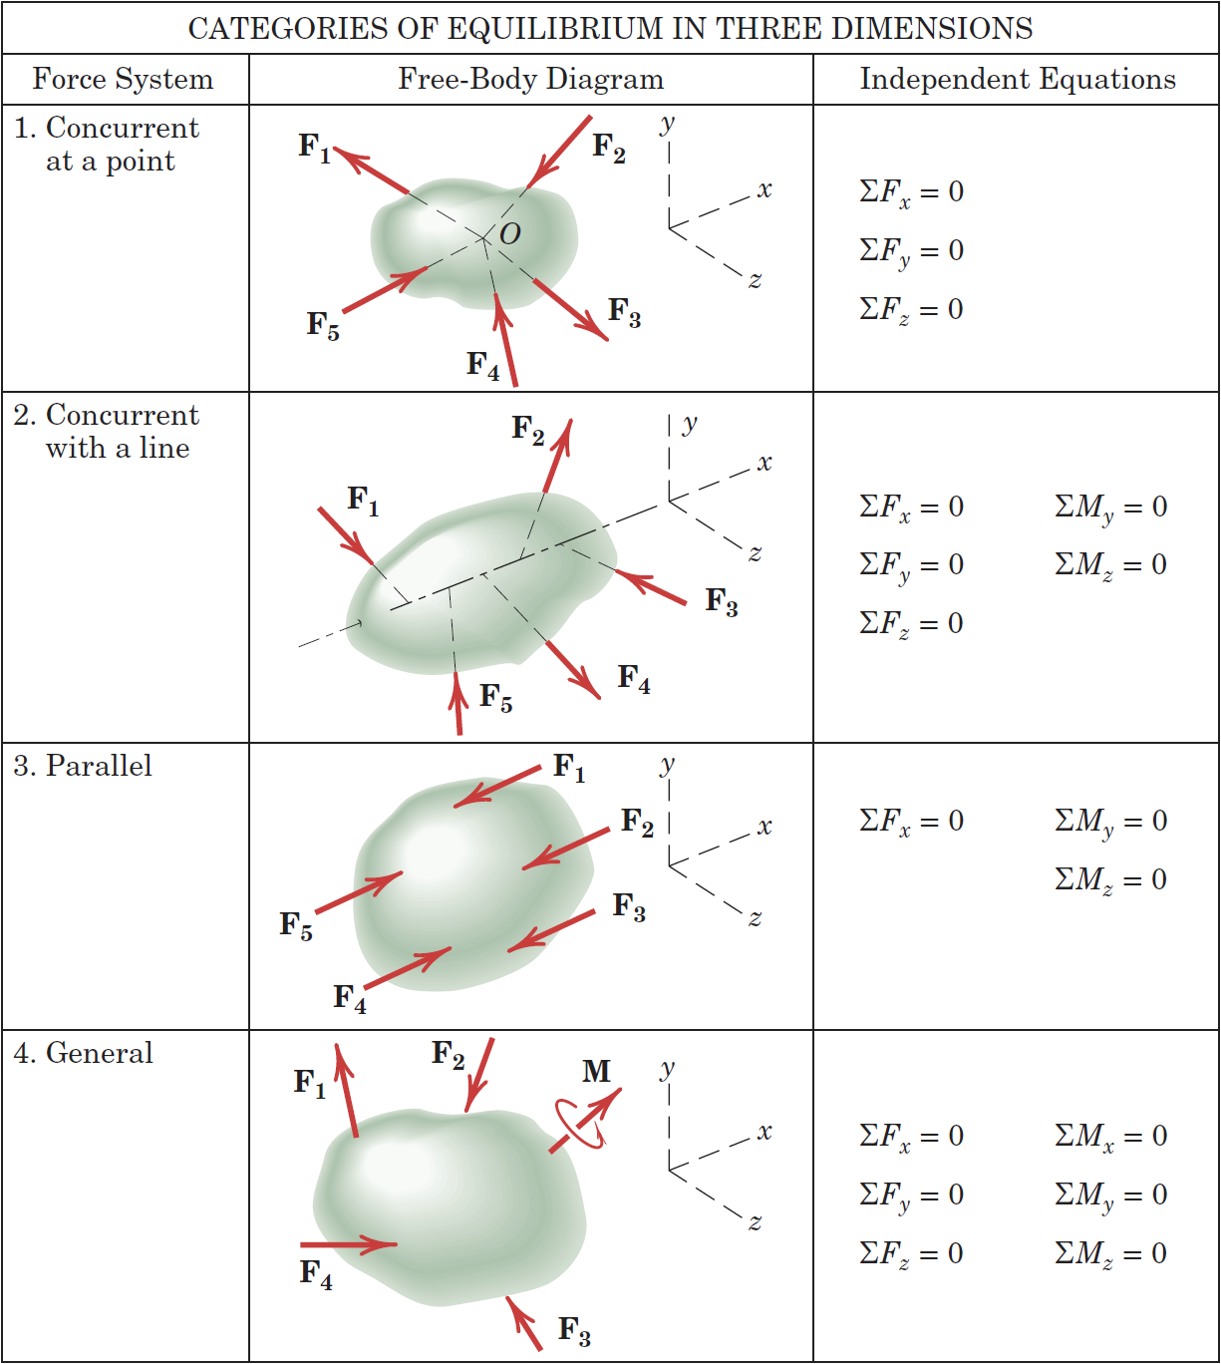
Article 3/4 – Categories of Equilibrium

Slide 41
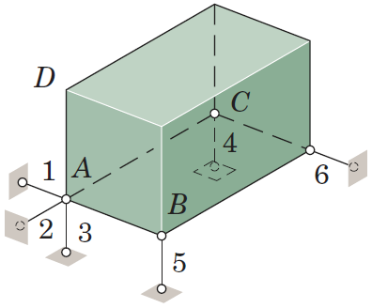
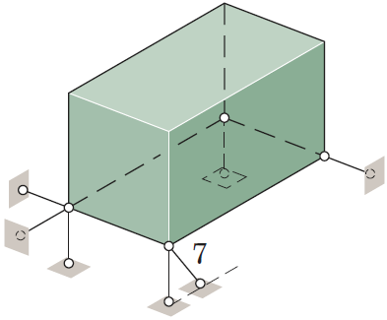
Article 3/4 – Constraints and Statical Determinacy
Complete Fixity (Adequate Constraints)
Excessive Fixity (Redundant Constraints)

Slide 42
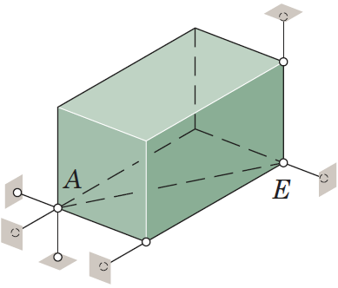
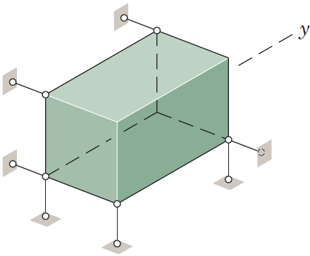
Article 3/4 – Constraints and Statical Determinacy
Incomplete Fixity (Partial Constraints)
No Moment Resistance about Line AE
Incomplete Fixity (Partial Constraints)
No Force Resistance along y-Axis

Slide 43
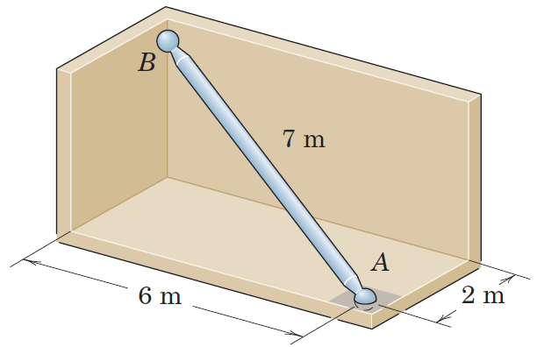
Article 3/4 – Sample Problem 3/5 (1 of 4)
Problem Statement
The uniform 7-m steel shaft has a mass of 200 kg and is supported by a ball-and-socket joint at A in the horizontal floor. The ball end B rests against the smooth vertical walls as shown. Compute the forces exerted by the walls and the floor on the ends of the shaft.
z
W=200*9.81
By
Bx
5 unknowns
6 eq. Equations
Statically determinate problem
rAB
Z=3m
Fx=Ax+Bx=0
Fy=0=By+Ay=0
Fz=0=-W+Az=0 Az=W
W
y
rAw
x
Ax
Ay
Az
MA=rABxB+rAWxW
rAB=(xB-xA)i+(yB-yA)j+(zB-zA)k
rAB=(0-2)i+(0-6)j+(3-0)k

Slide 44
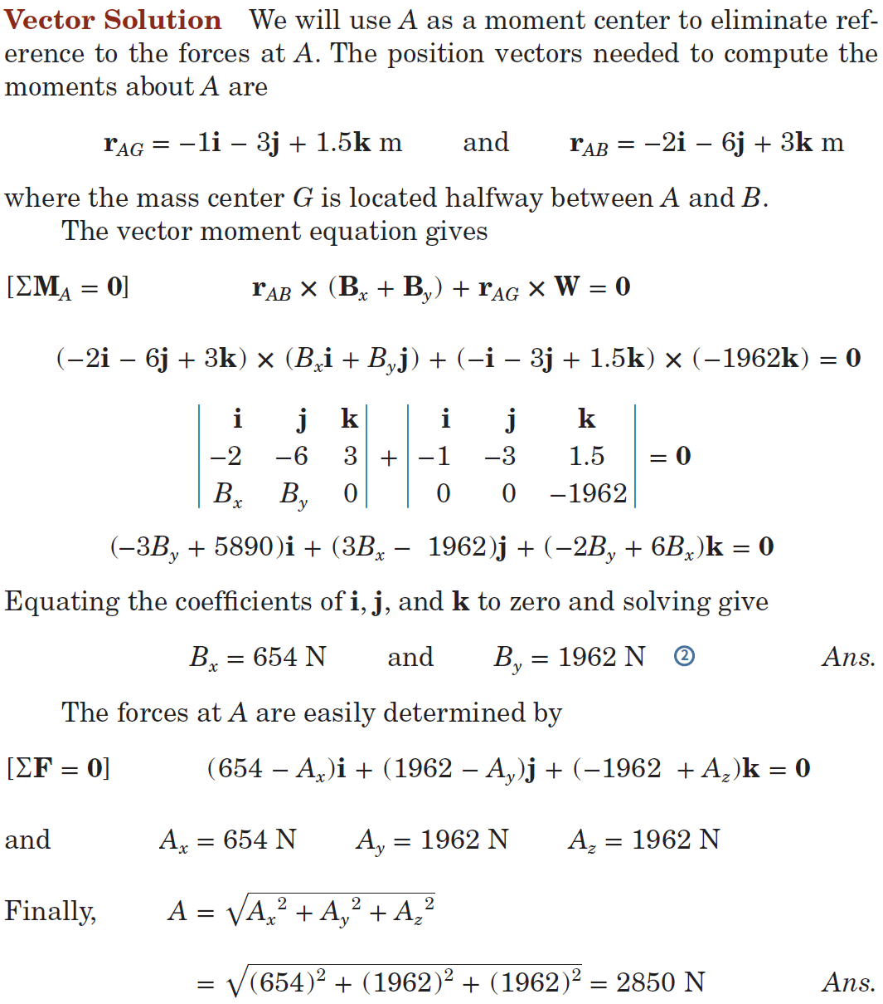
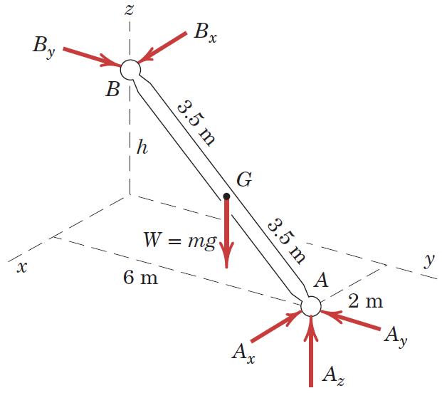
Article 3/4 – Sample Problem 3/5 (2 of 4)
Free-Body Diagram
Equilibrium Conditions – Moment Balance
+ - +
-3By i+(-3Bx)(-j)+(-2By+6Bx)k
+3*1962 i+1*1962(-j)+0k

Slide 45
Article 3/4 – Sample Problem 3/5 (3 of 4)
Equilibrium Conditions – Force Balance
z
y

Slide 46
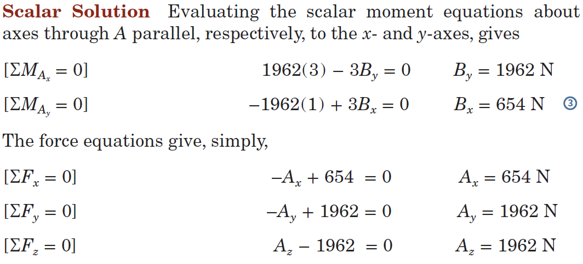
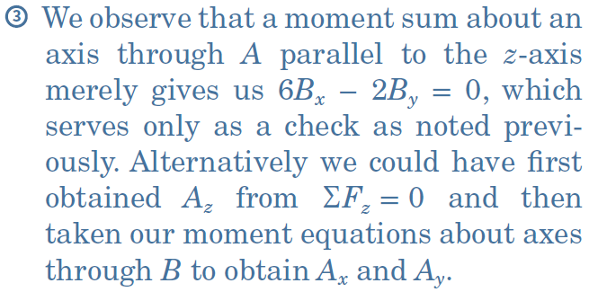
Article 3/4 – Sample Problem 3/5 (4 of 4)
Equilibrium Conditions

Slide 47
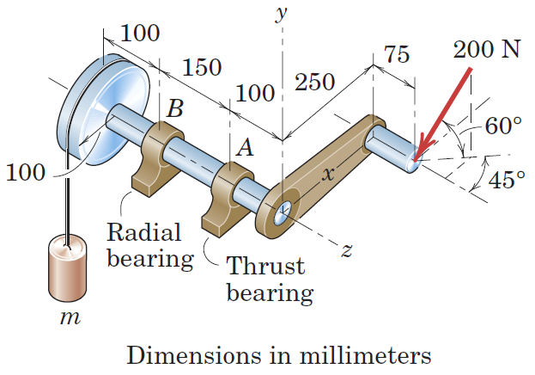
Article 3/4 – Sample Problem 3/6 (1 of 2)
Problem Statement
A 200-N force is applied to the handle of the hoist in the direction shown. The bearing A supports the thrust (force in the direction of the shaft axis), while bearing B supports only radial load (load normal to the shaft axis). Determine the mass m which can be supported and the total radial force exerted on the shaft by each bearing. Assume neither bearing to be capable of supporting a moment about a line normal to the shaft axis.
200xsin60
Bx
Az
Bz
Ax
W=mg
Ay

Slide 48


Article 3/4 – Sample Problem 3/6 (2 of 2)
Free-Body Diagram (Orthographic Projections)
Equilibrium Conditions

Slide 49

Article 3/4 – Sample Problem 3/7 (1 of 3)
Problem Statement
The welded tubular frame is secured to the horizontal x-y plane by a ball-and-socket joint at A and receives support from the loose-fitting ring at B. Under the action of the 2-kN load, rotation about a line from A to B is prevented by the cable CD, and the frame is stable in the position shown. Neglect the weight of the frame compared with the applied load and determine the tension T in the cable, the reaction at the ring, and the reaction components at A.

Slide 50


Article 3/4 – Sample Problem 3/7 (2 of 3)
Free-Body Diagram
Moment Sum about Line AB

Slide 51


Article 3/4 – Sample Problem 3/7 (3 of 3)
Remaining Equilibrium Conditions

