Slide 1

ME 113
ME 113 ENGINEERING DRAWING I
ENGINEERING
DRAWING I

Slide 2
ME 113 ENGINEERING DRAWING I
CHAPTER 4
ORTHOGRAPHIC DRAWING
1

Slide 3
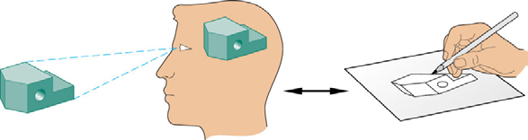
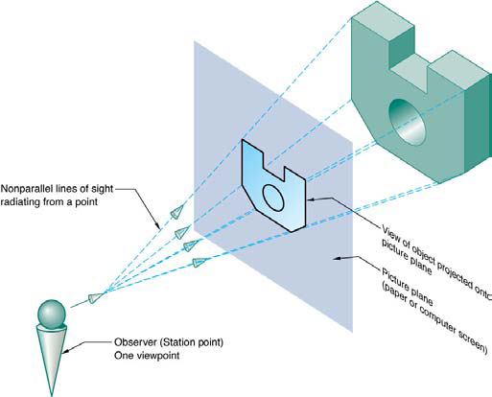
Introduction and Objectives
Ortho_ Greek word meaning perpendicular.
A system of drawing to represent 3D objects by using multiple-view drawings.
In this system of projection, the 3D object is projected perpendicularly onto a projection plane with parallel projectors.
Objectives:
To understand the basic principles of orthographic projection
To be able to construct orthographic views of simple objects
To visualize 3D objects from drawings showing their orthographic views

Slide 4
ME 113 ENGINEERING DRAWING I
4.1 THEORY OF PROJECTION
Technical drawing is a "Universal Graphic Language" by means of which the shape, size, finish; construction of an object can be described accurately and clearly. Only as a supplement, for notes and specifications is the word- language used. This language used by engineers and architects to develop and record their ideas and then communicate every detail of their design to the people who are to execute the design and to manufacturers.
The descriptions must be prepared that show every aspects of the shape and size of each part and of the complete machine and structure shape described by projection, that is, by the process of causing an image to be formed by rays of sight taken in a particular direction from an object to a picture plane.

Slide 5
Projection Theory
A projection is a mapping of a 3D space onto a 2D subspace
2D space is called the projection plane
Projection also refers to image resulting from such a mapping

Slide 6
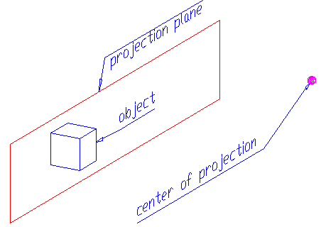
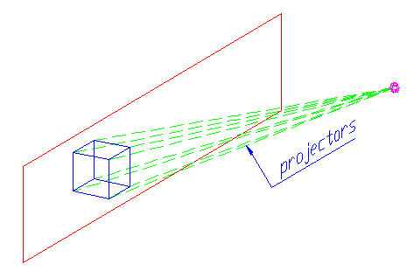
Common Elements of a Projection System
Center of Projection (Perspective)/Direction of Projection (Parallel)
Projection Plane
Object(s) to be projected
Projectors

Slide 7
Some Terminology
Center of Projection = Station Point = Viewpoint of observer
Projection Plane = Viewplane = Picture Plane
Projectors = Sightlines = Line of Sight

Slide 8
Classification of Projections

Slide 9
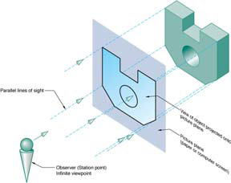

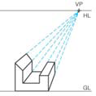
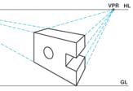
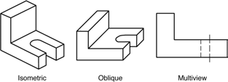
Projection Methods
Perspective projection
Parallel projection

Slide 10
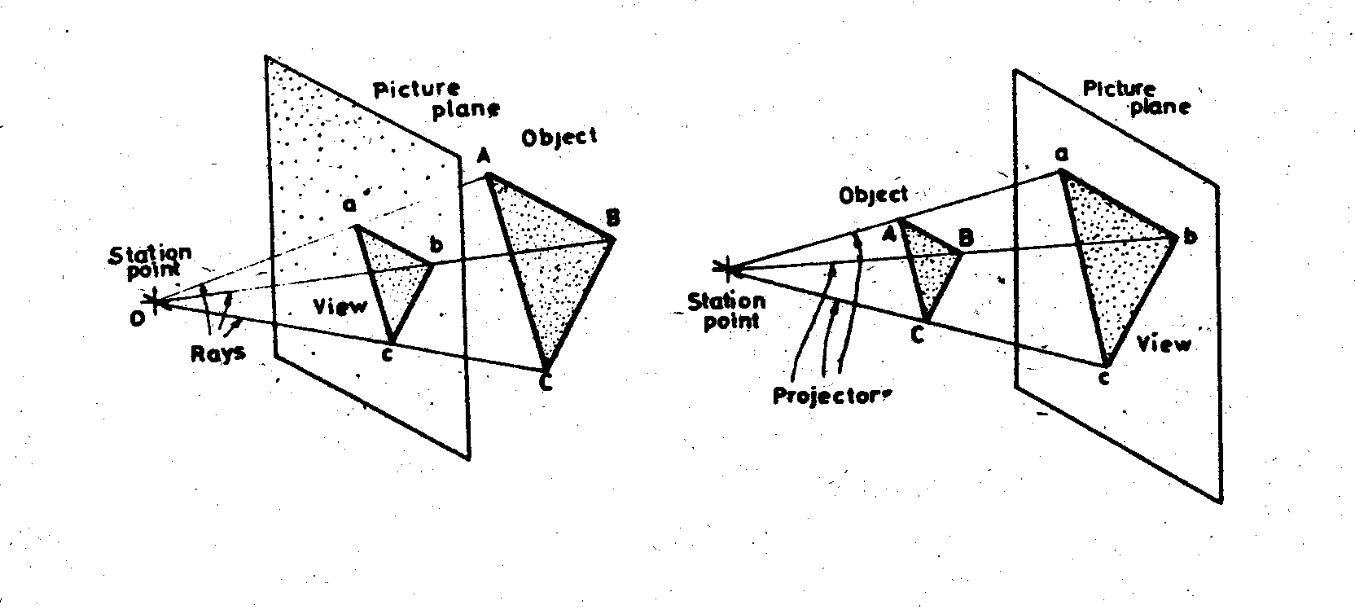
ME 113 ENGINEERING DRAWING I
Projection Methods: Perspective projection
Fig.4.1. Perspective projection
Projection methods vary according to the direction in which the rays of sight are taken to the plane. If the rays are taken to a particular station point result is called “perspective projection" or "central projection" (Fig.4.1)

Slide 11
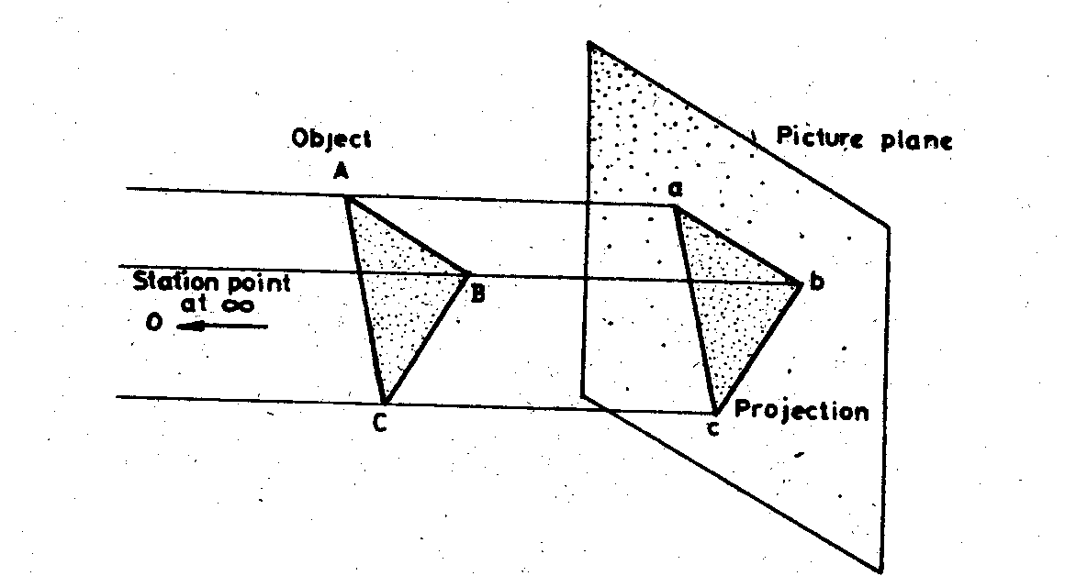
When the station point O is infinitely distant from the projection plane, the rays of projection will be parallel to each other as shown in (Fig.4.2). In this case the projection is called “parallel projection”.
ME 113 ENGINEERING DRAWING I
Projection Methods: Parallel projection
Fig.4.2. Parallel projection

Slide 12
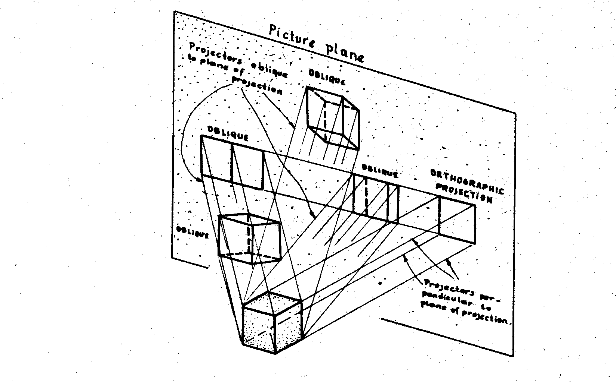
ME 113 ENGINEERING DRAWING I
If the rays of parallel projection are perpendicular to the plane of projection, the resulting projection is an “Orthographic projection”, if the rays of parallel projection, oblique to the plane of projection the resulting projection is an “oblique projection” (Fig.4.3).
Fig.4.3. Orthographic and oblique projections

Slide 13
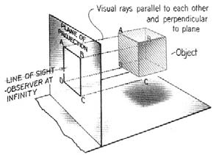
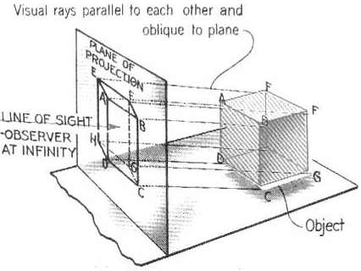
Projection Methods: Parallel projections
Orthographic
Oblique
Line of sight is perpendicular to plane
Line of sight is oblique to plane

Slide 14
ME 101 ENGINEERING GRAPHICS
As shown in (Fig.4.3) the cube A can have only one orthographic projection; but it can have any number of oblique projections on the plane since any number of lines can be drawn through any point in the cube oblique to the plane.
Projective theory is the basis of background information necessary for shape representation. In engineering drawing, two fundamental methods of shape representation are used:
1-Orthographic projections,
2-Pictorial projections
In this section we will discuss only the orthographic projection

Slide 15
ME 101 ENGINEERING GRAPHICS
4.2. DEFINITION OF ORTHOGRAPHIC PROJECTION
Orthographic projection is the method of representing the exact shape of an object by dropping perpendiculars from two or more sides of the object to planes, generally at right angles to each other; collectively, the views on these planes describe the object completely.
Views may be thought of as being projected onto planes that form a transparent "box" around the object:

Slide 16
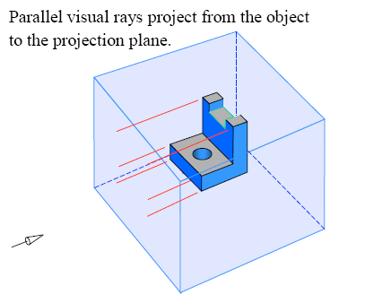
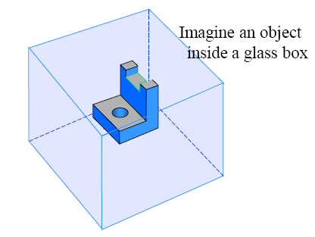
Glass-box approach
Place the object in a glass box
Glass-box approach is used for developing orthographic projection drawings
Project points on the front view of the glass-box

Slide 17
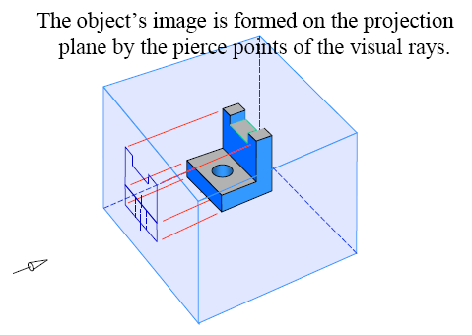
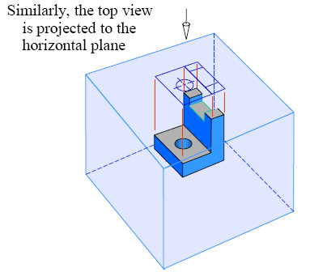
Glass-box approach

Slide 18
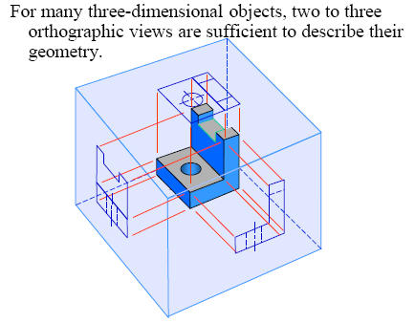
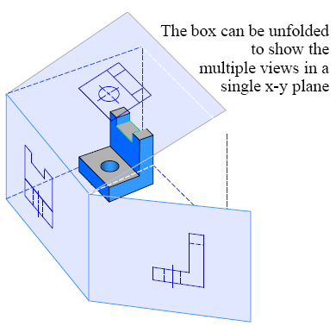
Glass-box approach

Slide 19
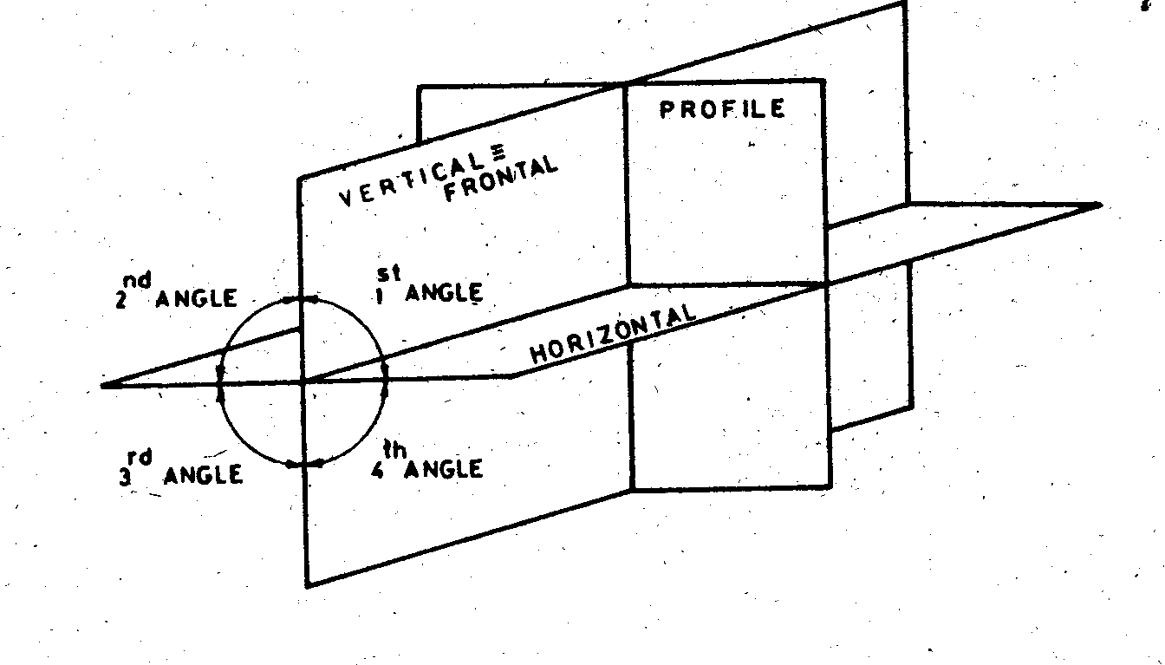
4.3. MULTIVIEW PROJECTION
ME 113 ENGINEERING DRAWING I
There are three principal planes of projection-horizontal, vertical and profile-as illustrated in Fig.4.4.
Fig.4.4. Three planes of projection

Slide 20
ME 101 ENGINEERING GRAPHICS
Fig.4.4. Three planes of projection

Slide 21
ME 101 ENGINEERING GRAPHICS
These planes intersect each other at right angles, forming the first, second, third and fourth angles or quadrants. Theoretically, an object can be projected in any one of the four angles. An object projected in any angle or quadrant so that. Its sides are parallel to the principal planes will show the object in its true size and shape. Remember that, the observer should view every object projected from a position in front of the vertical plane and above the horizontal plane as shown in Fig.4.5 and 4.6.

Slide 22
ME 101 ENGINEERING GRAPHICS
Technical people are concerned chiefly first angle and third angle projection. Third angle projection is used in America, England and some other countries First angle projection is used in Turkey and in the other countries those are using metric system.

Slide 23
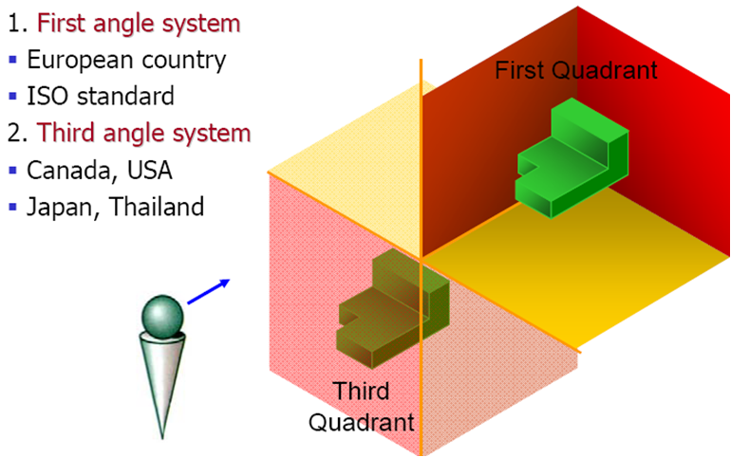
Projection Systems

Slide 24
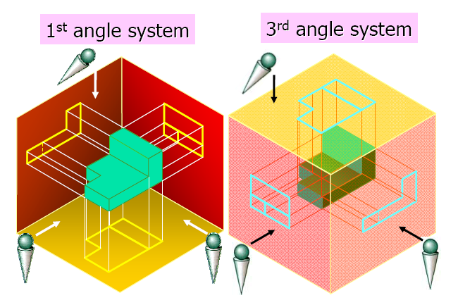
Projection Systems

Slide 25
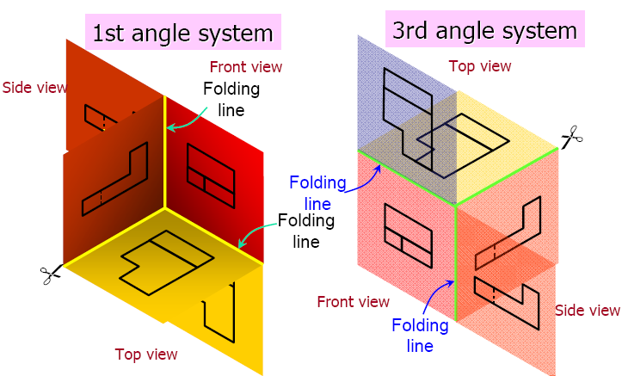
Projection Systems

Slide 26
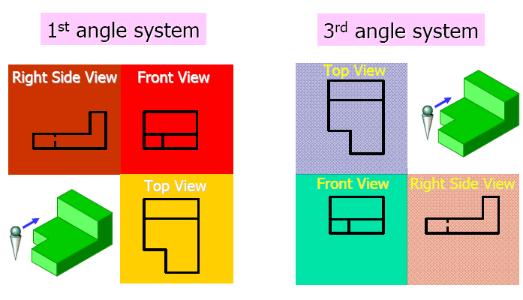
Projection Systems

Slide 27
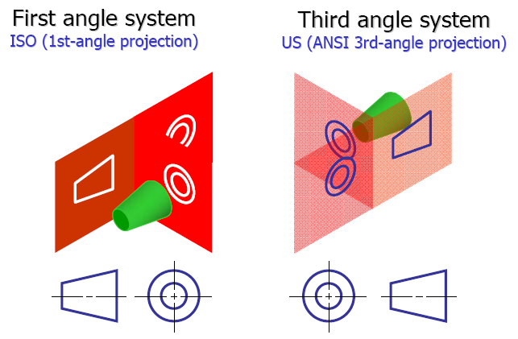
Projection System symbols

Slide 28
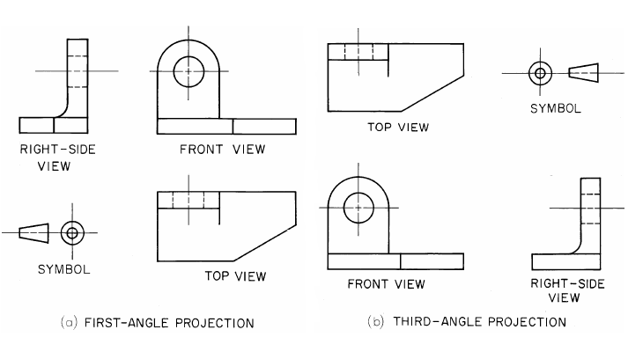
Projection Systems

Slide 29
ME 101 ENGINEERING GRAPHICS

Slide 30
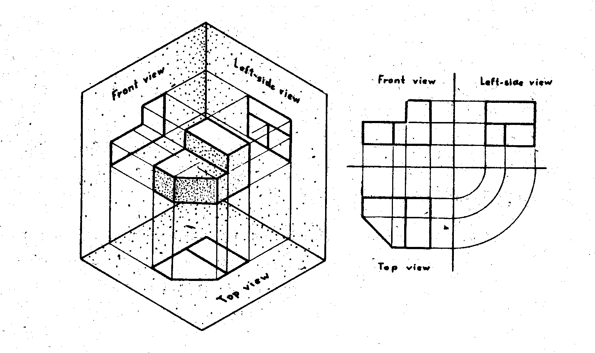
ME 101 ENGINEERING GRAPHICS
Fig.4.5. First-angle projection

Slide 31
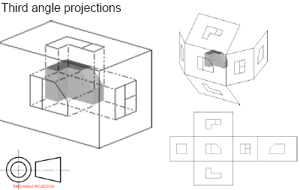
ME 101 ENGINEERING GRAPHICS

Slide 32
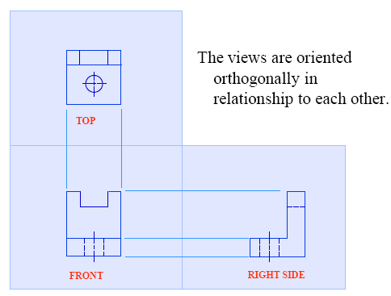
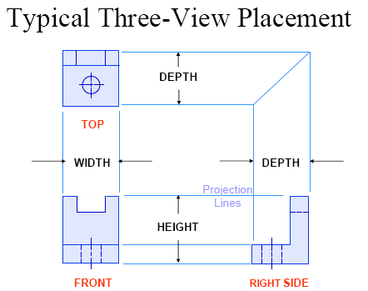
Glass-box approach

Slide 33
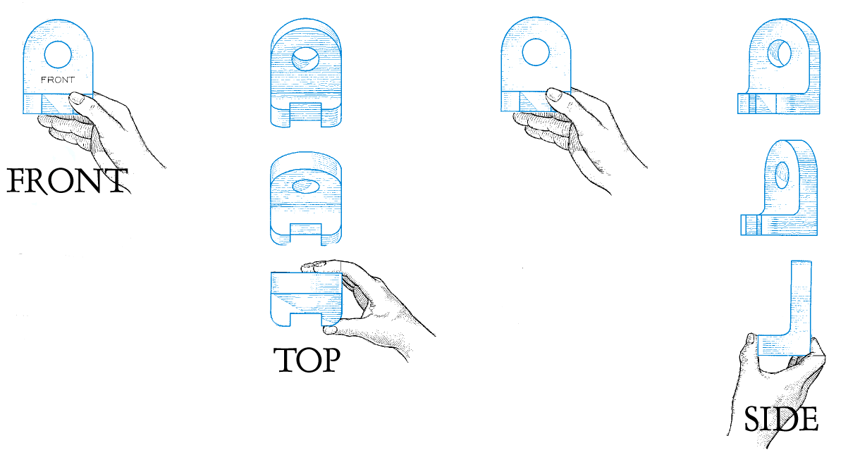
Multi-view
Rotate Back
Rotate 90 degrees “up” to get top view
Rotate 90 degrees clockwise to get right side
FRONT view is the most descriptive view of the object. The view that gives more information about the object.

Slide 34
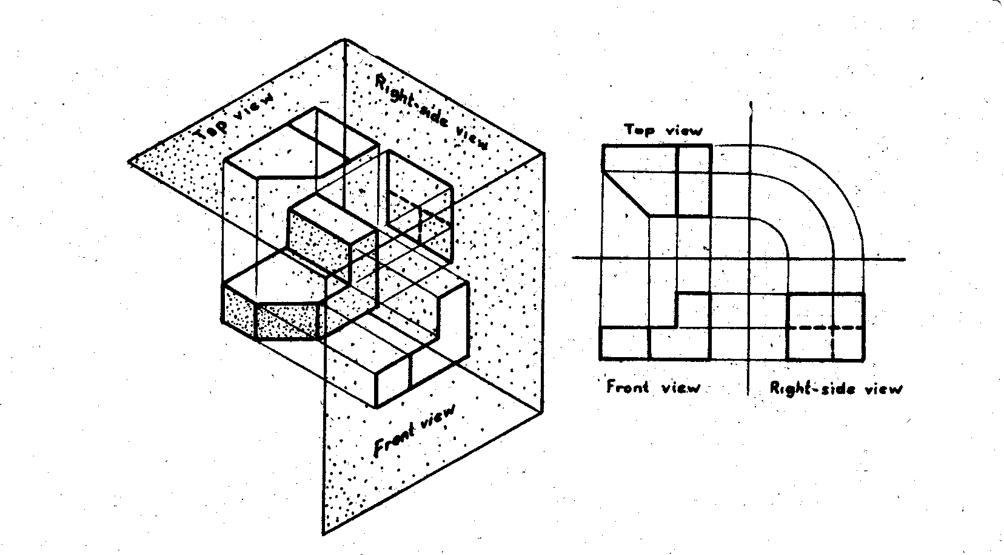
ME 113 ENGINEERING DRAWING I
Fig.4.6. Third-angle projection

Slide 35
4.4. FIRST-ANGLE PROJECTION
ME 113 ENGINEERING DRAWING I
If the object is situated so that its front and back faces are parallel to the vertical plane of projection, and its top and bottom faces parallel to the horizontal plane, the side face also be parallel to the profile plane, and the faces will be shown in their true forms and sizes in their respective projections. These projections are known respectively in technical drawing as front, top and side views of the object Fig.4.7. Having determined the three views of the object on the respective planes situated at right angles to each other as shown in (Fig.4.7a), the next step in the representation of the object is to revolve two of the panes into the third plane, so that the three views of the object may be shown on one plane as is necessary when the views are to be drawn on a sheet of paper as shown in (Fig.4.7b). It should be noted that the top view is directly below the front view and, the left side view is to the right of the front view. This system allows three-dimensional objects to be represented by means of related, two-dimensional views in a manner, which is developed in this chapter.

Slide 36
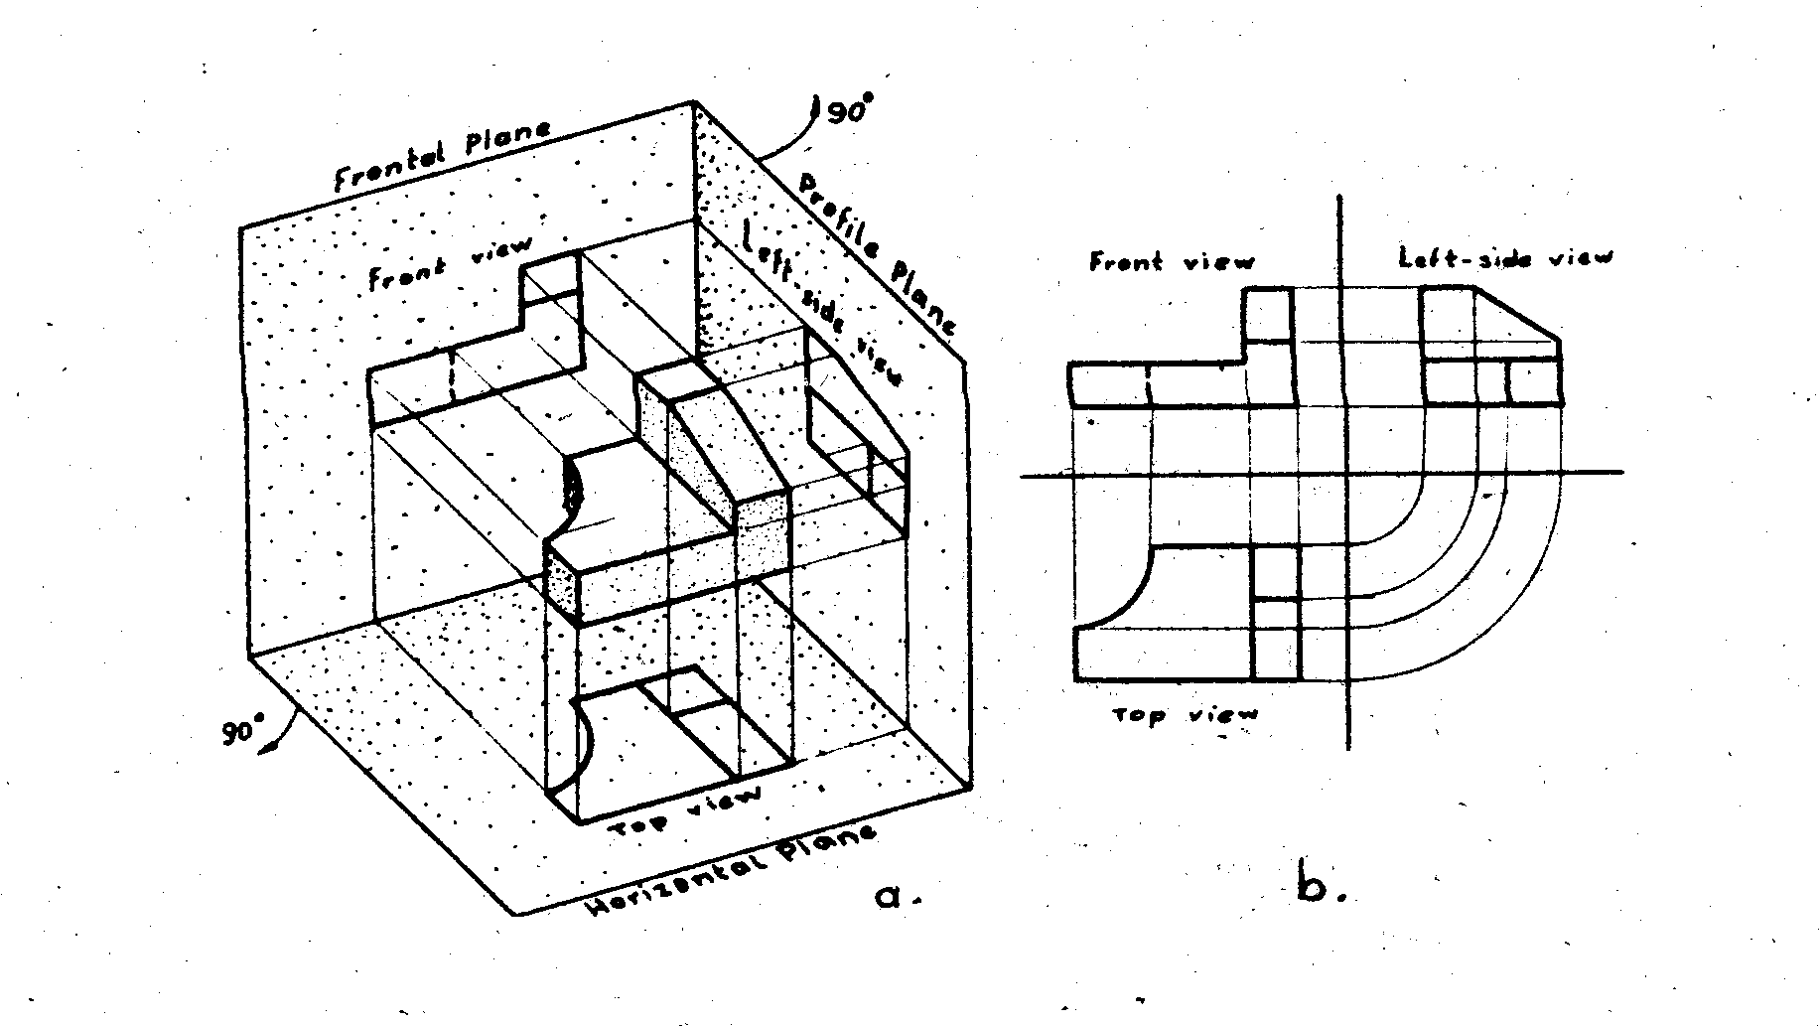
ME 113 ENGINEERING DRAWING I
Fig.4.7. First-angle projection and-revolved position of planes

Slide 37
4.5. THIRD ANGLE PROJECTION
ME 113 ENGINEERING DRAWING I
If the object in third angle (Fig.4.8) with is faces parallel, respectively, to the planes of projection, the front, top and side faces of the object will be shown in their true forms and sizes in the respective views. The horizontal and profile planes are in the conventional direction as shown by arrows till coincide with the vertical plane and the three views of the object will appear as shown in Fig.4.9.
It should be noted that the top view, in this case, is directly above the front view, and the right-side view is directly to the right of the front view.

Slide 38
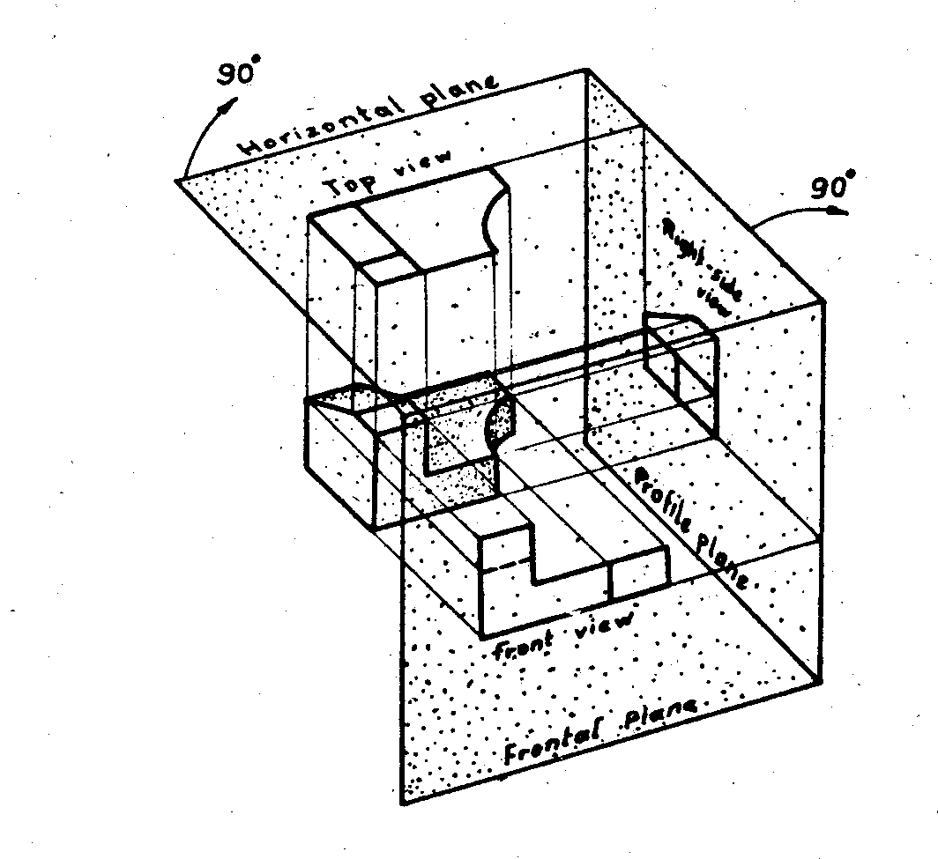
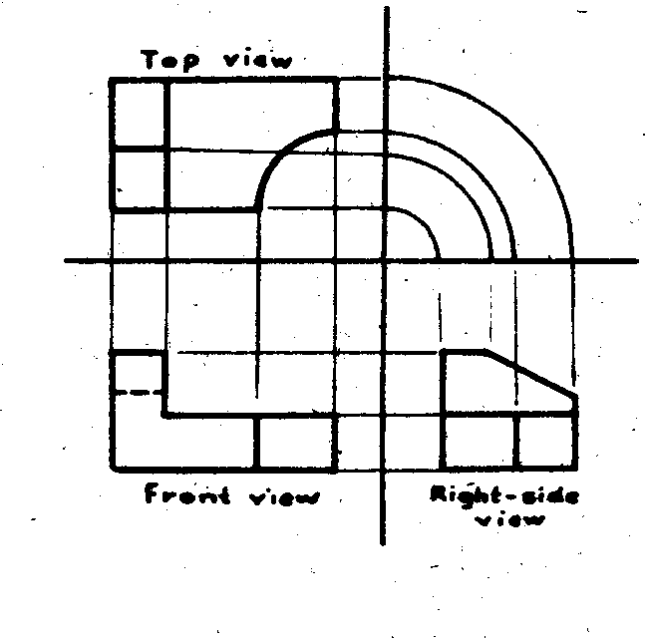
ME 113 ENGINEERING DRAWING I
Fig.4.9. Revolved position-of planes in third-angle projection
Fig.4.8.Third-angle projection

Slide 39
ME 101 ENGINEERING GRAPHICS

Slide 40
4.6. THE SIX PRINCIPAL VIEWS
ME 113 ENGINEERING DRAWING I
Some objects can not be fully represented through the three views mentioned before, but require separate views projected from each side. The system of orthographic projection permits six principal views of a given object to be drawn. (Fig.4.10) Suggests how an imaginary box formed by the six principal planes is opened to form one common plane- as shown in (Fig.4.11).
It should be observed that the top and bottom planes are both horizontal planes, the front and rear views are both frontal planes, the left and right-side views are both profile planes. In actual work, there is rarely an occasion when all six principal views are needed on one drawing. But no matter how many are required to give full shape description of the object. Their positions relative to one another should be as in (Fig.4.11). All these six views are principal views. Each of the six views shows two of three dimensions of Height, Width, and Depth

Slide 41
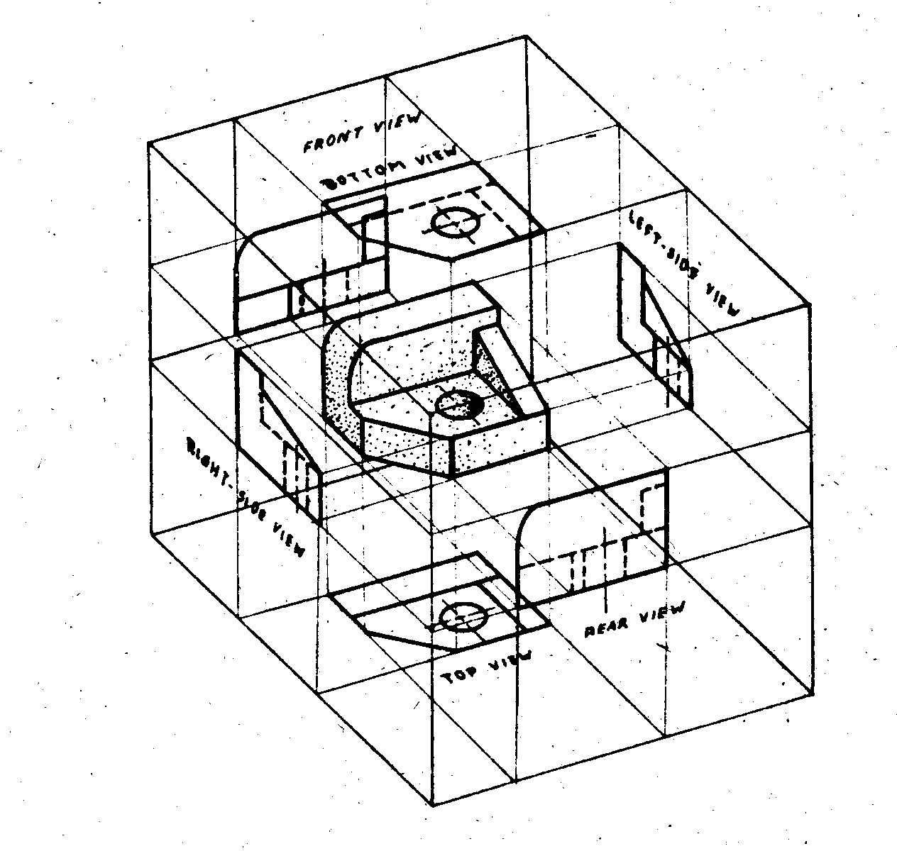
ME 113 ENGINEERING DRAWING I
Fig.4.10.The six projection planes enclose the object. This box can be opened into a single plane to give six principal views of an object

Slide 42
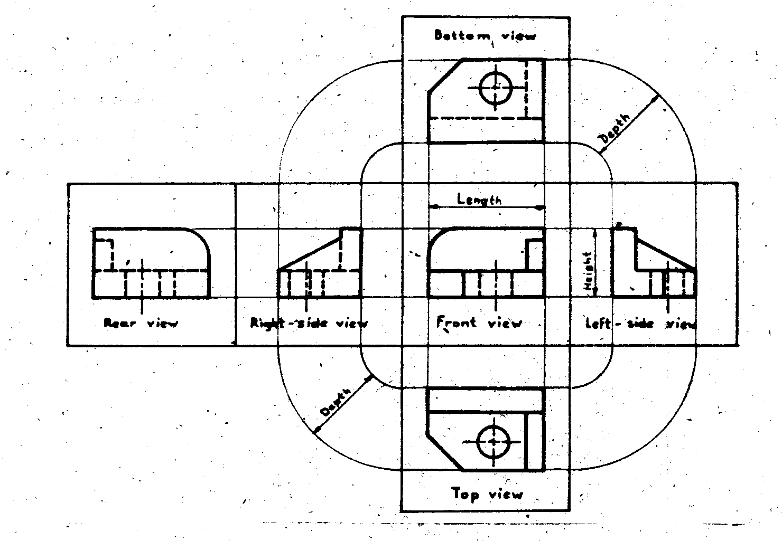
ME 113 ENGINEERING DRAWING I
Fig.4.11. The relative positions of the six views. Study this figure carefully

Slide 43
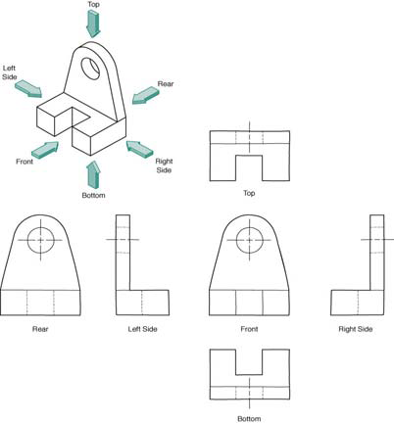
Six principal views
Generally do not need all six to fully describe the object.
A conventional Engineering Drawing will normally have 2 to 3 views unless it required more views to describe the geometry/ profile.

Slide 44
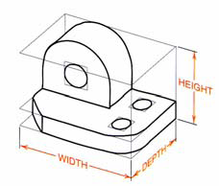
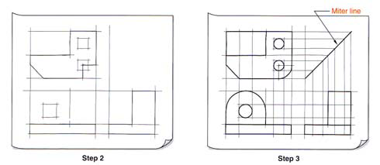
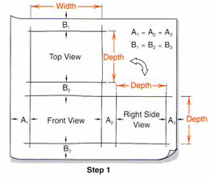
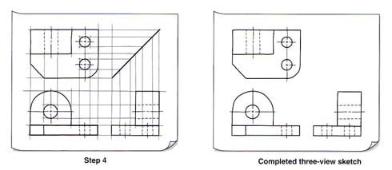
Conventional Orthographic Views
Height

Slide 45
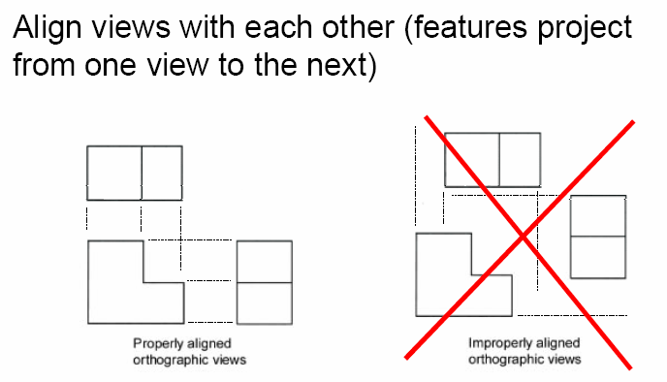
Conventional Orthographic Views

Slide 46
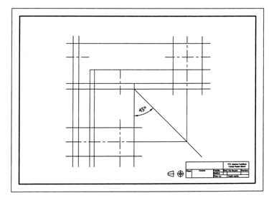
Transferring dimensions
Draw a miter line at 45 degrees
at a convenient distance to produce the desired view.

Slide 47
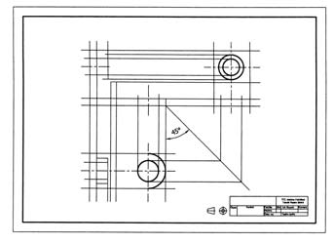
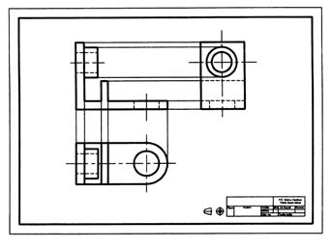
Transferring dimensions
Sketch light lines projecting depth locations for points to miter line and then up into side view as shown.

Slide 48
4.7. COMBINATION OF VIEWS
ME 113 ENGINEERING DRAWING I
The most usual combination selected from the six possible views consists of the top, Front and left side views as shown in fig.4.12. In each case the best shape description of the object is necessary. For this reason, sometimes we can select different combination of views. They can be only two views such as front and top or front and a side view, three views such as front, top and left-side views (Fig.4.13).

Slide 49
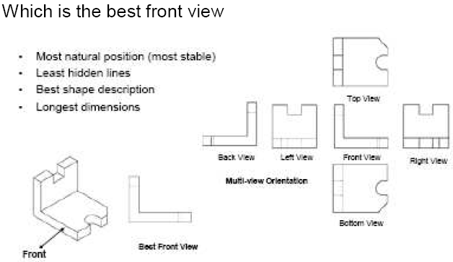
ME 101 ENGINEERING GRAPHICS

Slide 50
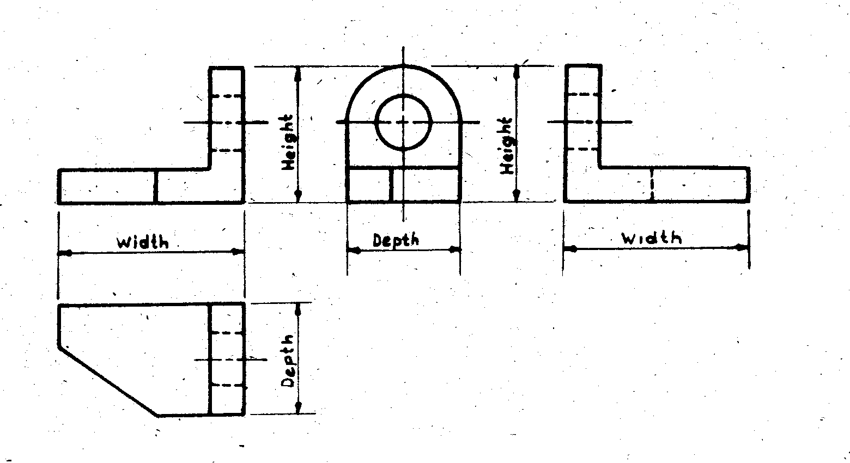
ME 113 ENGINEERING DRAWING I
Fig. 4. 12. Top, front and left side views. This is the most common combination. Note that the top view is directly blow and in projection with the front view. The left-side view is to the right of and in the projection with the front view. Observe also that two (remember which to) space dimension are represented in each view

Slide 51
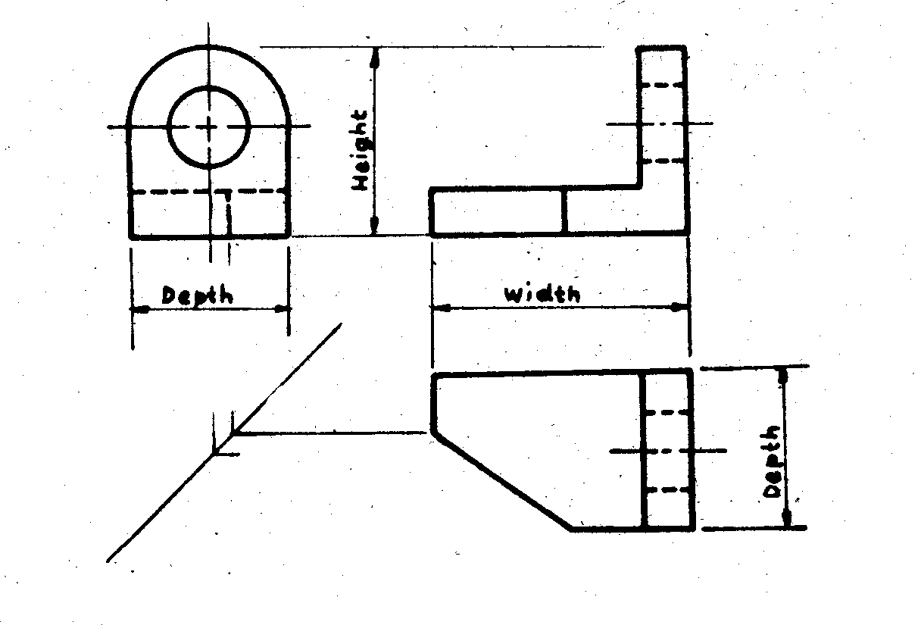
ME 113 ENGINEERING DRAWING I
Fig. 4. 13 Front top and right-side views. The right-side view is preferred only because of the shape of the object; representation is clearer with the right-side view than the left-side view.

Slide 52
ME 113 ENGINEERING DRAWING I
If the object is a complicated one and for the one or more additional view or views could be required at that time we could add those necessary views to the principal views. Such as bottom, right side, rear or required one (Fig.4.14).
Fig. 4. 14. Top, front, left-side and rear views. The rear view is added only when same details on the rear of the object is important and the shape representation can be improved by its use.

